Slide 1
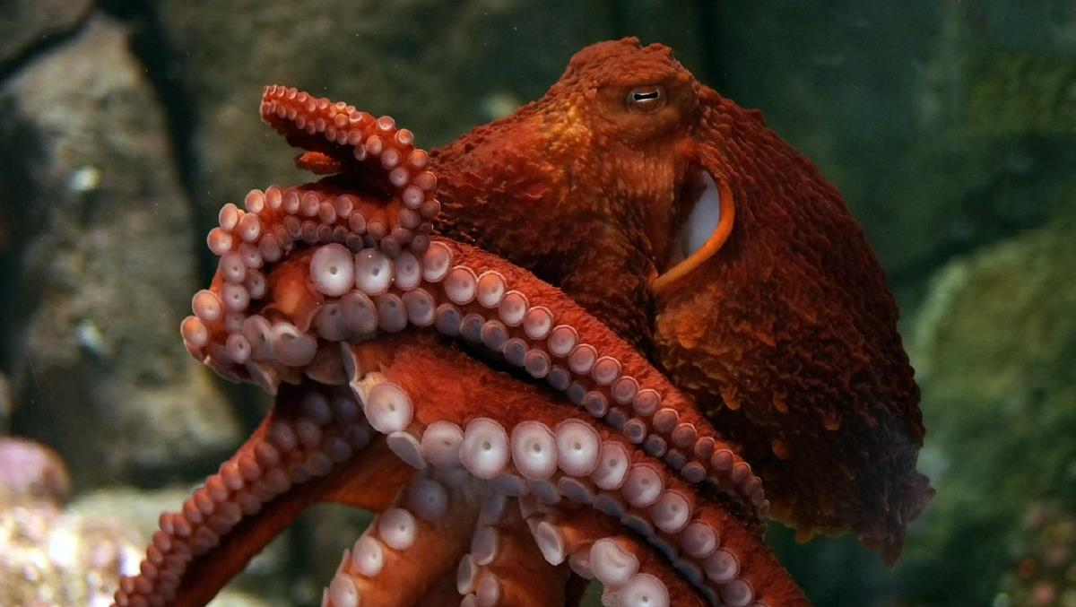
Yarm Primary - Nursery
Under the sea? What creatures live under the sea?
Subject Specific Vocabulary​ |  |  | Sticky Knowledge about under the sea
sea | An expanse of salt water that covers most of the earths surface. | After half term, we will be learning all about what lives under the sea. We have included some information that you may like to share with your child as well as some suggested activities. Have fun! | Most of life on earth is aquatic, as so much of the earths’ surface is underwater.
ocean | A very large expanse of sea. |  | There are more historic artefacts under the sea than there are in all the museums in the world!
fish | A limb-less cold blooded vertebrate animal with gills and fins and lives in water.
 |  | Brain Teaser….. | Atlantic, Pacific, Indian, Arctic and Southern are the names of the oceans on earth.
 |  | ​ What is this picture of? How is it linked to under the sea?
vertebrate | An animal with a back bone / spine
 |  |  | Jellyfish have been around for more than 650 million years which is long before the dinosaurs lived!
sea mammals aquatic animals | A warm blooded creature with a backbone that lives in the sea. Eg- Whale, sea otters, dolphins, seals. Animals which live in water.
 |  |  | Seahorses are the only animals in which the male give birth to their babies!
 |  |  | An octopus has 8 legs, 3 hearts and has blue blood!
marine life | All plants and animals that live in salt water either in the sea or an ocean.

Slide 2
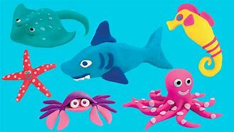
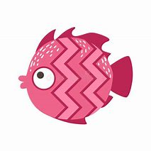
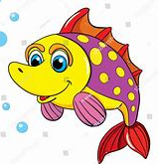
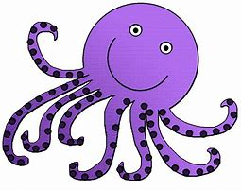
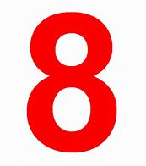
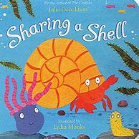
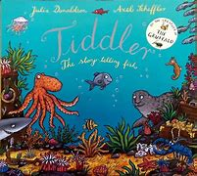
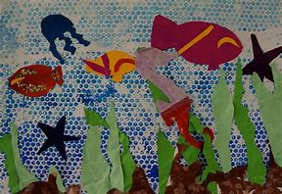
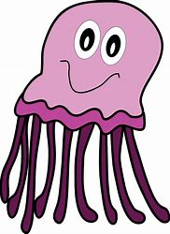
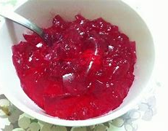
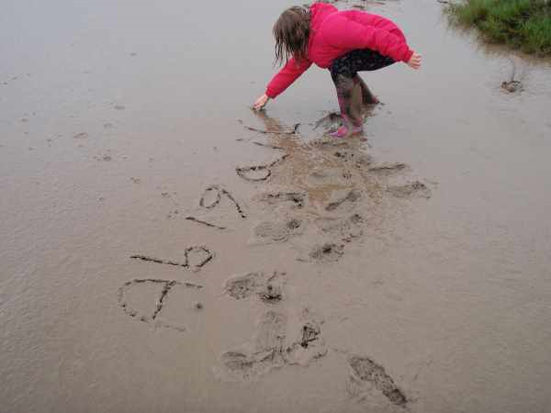
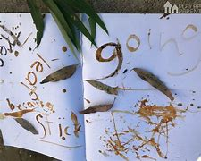
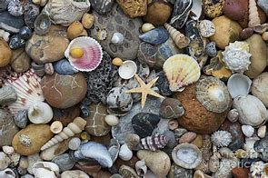
Draw patterns on the template of the fish (attached) to make the scales. What patterns can you draw? Eg - Zig zags, lines, wiggles, dots, circles, crosses etc | Do you know how many legs an Octopus has? Can you count to 8? Can you write an 8? Can you count out 8 objects accurately? Can you spot any number 8’s around your house? What is 1 more/ less than 8? | Use/make some playdoh. What sea animals can you make with your dough?
Can you create an ‘Under the Sea’ picture? You could use pencils, pens or paint or you could even use different materials to make an ‘under the sea’ collage! | Under the Sea Activities You may want to choose a couple of the activities to complete. | Find an ‘Under the sea’ story to read. What was your favourite part of the story?
Go on a pebble or shell hunt around your garden (or at a beach) Can you sort your pebbles / shells? Can you tell an adult how you have sorted them? Did you sort by colour, shape, size etc? | What can you find out about Jelly fish? Why not make some yummy jelly to eat as a treat? Or play with jelly in a large bowl? What does it feel like? Can you squeeze it through your fingers? | Write your name in sand / salt with a stick, or your finger. Can you remember the letters in your name? The order they go in?

Slide 3


