Slide 2
What Are Single-Use Plastics?
Single-use plastics are items which are designed to be used once and then thrown away, such as food packaging, bottles, bags, wrappers, straws, takeaway cups and containers.
Plastic is a non-biodegradable material that can take up to 1000 years to decompose on a landfill. Every piece of plastic ever produced is still in existence today. If we don’t find uses for this plastic, it will still be in our oceans and environment for another 1000 years. Reusing plastic is a great way to reduce our impact on the planet.
So what can we do to help?

Slide 3
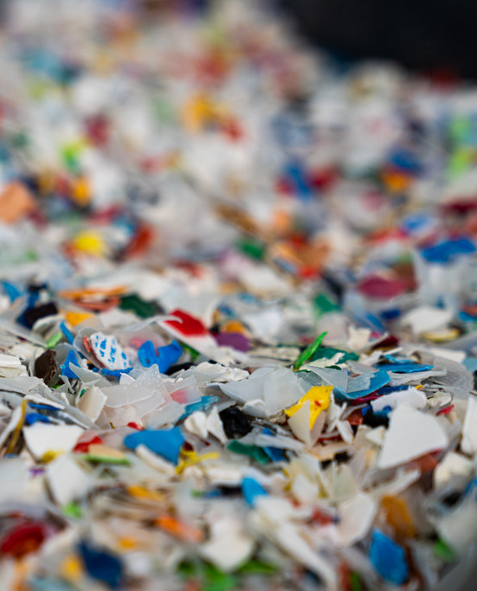
Building Houses
At least one company is using discarded plastic to build houses!
A New Zealand inventor and engineer spent years working on a portable machine which took unwashed, unsorted plastic and moulded it into blocks.
The process washes and shreds the plastic, creating bricks which can then be used for low-cost building.
Amazingly, the plastic bricks are strong, durable and provide insulation. The process is still being refined but has been used to build some housing in Hawaii.
“Recycled Plastic Shreds” by [Tony Webster] is licensed under CC BY 2.0
Plastic is shredded ready to make bricks.

Slide 4
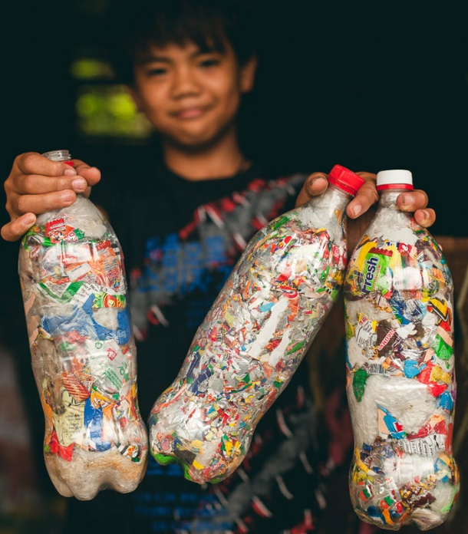
Building Schools
Another form of plastic building brick has been devised by using empty plastic bottles. These are stuffed with other types of waste plastic such as crisp packets and plastic bags.
When the bottle is packed as tightly as possible with waste materials (pushed in with the help of a stick), it becomes a solid ‘brick’.
These have been used to construct buildings, including a number of schools in Guatemala, by being mortared together with clay or cement.
Students in the Philippines were even asked to create a brick each and bring it to school with their homework written on the side!
“A student in Bontoc, Northern Philippines proudly holds his Ecobricks.”
by [Russs95] is licensed under CC BY 2.0

Slide 5
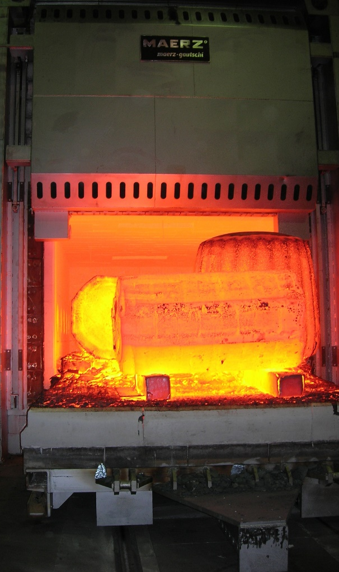
Waste Plastic as Fuel
A company in Norway is experimenting with turning waste plastic into a type of fuel.
They have partnered with countries including China and India who will use the fuel in the manufacturing of cement.
Waste plastic is recovered from landfill sites where it cannot be recycled. It is burned instead of coal to heat up limestone in huge furnaces.
“industrial furnace” by [Guenter Sonnenschein] is licensed under CC BY 2.0

Slide 6
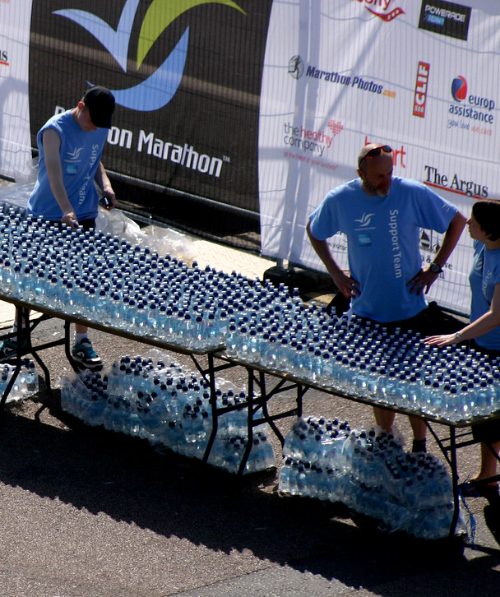
A Packaging Problem
A common example of single-use plastic is the film-wrap packaging we see on some items in our supermarkets and grocery stores. Water or other drinks sold in plastic bottles often end up with that bottle being thrown away after one use.
One company is trying to reduce this by using a surprising alternative: seaweed. This product is not only biodegradable but it is also edible – meaning the packaging can be eaten!
At one of the drinks stations for the London Marathon in 2019, seaweed pods containing a sports energy drink were handed out to runners instead of plastic bottles. Instead of just drinking, runners could harmlessly eat the entire packaging!
“Brighton Marathon 2011 - Finish” by [Dominic Alves] is licensed under CC BY 2.0
Thousands of plastic water bottles are lined up ready for runners.

Slide 7
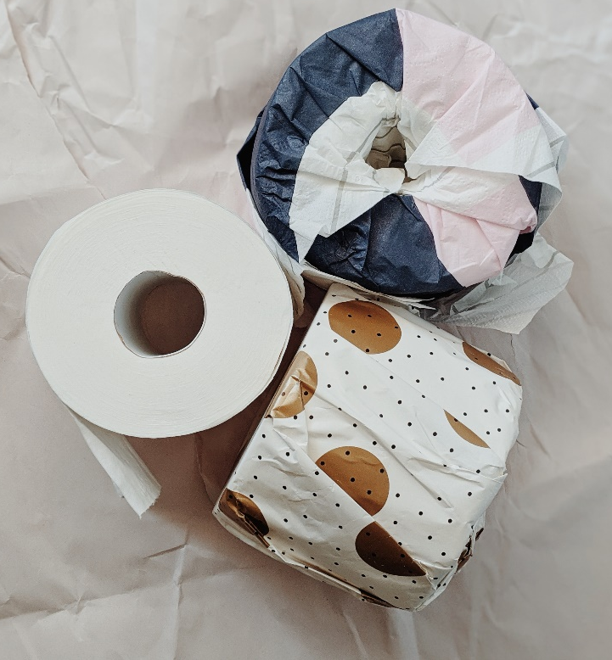
Finding Alternative Materials
One company has set out to create products made from alternative materials in order to reduce the use of plastic.
Microwaveable bowls made from paper were the first step. This led to similar materials being used for cups to serve hot drinks, trays for packaging meat and more.
One of their hopes is for customers to walk through a supermarket that is completely free of plastic.
Can you think of all the examples of plastic you see on supermarket shelves at the moment?
An alternative to plastic-wrapped toilet rolls are these which are individually wrapped using recyclable paper.

Slide 8
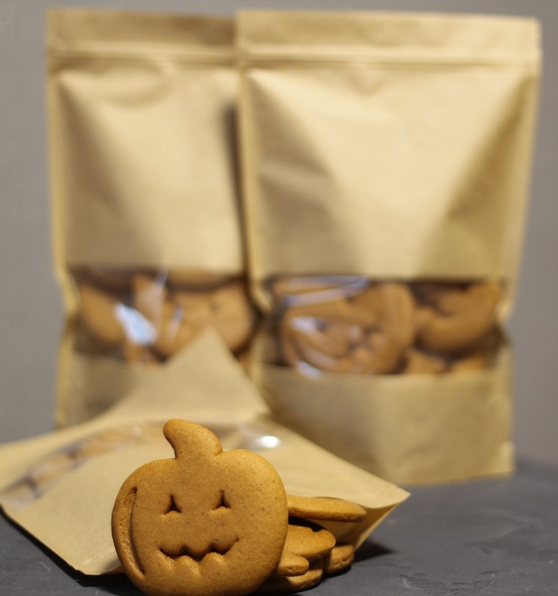
Finding Alternative Materials
Several other companies are already manufacturing compostable materials as an alternative to single-use plastic. If a material will naturally biodegrade, it will not end up floating in the ocean for hundreds of years.
A research centre in Finland has created a material from wood that can be used for packaging of food items, such as nuts, rice or cereal bars.
The challenge with any alternative material is to make it safe for food packaging, strong and durable, biodegradable and cheap enough to manufacture.

Slide 9
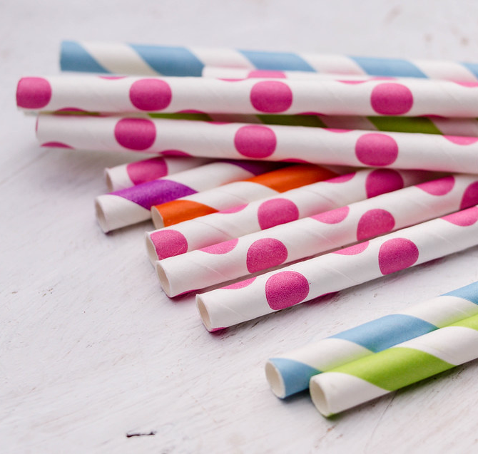
The Last Straw
One particular use of plastic that is declining is single-use disposable straws for drinking.
Billions of plastic straws are thrown away every year in the UK alone. All of these stay around in the environment as they are not recycled.
Reusable metal straws are becoming more common, along with single-use recyclable paper straws. However, some companies have been more adventurous with experimental straws even being made from hay or bamboo. At least they avoid the ocean pollution of plastic!
“Marco Verch” by [Paper straws in different patterns and colours] is licensed under CC BY 2.0

Slide 10
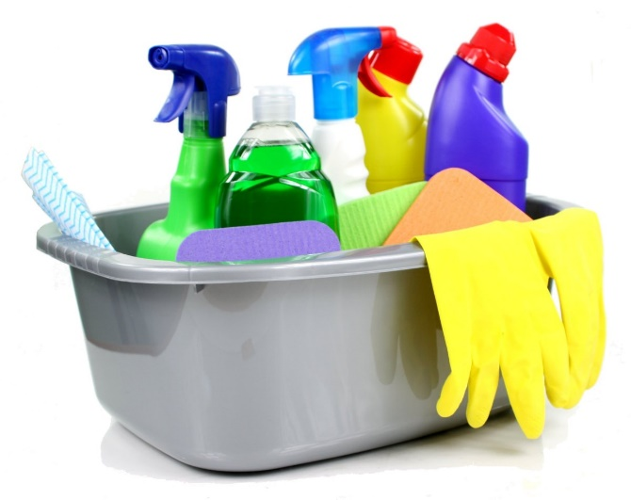
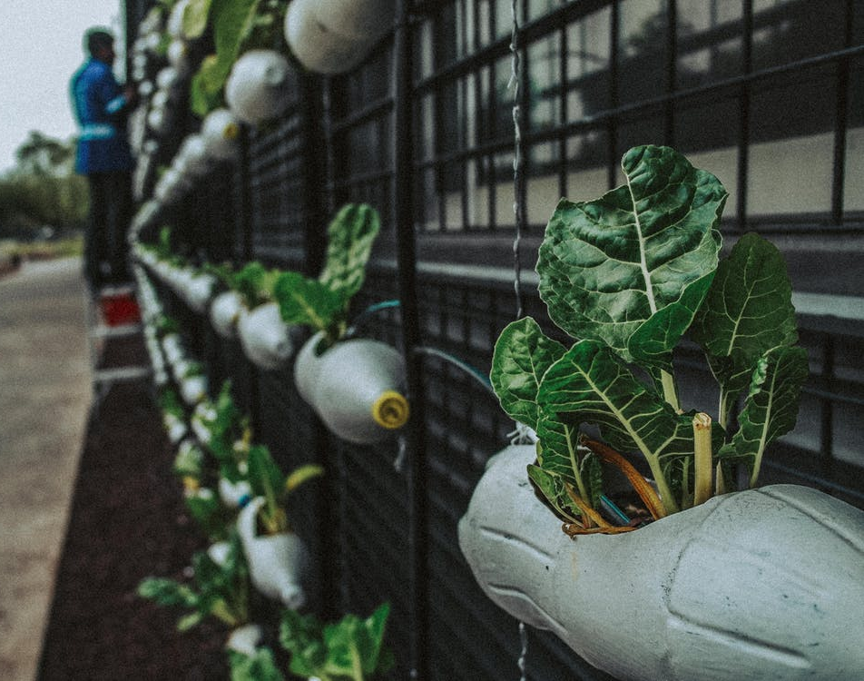
More to Come?
The population around the world is currently making a bigger effort to reduce the amount of plastic waste that we generate.
More and more companies and organisations are trying to come up with new solutions to use the plastic waste for other purposes or to reduce the amount that is created in the first place.
“Cleaning supplies in a grey bucket on a white background” by [Nick Youngson] is licensed under CC BY 3.0
What changes could you make in your daily life to try and reduce the amount of single-use plastic you use?

