Slide 1
Monday 1st February 2021
Topic/History

Slide 2
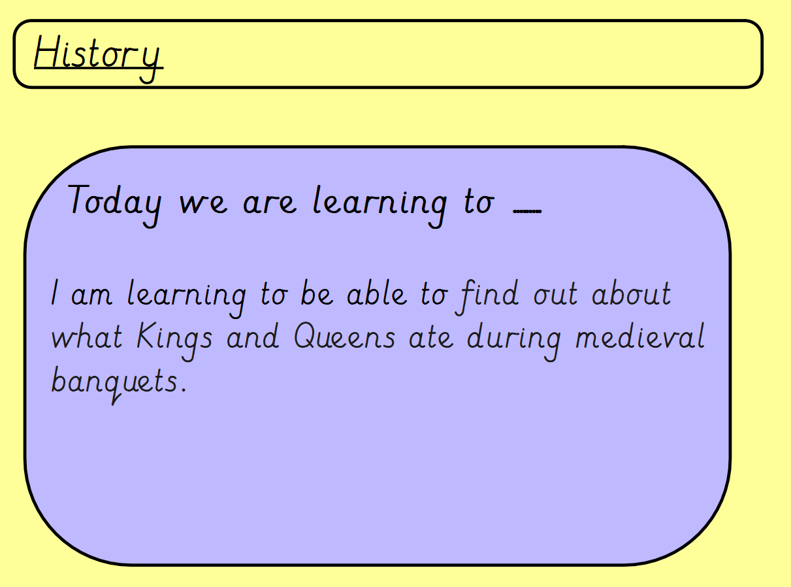

Slide 3
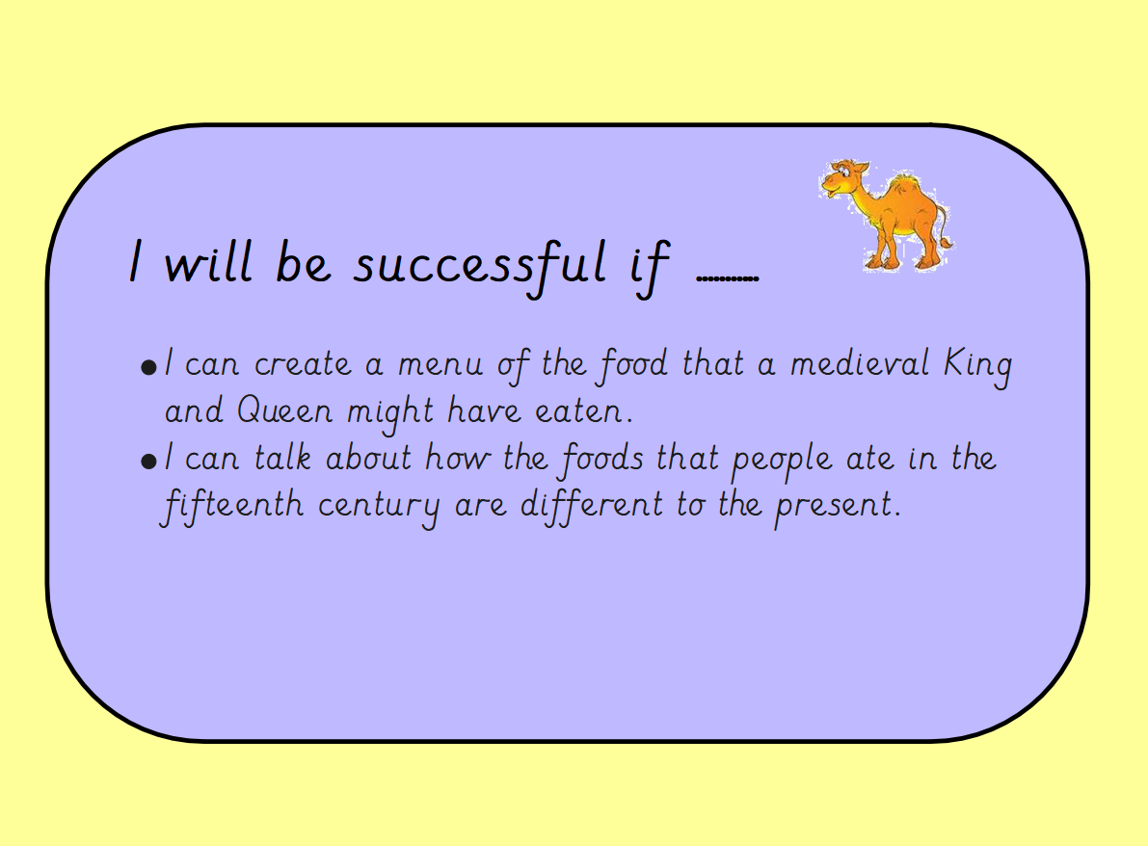

Slide 4
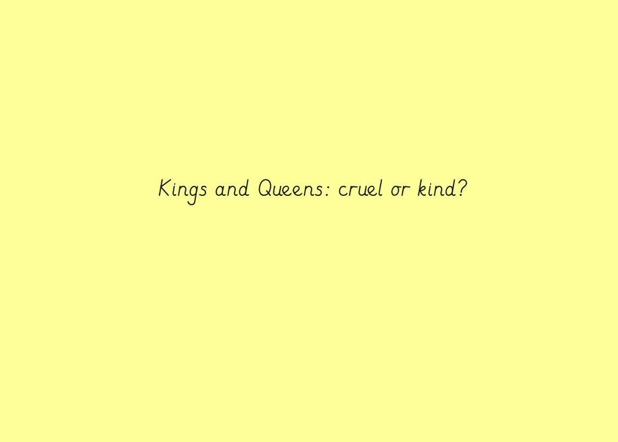
Thinking back from out previous learning from last week…. Can you discuss whether Queen Victoria is cruel or kind? Can you explain your answer?

Slide 5
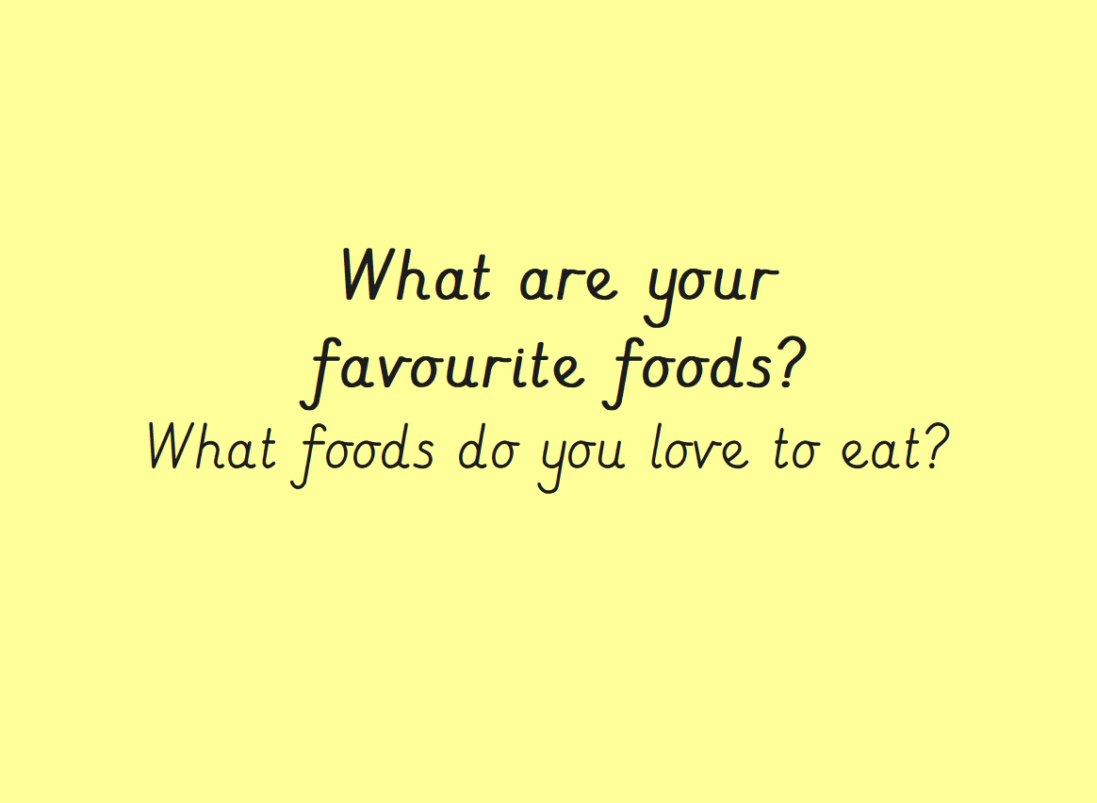
Can you create a list of your favourite foods that you like to eat? Can you list at least 5?

Slide 6
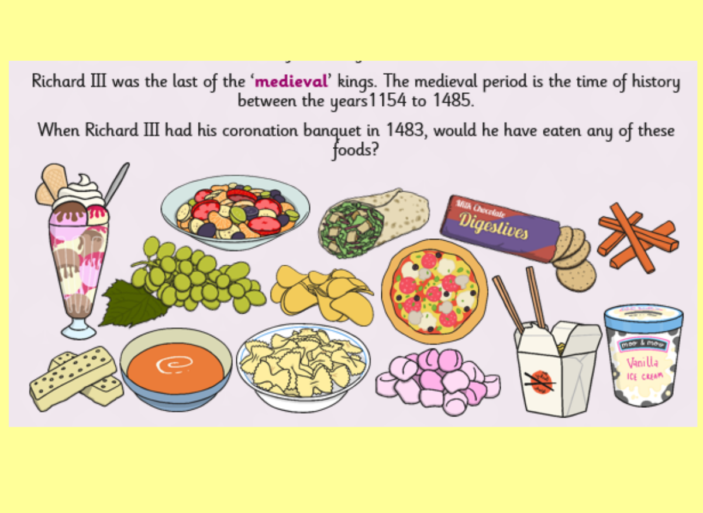
What does ‘medieval’ mean?
Can you go through the food Richard III ate and discuss whether you would have eaten any of these foods?

Slide 7
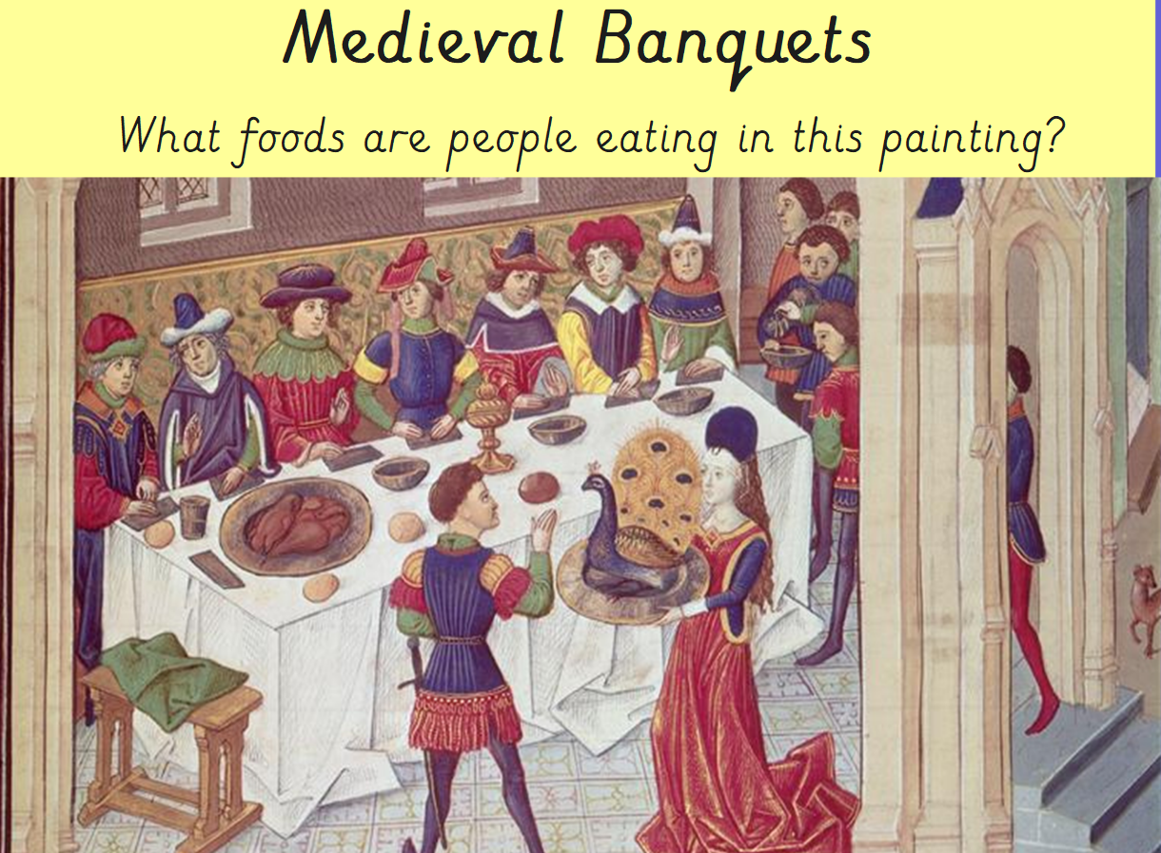

Slide 8
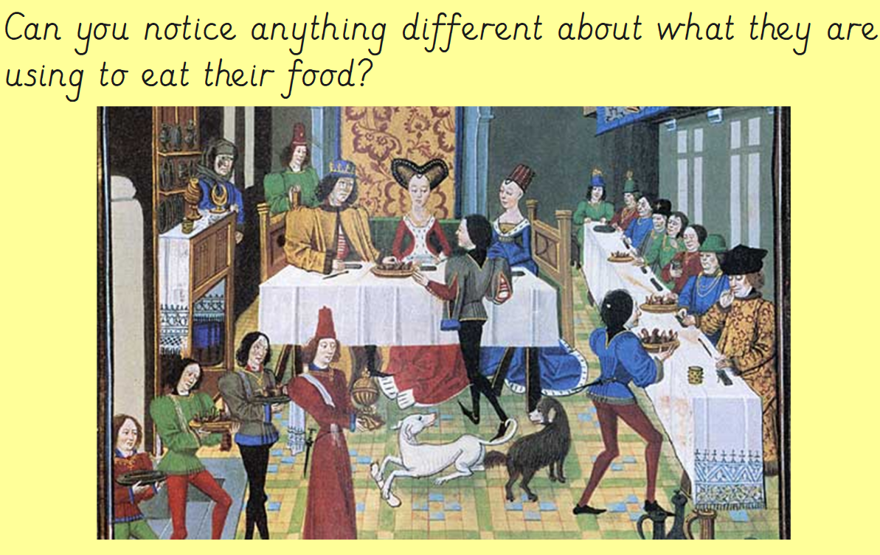
Discuss with an adult… What can you see in this picture?

Slide 9
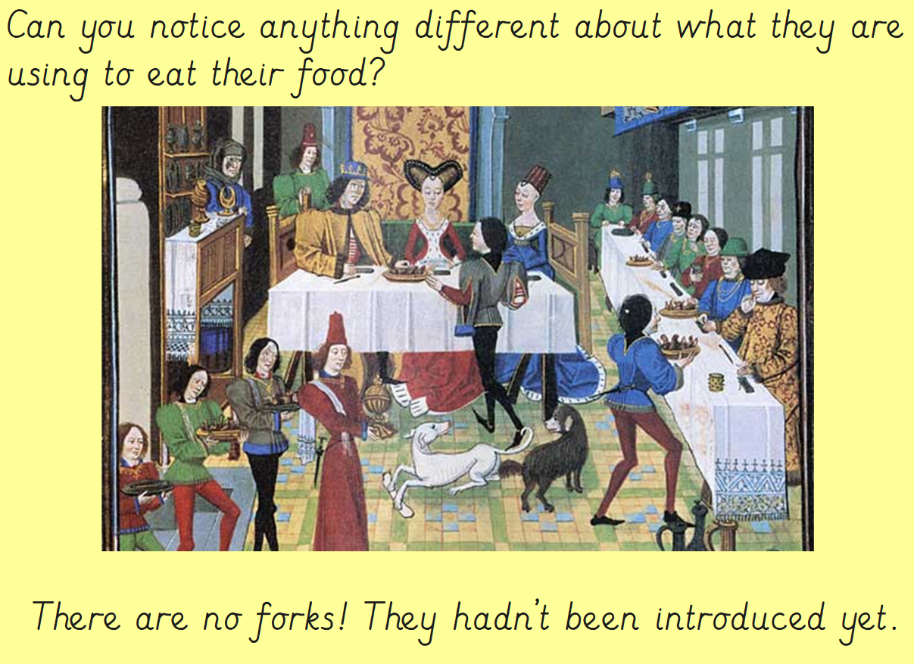

Slide 10
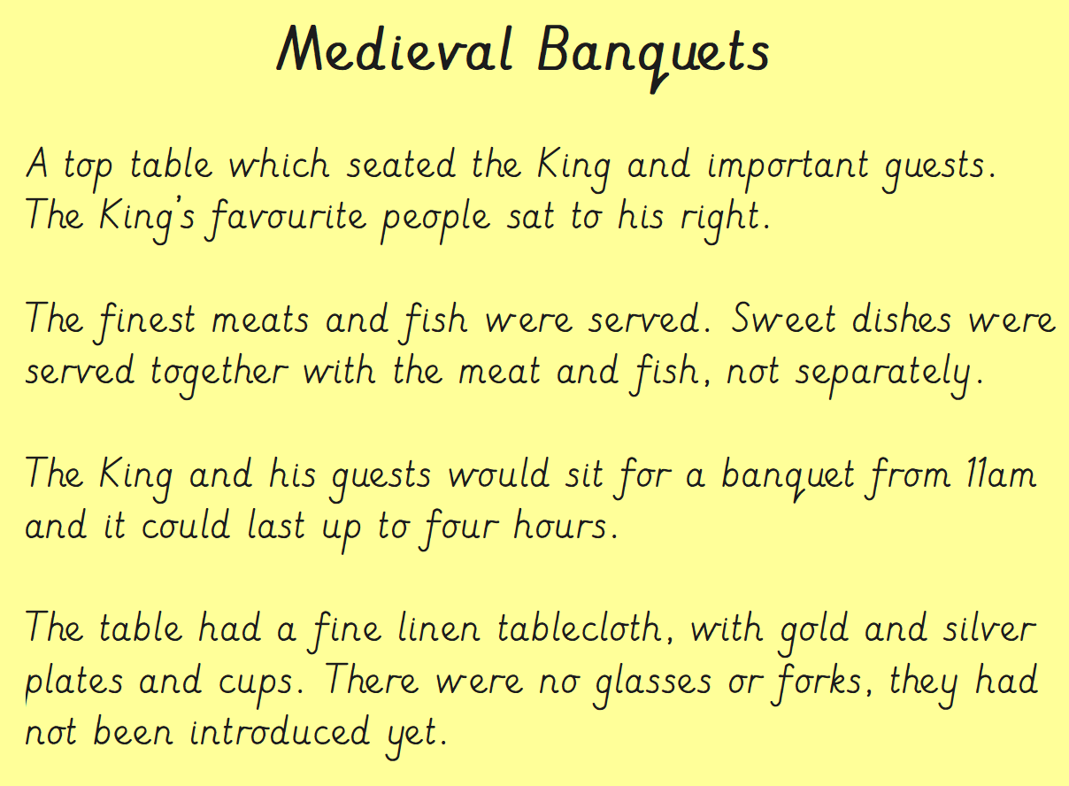

Slide 11
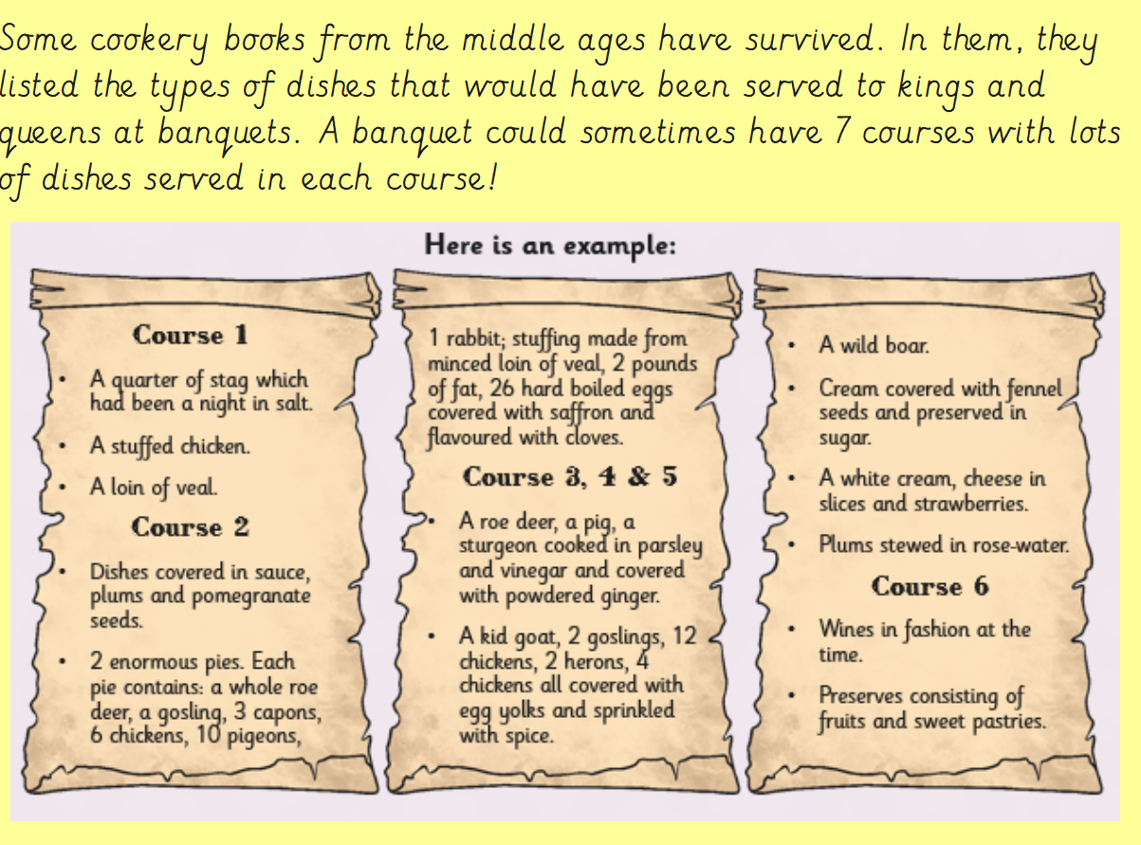

Slide 12
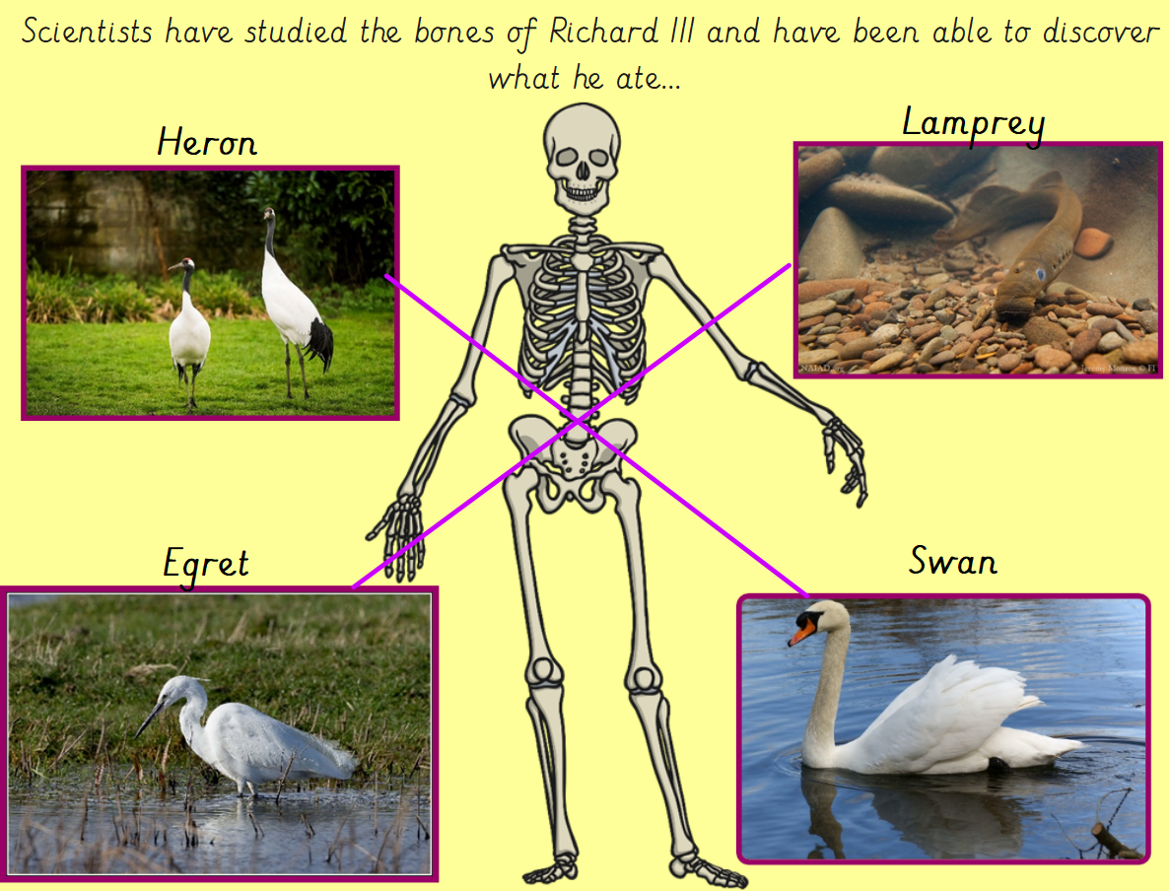

Slide 13
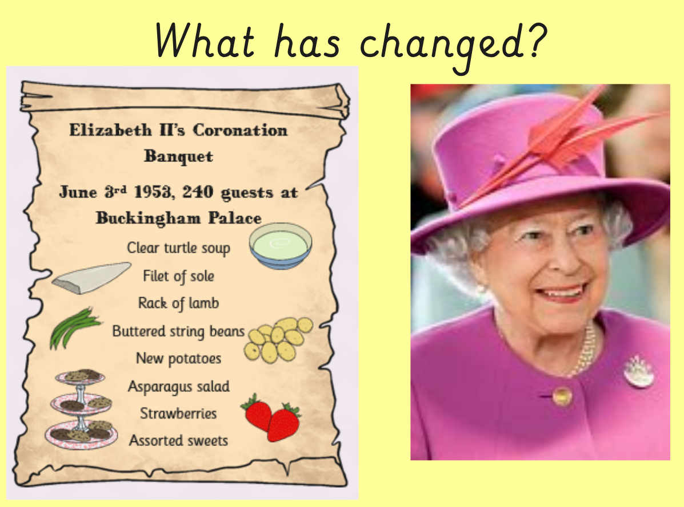

Slide 14
