Slide 1
Monday 18th January 2021
History/Topic

Slide 2
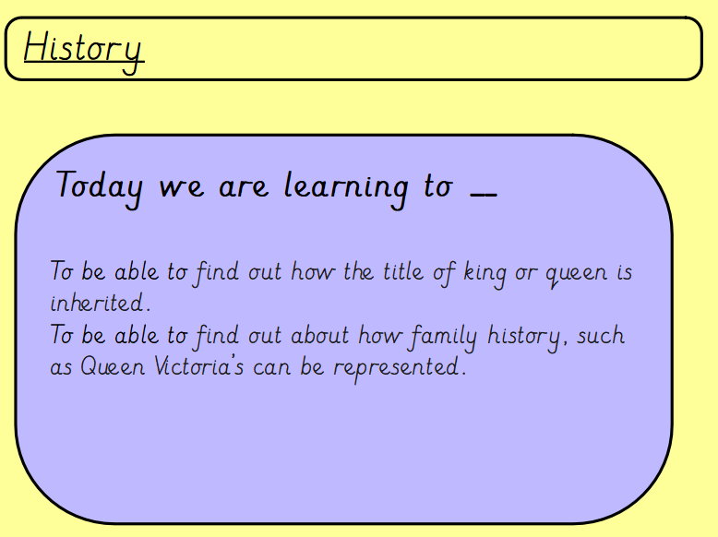

Slide 3
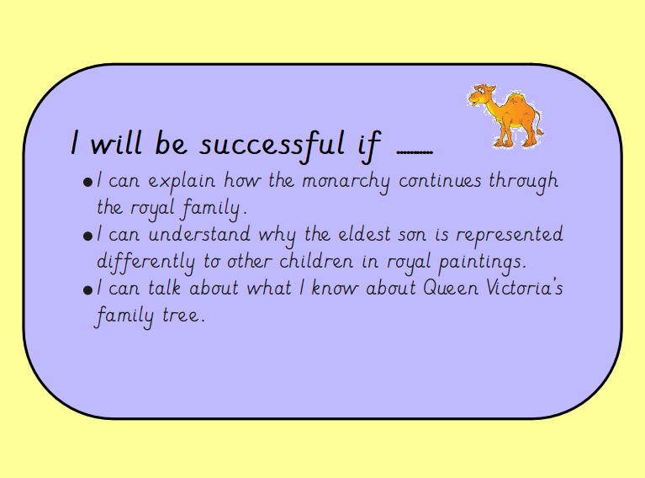

Slide 4
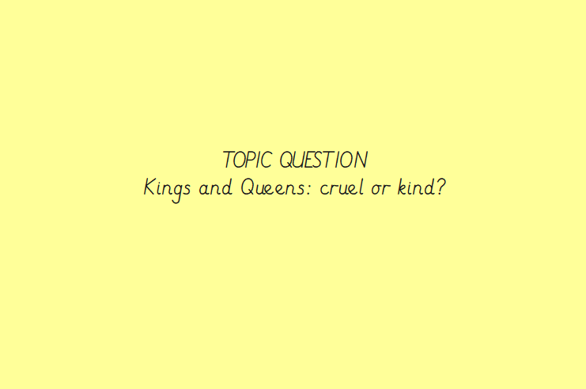
From previous learing last week – Can you discuss the significant British Monarchs that we looked at last week? Thinking about the question – Do you think they are cruel or kind? Explain your answers.

Slide 5
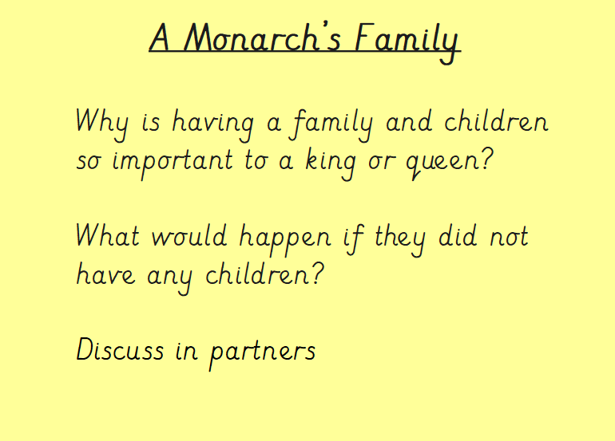

Slide 6
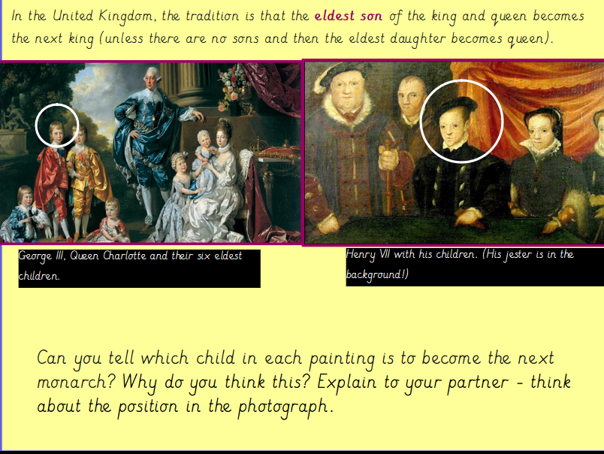

Slide 7
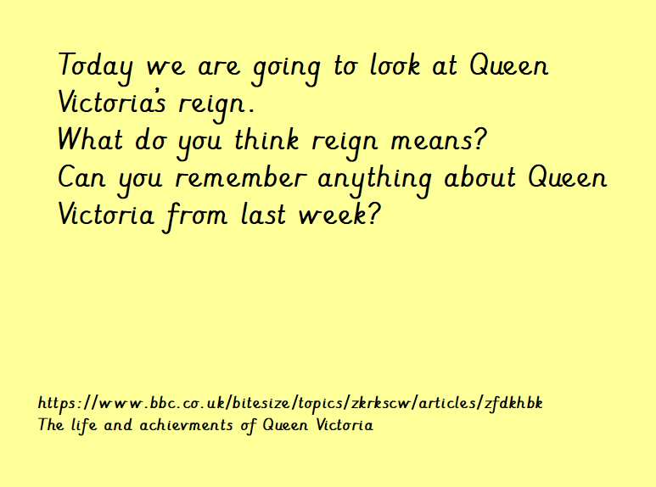

Slide 8
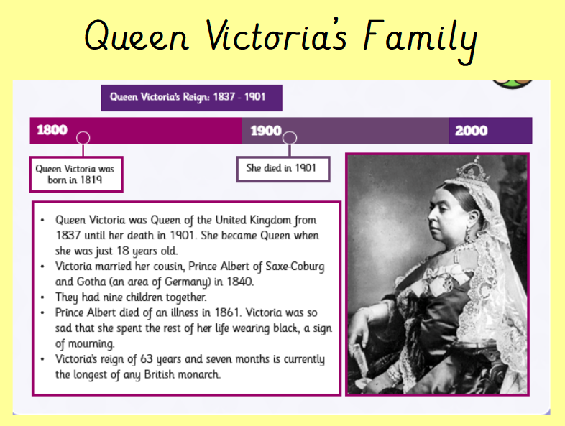

Slide 9
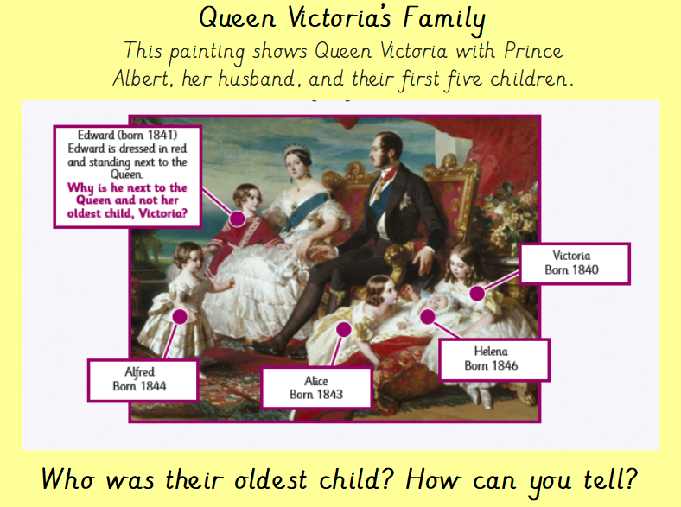

Slide 10
Task – Can you research Queen Victoria’s family tree? Can you write it down on a piece of paper or make it into a poster?

