Slide 1
Monday 25th January 2021
History/Topic

Slide 2
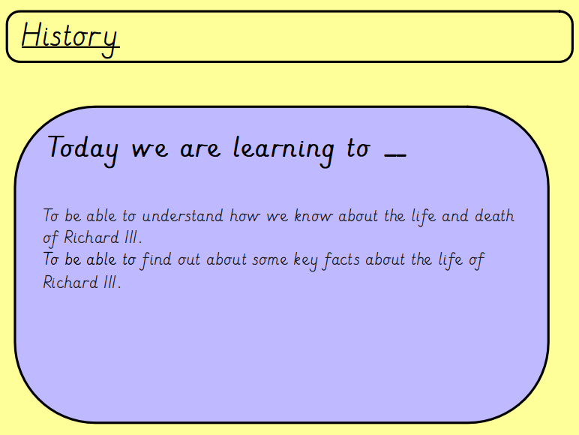

Slide 3
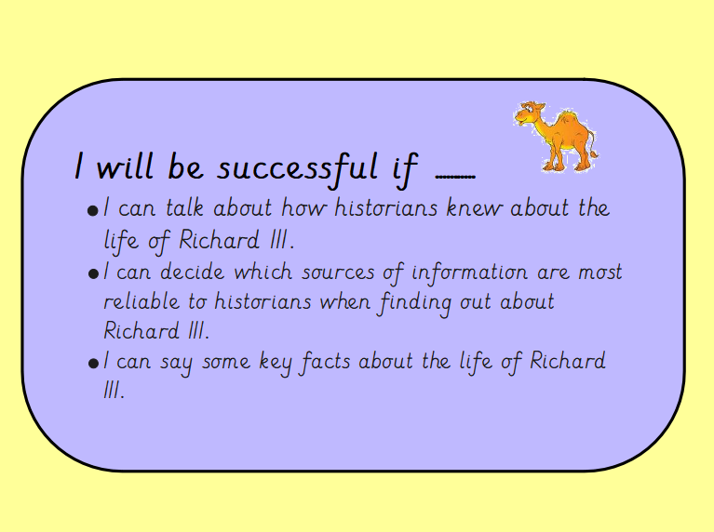

Slide 4
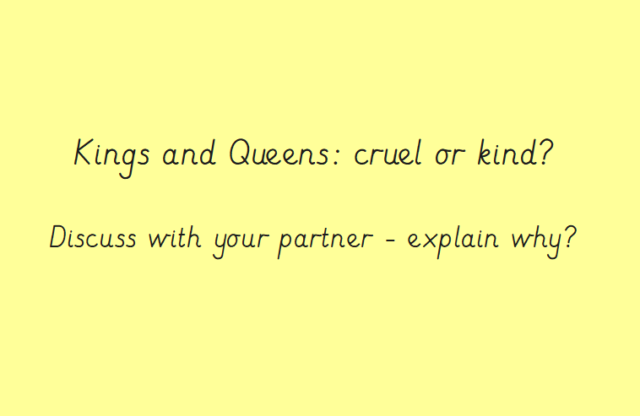
Think about Queen Victoria that we looked at last week – Was the Queen cruel or kind?
Explain your answers.

Slide 5
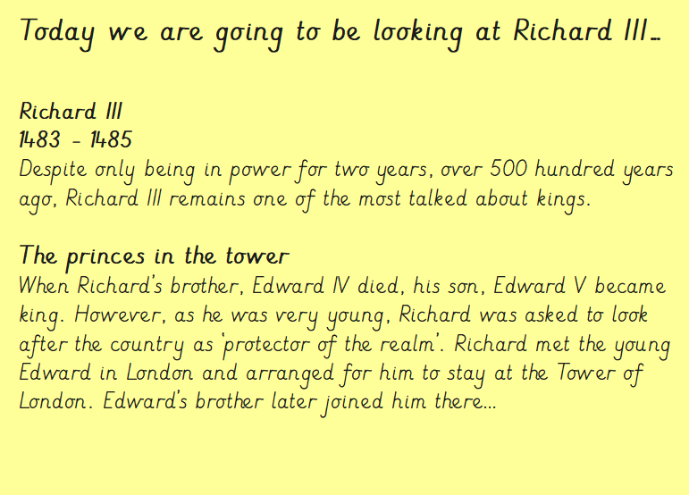
As you are working through the power point – think about why you think Richard III is one of the most talked about Kings.
Can you pick one fact that you are going to remember from this first slide?

Slide 6
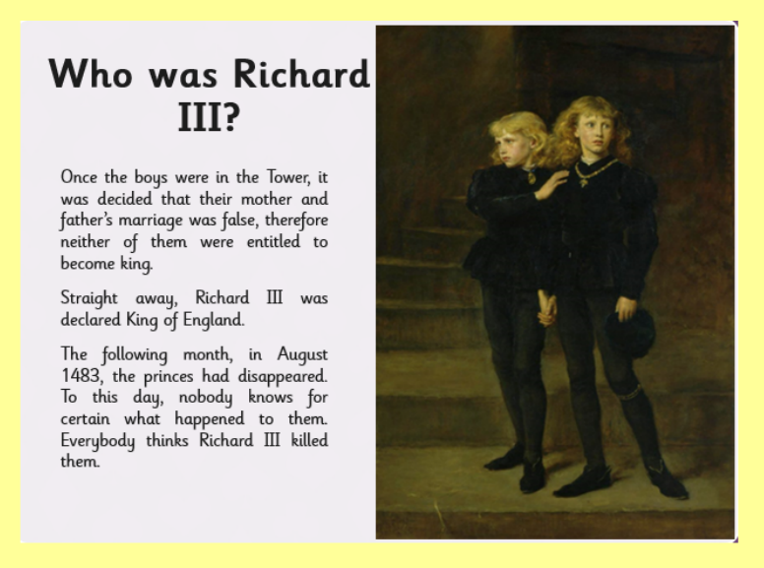
Why do you think Richard III became King of England after the two boys?
Can you look back at Richard III’s family tree?

Slide 7
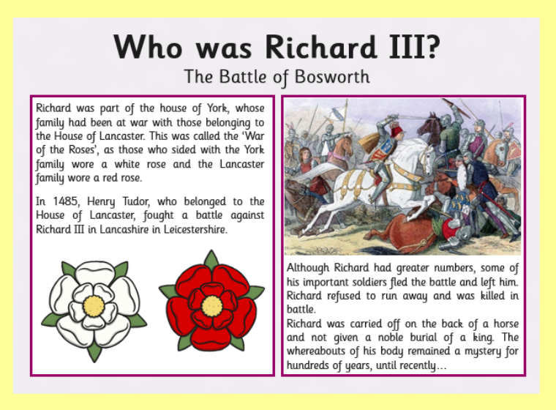
Questions to ask –
Why did the Battle of Bosworth start?
In what year did the Battle of Bosworth start?
Why do you think one family wore a white rose and the other wore a red rose?

Slide 8
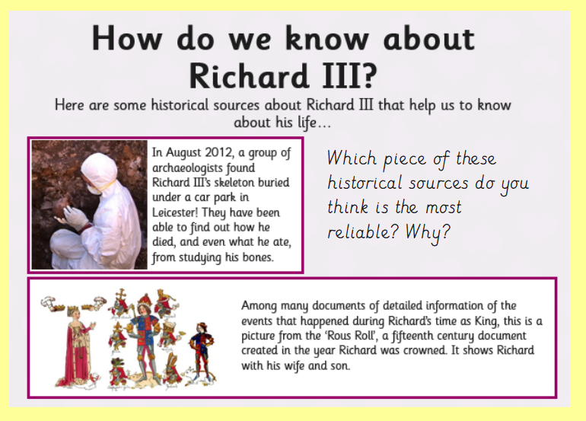

Slide 9
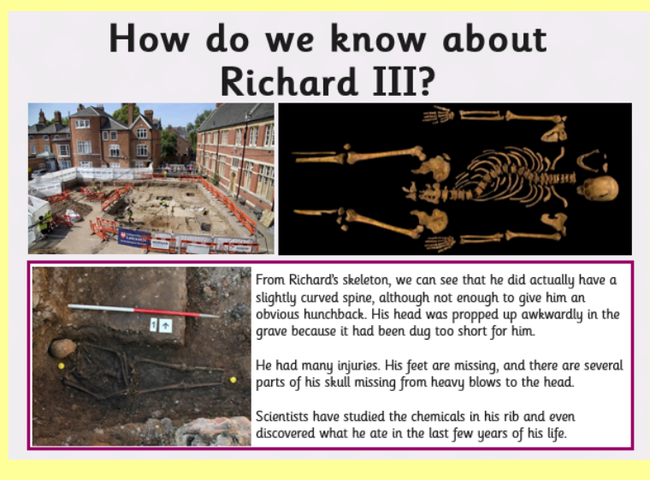
How did the scientists know what Richard III had ate in the last few years of his life?
What do you notice about the picture of the skeleton?
Can you recognise any bones?

Slide 10
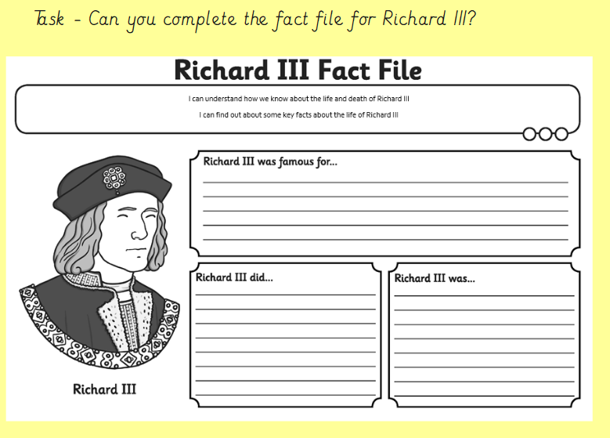
Using the information throughout the power point – Can you complete the fact file for Richard III?
Think about….
What he was famous for?
What did he do?

Slide 11
