Slide 1

2 apples $+$ 4 apples $=$ apples
2 ones $+$ 4 ones $=$ ones
2 thousands $+$ 4 thousands $=$
£2 $+$ £4 $=$
What fraction is shown?
Show $\frac{\text{3}}{\text{7}}$ on a bar model.

Slide 2

6
2 apples $+$ 4 apples $=$ apples
2 ones $+$ 4 ones $=$ ones
2 thousands $+$ 4 thousands $=$
£2 $+$ £4 $=$
What fraction is shown?
Show $\frac{\text{3}}{\text{7}}$ on a bar model.
6
6 thousands
£6
$\frac{\text{4}}{\text{5}}$

Slide 3


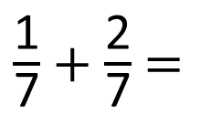
$\frac{\text{1}}{\text{7}}$ $+$ $\frac{\text{2}}{\text{7}}$ $=$
$\frac{\text{3}}{\text{7}}$
one seventh $+$ two sevenths $=$ three sevenths

Slide 4
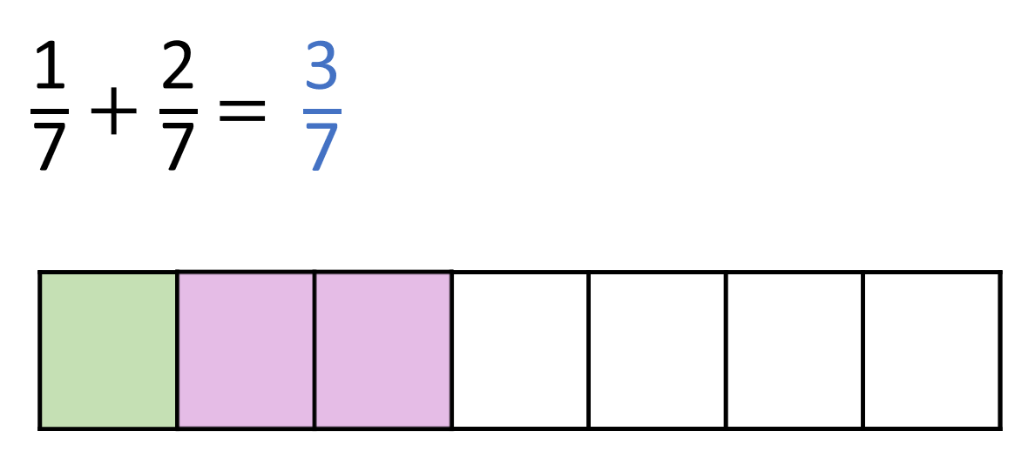

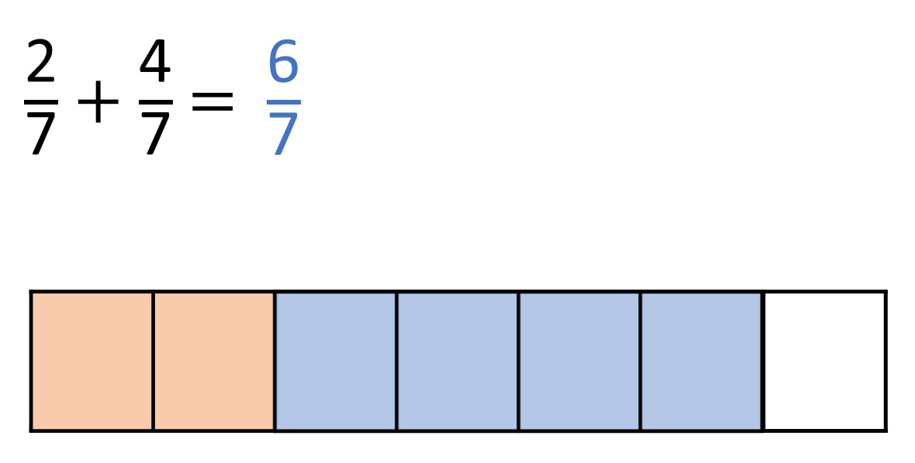
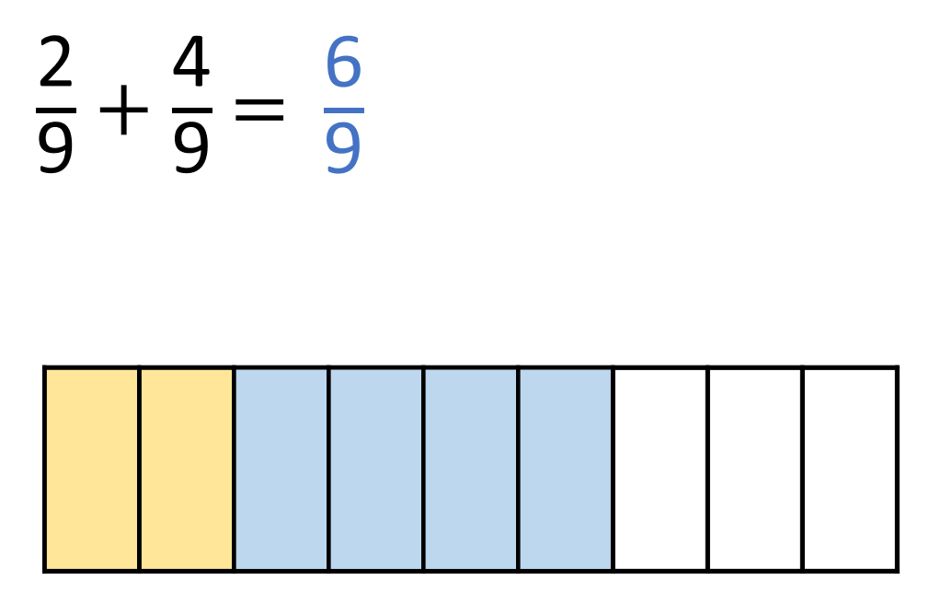
What do you notice?
Have a think
Add the numerators
Keep the denominators
the same

Slide 5

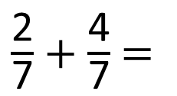
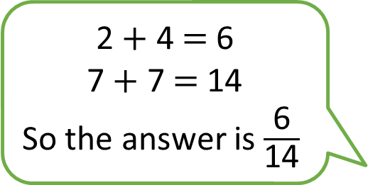
$\frac{\text{2}}{\text{7}}$ $+$ $\frac{\text{4}}{\text{7}}$ $=$
2 $+$ 4 $=$ 6
7 $+$ 7 $=$ 14
So the answer is $\frac{\text{6}}{\text{14}}$
Do you agree with Tiny?
Have a think

Slide 6


$\frac{\text{2}}{\text{7}}$ $+$ $\frac{\text{4}}{\text{7}}$ $=$
$\frac{\text{6}}{\text{7}}$
2 $+$ 4 $=$ 6
7 $+$ 7 $=$ 14
So the answer is $\frac{\text{6}}{\text{14}}$

Slide 7
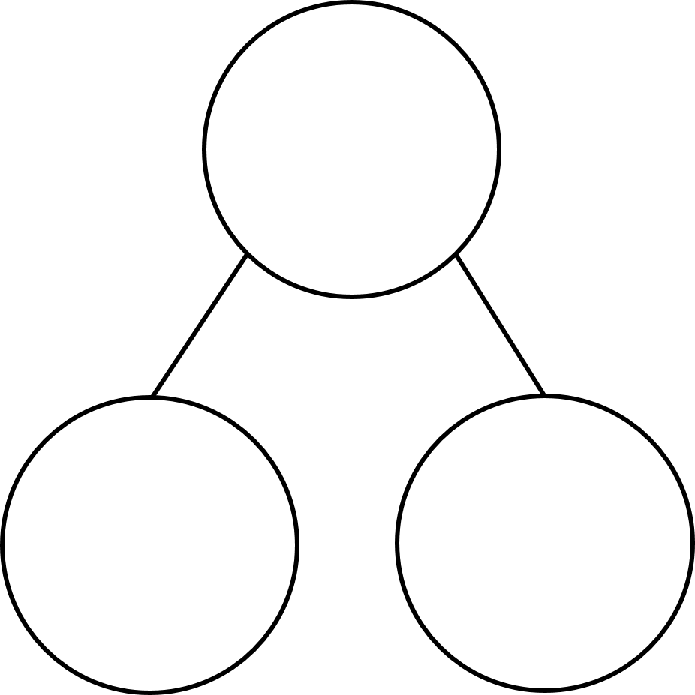


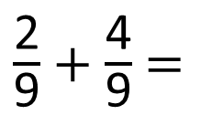


$\frac{\text{2}}{\text{9}}$ $+$ $\frac{\text{4}}{\text{9}}$ $=$
$\frac{\text{6}}{\text{9}}$
Have a think
$\frac{\text{6}}{\text{9}}$
$\frac{\text{2}}{\text{9}}$
$\frac{\text{4}}{\text{9}}$

