Slide 1




What’s the same? What’s different?
Complete the number lines.
Fill in the missing fractions.
0
1
0
2
0
$\frac{\text{1}}{\text{7}}$
$\frac{\text{2}}{\text{7}}$
$\frac{\text{4}}{\text{7}}$
$\frac{\text{5}}{\text{7}}$
1

Slide 2
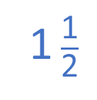


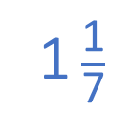






What’s the same? What’s different?
Complete the number lines.
Fill in the missing fractions.
$\frac{\text{1}}{\text{4}}$
$\frac{\text{2}}{\text{4}}$
$\frac{\text{3}}{\text{4}}$
0
1
$\frac{\text{1}}{\text{2}}$
1 $\frac{\text{1}}{\text{2}}$
0
1
2
$\frac{\text{7}}{\text{7}}$
$\frac{\text{8}}{\text{7}}$
0
$\frac{\text{1}}{\text{7}}$
$\frac{\text{2}}{\text{7}}$
$\frac{\text{3}}{\text{7}}$
$\frac{\text{4}}{\text{7}}$
$\frac{\text{5}}{\text{7}}$
$\frac{\text{6}}{\text{7}}$
1
1 $\frac{\text{1}}{\text{7}}$

Slide 3
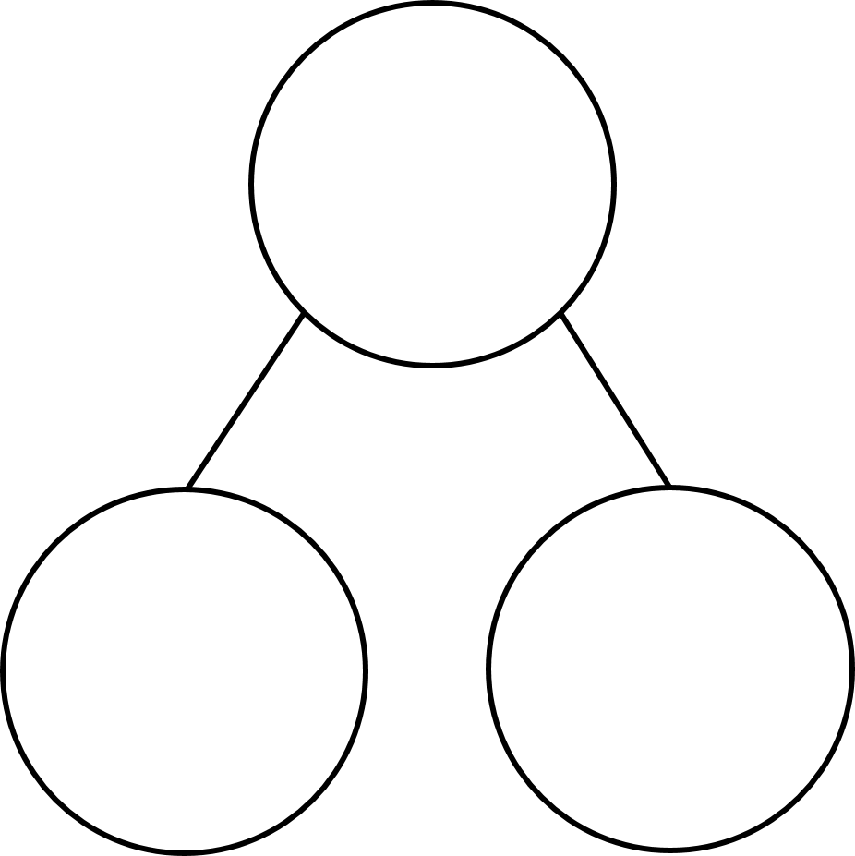


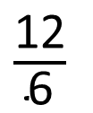
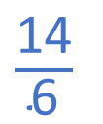
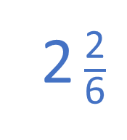

2 $\frac{\text{2}}{\text{6}}$
$\frac{\text{14}}{\text{6}}$
$\frac{\text{6}}{\text{6}}$
1 whole
1 whole
$\frac{\text{6}}{\text{6}}$
$\frac{\text{12}}{\text{6}}$
$\frac{\text{2}}{\text{6}}$
2 wholes
2 sixths

Slide 4


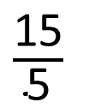

$\frac{\text{18}}{\text{5}}$
$\frac{\text{5}}{\text{5}}$
1 whole
$\frac{\text{15}}{\text{5}}$
$\frac{\text{3}}{\text{5}}$
3 wholes
3 fifths

Slide 5


































$+$ $\frac{\text{1}}{\text{6}}$
1
1 $\frac{\text{1}}{\text{6}}$
1 $\frac{\text{2}}{\text{6}}$
1 $\frac{\text{3}}{\text{6}}$
1 $\frac{\text{4}}{\text{6}}$
1 $\frac{\text{5}}{\text{6}}$
2
2 $\frac{\text{1}}{\text{6}}$
2 $\frac{\text{2}}{\text{6}}$
2 $\frac{\text{3}}{\text{6}}$
2 $\frac{\text{4}}{\text{6}}$
2 $\frac{\text{5}}{\text{6}}$
3
3 $\frac{\text{1}}{\text{6}}$
$\frac{\text{4}}{\text{6}}$
$\frac{\text{5}}{\text{6}}$
$\frac{\text{6}}{\text{6}}$
$\frac{\text{7}}{\text{6}}$
$\frac{\text{8}}{\text{6}}$
$\frac{\text{9}}{\text{6}}$
$\frac{\text{10}}{\text{6}}$
$\frac{\text{11}}{\text{6}}$
$\frac{\text{12}}{\text{6}}$
$\frac{\text{13}}{\text{6}}$
$\frac{\text{14}}{\text{6}}$
$\frac{\text{15}}{\text{6}}$
$\frac{\text{16}}{\text{6}}$
$\frac{\text{17}}{\text{6}}$
$\frac{\text{18}}{\text{6}}$
$\frac{\text{19}}{\text{6}}$

Slide 6


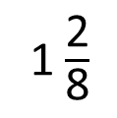




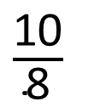
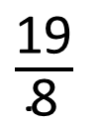

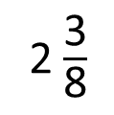


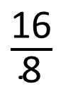


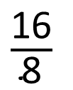

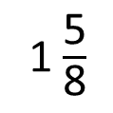

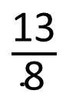
Have a think
$+$ $\frac{\text{3}}{\text{8}}$
$\frac{\text{1}}{\text{8}}$
$\frac{\text{4}}{\text{8}}$
$\frac{\text{7}}{\text{8}}$
$\frac{\text{10}}{\text{8}}$
$\frac{\text{13}}{\text{8}}$
$\frac{\text{16}}{\text{8}}$
$\frac{\text{19}}{\text{8}}$
1 $\frac{\text{2}}{\text{8}}$
1 $\frac{\text{5}}{\text{8}}$
2
2 $\frac{\text{3}}{\text{8}}$
$\frac{\text{10}}{\text{8}}$
$\frac{\text{13}}{\text{8}}$
$\frac{\text{16}}{\text{8}}$
$\frac{\text{19}}{\text{8}}$
$\frac{\text{16}}{\text{8}}$
$\frac{\text{8}}{\text{8}}$
$\frac{\text{2}}{\text{8}}$
$\frac{\text{5}}{\text{8}}$
$\frac{\text{3}}{\text{8}}$
2 wholes
1 whole

Slide 7
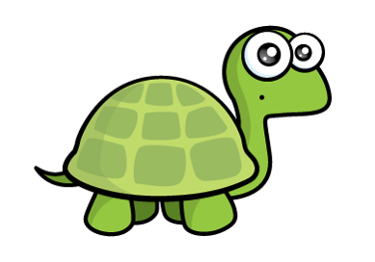
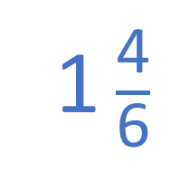

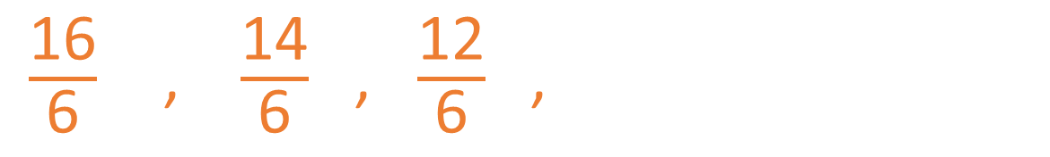
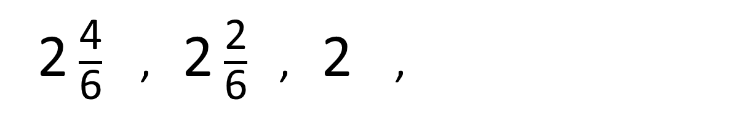
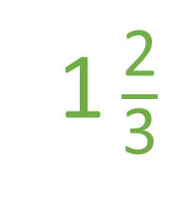

I can think of two different ways to answer this.
Have a think
$−$ $\frac{\text{2}}{\text{6}}$
1 $\frac{\text{2}}{\text{3}}$
2 $\frac{\text{4}}{\text{6}}$ , 2 $\frac{\text{2}}{\text{6}}$ , 2 ,
1 $\frac{\text{4}}{\text{6}}$
$\frac{\text{10}}{\text{6}}$
$\frac{\text{16}}{\text{6}}$ , $\frac{\text{14}}{\text{6}}$ , $\frac{\text{12}}{\text{6}}$ ,

Slide 8



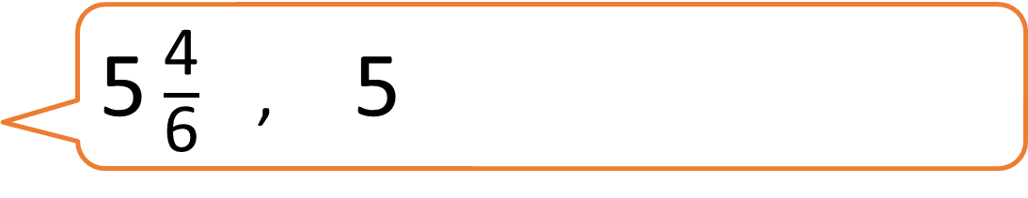
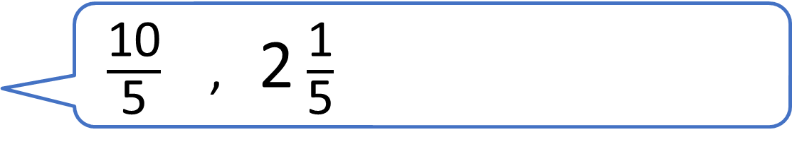

$\frac{\text{10}}{\text{5}}$ , 2 $\frac{\text{1}}{\text{5}}$
5 $\frac{\text{4}}{\text{6}}$ , 5
$\frac{\text{3}}{\text{4}}$ , $\frac{\text{6}}{\text{4}}$
Who will reach 3 wholes first?

