Slide 1
1) What fraction of each shape is shaded?
2) How many sevenths are there in one?
3) How many tenths are there in two?

Slide 2



1) What fraction of each shape is shaded?
$$\frac{\text{5}}{\text{9}}$$
$$\frac{\text{1}}{\text{4}}$$
$$\frac{\text{1}}{\text{1}}$$
Or 1
2) How many sevenths are there in one?
7
3) How many tenths are there in two?
20

Slide 3
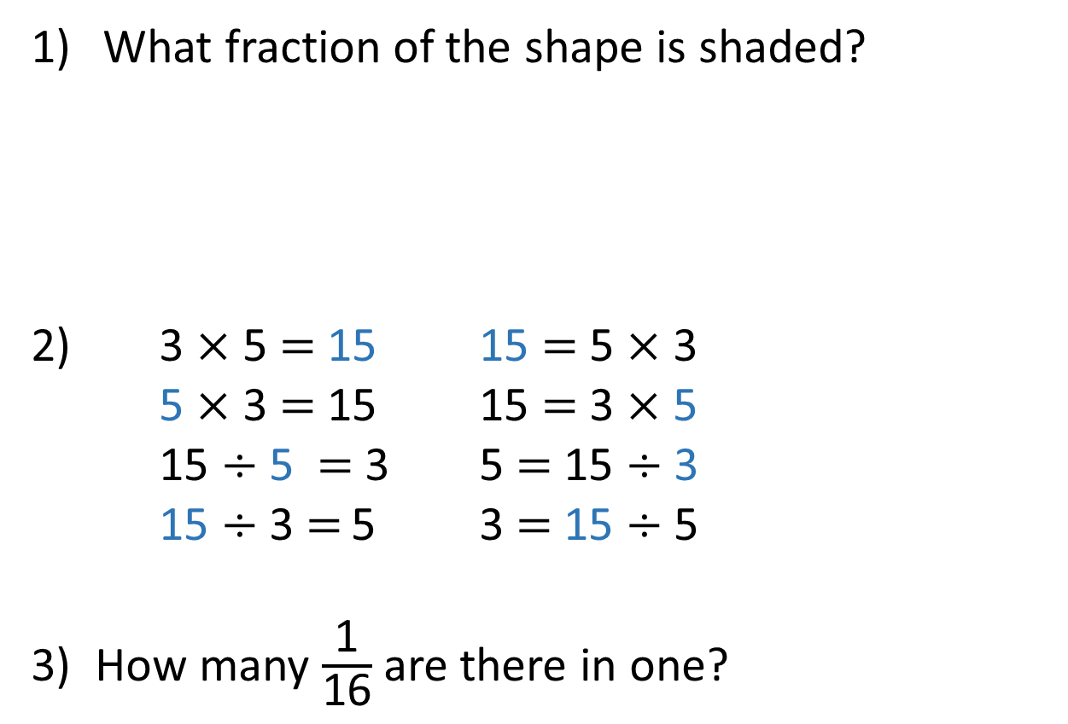
What fraction of the shape is shaded?
3 $×$ 5 $=$ 15 15 $=$ 5 $×$ 3
5 $×$ 3 $=$ 15 15 $=$ 3 $×$ 5
15 $÷$ 5 $=$ 3 5 $=$ 15 $÷$ 3
15 $÷$ 3 $=$ 5 3 $=$ 15 $÷$ 5
3) How many $\frac{\text{1}}{\text{16}}$ are there in one?

Slide 4

What fraction of the shape is shaded?
3 $×$ 5 $=$ 15 15 $=$ 5 $×$ 3
5 $×$ 3 $=$ 15 15 $=$ 3 $×$ 5
15 $÷$ 5 $=$ 3 5 $=$ 15 $÷$ 3
15 $÷$ 3 $=$ 5 3 $=$ 15 $÷$ 5
3) How many $\frac{\text{1}}{\text{16}}$ are there in one?
$\frac{\text{5}}{\text{10}} \text{or} \frac{\text{1}}{\text{2}}$
16

Slide 5

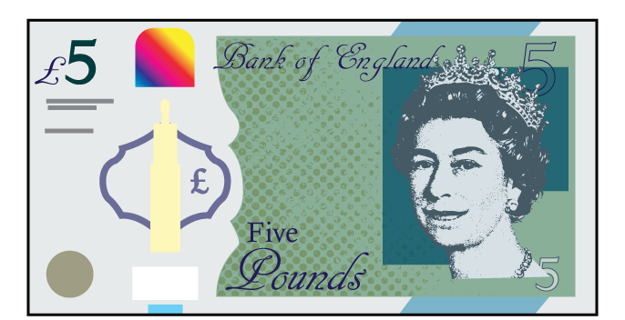
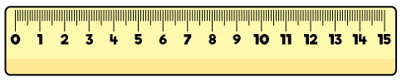
equivalent
“of equal value, amount or meaning”
are equivalent to
3 $+$ 3
is equivalent to
5 $+$ 1
1 cm
is equivalent to
10 mm

Slide 6



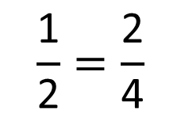



$$\frac{\text{1}}{\text{2}}$$
$$\frac{\text{1}}{\text{2}}$$
$$\frac{\text{1}}{\text{4}}$$
$$\frac{\text{1}}{\text{4}}$$
$$\frac{\text{1}}{\text{4}}$$
$$\frac{\text{1}}{\text{4}}$$
$$\frac{\text{1}}{\text{2}}=\frac{\text{2}}{\text{4}}$$

Slide 7





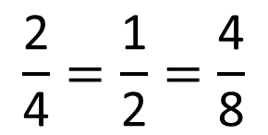








$$\frac{\text{1}}{\text{4}}$$
$$\frac{\text{1}}{\text{4}}$$
$$\frac{\text{1}}{\text{4}}$$
$$\frac{\text{1}}{\text{4}}$$
$$\frac{\text{1}}{\text{8}}$$
$$\frac{\text{1}}{\text{8}}$$
$$\frac{\text{1}}{\text{8}}$$
$$\frac{\text{1}}{\text{8}}$$
$$\frac{\text{1}}{\text{8}}$$
$$\frac{\text{1}}{\text{8}}$$
$$\frac{\text{1}}{\text{8}}$$
$$\frac{\text{1}}{\text{8}}$$
How many eighths are equivalent to a half?
$$\frac{\text{2}}{\text{4}}=\frac{\text{1}}{\text{2}}=\frac{\text{4}}{\text{8}}$$
Have a think

Slide 8

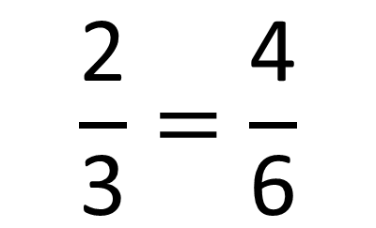
Have a think
$$\frac{\text{2}}{\text{3}}=\frac{\text{4}}{\text{6}}$$

Slide 9
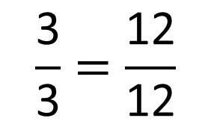
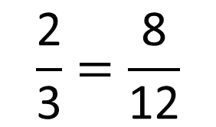
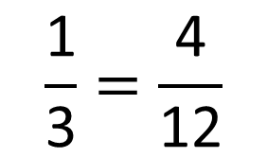
$$\frac{\text{1}}{\text{3}}=\frac{\text{4}}{\text{12}}$$
$$\frac{\text{2}}{\text{3}}=\frac{\text{8}}{\text{12}}$$
$$\frac{\text{3}}{\text{3}}=\frac{\text{12}}{\text{12}}$$

Slide 10


$$\frac{\text{4}}{\text{12}}$$
$$\frac{\text{1}}{\text{3}}$$
Have a think

Slide 11
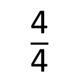
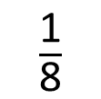
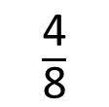
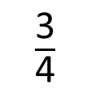
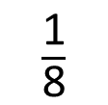
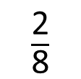
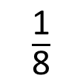
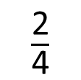
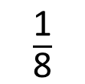
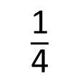
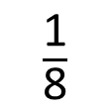
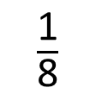
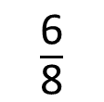
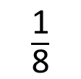
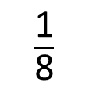
$\frac{\text{1}}{\text{8}}$
$\frac{\text{1}}{\text{8}}$
$\frac{\text{1}}{\text{8}}$
$\frac{\text{1}}{\text{8}}$
$\frac{\text{1}}{\text{8}}$
$\frac{\text{1}}{\text{8}}$
$\frac{\text{1}}{\text{8}}$
$\frac{\text{1}}{\text{8}}$
$\frac{\text{2}}{\text{8}}$
$\frac{\text{4}}{\text{8}}$
$\frac{\text{6}}{\text{8}}$
0
$\frac{\text{1}}{\text{4}}$
$\frac{\text{2}}{\text{4}}$
$\frac{\text{3}}{\text{4}}$
1
$\frac{\text{4}}{\text{4}}$

Slide 12

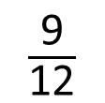


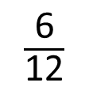
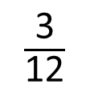









$\frac{\text{1}}{\text{12}}$
$\frac{\text{1}}{\text{12}}$
$\frac{\text{1}}{\text{12}}$
$\frac{\text{1}}{\text{12}}$
$\frac{\text{1}}{\text{12}}$
$\frac{\text{1}}{\text{12}}$
$\frac{\text{1}}{\text{12}}$
$\frac{\text{1}}{\text{12}}$
$\frac{\text{1}}{\text{12}}$
$\frac{\text{1}}{\text{12}}$
$\frac{\text{1}}{\text{12}}$
$\frac{\text{1}}{\text{12}}$
$\frac{\text{3}}{\text{12}}$
$\frac{\text{6}}{\text{12}}$
$\frac{\text{9}}{\text{12}}$
0
$\frac{\text{1}}{\text{4}}$
$\frac{\text{2}}{\text{4}}$
$\frac{\text{3}}{\text{4}}$
1
$\frac{\text{4}}{\text{4}}$

Slide 13






0
$\frac{\text{12}}{\text{16}}$
1
$\frac{\text{1}}{\text{16}}$
$\frac{\text{3}}{\text{4}}$
$\frac{\text{2}}{\text{16}}$
$\frac{\text{3}}{\text{16}}$
$\frac{\text{1}}{\text{4}}$
$\frac{\text{4}}{\text{16}}$
$\frac{\text{2}}{\text{4}}$
$\frac{\text{8}}{\text{16}}$
$\frac{\text{4}}{\text{4}}$

Slide 14
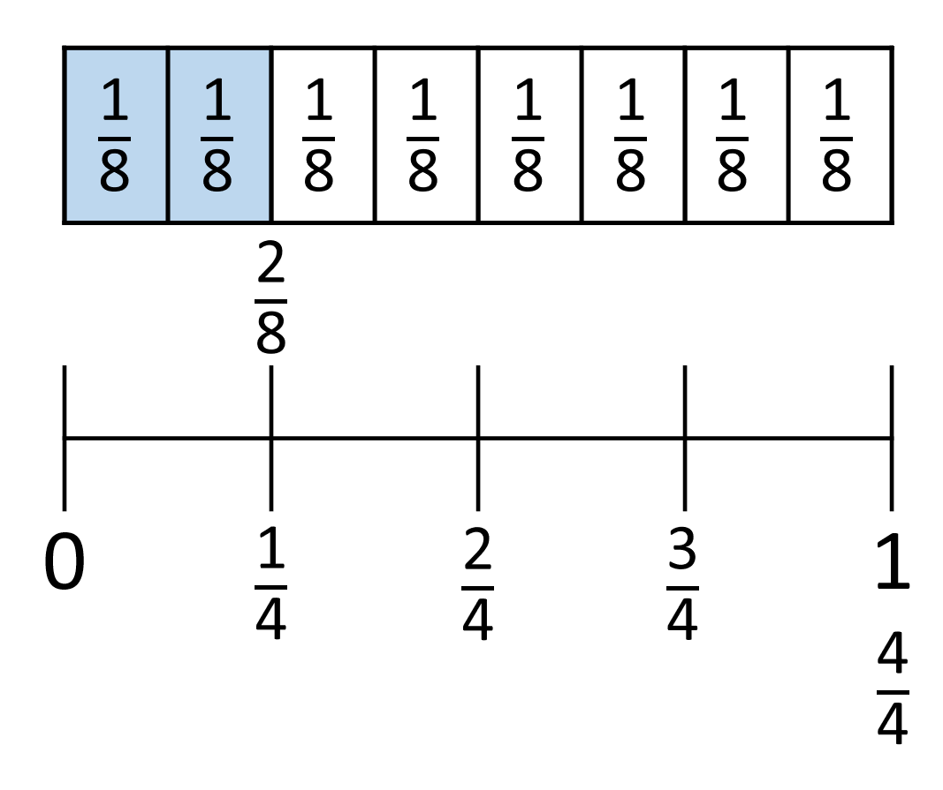
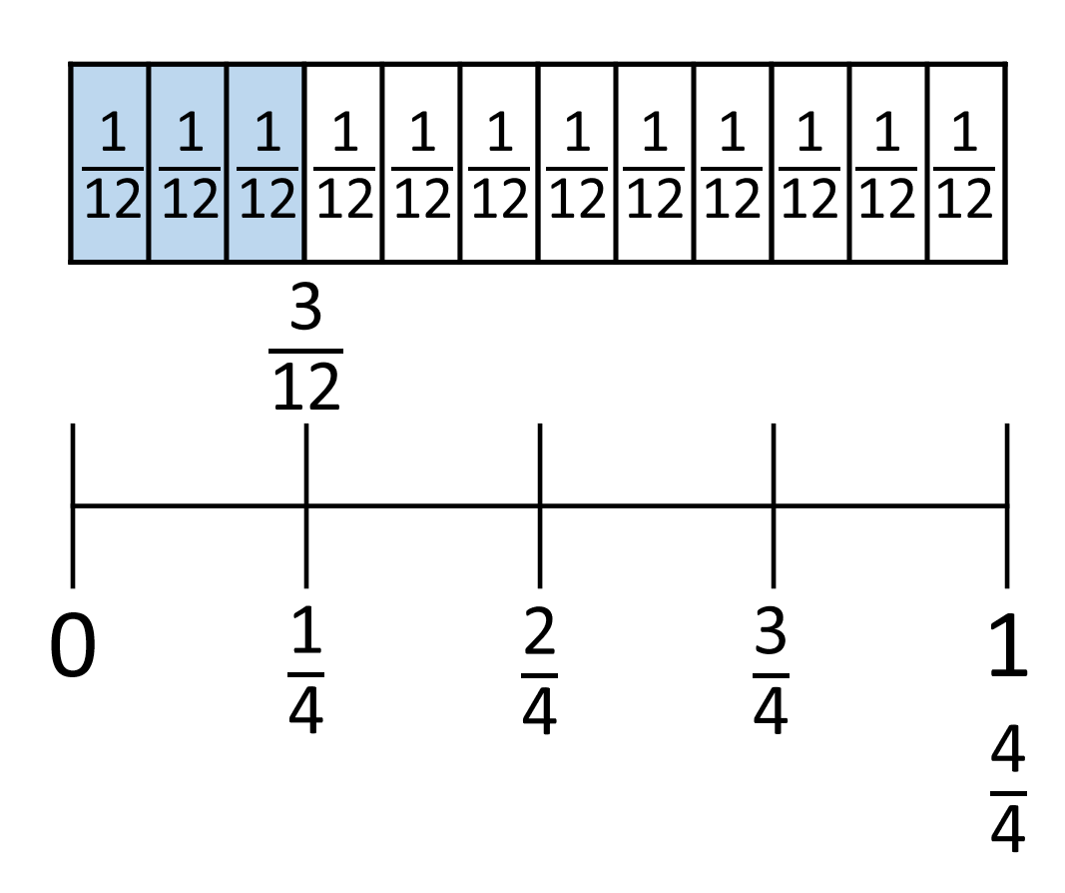
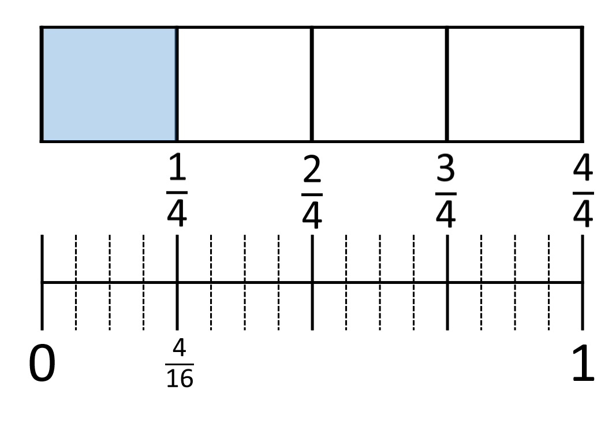
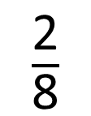


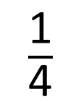
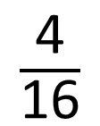
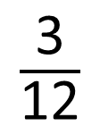

$\frac{\text{1}}{\text{4}}$
$\frac{\text{2}}{\text{8}}$
$\frac{\text{3}}{\text{12}}$
$\frac{\text{4}}{\text{16}}$
$$=$$
$$=$$
$$=$$
What other equivalent fractions can you find?
Have you spotted a pattern?

