Slide 1
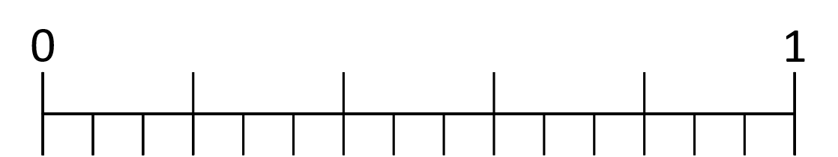
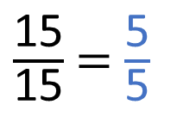
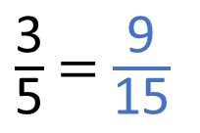
What equivalent fractions can you see in the bar models?
Use the number line to find the equivalent fractions.
$\frac{\text{3}}{\text{5}}$ = $\frac{\text{9}}{\text{15}}$
$\frac{\text{15}}{\text{15}}$ = $\frac{\text{5}}{\text{5}}$

Slide 2














What equivalent fractions can you see in the bar models?
Use the number line to find the equivalent fractions.
$\frac{\text{1}}{\text{9}}$
$\frac{\text{1}}{\text{9}}$
$\frac{\text{1}}{\text{9}}$
$\frac{\text{1}}{\text{9}}$
$\frac{\text{1}}{\text{9}}$
$\frac{\text{1}}{\text{9}}$
$\frac{\text{1}}{\text{9}}$
$\frac{\text{1}}{\text{9}}$
$\frac{\text{1}}{\text{9}}$
$\frac{\text{1}}{\text{3}}$
$\frac{\text{1}}{\text{3}}$
$\frac{\text{1}}{\text{3}}$
$\frac{\text{3}}{\text{5}}$ = $\frac{\text{9}}{\text{15}}$
$\frac{\text{15}}{\text{15}}$ = $\frac{\text{5}}{\text{5}}$
$\frac{\text{3}}{\text{5}}$
$\frac{\text{15}}{\text{15}}$

Slide 3





















$\frac{\text{1}}{\text{2}}$
$\frac{\text{1}}{\text{2}}$
$\frac{\text{1}}{\text{4}}$
$\frac{\text{1}}{\text{4}}$
$\frac{\text{1}}{\text{4}}$
$\frac{\text{1}}{\text{4}}$
$\frac{\text{1}}{\text{2}}$ $=$ $\frac{\text{2}}{\text{4}}$ $=$ $\frac{\text{3}}{\text{6}}$ $=$ $\frac{\text{4}}{\text{8}}$
$\frac{\text{1}}{\text{6}}$
$\frac{\text{1}}{\text{6}}$
$\frac{\text{1}}{\text{6}}$
$\frac{\text{1}}{\text{6}}$
$\frac{\text{1}}{\text{6}}$
$\frac{\text{1}}{\text{6}}$
$\frac{\text{1}}{\text{8}}$
$\frac{\text{1}}{\text{8}}$
$\frac{\text{1}}{\text{8}}$
$\frac{\text{1}}{\text{8}}$
$\frac{\text{1}}{\text{8}}$
$\frac{\text{1}}{\text{8}}$
$\frac{\text{1}}{\text{8}}$
$\frac{\text{1}}{\text{8}}$

Slide 4











$\frac{\text{1}}{\text{2}}$
$\frac{\text{1}}{\text{2}}$
1
$\frac{\text{1}}{\text{2}}$
$\frac{\text{1}}{\text{3}}$
$\frac{\text{1}}{\text{4}}$
$\frac{\text{1}}{\text{4}}$
$\frac{\text{1}}{\text{4}}$
$\frac{\text{1}}{\text{4}}$
$\frac{\text{1}}{\text{4}}$
$\frac{\text{1}}{\text{5}}$
$\frac{\text{1}}{\text{2}}$ $=$ $\frac{\text{2}}{\text{4}}$ $=$ $\frac{\text{3}}{\text{6}}$ $=$ $\frac{\text{4}}{\text{8}}$
$\frac{\text{1}}{\text{6}}$
$\frac{\text{1}}{\text{7}}$
$\frac{\text{1}}{\text{6}}$
$\frac{\text{1}}{\text{6}}$
$\frac{\text{1}}{\text{6}}$
$\frac{\text{1}}{\text{6}}$
$\frac{\text{1}}{\text{6}}$
$\frac{\text{1}}{\text{6}}$
$\frac{\text{1}}{\text{8}}$
$\frac{\text{1}}{\text{9}}$
$\frac{\text{1}}{\text{10}}$
$\frac{\text{1}}{\text{8}}$
$\frac{\text{1}}{\text{8}}$
$\frac{\text{1}}{\text{8}}$
$\frac{\text{1}}{\text{8}}$
$\frac{\text{1}}{\text{8}}$
$\frac{\text{1}}{\text{8}}$
$\frac{\text{1}}{\text{8}}$
$\frac{\text{1}}{\text{8}}$
$\frac{\text{1}}{\text{11}}$
$\frac{\text{1}}{\text{12}}$

Slide 5




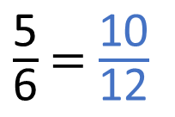







$\frac{\text{5}}{\text{6}}$ = $\frac{\text{10}}{\text{12}}$
1
$\frac{\text{1}}{\text{2}}$
$\frac{\text{1}}{\text{3}}$
$\frac{\text{1}}{\text{4}}$
$\frac{\text{1}}{\text{5}}$
$\frac{\text{1}}{\text{6}}$
$\frac{\text{1}}{\text{7}}$
$\frac{\text{1}}{\text{8}}$
$\frac{\text{1}}{\text{9}}$
$\frac{\text{1}}{\text{10}}$
$\frac{\text{1}}{\text{11}}$
$\frac{\text{1}}{\text{12}}$

Slide 6

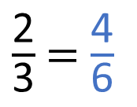
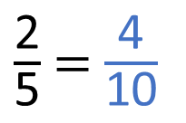
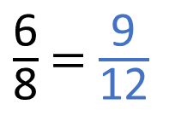
$\frac{\text{2}}{\text{5}}$ = $\frac{\text{4}}{\text{10}}$
$\frac{\text{2}}{\text{3}}$ = $\frac{\text{4}}{\text{6}}$
$\frac{\text{6}}{\text{8}}$ = $\frac{\text{9}}{\text{12}}$
Have a think
1
$\frac{\text{1}}{\text{2}}$
$\frac{\text{1}}{\text{3}}$
$\frac{\text{1}}{\text{4}}$
$\frac{\text{1}}{\text{5}}$
$\frac{\text{1}}{\text{6}}$
$\frac{\text{1}}{\text{7}}$
$\frac{\text{1}}{\text{8}}$
$\frac{\text{1}}{\text{9}}$
$\frac{\text{1}}{\text{10}}$
$\frac{\text{1}}{\text{11}}$
$\frac{\text{1}}{\text{12}}$

Slide 7
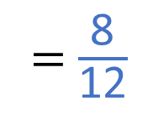
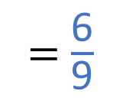
$\frac{\text{2}}{\text{5}}$ = $\frac{\text{4}}{\text{10}}$
$\frac{\text{2}}{\text{3}}$ = $\frac{\text{4}}{\text{6}}$
= $\frac{\text{6}}{\text{9}}$
= $\frac{\text{8}}{\text{12}}$
$\frac{\text{6}}{\text{8}}$ = $\frac{\text{9}}{\text{12}}$
1
$\frac{\text{1}}{\text{2}}$
$\frac{\text{1}}{\text{3}}$
$\frac{\text{1}}{\text{4}}$
$\frac{\text{1}}{\text{5}}$
$\frac{\text{1}}{\text{6}}$
$\frac{\text{1}}{\text{7}}$
$\frac{\text{1}}{\text{8}}$
$\frac{\text{1}}{\text{9}}$
$\frac{\text{1}}{\text{10}}$
$\frac{\text{1}}{\text{11}}$
$\frac{\text{1}}{\text{12}}$

Slide 8
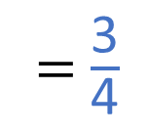
$\frac{\text{2}}{\text{5}}$ = $\frac{\text{4}}{\text{10}}$
$\frac{\text{2}}{\text{3}}$ = $\frac{\text{4}}{\text{6}}$
= $\frac{\text{6}}{\text{9}}$
= $\frac{\text{8}}{\text{12}}$
$\frac{\text{6}}{\text{8}}$ = $\frac{\text{9}}{\text{12}}$
= $\frac{\text{3}}{\text{4}}$
1
$\frac{\text{1}}{\text{2}}$
$\frac{\text{1}}{\text{3}}$
$\frac{\text{1}}{\text{4}}$
$\frac{\text{1}}{\text{5}}$
$\frac{\text{1}}{\text{6}}$
$\frac{\text{1}}{\text{7}}$
$\frac{\text{1}}{\text{8}}$
$\frac{\text{1}}{\text{9}}$
$\frac{\text{1}}{\text{10}}$
$\frac{\text{1}}{\text{11}}$
$\frac{\text{1}}{\text{12}}$

Slide 9
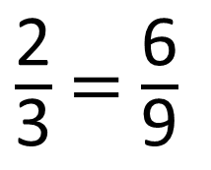
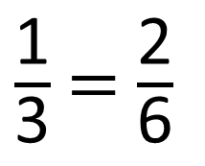
2
$\frac{\text{1}}{\text{3}}$ = $\frac{\text{2}}{\text{6}}$
6
$\frac{\text{2}}{\text{3}}$ = $\frac{\text{6}}{\text{9}}$
Have a think

Slide 10
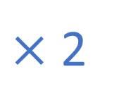
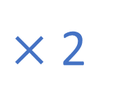
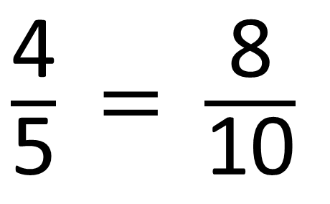
Have a think
$×$ 2
$\frac{\text{4}}{\text{5}}$ = $\frac{\text{8}}{\text{10}}$
$×$ 2
What do you notice?

Slide 11
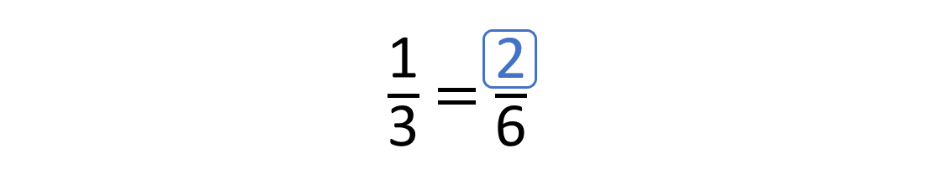
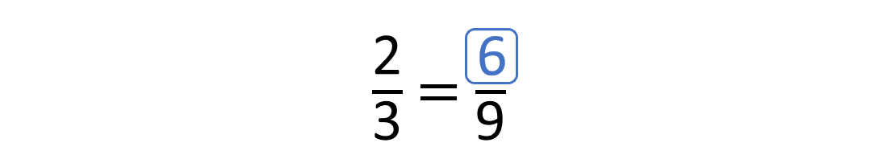




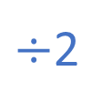

$×$2
$÷$2
$×$2
$÷$2
$×$3
$×$3

Slide 12

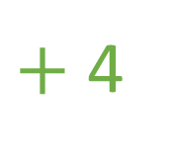

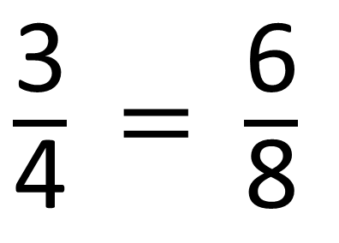
Have a think
$+$ 4
7
$\frac{\text{3}}{\text{4}}$ = $\frac{\text{6}}{\text{8}}$
$+$ 4
Do you agree with Tiny?

Slide 13
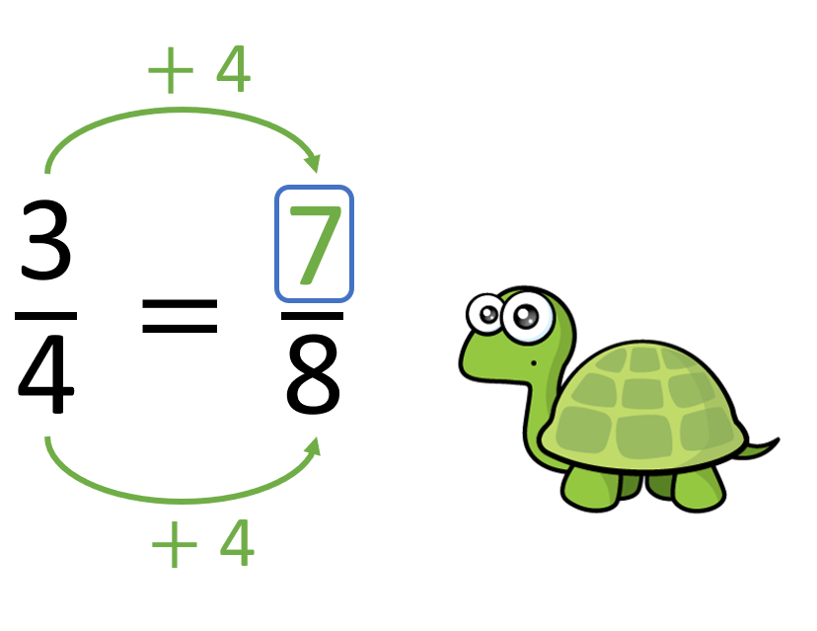


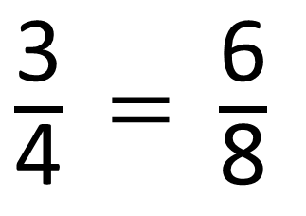
$×$ 2
$\frac{\text{3}}{\text{4}}$ = $\frac{\text{6}}{\text{8}}$
$×$ 2

Slide 14
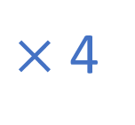
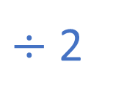

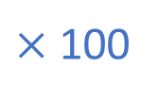
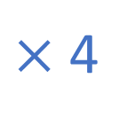
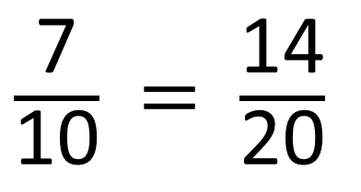

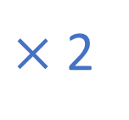

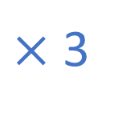






Have a think
$×$ 4
$×$ 3
12
$\frac{\text{3}}{\text{4}}$ = $\frac{\text{12}}{\text{16}}$
$\frac{\text{2}}{\text{9}}$ = $\frac{\text{6}}{\text{27}}$
27
$×$ 4
$×$ 3
$÷$ 2
$×$ 12
$×$ 2
$×$ 100
6
36
$\frac{\text{7}}{\text{10}}$ = $\frac{\text{14}}{\text{20}}$
$\frac{\text{3}}{\text{7}}$ = $\frac{\text{12}}{\text{16}}$
300
10
14
84
700
$×$ 12
$÷$ 2
$×$ 2
$×$ 100

