Slide 1






What fraction is green? Match the fractions to the representations.
Which of the representations show $\frac{\text{1}}{\text{3}}$ ?
$\frac{\text{3}}{\text{5}}$
$\frac{\text{1}}{\text{4}}$
$\frac{\text{3}}{\text{4}}$

Slide 2

What fraction is green? Match the fractions to the representations.
Which of the representations show $\frac{\text{1}}{\text{3}}$ ?
$\frac{\text{3}}{\text{5}}$
$\frac{\text{1}}{\text{4}}$
$\frac{\text{3}}{\text{4}}$

Slide 3



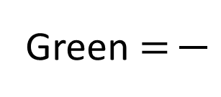
What fractions of the cubes are each colour?
Which of the fractions above are unit fractions?
Which of the fractions above are non-unit fractions?
Yellow $=$
Red $=$
Green $=$

Slide 4



What fractions of the cubes are each colour?
Which of the fractions above are unit fractions?
Which of the fractions above are non-unit fractions?
5
4
1
Yellow $=$
Red $=$
Green $=$
10
10
10
Green $\frac{\text{1}}{\text{10}}$
Yellow $\frac{\text{5}}{\text{10}}$
Red $\frac{\text{4}}{\text{10}}$

Slide 5





Have a think
$\frac{\text{7}}{\text{10}}$
What fraction of the flowers are blue?
What fraction of the flowers are orange?
10
There are flowers altogether.
out of flowers are blue.
of the flowers are blue.
This is a fraction.
3
10
$\frac{\text{3}}{\text{10}}$
non-unit

Slide 6

Tenths
$\frac{\text{1}}{\text{10}}$

Slide 7




Have a think
Tenths
$\frac{\text{1}}{\text{10}}$
$\frac{\text{4}}{\text{10}}$
$\frac{\text{9}}{\text{10}}$
$\frac{\text{1}}{\text{10}}$
$\frac{\text{6}}{\text{10}}$
What fraction is not shaded?

Slide 8




What fraction are yellow?
$\frac{\text{1}}{\text{10}}$
0
$\frac{\text{2}}{\text{10}}$
$\frac{\text{3}}{\text{10}}$
$\frac{\text{4}}{\text{10}}$

Slide 9




What fraction are yellow?
$\frac{\text{1}\text{0}}{\text{10}}$
or 1
$\frac{\text{9}}{\text{10}}$
$\frac{\text{8}}{\text{10}}$
$\frac{\text{7}}{\text{10}}$

Slide 10

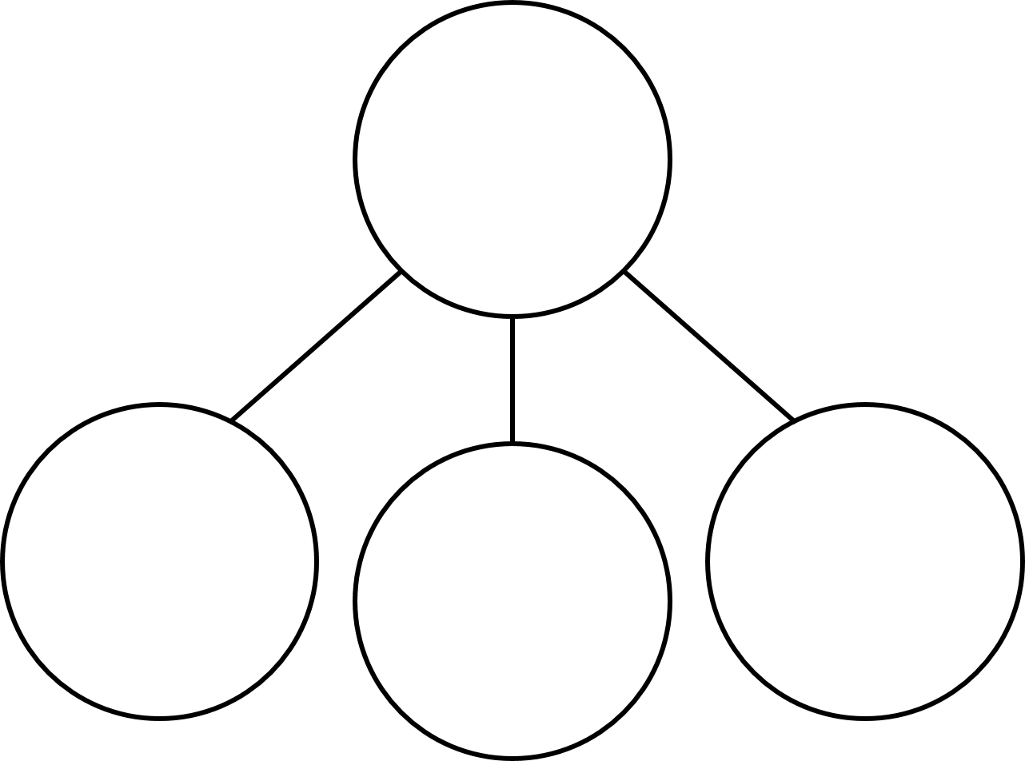







Have a think
What fraction of the cubes are red?
What fraction are blue?
What fraction are yellow?
$\frac{\text{2}}{\text{10}}$
$\frac{\text{5}}{\text{10}}$
$\frac{\text{3}}{\text{10}}$
$\frac{\text{10}}{\text{10}}$
$\frac{\text{2}}{\text{10}}$
$\frac{\text{5}}{\text{10}}$
$\frac{\text{3}}{\text{10}}$

Slide 11



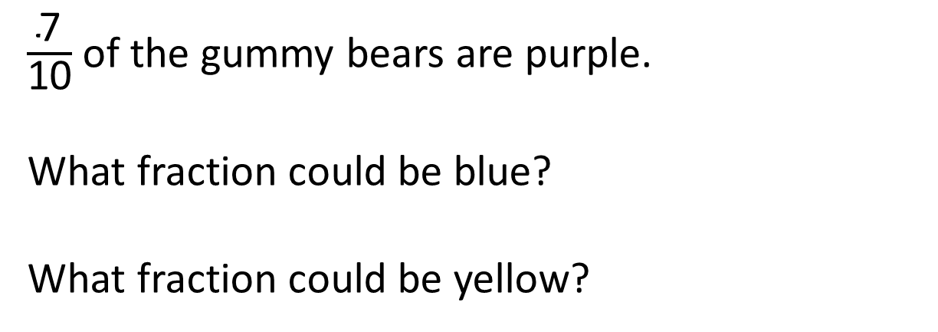







$\frac{\text{7}}{\text{10}}$ of the gummy bears are purple.
What fraction could be blue?
What fraction could be yellow?
$\frac{\text{3}}{\text{10}}$
$\frac{\text{2}}{\text{10}}$
$\frac{\text{1}}{\text{10}}$
0
0
$\frac{\text{0}}{\text{10}}$
$\frac{\text{1}}{\text{10}}$
$\frac{\text{2}}{\text{10}}$
$\frac{\text{3}}{\text{10}}$
Have a think

Slide 12
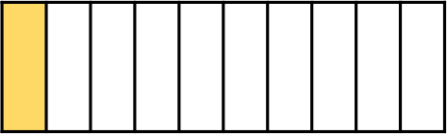
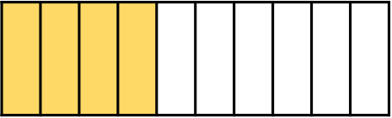
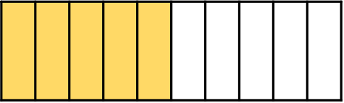
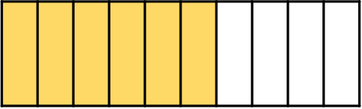
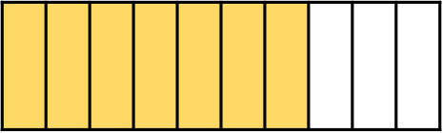
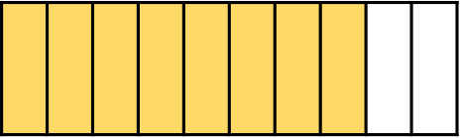
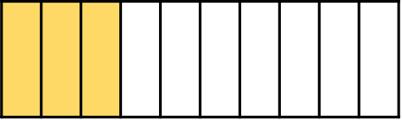
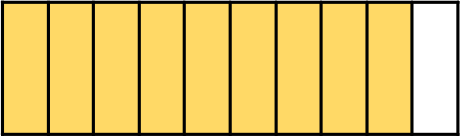

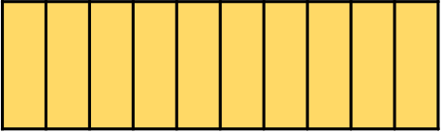
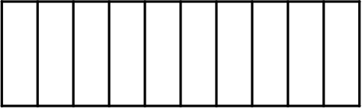
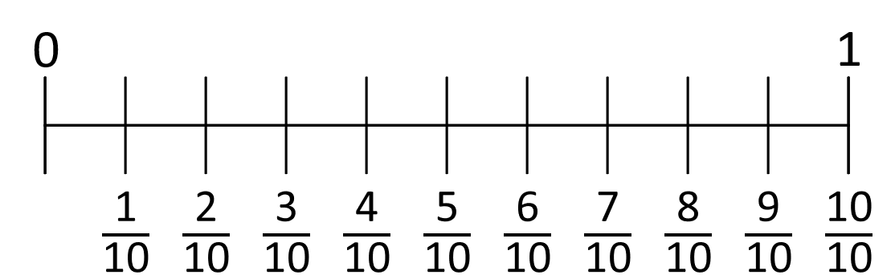
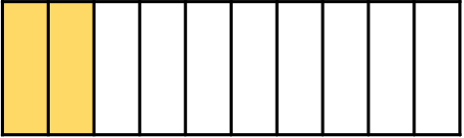









2
$\frac{\text{1}\text{1}}{\text{10}}$
$\frac{\text{12}}{\text{10}}$
$\frac{\text{13}}{\text{10}}$
$\frac{\text{14}}{\text{10}}$
$\frac{\text{15}}{\text{10}}$
$\frac{\text{16}}{\text{10}}$
$\frac{\text{17}}{\text{10}}$
$\frac{\text{18}}{\text{10}}$
$\frac{\text{19}}{\text{10}}$
$\frac{\text{20}}{\text{10}}$

