Slide 1


Slide 3



$\frac{\text{1}}{\text{3}}$ of 93 $=$
$\frac{\text{1}}{\text{4}}$ of 56 $=$
$\frac{\text{3}}{\text{4}}$ of 16 $=$

Slide 4
93
$\frac{\text{1}}{\text{3}}$ of 93 $=$
$\frac{\text{1}}{\text{4}}$ of 56 $=$
$\frac{\text{3}}{\text{4}}$ of 16 $=$
31
31
31 | 31 | 31
31 | 31 | 31
14
16
12
4 | 4 | 4 | 4
4 | 4 | 4 | 4
12

Slide 6

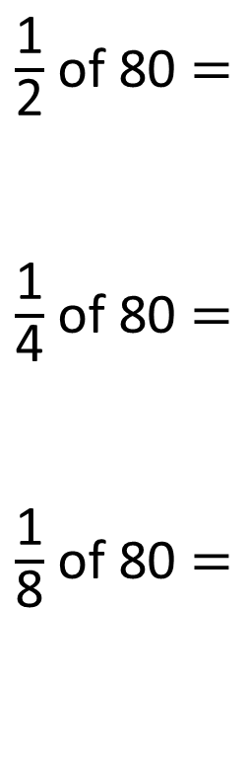
80
$\frac{\text{1}}{\text{2}}$ of 80 $=$
$\frac{\text{1}}{\text{4}}$ of 80 $=$
$\frac{\text{1}}{\text{8}}$ of 80 $=$
40
40 | 40
80
20
20 | 20 | 20 | 20
80
10
10 | 10 | 10 | 10 | 10 | 10 | 10 | 10
Have a think

Slide 7






80
$\frac{\text{1}}{\text{2}}$ of 80 $=$
$\frac{\text{1}}{\text{4}}$ of 80 $=$
$\frac{\text{1}}{\text{8}}$ of 80 $=$
40
40 | 40
$×$2
$÷$2
80
$×$4
20
$÷$4
20 | 20 | 20 | 20
$×$2
$÷$2
80
10
10 | 10 | 10 | 10 | 10 | 10 | 10 | 10
What do you notice?
What’s stayed the same? What’s changed?
Have a think

Slide 8
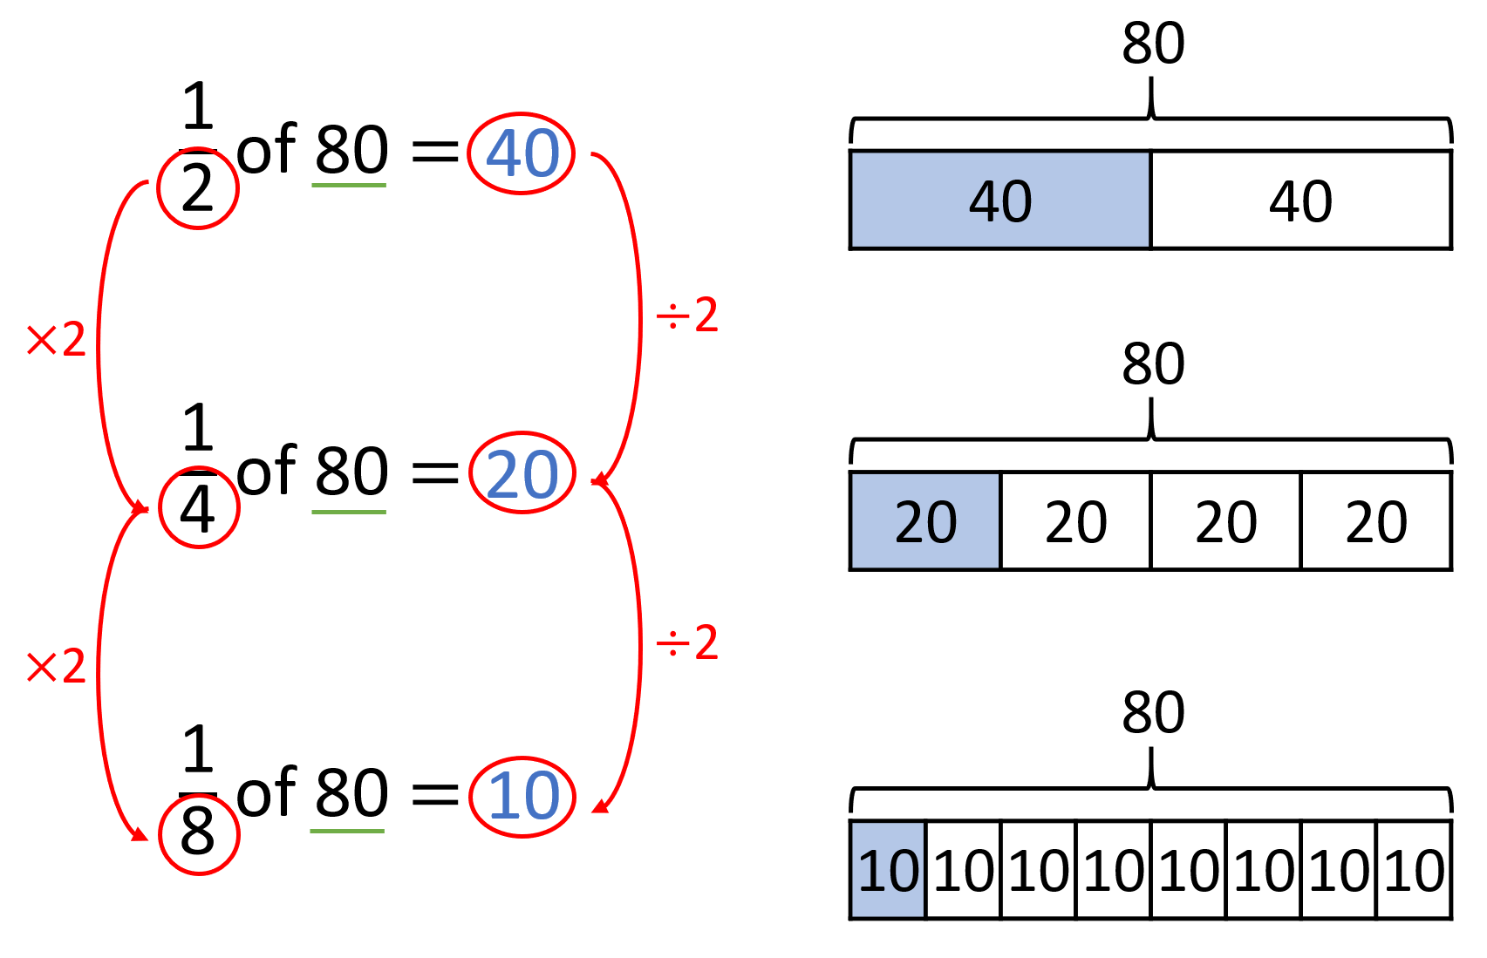
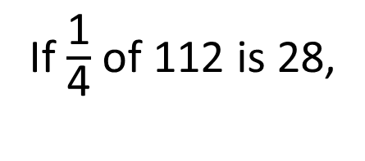

what is $\frac{\text{1}}{\text{8}}$ of 112?
what is $\frac{\text{1}}{\text{2}}$ of 112?
If $\frac{\text{1}}{\text{4}}$ of 112 is 28,
Have a think

Slide 9



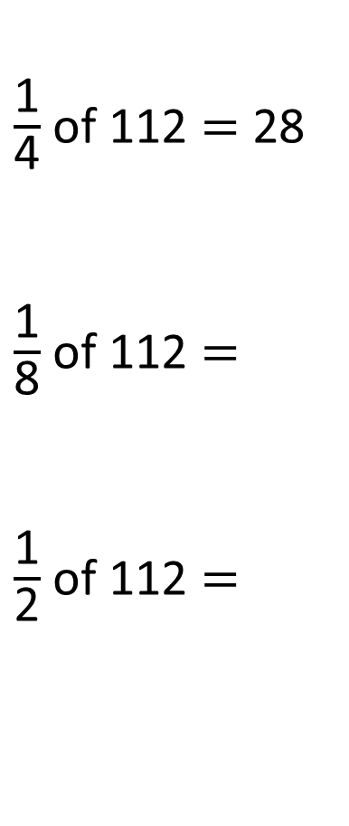

$\frac{\text{1}}{\text{4}}$ of 112 $=$ 28
$\frac{\text{1}}{\text{8}}$ of 112 $=$
$\frac{\text{1}}{\text{2}}$ of 112 $=$
$×$2
$÷$2
14
$÷$4
$×$4
56

Slide 10
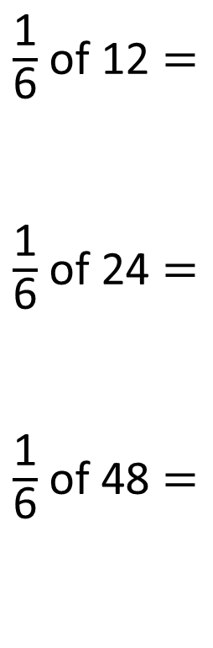
12
$\frac{\text{1}}{\text{6}}$ of 12 $=$
$\frac{\text{1}}{\text{6}}$ of 24 $=$
$\frac{\text{1}}{\text{6}}$ of 48 $=$
Have a think
2
2 | 2 | 2 | 2 | 2 | 2
24
4
4 | 4 | 4 | 4 | 4 | 4
48
8
8 | 8 | 8 | 8 | 8 | 8

Slide 11




12
$\frac{\text{1}}{\text{6}}$ of 12 $=$
$\frac{\text{1}}{\text{6}}$ of 24 $=$
$\frac{\text{1}}{\text{6}}$ of 48 $=$
2
2 | 2 | 2 | 2 | 2 | 2
$×$2
$×$2
24
$×$4
4
$×$4
4 | 4 | 4 | 4 | 4 | 4
48
8
8 | 8 | 8 | 8 | 8 | 8
What do you notice?
What’s stayed the same? What’s changed?
Have a think

Slide 12
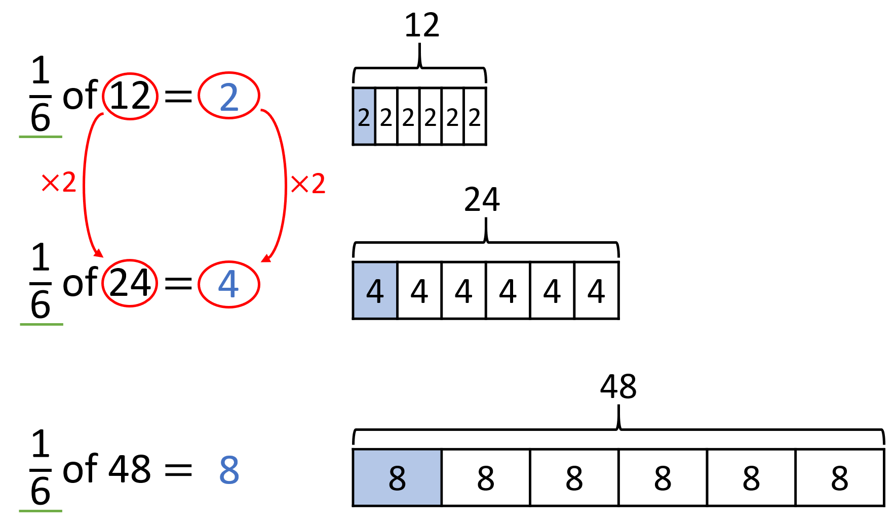
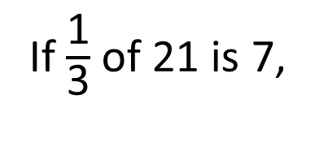

what is $\frac{\text{1}}{\text{3}}$ of 63?
what is $\frac{\text{1}}{\text{3}}$ of 210?
If $\frac{\text{1}}{\text{3}}$ of 21 is 7,
Have a think

Slide 13



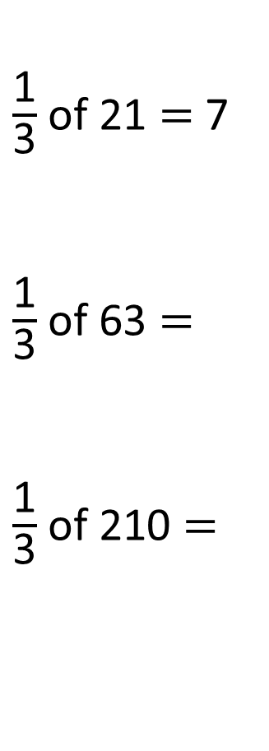

$\frac{\text{1}}{\text{3}}$ of 21 $=$ 7
$\frac{\text{1}}{\text{3}}$ of 63 $=$
$\frac{\text{1}}{\text{3}}$ of 210 $=$
$×$3
$×$3
$×$10
21
$×$10
70

Slide 14
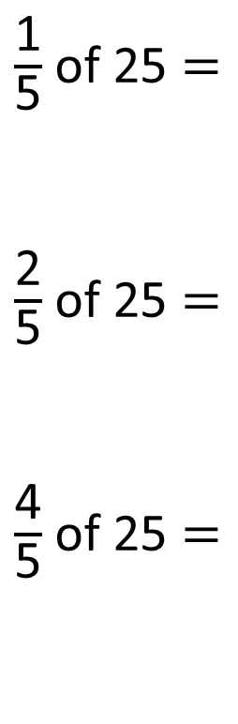
25
$\frac{\text{1}}{\text{5}}$ of 25 $=$
$\frac{\text{2}}{\text{5}}$ of 25 $=$
$\frac{\text{4}}{\text{5}}$ of 25 $=$
Have a think
5
5 | 5 | 5 | 5 | 5
25
10
5 | 5 | 5 | 5 | 5
5 | 5 | 5 | 5 | 5
10
25
20
5 | 5 | 5 | 5 | 5
5 | 5 | 5 | 5 | 5
20

Slide 15




25
$\frac{\text{1}}{\text{5}}$ of 25 $=$
$\frac{\text{2}}{\text{5}}$ of 25 $=$
$\frac{\text{4}}{\text{5}}$ of 25 $=$
5
5 | 5 | 5 | 5 | 5
$×$2
$×$2
25
$×$4
10
$×$4
5 | 5 | 5 | 5 | 5
5 | 5 | 5 | 5 | 5
10
25
20
5 | 5 | 5 | 5 | 5
5 | 5 | 5 | 5 | 5
20
Have a think
What do you notice?
What’s stayed the same? What’s changed?

Slide 16
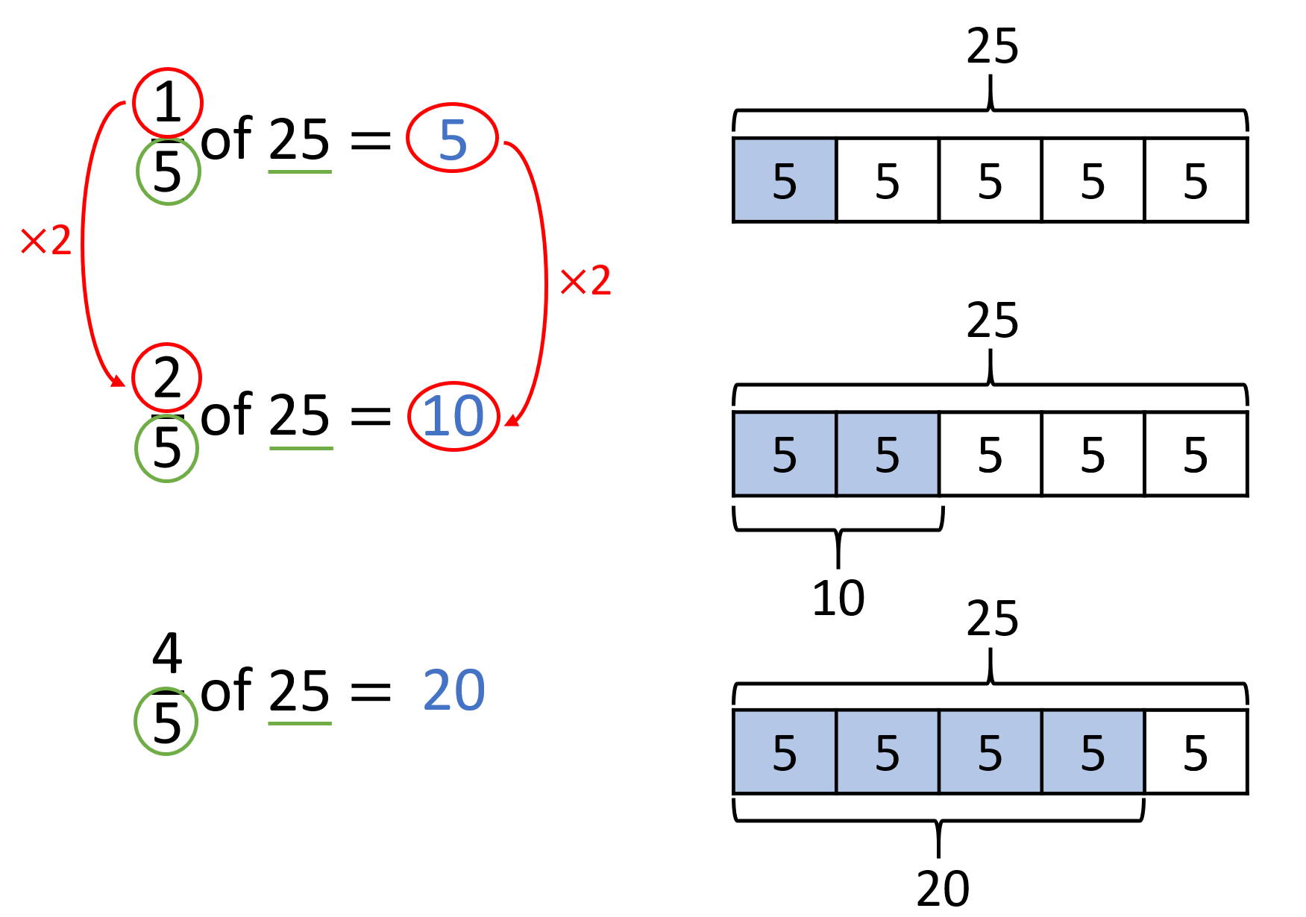
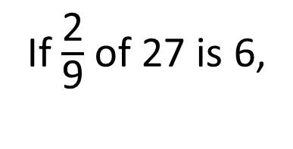

what is $\frac{\text{4}}{\text{9}}$ of 27?
what is $\frac{\text{8}}{\text{9}}$ of 27?
what is $\frac{\text{6}}{\text{9}}$ of 27?
If $\frac{\text{2}}{\text{9}}$ of 27 is 6,
Have a think

Slide 17




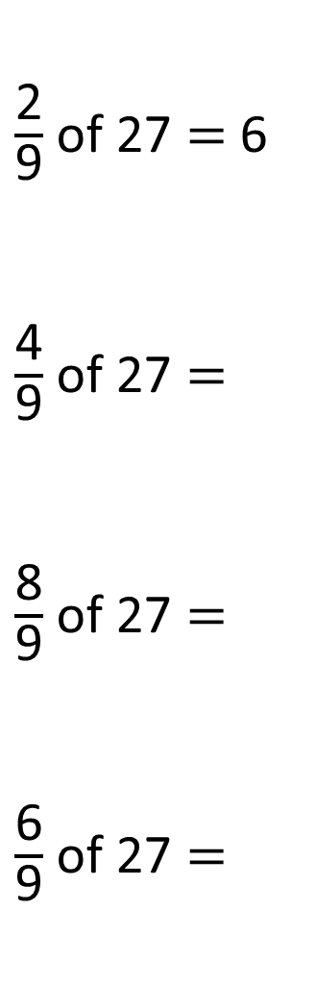


$\frac{\text{2}}{\text{9}}$ of 27 $=$ 6
$\frac{\text{4}}{\text{9}}$ of 27 $=$
$\frac{\text{8}}{\text{9}}$ of 27 $=$
$\frac{\text{6}}{\text{9}}$ of 27 $=$
$×$2
$×$2
12
$×$3
$×$2
$×$3
$×$2
24
18

Slide 18
Have a go at questions 1 – 5 on the worksheet

Slide 19





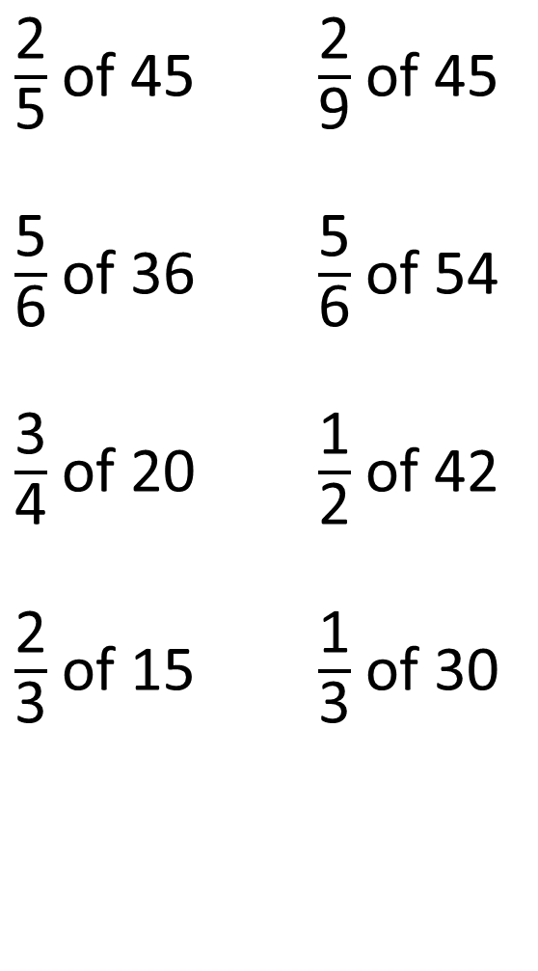

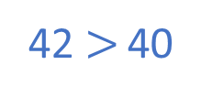


Have a think
$\frac{\text{2}}{\text{5}}$ of 45 $\frac{\text{2}}{\text{9}}$ of 45
$\frac{\text{5}}{\text{6}}$ of 36 $\frac{\text{5}}{\text{6}}$ of 54
$\frac{\text{3}}{\text{4}}$ of 20 $\frac{\text{1}}{\text{2}}$ of 42
$\frac{\text{2}}{\text{3}}$ of 15 $\frac{\text{1}}{\text{3}}$ of 30
$$>$$
$$<$$
$\frac{\text{1}}{\text{2}}$ of 40 $=$ 20
$$<$$
42 $>$ 40
$÷$2
$\frac{\text{1}}{\text{2}}$ of 42 $>$ 20
$$=$$
$×$2

Slide 20
Have a go at the rest of the questions on the worksheet

