Slide 1


Slide 3

8 $×$ 3 $=$ 8 $×$ 4 $=$ 8 $×$ 7 $=$
4 $×$ 3 $=$ 4 $×$ 6 $=$ 4 $×$ 7 $=$
$\frac{\text{1}}{\text{4}}$ of 8 $=$
Complete the number sentences represented by the bar models.
a) $\frac{\text{1}}{\text{2}}$ of 24 $=$ 12
b) $\frac{\text{4}}{\text{5}}$ of 15 $=$ 12
24
12 | 12
15
3 | 3 | 3 | 3 | 3

Slide 4
8 $×$ 3 $=$ 8 $×$ 4 $=$ 8 $×$ 7 $=$
4 $×$ 3 $=$ 4 $×$ 6 $=$ 4 $×$ 7 $=$
$\frac{\text{1}}{\text{4}}$ of 8 $=$
Complete the number sentences represented by the bar models.
a) $\frac{\text{1}}{\text{2}}$ of 24 $=$ 12
b) $\frac{\text{4}}{\text{5}}$ of 15 $=$ 12
24
32
56
12
24
28
8
2
2
24
1
12 | 12
24
12
2
15
4
15
12
3 | 3 | 3 | 3 | 3
5

Slide 6
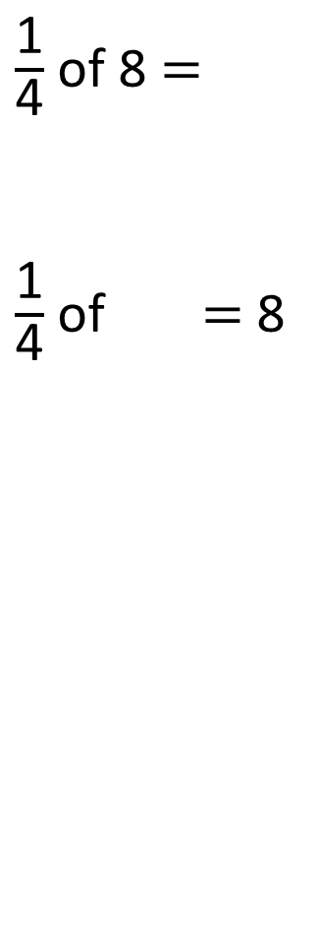
8
$\frac{\text{1}}{\text{4}}$ of 8 $=$
$\frac{\text{1}}{\text{4}}$ of $=$ 8
2
2 | 2 | 2 | 2
2 | 2 | 2 | 2
32
?
32
8
8 | 8 | 8 | 8

Slide 7

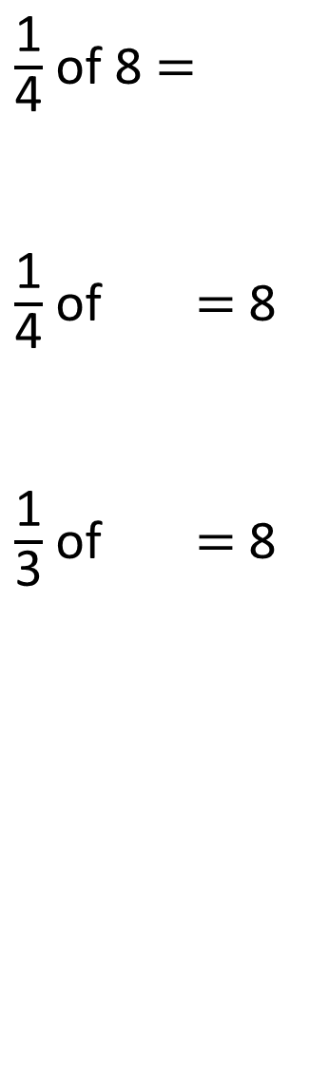
8
$\frac{\text{1}}{\text{4}}$ of 8 $=$
$\frac{\text{1}}{\text{4}}$ of $=$ 8
$\frac{\text{1}}{\text{3}}$ of $=$ 8
2
2 | 2 | 2 | 2
32
32
8
8 | 8 | 8 | 8
?
24
24
8
8 | 8 | 8
Have a think

Slide 8
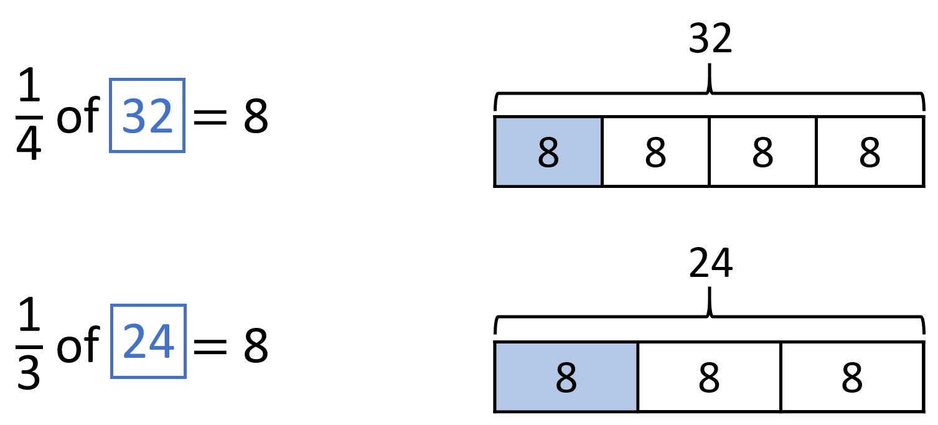

$\frac{\text{1}}{\text{3}}$ of $=$ 4
$\frac{\text{1}}{\text{6}}$ of $=$ 4
?
12
12
4
4 | 4 | 4
?
24
24
4
4 | 4 | 4 | 4 | 4 | 4
Have a think

Slide 9
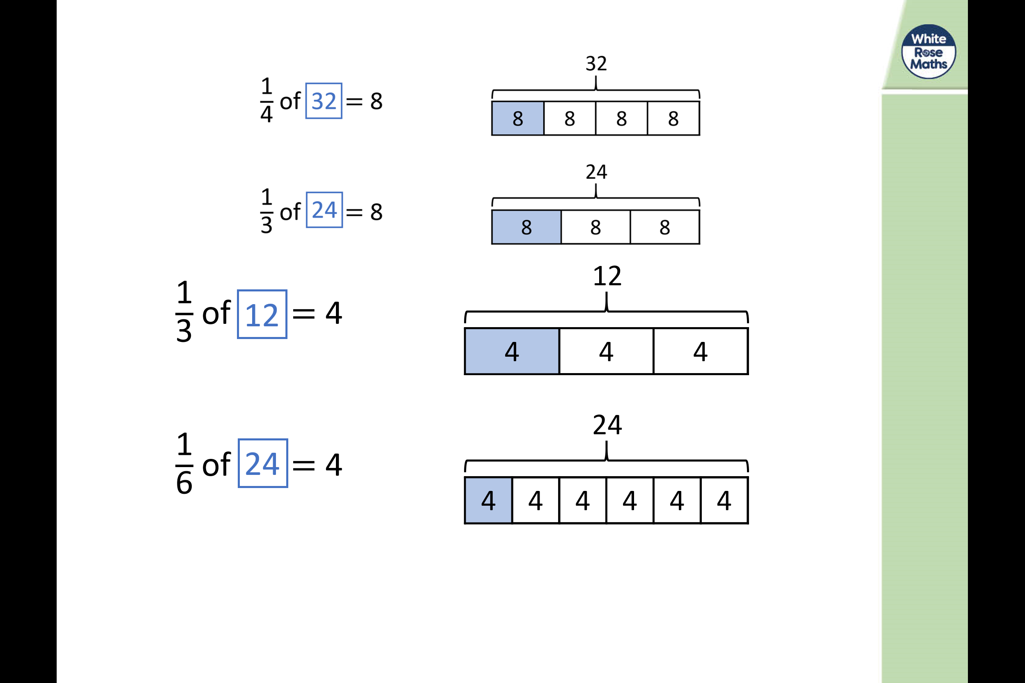
What do you notice?

Slide 10
Have a go at questions 1 – 2 on the worksheet

Slide 11
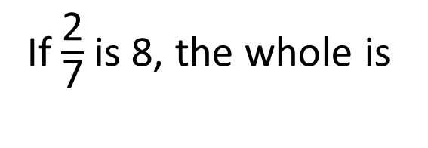
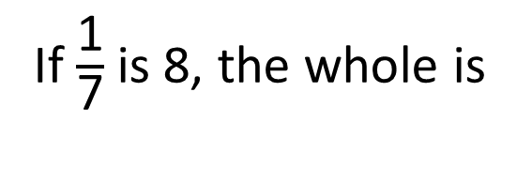
56
If $\frac{\text{1}}{\text{7}}$ is 8, the whole is
56
8
28
?
If $\frac{\text{2}}{\text{7}}$ is 8, the whole is
28
4 | 4
4 | 4 | 4 | 4 | 4 | 4 | 4
8

Slide 12
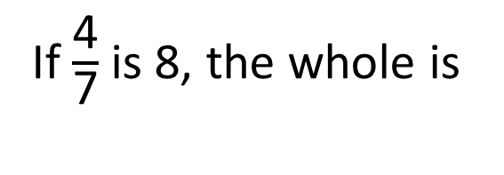
56
If $\frac{\text{1}}{\text{7}}$ is 8, the whole is
56
8
28
If $\frac{\text{2}}{\text{7}}$ is 8, the whole is
28
4 | 4
4 | 4 | 4 | 4 | 4 | 4 | 4
8
?
14
If $\frac{\text{4}}{\text{7}}$ is 8, the whole is
14
2 | 2 | 2 | 2
2 | 2 | 2 | 2 | 2 | 2 | 2
Have a think
8

Slide 13
Have a go at question 3 on the worksheet

Slide 14
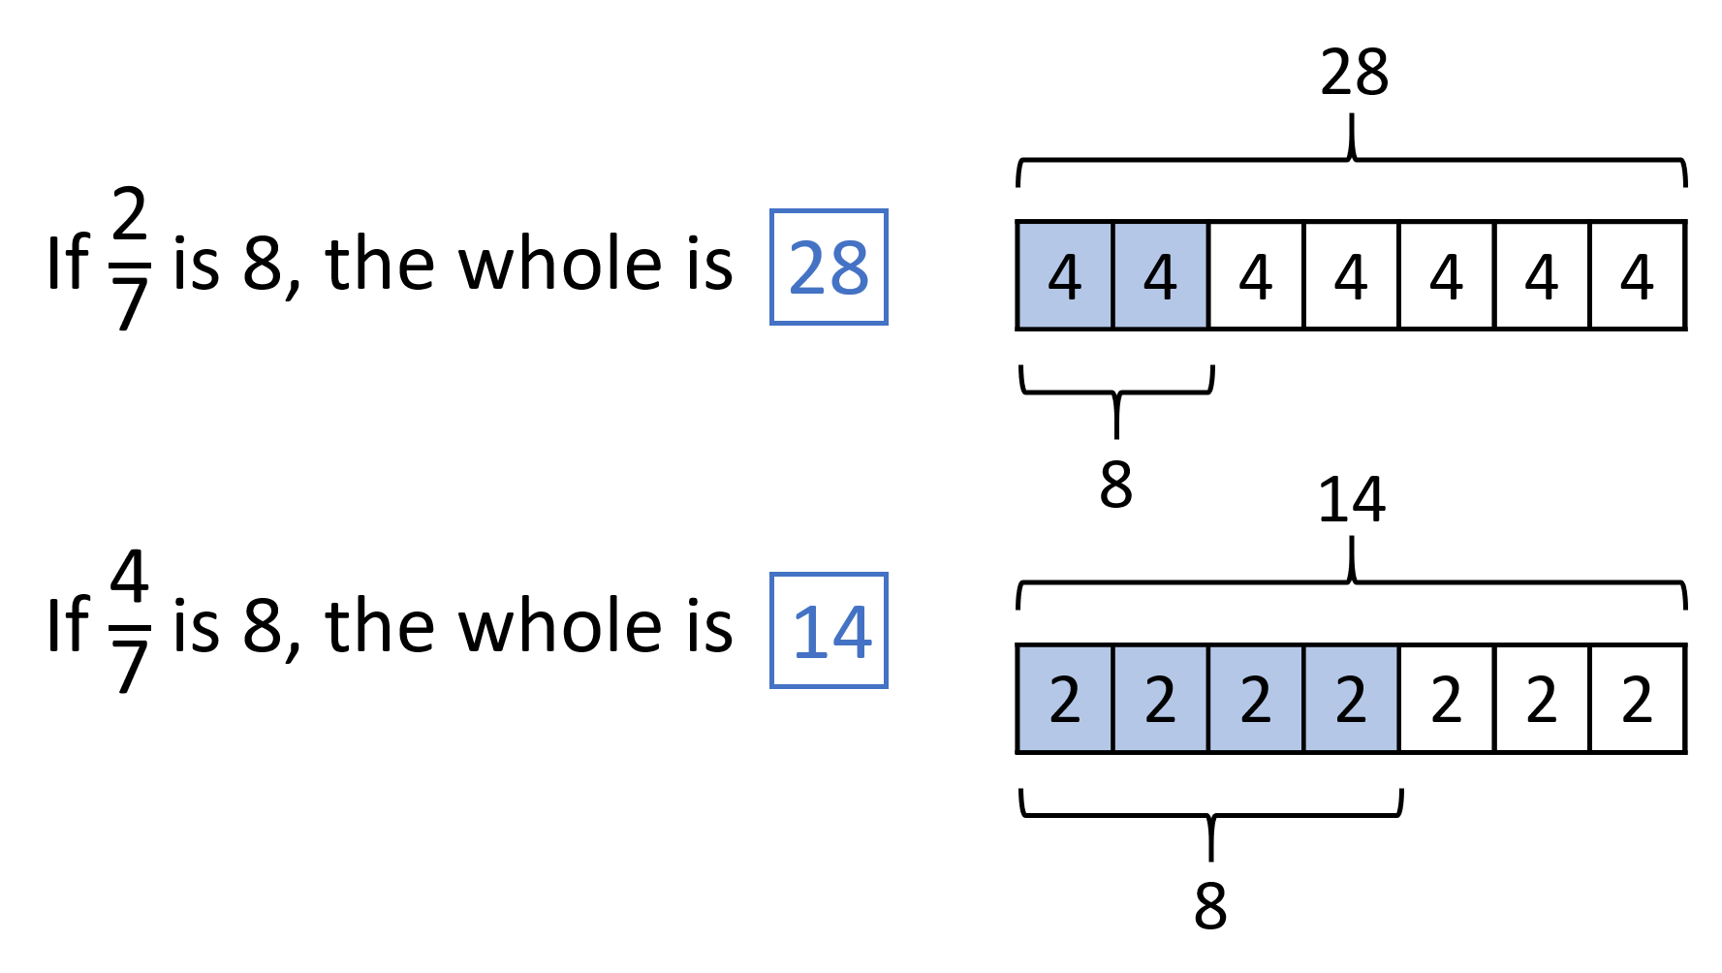








8
$$÷$$
2
$$=$$
4
8
$$÷$$
4
$$=$$
2
4
$$×$$
7
$$=$$
28
2
$$×$$
7
$$=$$
14

Slide 15
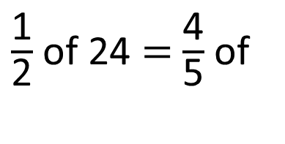
$\frac{\text{1}}{\text{2}}$ of 24 $=$ $\frac{\text{4}}{\text{5}}$ of
15
Have a think
24
12 | 12
3 | 3 | 3 | 3
3 | 3 | 3 | 3 | 3
?
15

Slide 16
Have a go at the rest of the questions on the worksheet

