Slide 1


Slide 3




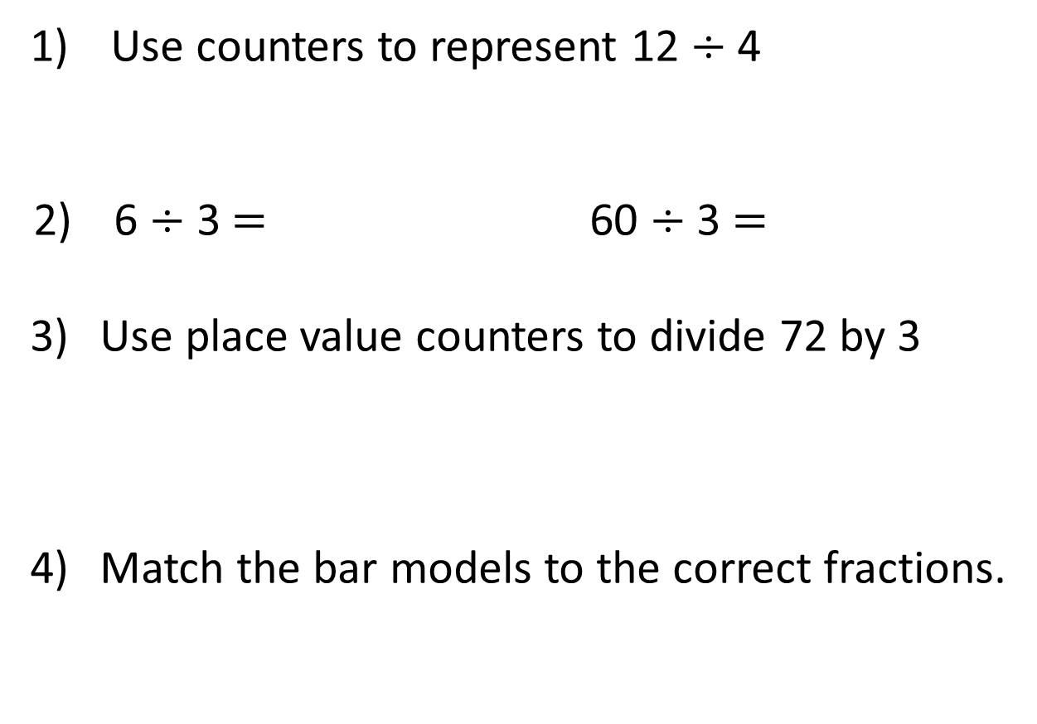
Use counters to represent 12 $÷$ 4
6 $÷$ 3 $=$ 60 $÷$ 3 $=$
Use place value counters to divide 72 by 3
Match the bar models to the correct fractions.
$\frac{\text{1}}{\text{3}}$
$\frac{\text{1}}{\text{4}}$
$\frac{\text{1}}{\text{2}}$
$\frac{\text{1}}{\text{6}}$

Slide 4






Use counters to represent 12 $÷$ 4
6 $÷$ 3 $=$ 60 $÷$ 3 $=$
Use place value counters to divide 72 by 3
Match the bar models to the correct fractions.
2
20
24
$\frac{\text{1}}{\text{3}}$
$\frac{\text{1}}{\text{4}}$
$\frac{\text{1}}{\text{2}}$
$\frac{\text{1}}{\text{6}}$

Slide 6

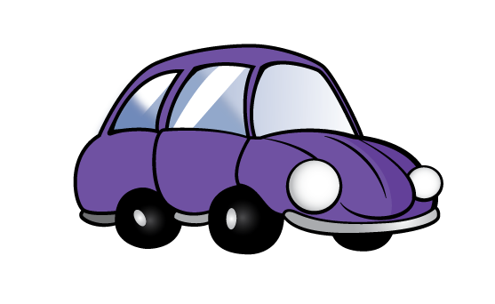
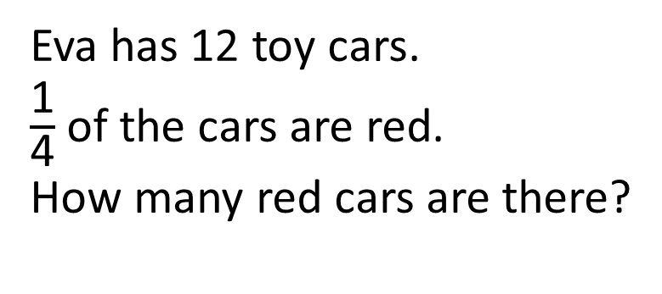
Eva has 12 toy cars.
$\frac{\text{1}}{\text{4}}$ of the cars are red.
How many red cars are there?
There are 3 red cars.

Slide 7

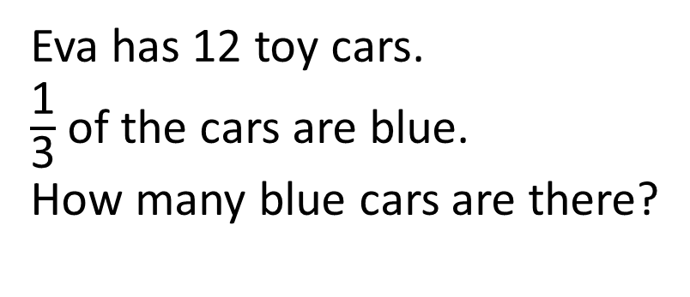
Eva has 12 toy cars.
$\frac{\text{1}}{\text{3}}$ of the cars are blue.
How many blue cars are there?
Have a think
There are 4 blue cars.

Slide 8
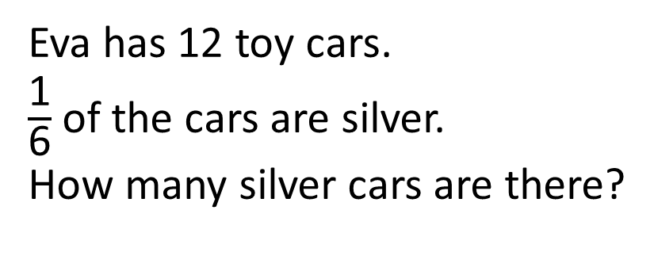
Eva has 12 toy cars.
$\frac{\text{1}}{\text{6}}$ of the cars are silver.
How many silver cars are there?
12
2
2
2
2
2
2
There are 2 silver cars.

Slide 9

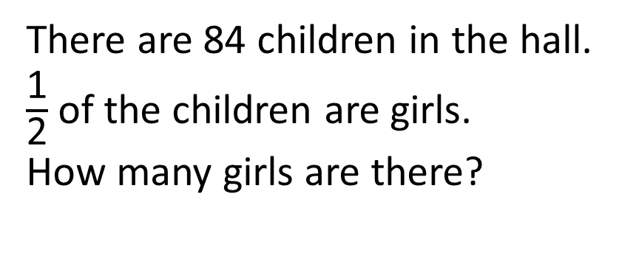
There are 84 children in the hall.
$\frac{\text{1}}{\text{2}}$ of the children are girls.
How many girls are there?
84
Have a think
42
42
There are 42 girls.

Slide 10
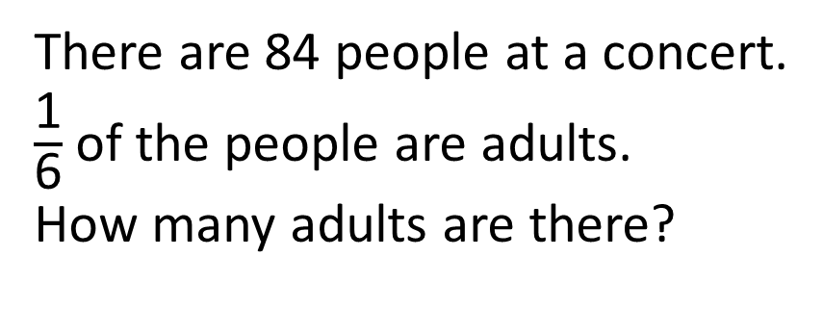
There are 84 people at a concert.
$\frac{\text{1}}{\text{6}}$ of the people are adults.
How many adults are there?
Have a think
There are 14 adults.
84
14
14
14
14
14
14

Slide 11
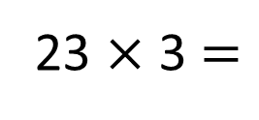
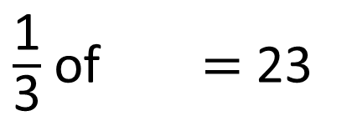
$\frac{\text{1}}{\text{3}}$ of $=$ 23
69
Have a think
69
?
23
23
23
23 $×$ 3 $=$

