Slide 1


Slide 3
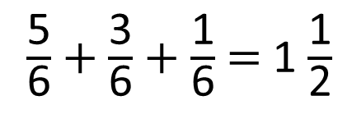
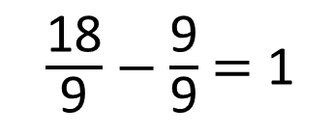
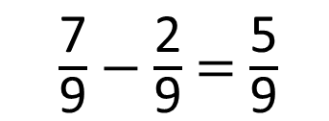
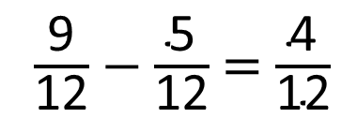
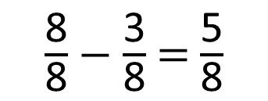
$\frac{\text{8}}{\text{8}}$ $−$ $\frac{\text{3}}{\text{8}}$ $=$ $\frac{\text{5}}{\text{8}}$
$\frac{\text{9}}{\text{12}}$ $−$ $\frac{\text{5}}{\text{12}}$ $=$ $\frac{\text{4}}{\text{12}}$
1)
$\frac{\text{7}}{\text{9}}$ $−$ $\frac{\text{2}}{\text{9}}$ $=$ $\frac{\text{5}}{\text{9}}$
$\frac{\text{18}}{\text{9}}$ $−$ $\frac{\text{9}}{\text{9}}$ $=$ 1
2)
?
3)
$\frac{\text{5}}{\text{6}}$ $+$ $\frac{\text{3}}{\text{6}}$ $+$ $\frac{\text{1}}{\text{6}}$ $=$ 1 $\frac{\text{1}}{\text{2}}$

Slide 4
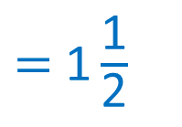

5
5
$\frac{\text{9}}{\text{12}}$ $−$ $\frac{\text{5}}{\text{12}}$ $=$ $\frac{\text{4}}{\text{12}}$
$\frac{\text{8}}{\text{8}}$ $−$ $\frac{\text{3}}{\text{8}}$ $=$ $\frac{\text{5}}{\text{8}}$
1)
9
7
$\frac{\text{18}}{\text{9}}$ $−$ $\frac{\text{9}}{\text{9}}$ $=$ 1
$\frac{\text{7}}{\text{9}}$ $−$ $\frac{\text{2}}{\text{9}}$ $=$ $\frac{\text{5}}{\text{9}}$
2)
$$\frac{\text{5}}{\text{7}}$$
?
3)
$\frac{\text{5}}{\text{6}}$ $+$ $\frac{\text{3}}{\text{6}}$ $+$ $\frac{\text{1}}{\text{6}}$ $=$ 1 $\frac{\text{1}}{\text{2}}$
$=$ 1 $\frac{\text{1}}{\text{2}}$
3
6

Slide 6
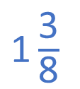
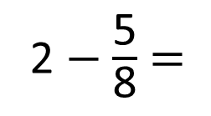
2 $−$ $\frac{\text{5}}{\text{8}}$ $=$
$\text{1}\frac{\text{3}}{\text{8}}$

Slide 7

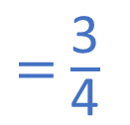

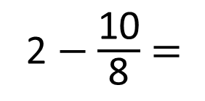

2 $−$ $\frac{\text{10}}{\text{8}}$ $=$
$\frac{\text{6}}{\text{8}}$
$=$ $\frac{\text{3}}{\text{4}}$
$\frac{\text{2}}{\text{8}}$
$\frac{\text{8}}{\text{8}}$

Slide 8

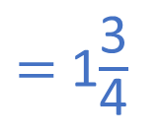
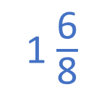
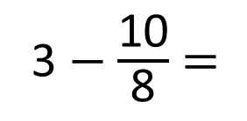


3 $−$ $\frac{\text{10}}{\text{8}}$ $=$
1 $\frac{\text{6}}{\text{8}}$
$=$ 1$\frac{\text{3}}{\text{4}}$
Have a think
$\frac{\text{2}}{\text{8}}$
$\frac{\text{8}}{\text{8}}$

Slide 9
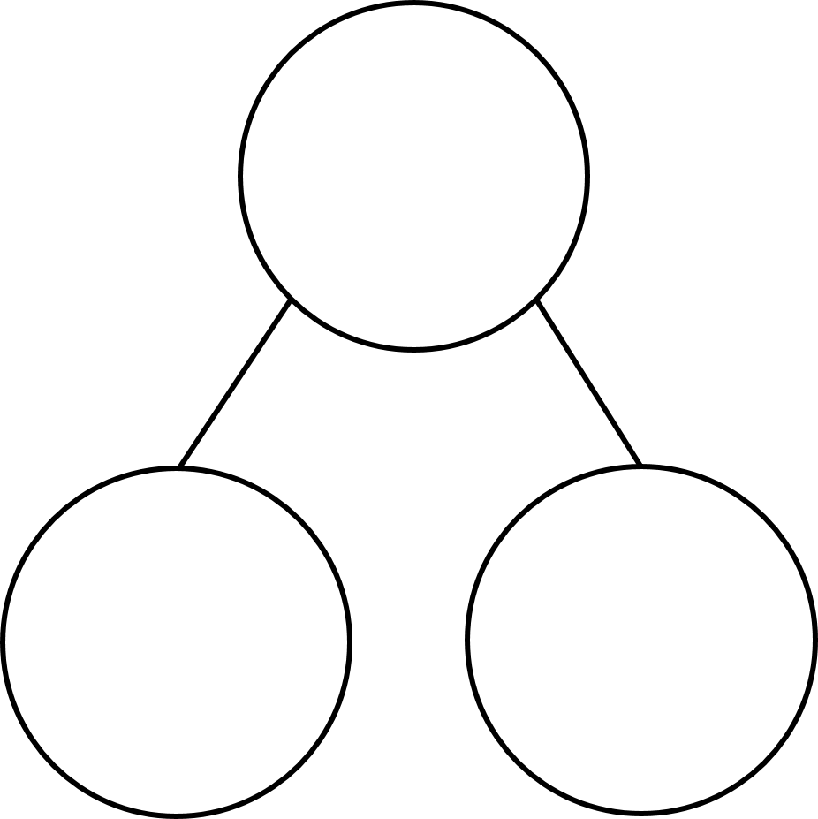
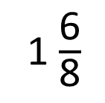

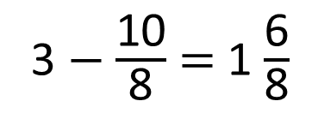
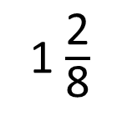
3 $−$ $\frac{\text{10}}{\text{8}}$ $=$ 1 $\frac{\text{6}}{\text{8}}$
3
1 $\frac{\text{6}}{\text{8}}$
1 $\frac{\text{2}}{\text{8}}$
$\frac{\text{10}}{\text{8}}$

Slide 10
3 $−$ $\frac{\text{10}}{\text{8}}$ $=$
1 $\frac{\text{6}}{\text{8}}$
Have a think

Slide 11
Have a go at questions 1 – 3 on the worksheet

Slide 12

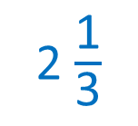
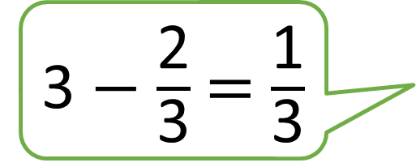
3 $−$ $\frac{\text{2}}{\text{3}}$ $=$ $\frac{\text{1}}{\text{3}}$
Do you agree with Tiny?
Have a think
2 $\frac{\text{1}}{\text{3}}$

Slide 13



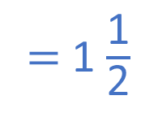
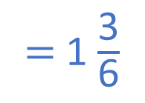
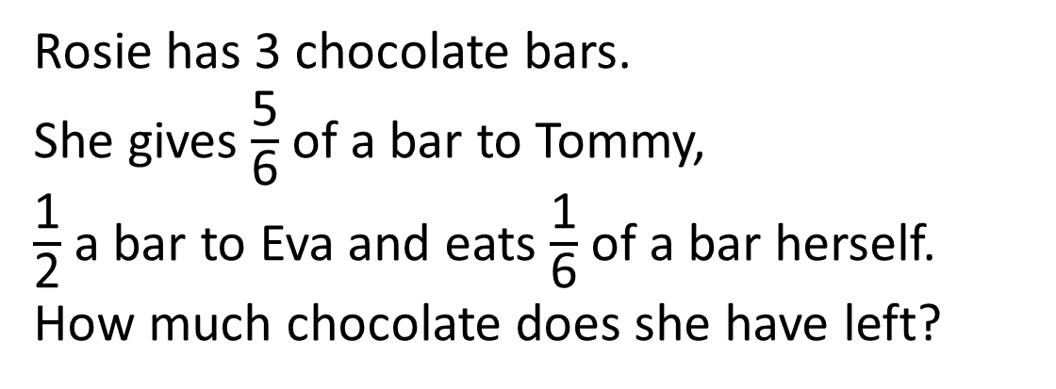

Rosie has 3 chocolate bars.
She gives $\frac{\text{5}}{\text{6}}$ of a bar to Tommy,
$\frac{\text{1}}{\text{2}}$ a bar to Eva and eats $\frac{\text{1}}{\text{6}}$ of a bar herself.
How much chocolate does she have left?
$$\frac{\text{9}}{\text{6}}$$
$=$ 1 $\frac{\text{3}}{\text{6}}$
Have a think
$=$ 1 $\frac{\text{1}}{\text{2}}$

Slide 14
Have a go at the rest of the questions on the worksheet

