Slide 1

Monday 1st February
Non-chronological report

Slide 2
Year 1 Spellings – Adding –er and –est to adjectives where no change is needed to the root word
grander
grandest
fresher
freshest
quicker
quickest
taller
tallest
slower
slowest
Year 2 Spellings – common exception word
all
ball
call
walk
talk
always
small
wall
fall
altogether
Write a list of your spellings. Adult say 5 sentences with the first 5 spellings in. Child should write each sentence down.

Slide 3
Today we are learning to... I am learning to read and write facts. I am learning to create a non-chronological report.
I will be successful if ... I can think of an interesting title. I can spell key words correctly. I can use capital letters for the start of a sentence and for proper nouns. I can use finger spaces and full stops. I can use conjunctions.

Slide 4
This week we are creating a booklet about Queen Elizabeth II
Each day we will complete a different section of our fact file.
Today we are going to create a front cover and write the introduction.
On Tuesday we will look at the Queen’s childhood.
On Wednesday we will write facts about the tasks that the Queen does as part of her role.
On Thursday we will write about the Queen’s family.
On Friday we will create a contents page and back cover.

Slide 5
Look at the front cover of any facts books you have...
What do they have on the front cover?

Slide 6
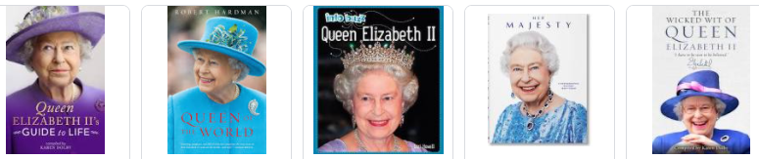
Here are some examples

Slide 7
Front covers often have:
A title - sometimes in capital letters
A picture which has bright colours
The Author’s name
Possibly a quote or caption
Task 1: Create your front cover

Slide 8
Task 2:
Create an introduction page.
In order to do this, we must know some general facts about who we are writing about.

Slide 9
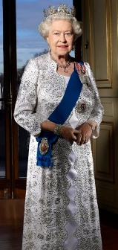
Introduction
Here is an example:
Queen Elizabeth the Second is the world’s most famous monarch. She is the head of the British Royal Family, and is known and loved by people all over the world. When she was young, she did not expect to become the queen, but something unusual happened in the Royal Family. The sweet, young princess’s life changed forever and then she knew she would be queen one day.
The Queen’s full title is: Elizabeth the Second, by the Grace of God, of the United Kingdom of Great Britain and Northern Island and Her Other Realms and Territories, Queen, Head of the Commonwealth, Defender of the faith.

