Slide 1

Monday 1st March 2021
Writing

Slide 2
Year 1 - The split vowel
digraphs ‘a-e’ and ‘e-e’
made
came
same
take
safe
date
lake
these
theme
complete
Year 2 - the ee sound spelt ey
key
donkey
monkey
chimney
valley
trolley
turkey
hockey
parsley
journey
Can you practise your spelling for 5 minutes? Look at how many letters are in each word. Write a list of all 10 spellings.
Write the first 5 words in sentences.

Slide 3
Today we are learning to:
I am learning to look closely at a picture and draw it.
I am learning to use a range of interesting adjectives
I am learning to write 2A phrases with a comma
I will be successful if:
Draw a detailed picture
Discuss what the setting looks like
I use 2 amazing adjectives for each phrase
I remember the comma to separate the adjectives
My writing is beautiful and neat

Slide 4

Our story is called Pirate Pete.
What kind of character do you think he might be? Why?

Slide 5
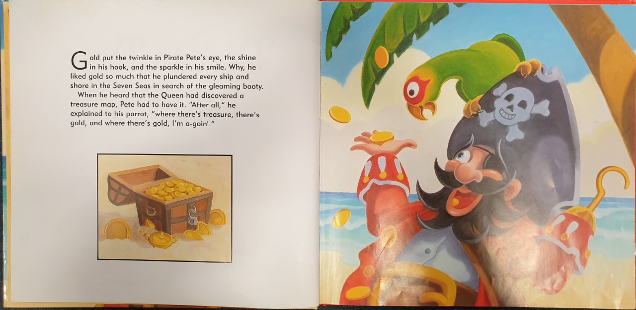

Slide 6
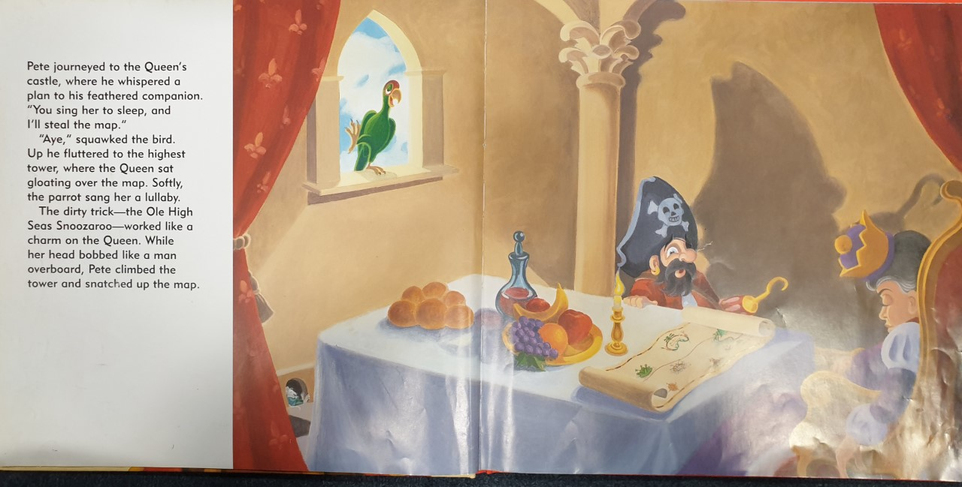

Slide 7
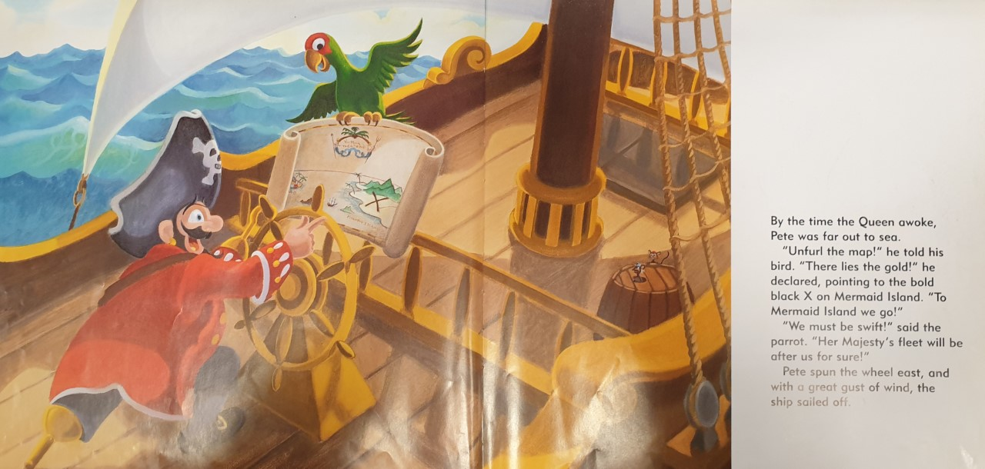

Slide 8
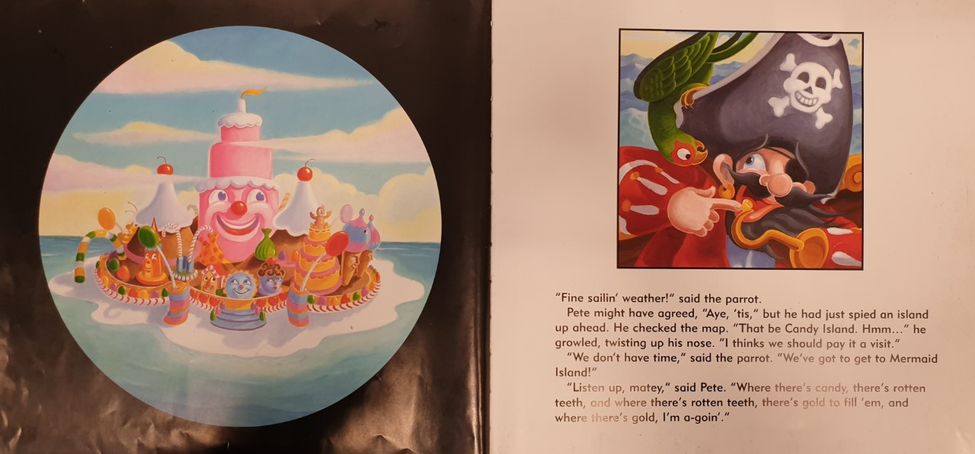

Slide 9
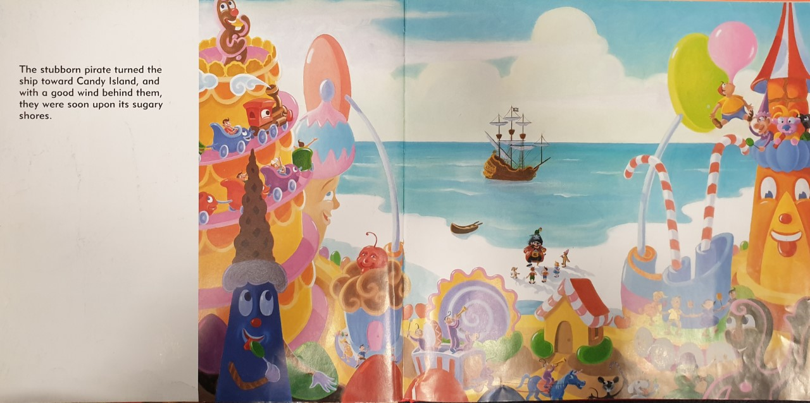

Slide 10
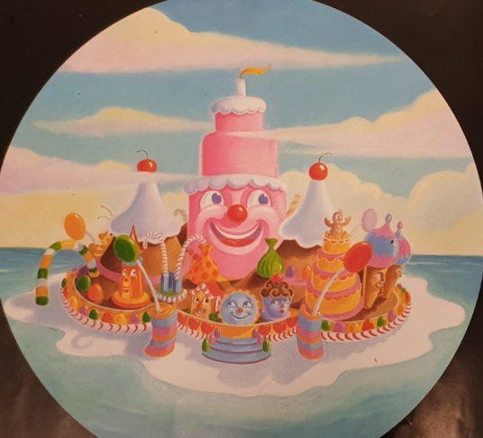
Task 1: Draw/create a picture of Candy Island
Write 2A phrases to describe the island.
A 2A phrase is 2 adjectives (describing words) with a comma between them followed by the noun (thing you are describing).

Slide 11

Task 2: Write 2A phrases to describe the island.
A 2A phrase is 2 adjectives (describing words) with a comma between them, followed by the noun (thing you are describing). Not full sentences!
You can use your imagination too.
E.g.
Soft, springy floor
Delicious, pink roof
Colourful, squishy sweets
The only punctuation you need to remember is the comma!

Slide 12
Here is a list of things you may describe:
Floor
Roof
House
Building
Road
Street
Lamp post
Cake
Jelly
Candy canes
Sweets
Lollies
Write at least eight 2A phrases

