Slide 1
Monday 11th January 2021
Writing

Slide 2
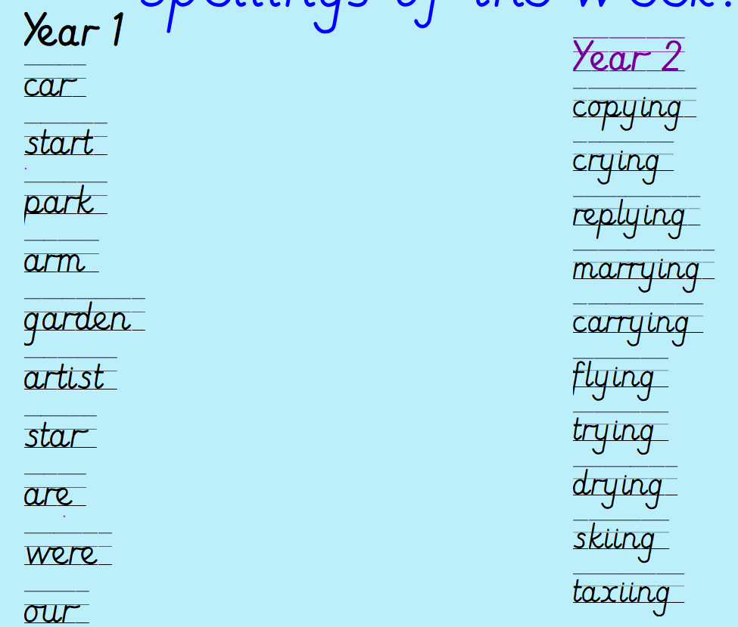
Can you practise your spelling for 5 minutes?
Spelling rule
Adding ing to a word ending in 'y' with a consonant before it
Spelling rule
The digraph ar

Slide 3
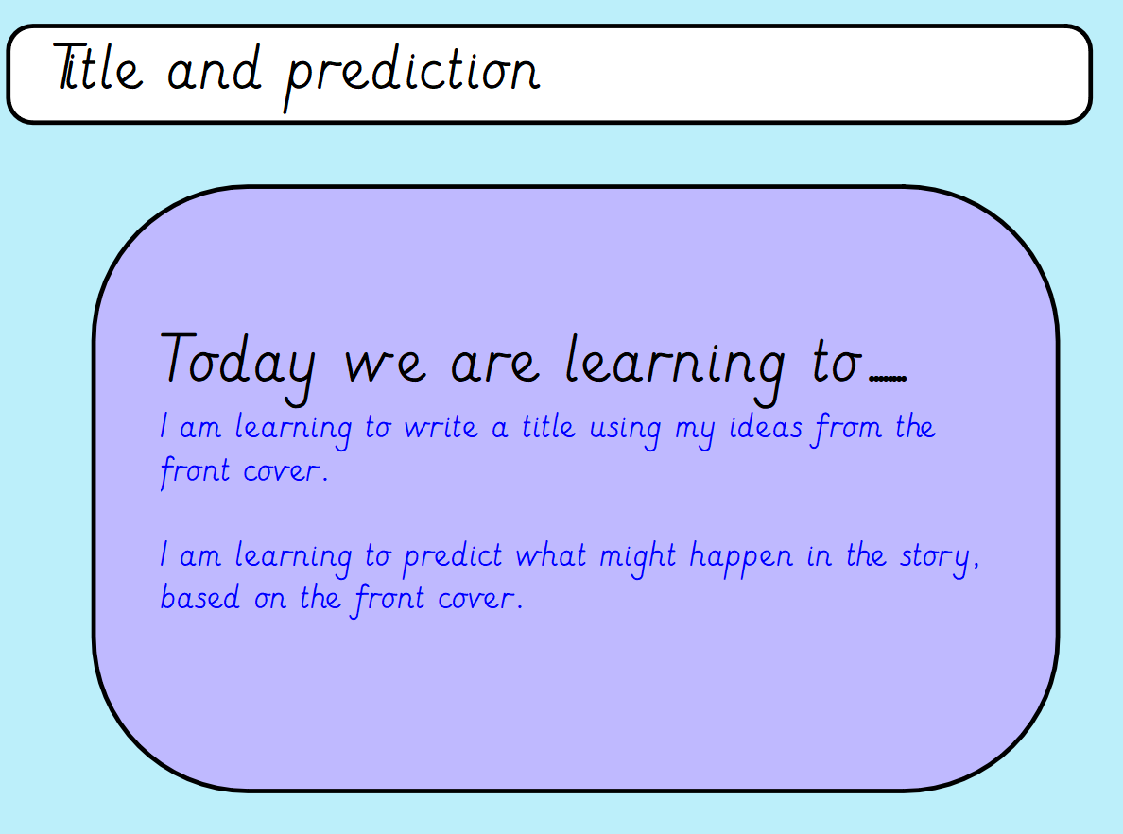

Slide 4
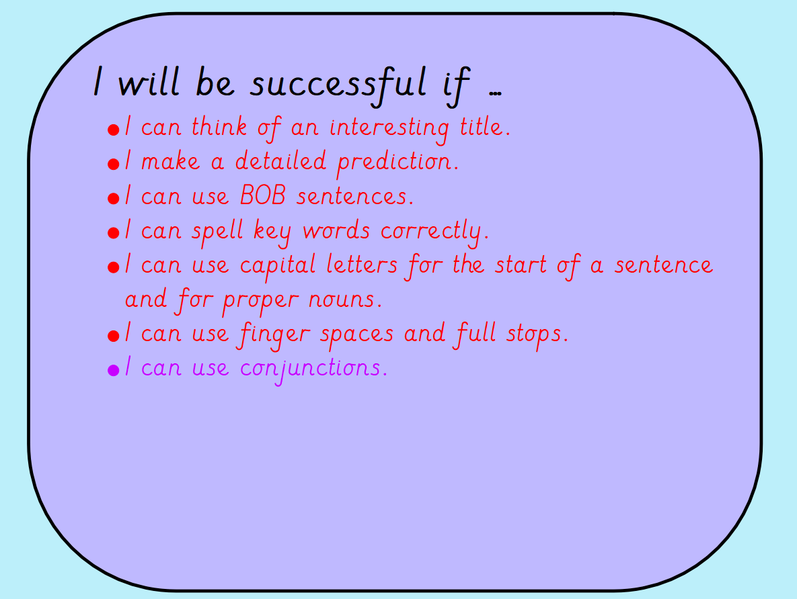

Slide 5
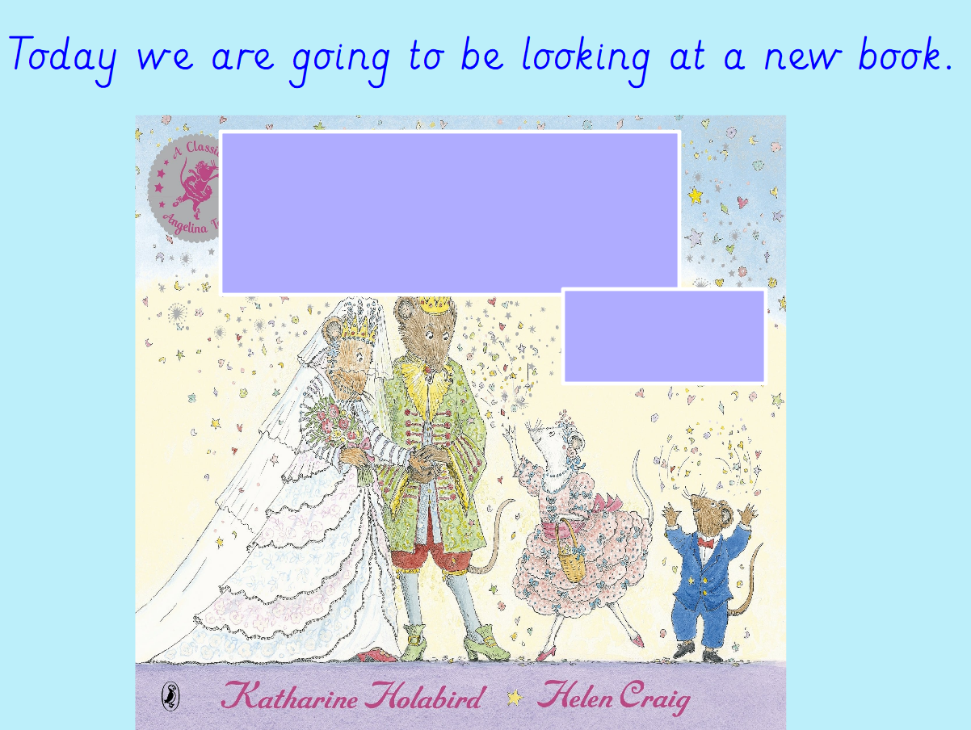

Slide 6
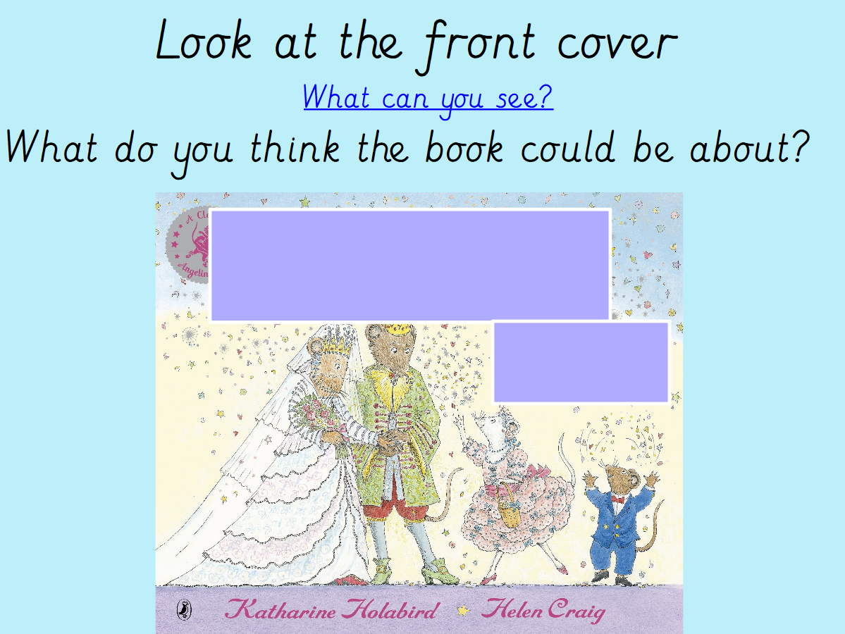

Slide 7
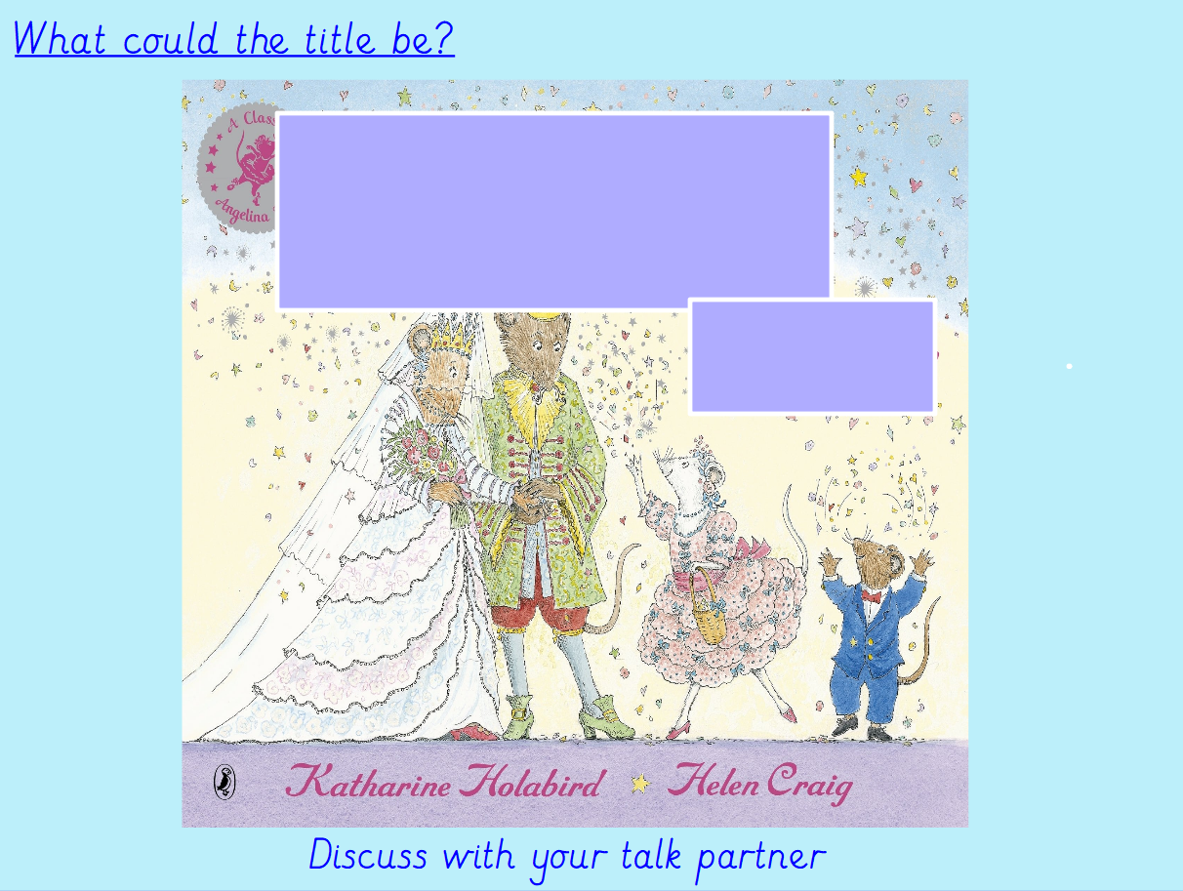

Slide 8
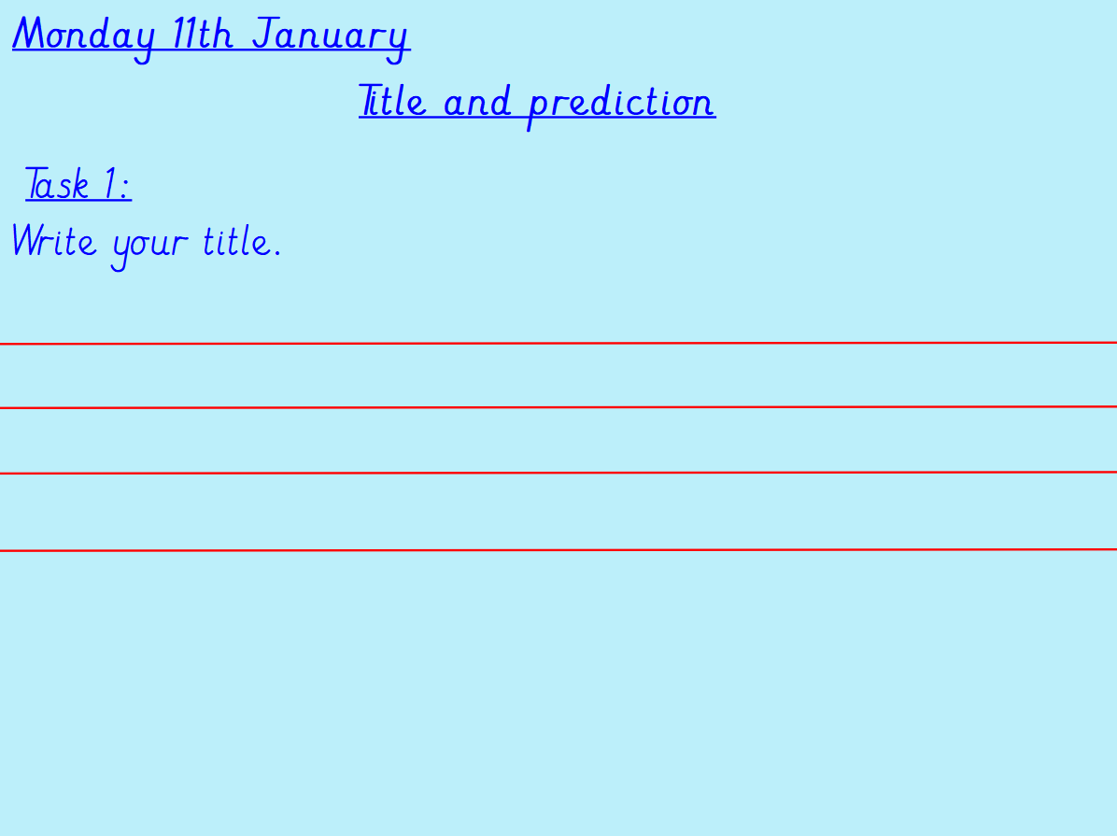
Can you think of 5 interesting titles of what the book could be called?
Remember each title needs to start with a capital letter!

Slide 9
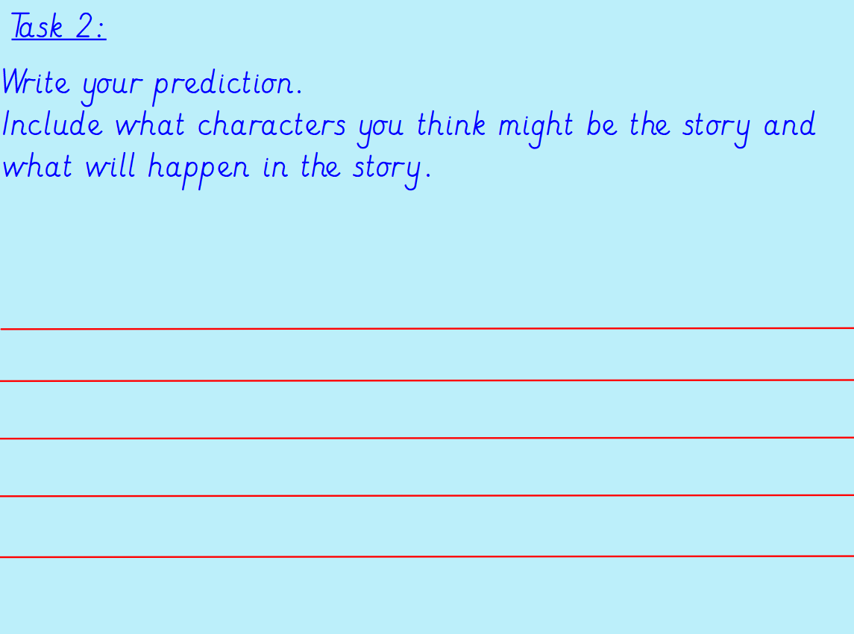
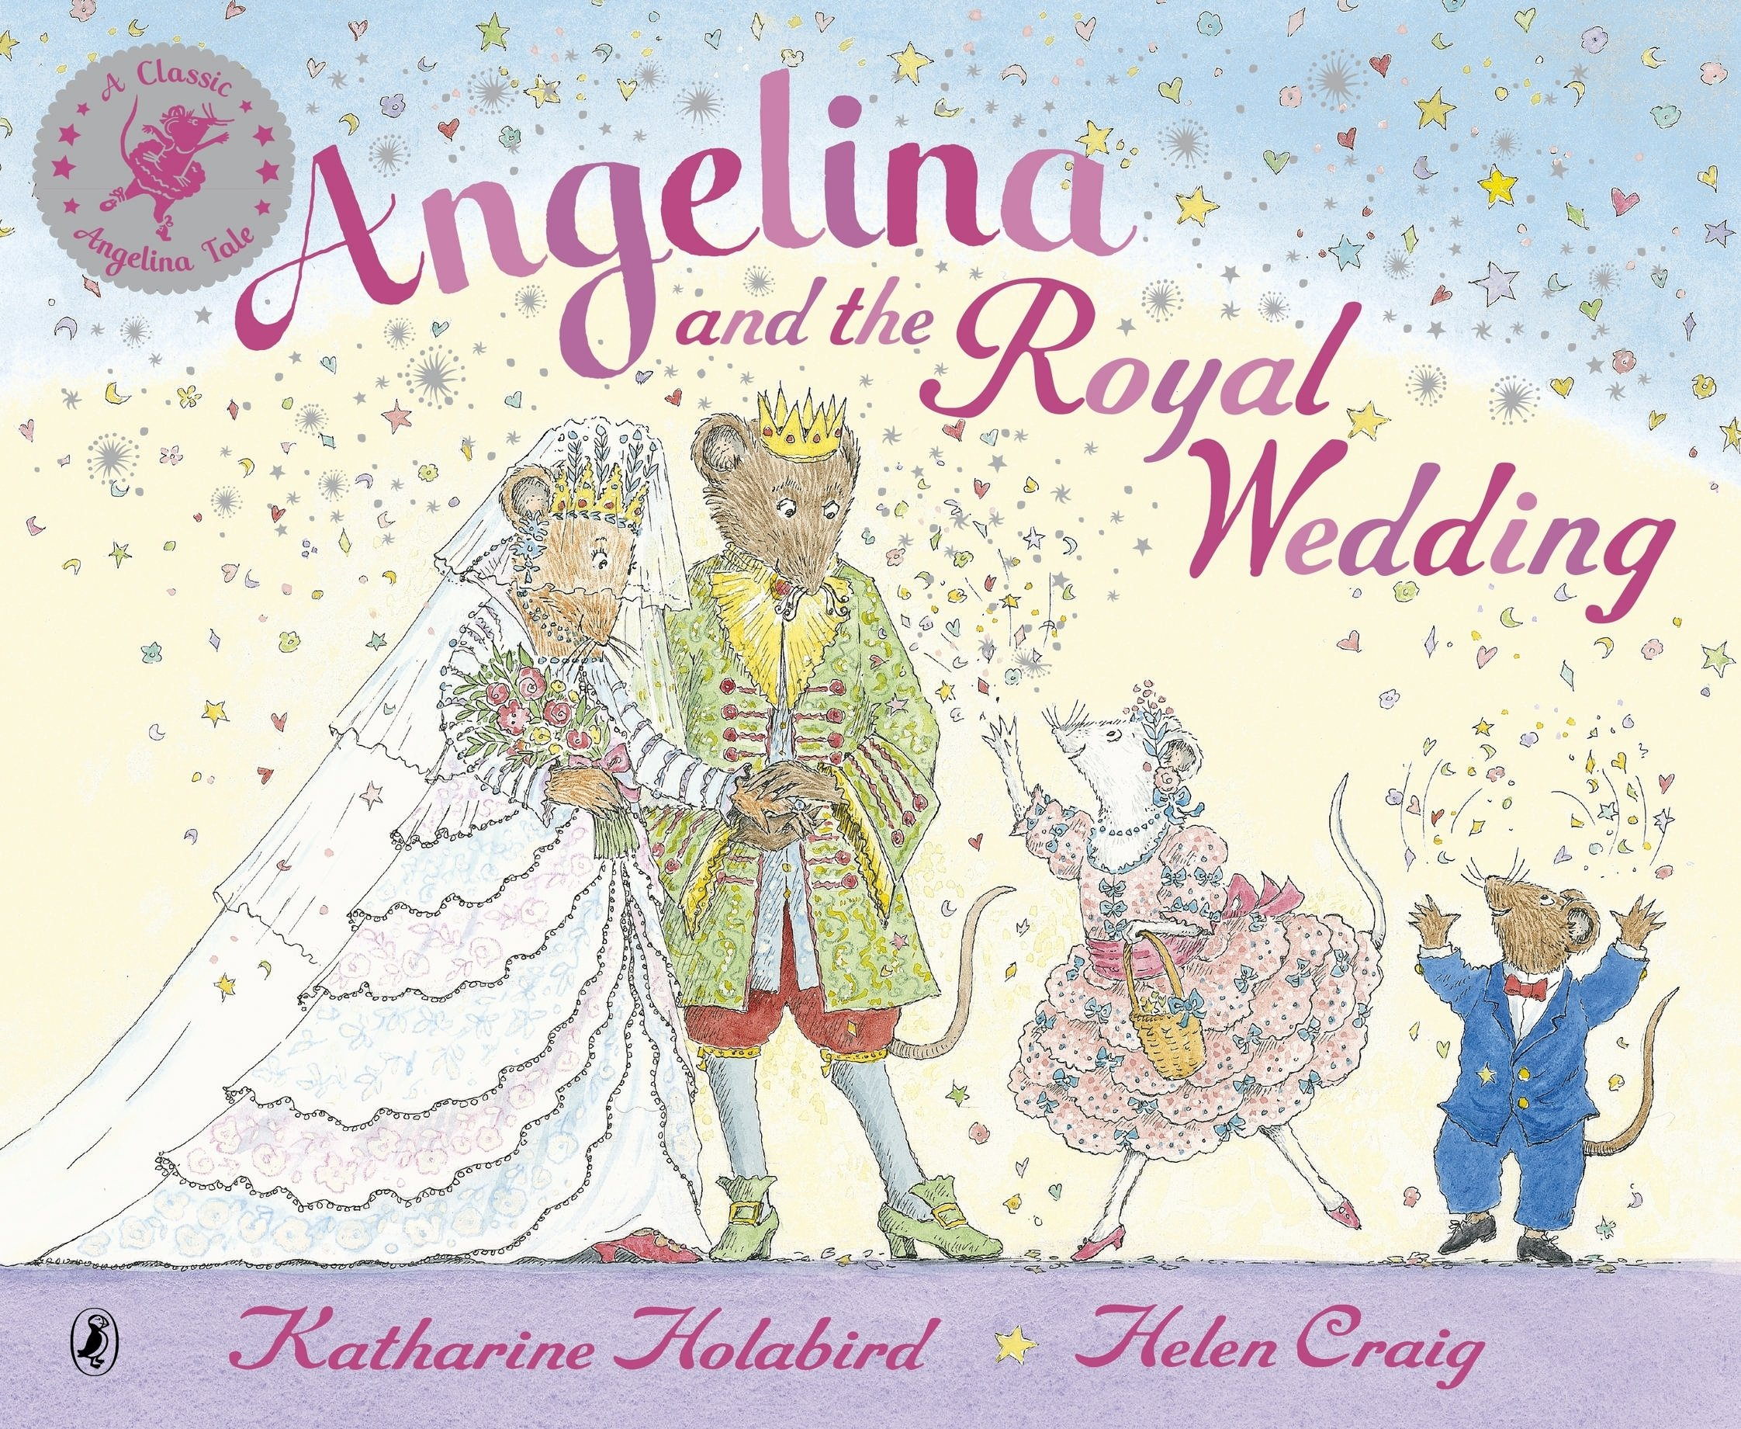
Our new book is called Angelina and the Royal Wedding. Can you write a prediction? Can you include some 2A sentences? Can you include some BOB and BOYS sentences?

