Slide 1
Thursday 11th February
Sikhism Fact File

Slide 2
Year 1 - Days of the week and common exception words
Monday, Munday
Tyoosday, Tuesday
Wensday, Wednesday
Thursday, Fursday
Friday, Friyay
Saterday, Saturday
Sunday, Sundday
ther, there
here, heer
they, vey
Year 2 – common exception word
fast, fast, fastt
last, larst, lastt
farther, father, faver
class, clas, clase
gras, grass, grase
passe, pass, pas
plant, plante, plnt
path, path, parth
baff, bath, barf
people, people, peepl
Which one looks right?
Write a list of the correct spellings.

Slide 3
Today we are learning to... I am learning to read and write facts. I am learning to create a non-chronological report.
I will be successful if ... I can think of an interesting title. I can spell key words correctly. I can use capital letters for the start of a sentence and for proper nouns. I can use finger spaces and full stops. I can use conjunctions.

Slide 4
This week we are creating a booklet about Sikhism
Each day we will complete a different section of our fact file.
Today we will look at the facts about food.
On Friday we will create a contents page and back cover.

Slide 5
Task: Create a page about Langar.
Use this link to find some facts:
https://www.bbc.co.uk/bitesize/topics/zsjpyrd/articles/zkjpkmn
Have a look at these videos:
https://www.bbc.co.uk/bitesize/clips/zmkq6sg
https://www.bbc.co.uk/bitesize/clips/zvx6yrd

Slide 6
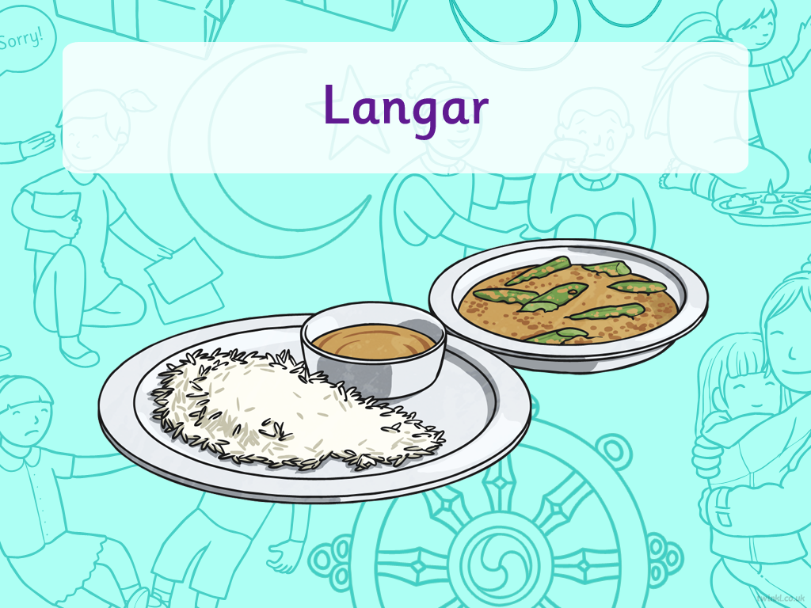


Slide 7

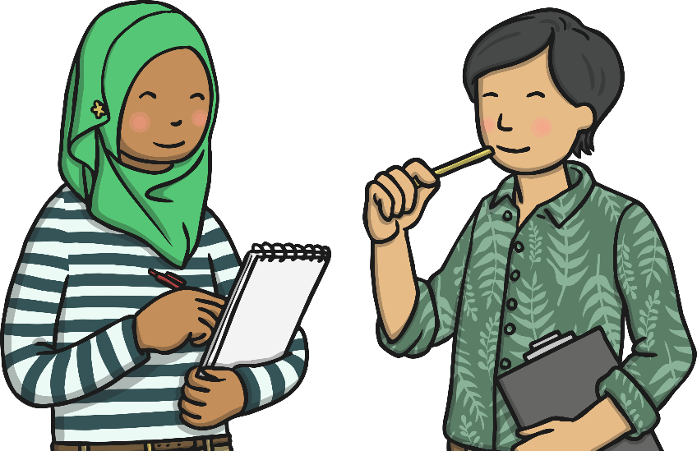
Eating Meals
Talk about these questions:
Do you ever go out to restaurants for meals with family and friends?
Do you ever eat at other people’s houses?
Who do you
eat with?
Do family and friends ever come to your house to eat?
Do you sit at
a table?
Who usually makes the meals in your house?
Where do you usually eat your breakfast, lunch and dinner?
Who clears up after dinner?

Slide 8
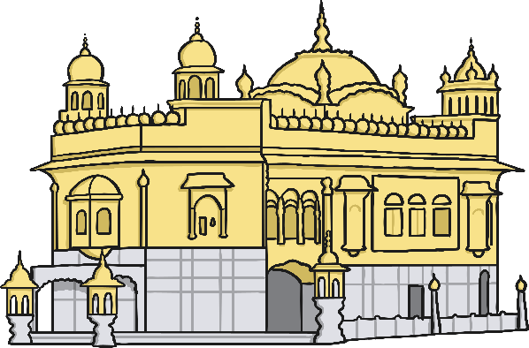
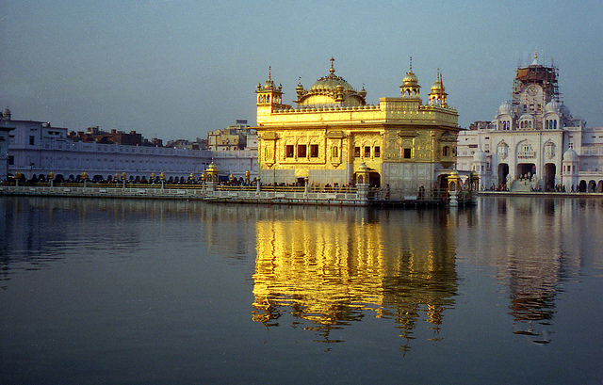
The Gurdwara
The Gurdwara is a special building for Sikhs and they go there to worship.
Probably the most famous Gurdwara is called Harmanhir Sahib (also known as The Golden Temple), which is in Amritsar, India.
Although the Gurdwara is a special building for Sikhs, people from all religions are welcome inside them.
Photo courtesy of Ryan@lickr.com - granted under creative commons licence - attribution

Slide 9
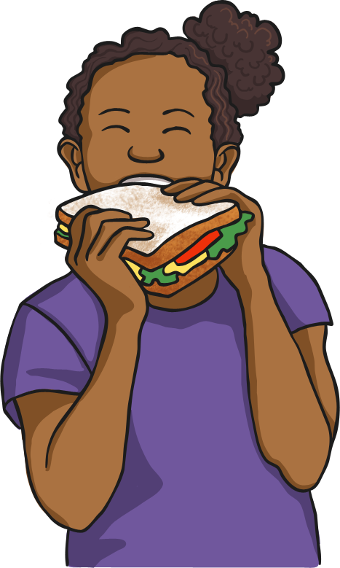
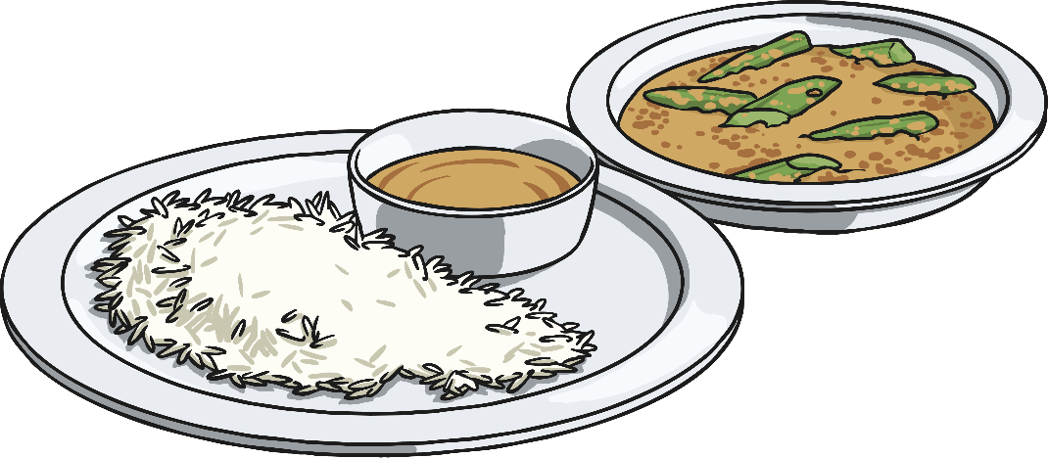
Langar
Each Gurdwara has a langar, which means free kitchen.
There is also a langar hall, where people can sit together and eat a free meal.
The langar meal is vegetarian so that people from all religions are able to eat it.
Guru Nanak Dev Ji created the langar because he believed in equality. That means that everyone is equal and should all be treated the same.
At the Gurdwara everyone takes it in turns to prepare, cook and serve the meal, then clear up afterwards.

Slide 10

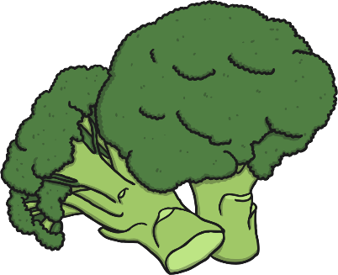







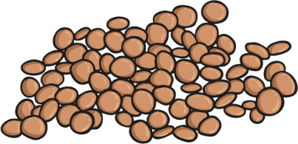

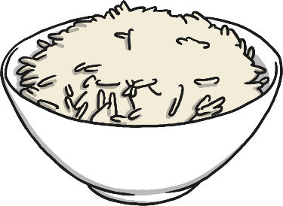


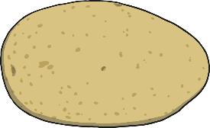
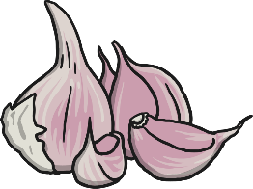


Langar

Slide 11
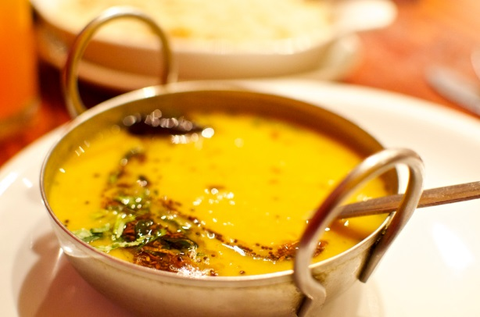
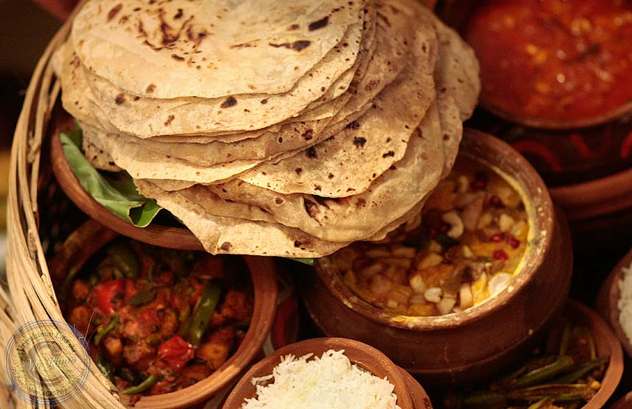
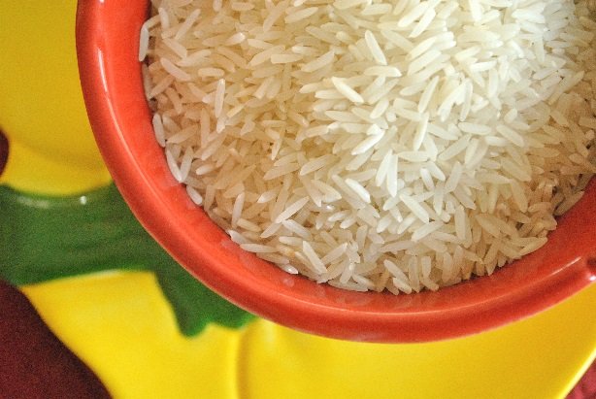
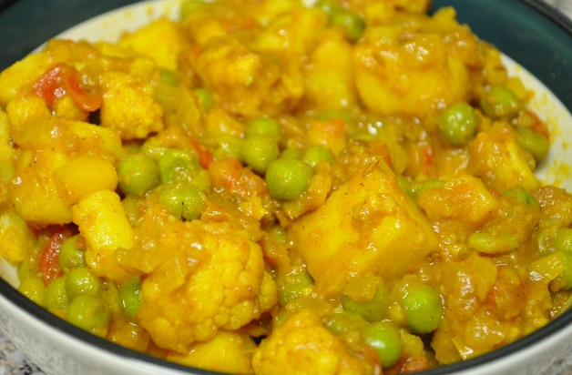
Traditional Langar Meals
Daal - lentils
Chapati - flatbread
Rice
Aloo - potatoes
Photo courtesy of aimee rivers, Vrindavan Lila, cookbookman17 and James@lickr.com - granted under creative commons licence - attribution

Slide 12
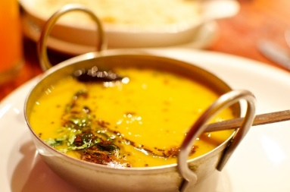



Food
Here is an example:
Eating food together is important for Sikh people. The food prepared is always vegetarian, so that anyone can come and eat together. It is prepared by a host family who may be celebrating a special event, and any food left over is given to charity.
In every Gurdwara, there is a place called a Langar where people cook, eat and share a meal. Guru Nanak created the Langar because he believed in equality. That means that everyone is equal and should all be treated the same. He wanted to make sure that everybody could have something to eat.
Traditional Langer meals are:
Daal
Chapati
Rice
Aloo

