Slide 1
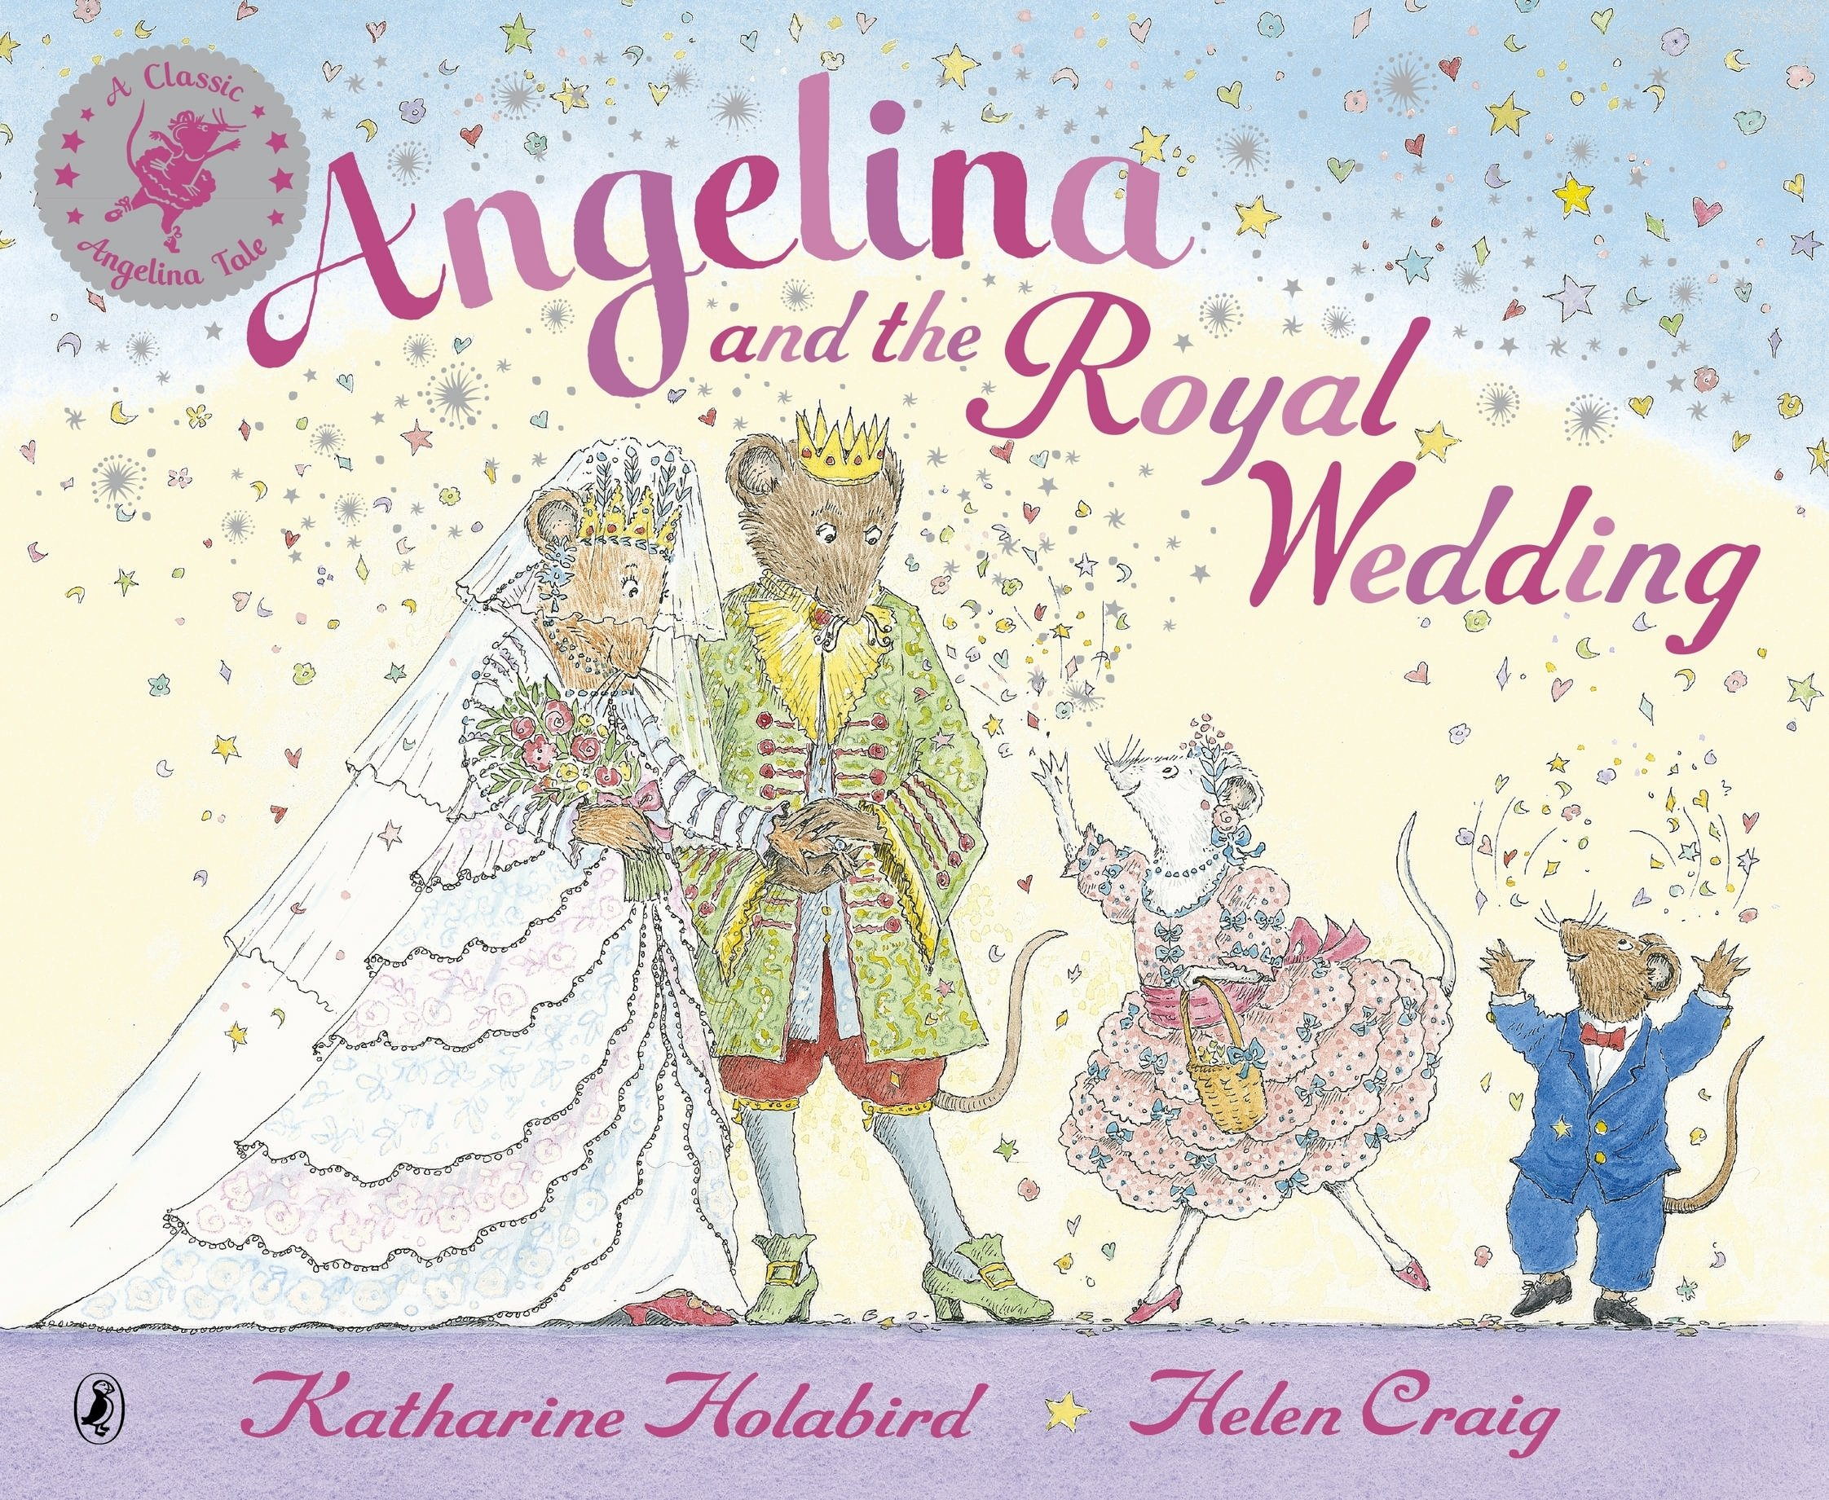
Tuesday 12th January 2021
Writing

Slide 2
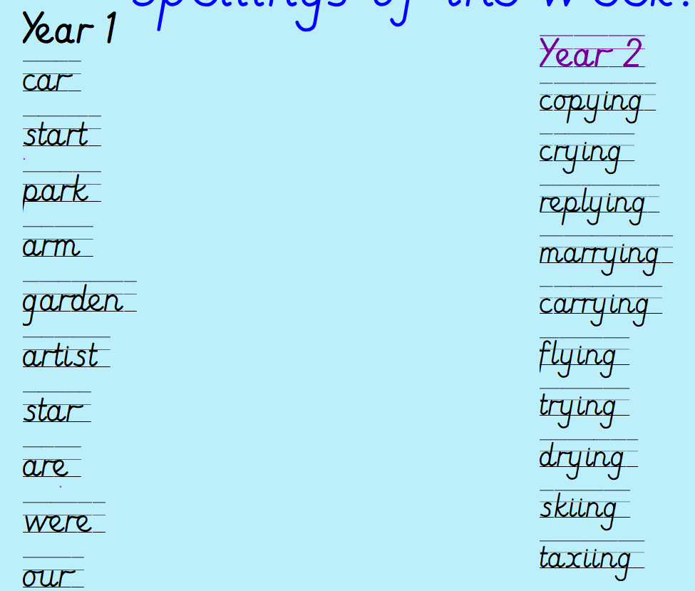
Can you practise your spelling for 5 minutes?
Spelling rule
Adding ing to a word ending in 'y' with a consonant before it
Spelling rule
The digraph ar

Slide 3
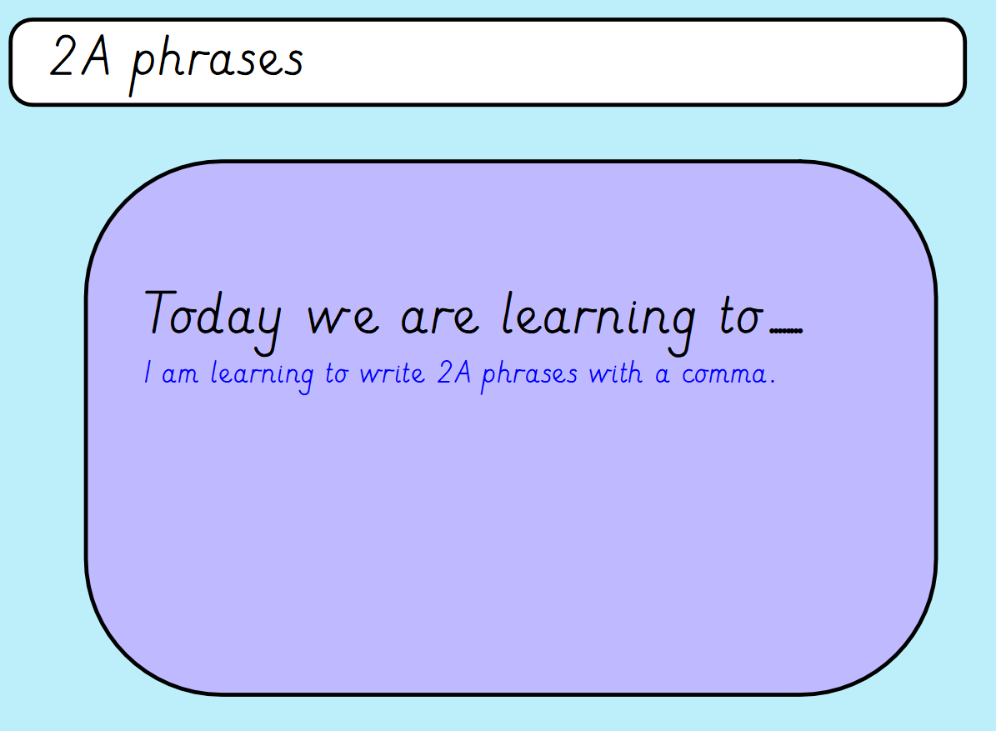

Slide 4
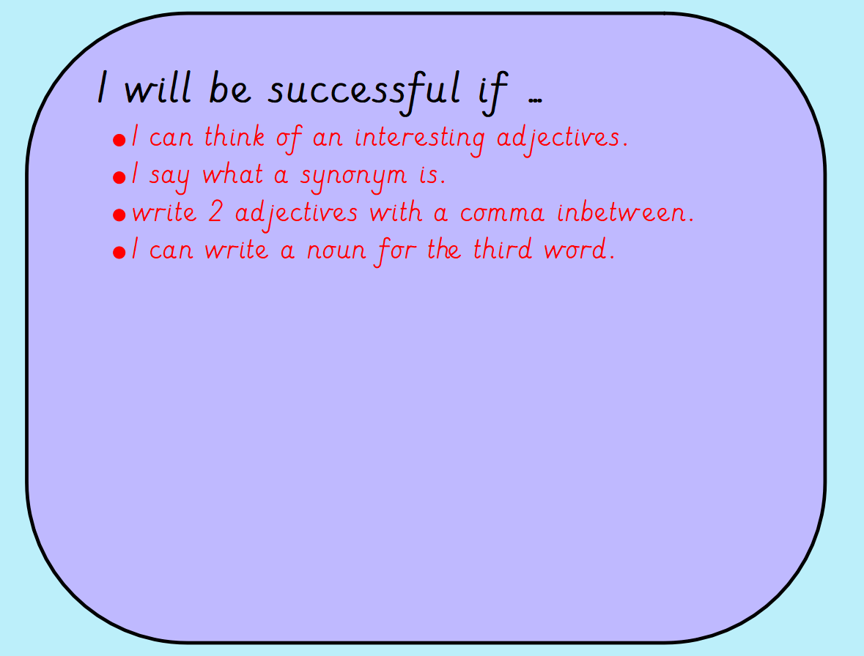

Slide 5
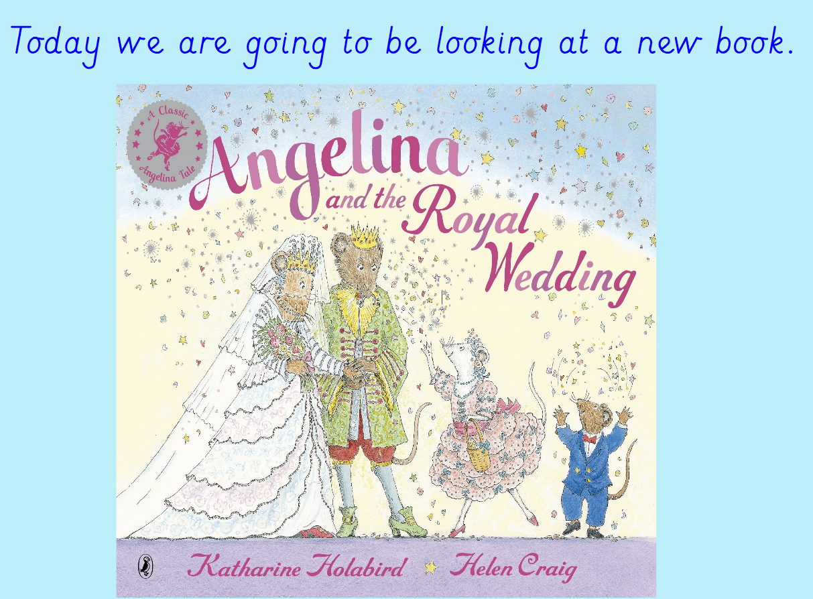
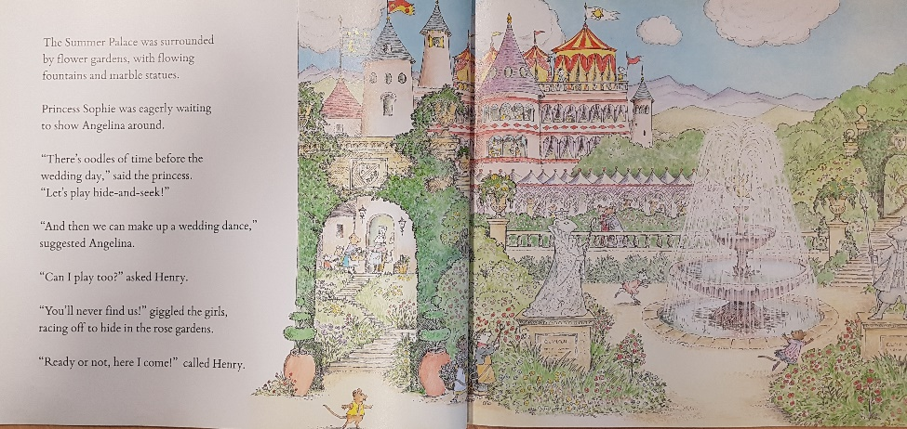
https://www.youtube.com/watch?v=6mFHNfaTaoM Listen to the story up to the part of the summer palace.

Slide 6
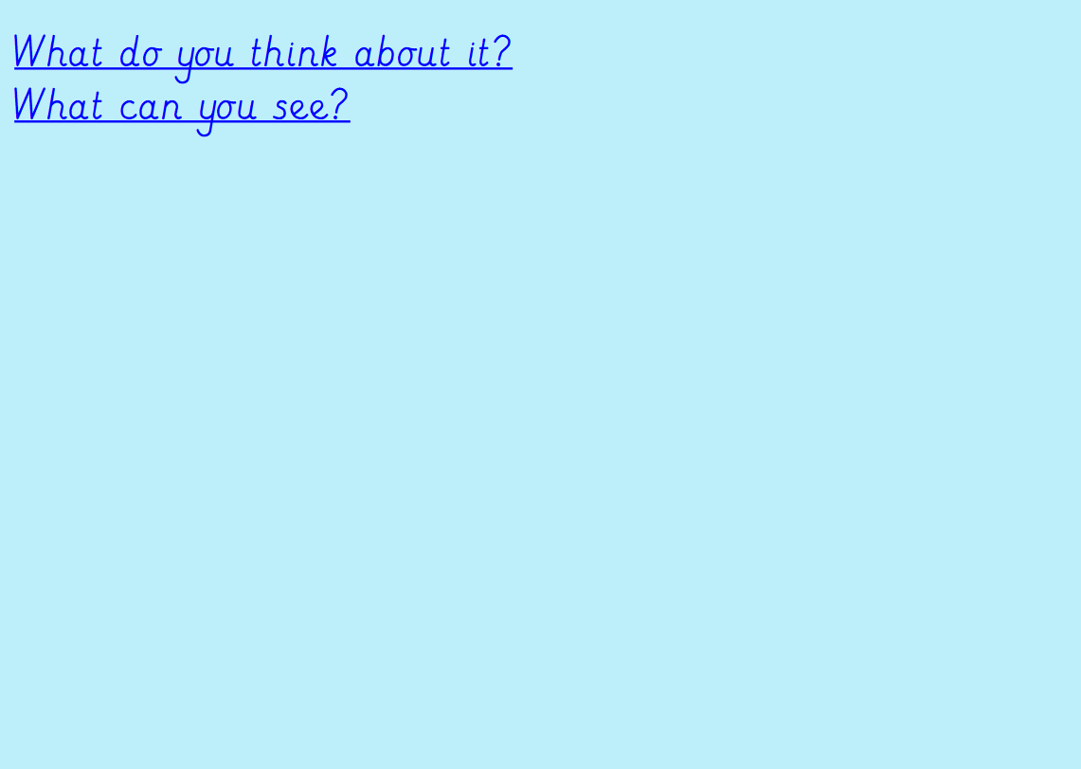

Today we are going to record some 2A phrases. Remember our 2A phrases need a comma in between the two adjectives. Also, remember they are NOT sentences.
Examples:
bright, colourful garden
glimmering, bold waterfall
There must be an adjective, comma, adjective then noun.

Slide 7
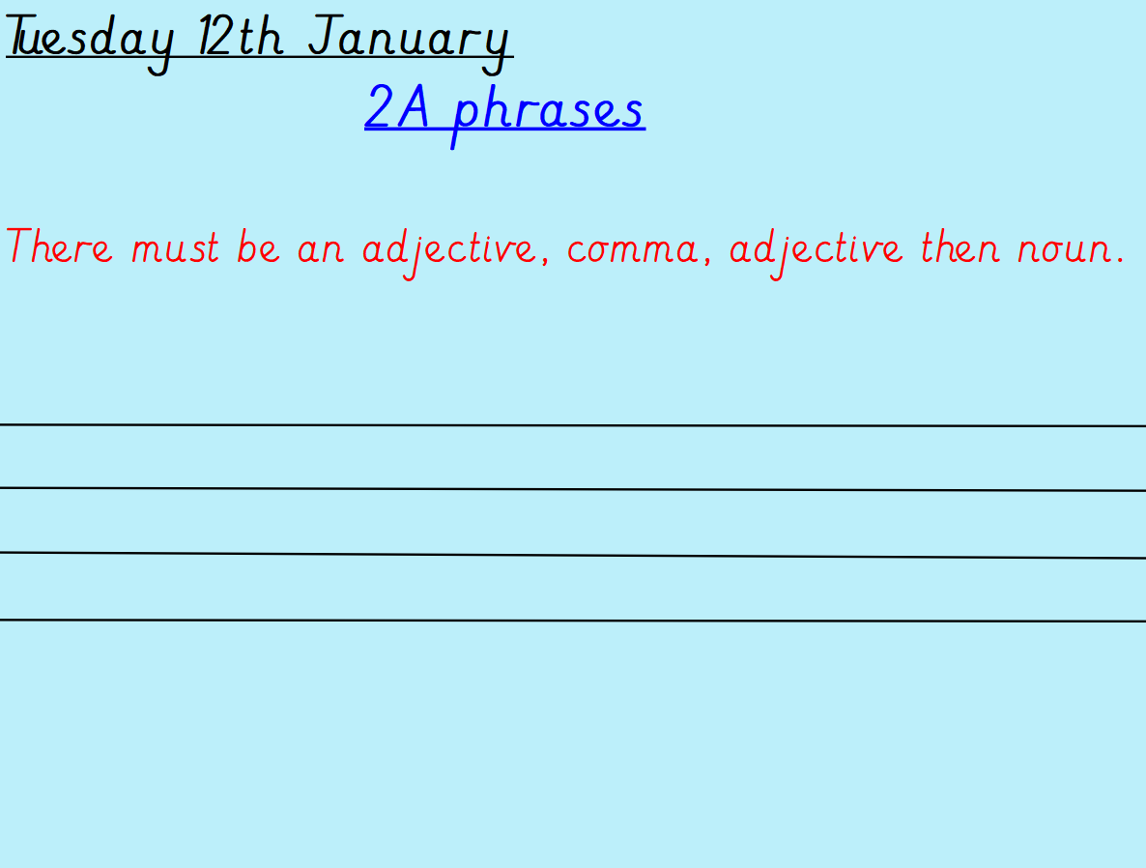
Can you write 10 2A phrases to describe the palace and the surroundings?
Remember to write in your beautiful handwriting!

