Slide 1
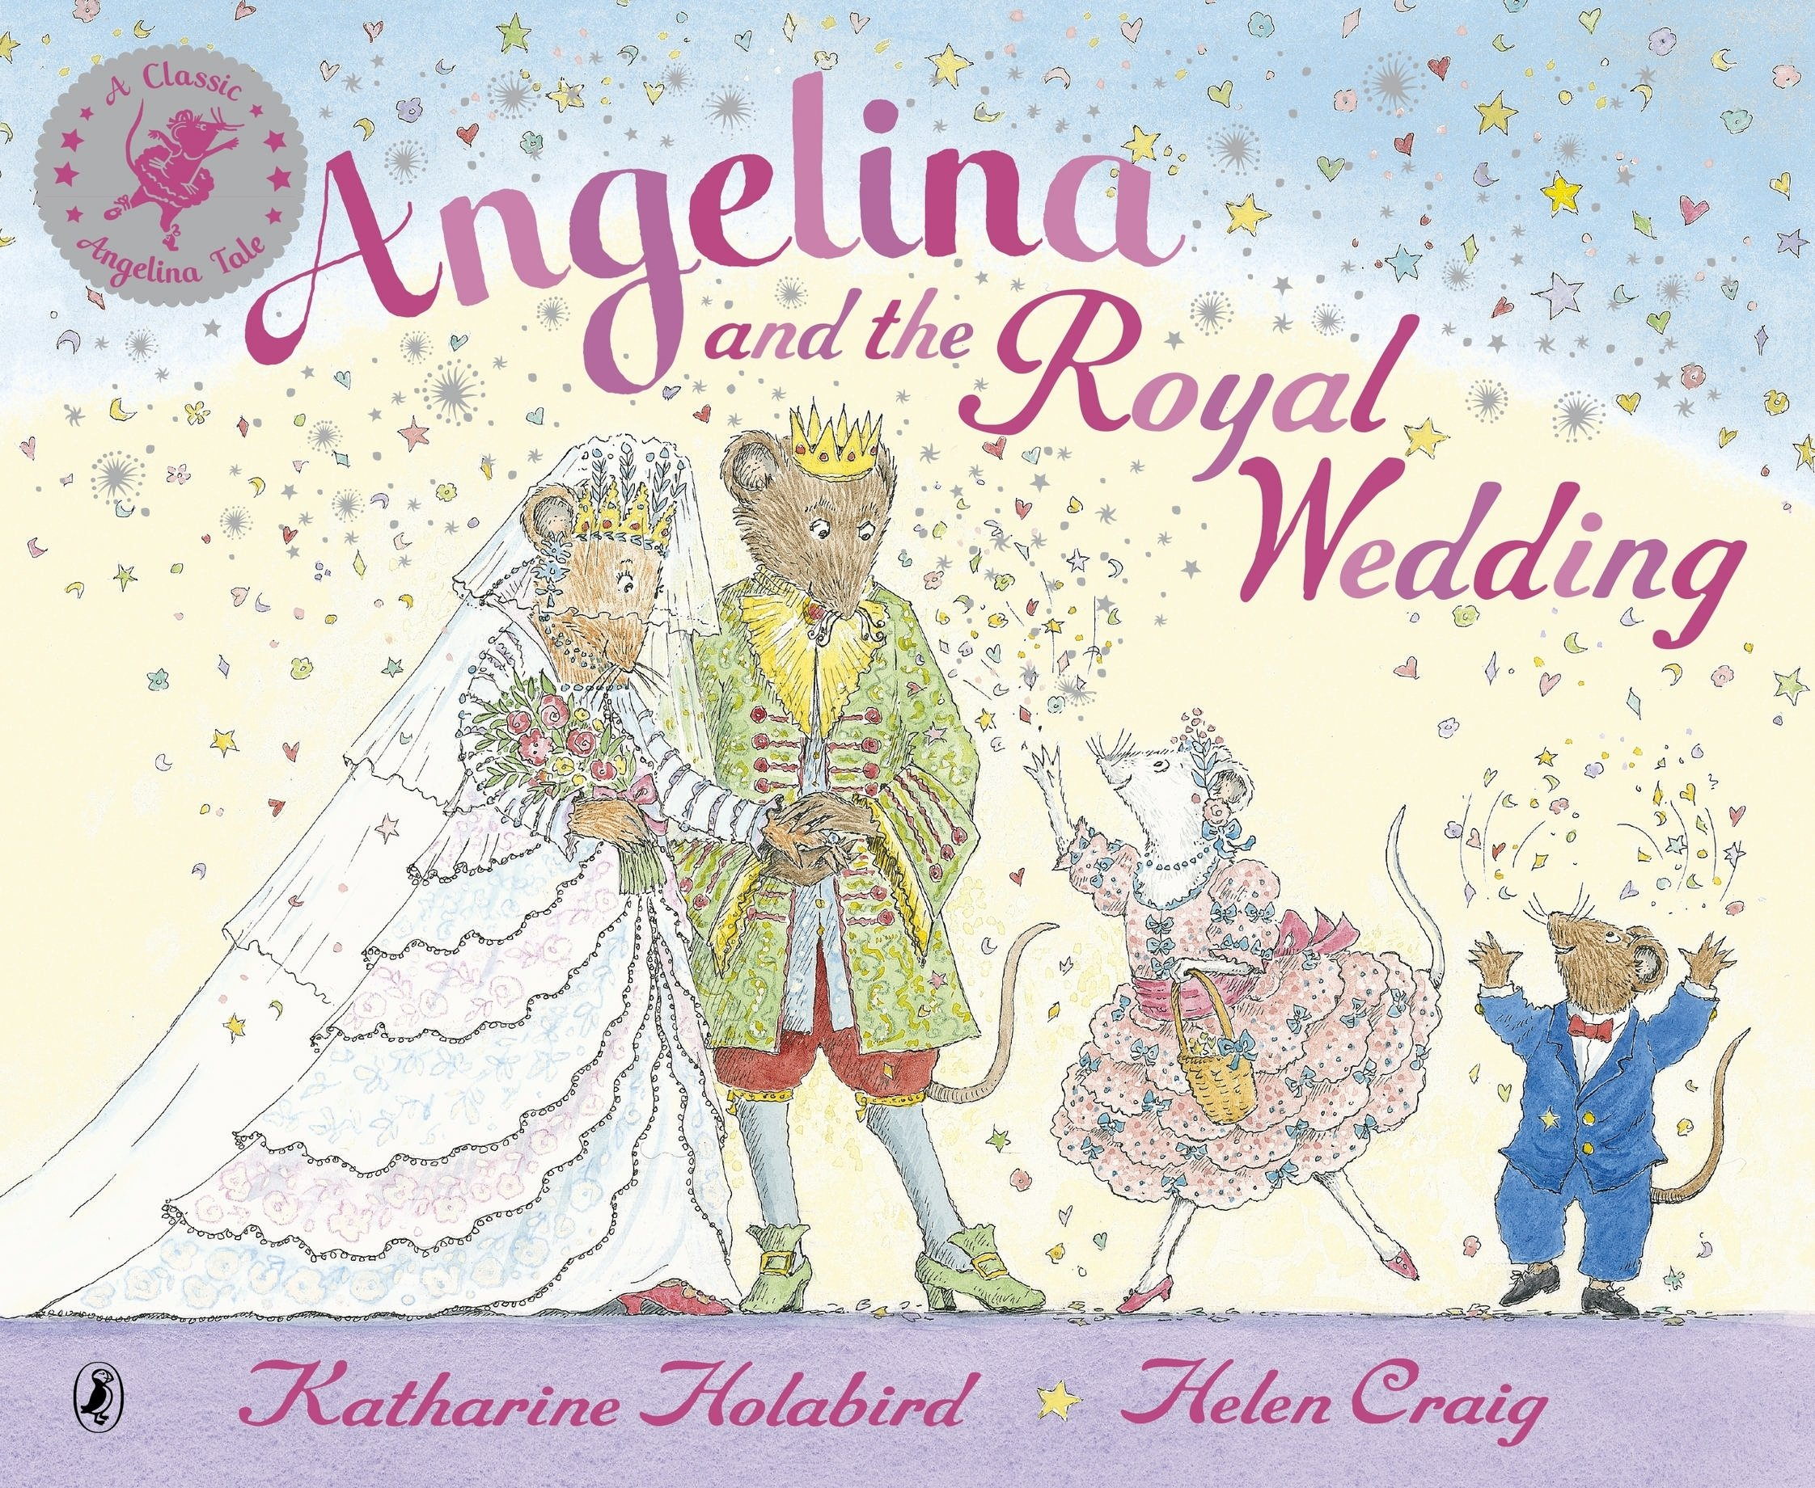
Wednesday 13th January 2021
Writing

Slide 2
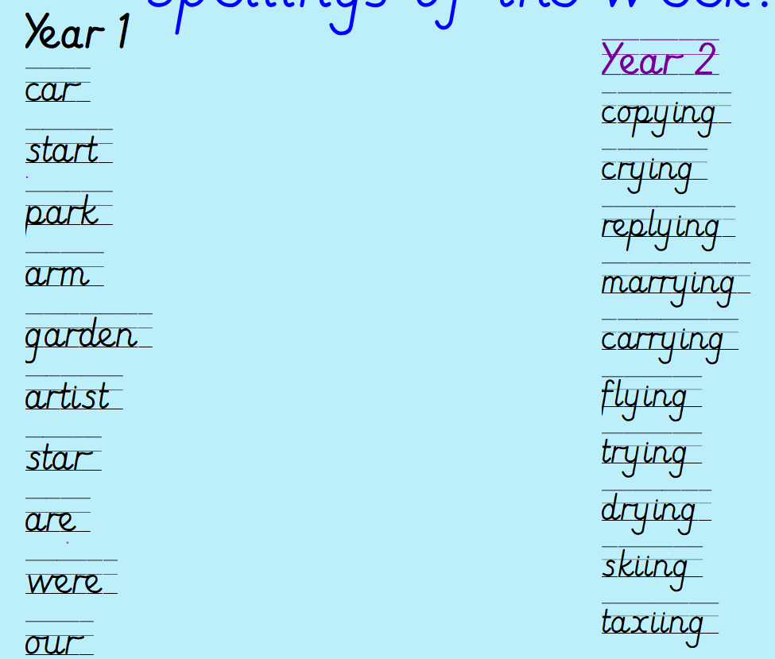
Can you practise your spelling for 5 minutes?
Spelling rule
Adding ing to a word ending in 'y' with a consonant before it
Spelling rule
The digraph ar

Slide 3
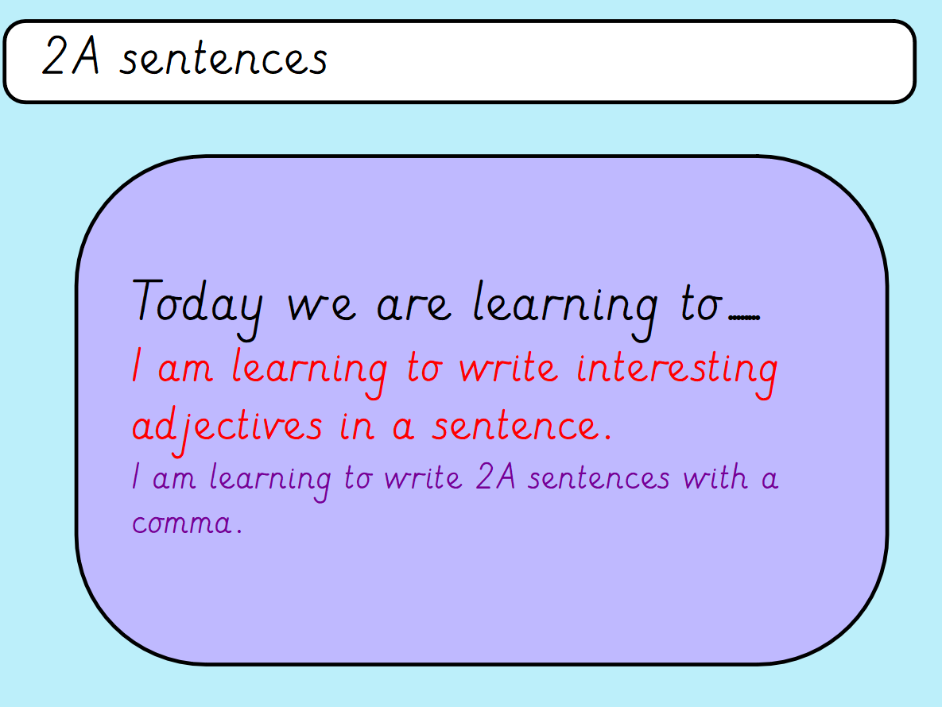

Slide 4
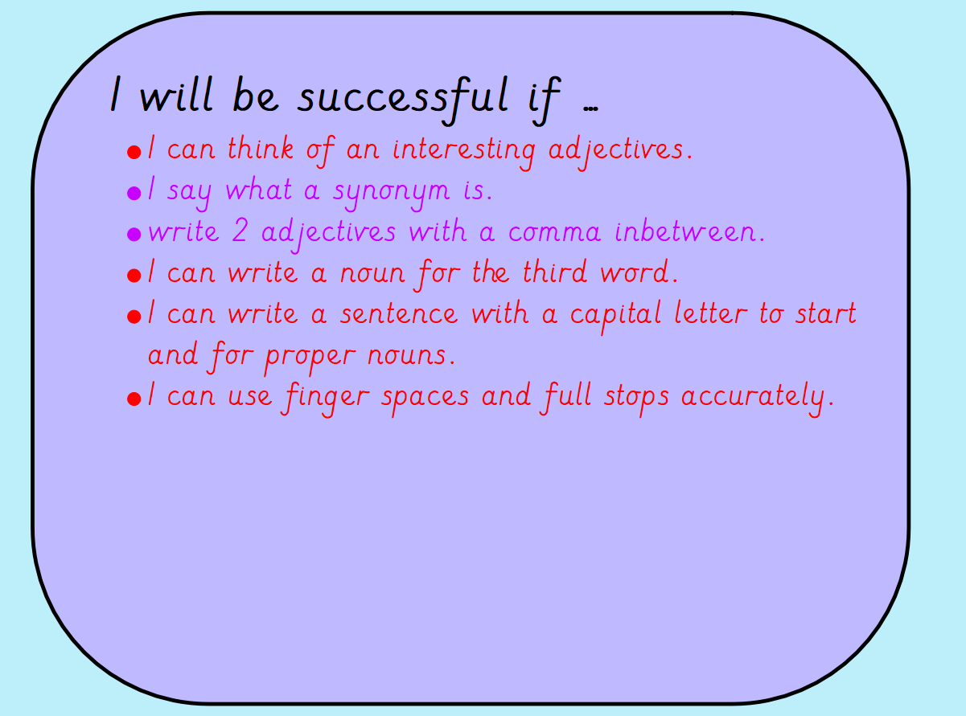

Slide 5
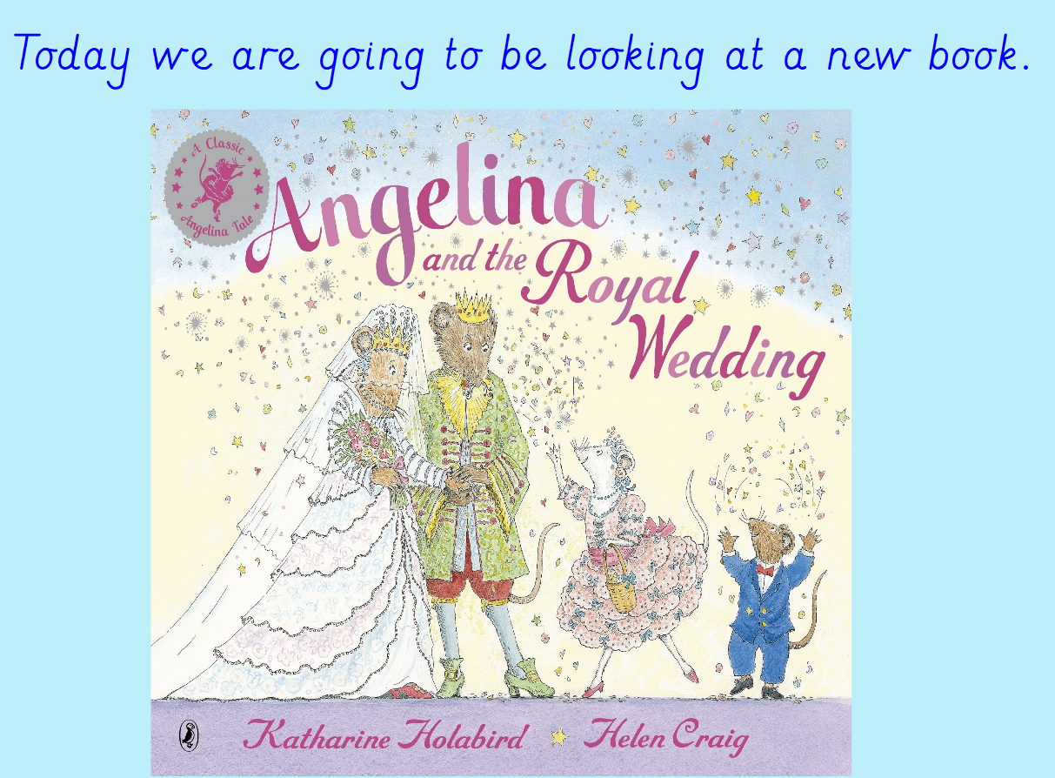
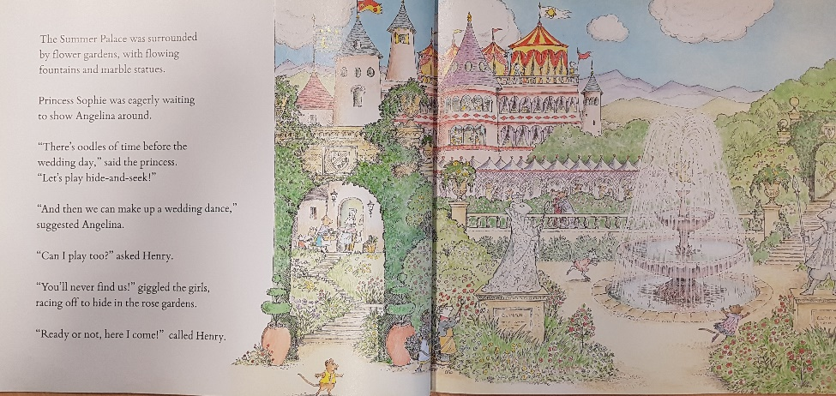
https://www.youtube.com/watch?v=6mFHNfaTaoM Recap and listen to the story up to the part of the summer palace.

Slide 6
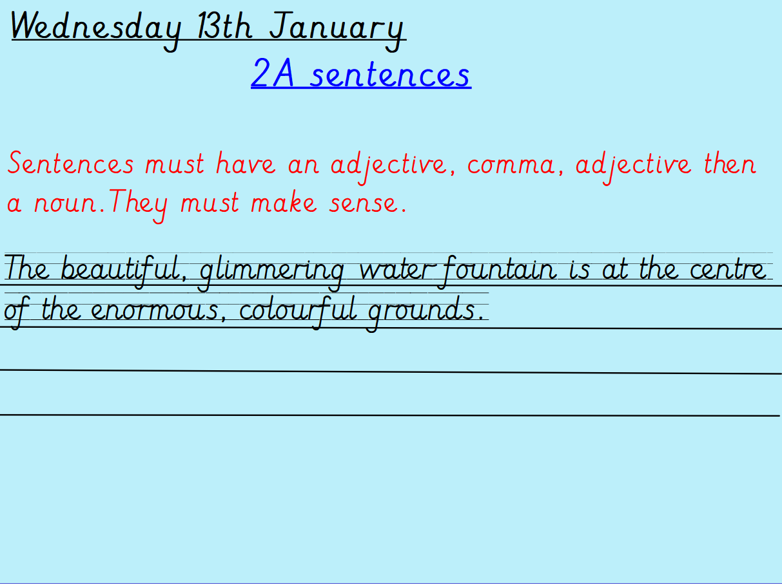
Using your ideas from yesterday – write your 2A phrases into sentences. Can you add some BOB or BOYS sentences to make them even better?
Remember your capital letters, finger spaces and full stops.
Remember your beautiful handwriting!

