Slide 1
Thursday 14th January 2021
Writing

Slide 2
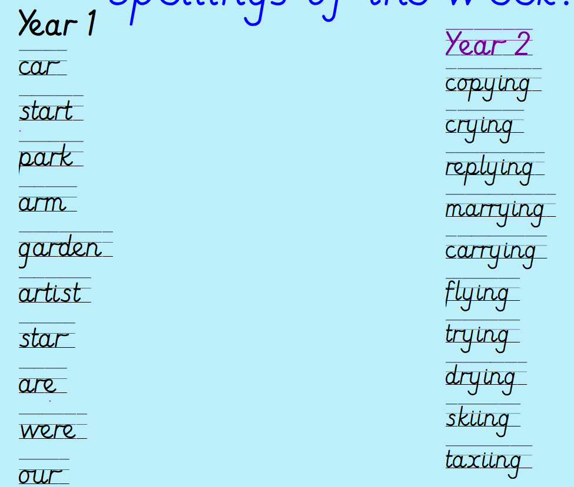
Can you practise your spelling for 5 minutes?
Spelling rule
Adding ing to a word ending in 'y' with a consonant before it
Spelling rule
The digraph ar

Slide 3
https://www.bbc.co.uk/bitesize/articles/zvp6dp3 - watch BBC bite size video on the four sentence types.
After watching the video – What are the four sentence types?

Slide 4
There are four different types of sentences: statements commands questions exclamations

Slide 5
Can you think of an example of a statement and command sentence?
Four Sentence Types
Statements usually end with a full stop but can also use an exclamation mark.
Commands can be punctuated with a full stop or an exclamation mark.

Slide 6
Questions must end with a question mark.
Exclamations must end with an exclamation mark.
Can you think of an example of a question and exclamation sentence?
Complete activity 1 and 2.

Slide 7
Thursday 14th January 2021 Statement, Command, Question and Exclamation
Can you write 2 examples for each of the sentence types?
Remember your beautiful handwriting and presentation!

