Slide 1
Friday 15th January 2021
Writing

Slide 2
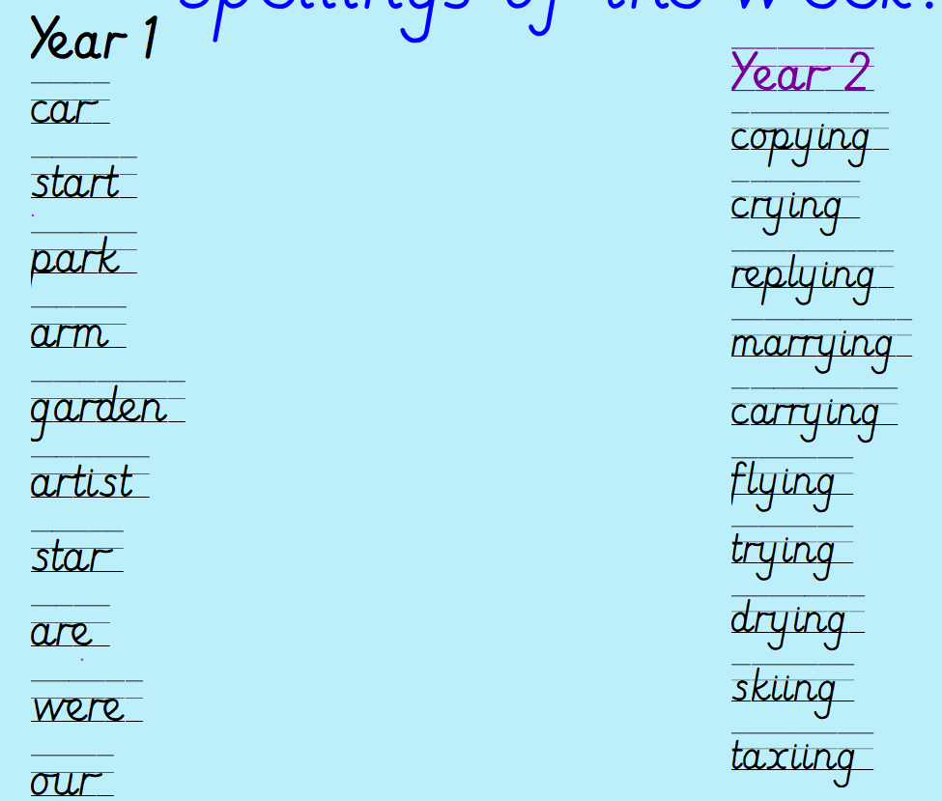
Can you practise your spelling for 5 minutes?
Spelling rule
Adding ing to a word ending in 'y' with a consonant before it
Spelling rule
The digraph ar

Slide 3
Can you remember the four sentence types?
https://www.bbc.co.uk/bitesize/articles/zvp6dp3 - Recap the video from yesterday on the four sentence types.

Slide 4
What is a statement? What is a command? What is a question? What is an exclamation sentence?
Can you say some examples of a statement, command, question and exclamation sentences?

Slide 5
Have a try at completing the four sentence activity worksheet.
Y1 – complete page 1 and 2
Y2 – complete all of the booklet

