Slide 1

Tuesday 2nd March 2021
Writing

Slide 2
Year 1 - The split vowel
digraphs ‘a-e’ and ‘e-e’
made
came
same
take
safe
date
lake
these
theme
complete
Year 2 - the ee sound spelt ey
key
donkey
monkey
chimney
valley
trolley
turkey
hockey
parsley
journey
Can you practise your spelling for 5 minutes? Look at how many letters are in each word. Write a list of all 10 spellings.
Write the last 5 words in sentences.

Slide 3
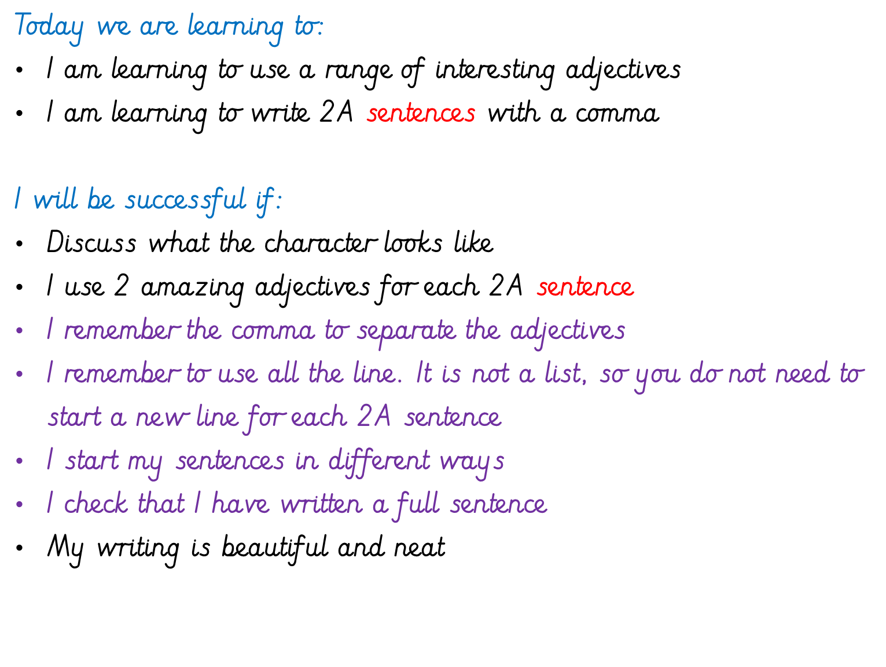

Slide 4
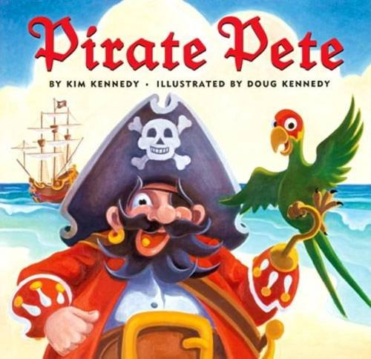
Our story is called Pirate Pete.
What kind of character do you think he might be? Why?

Slide 5
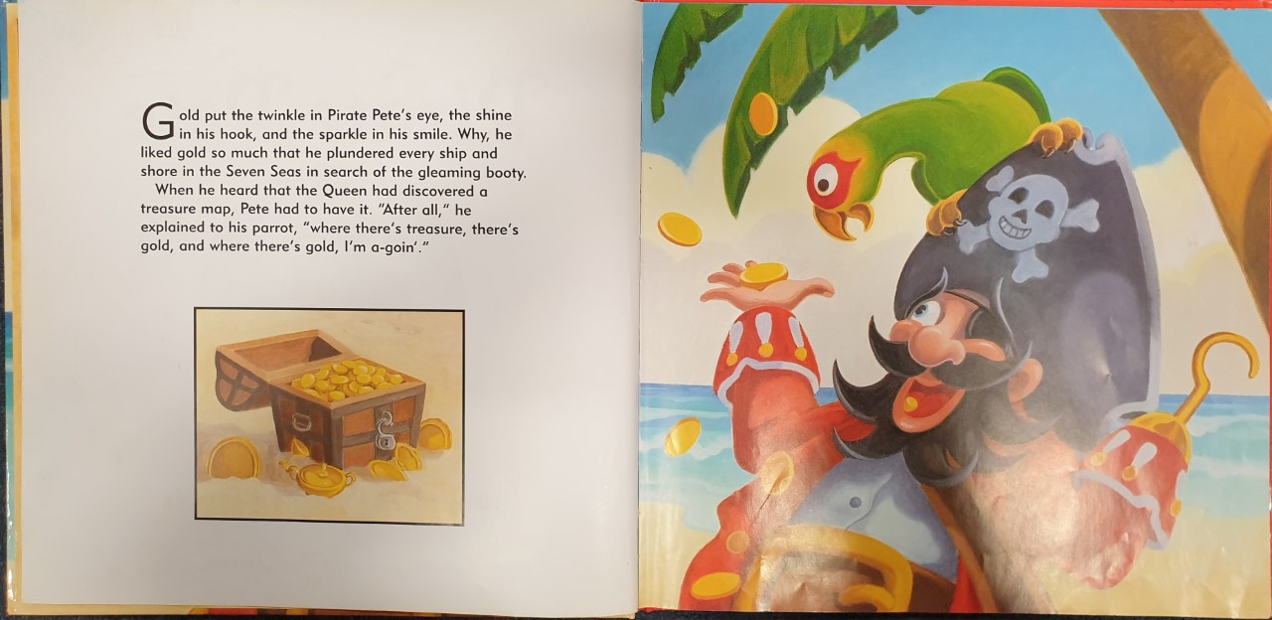

Slide 6
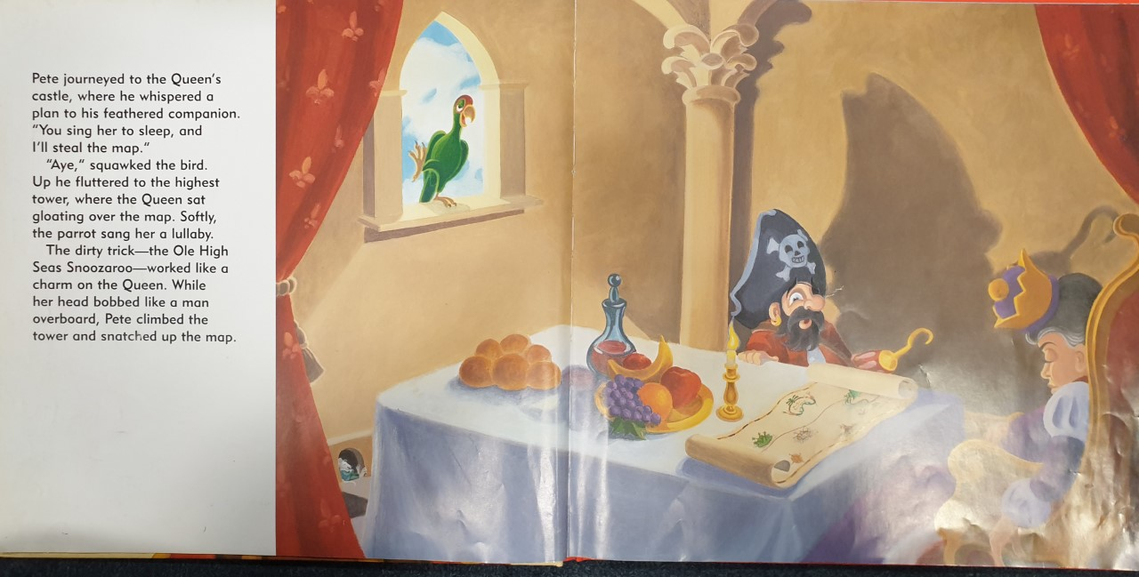

Slide 7
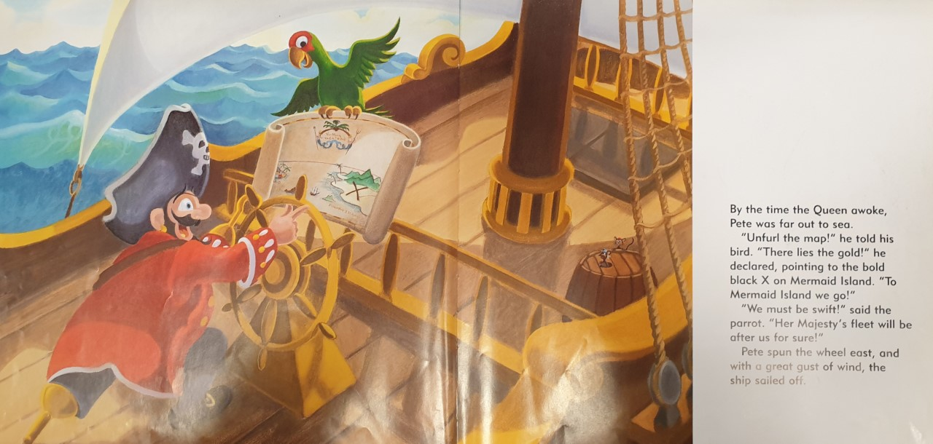

Slide 8
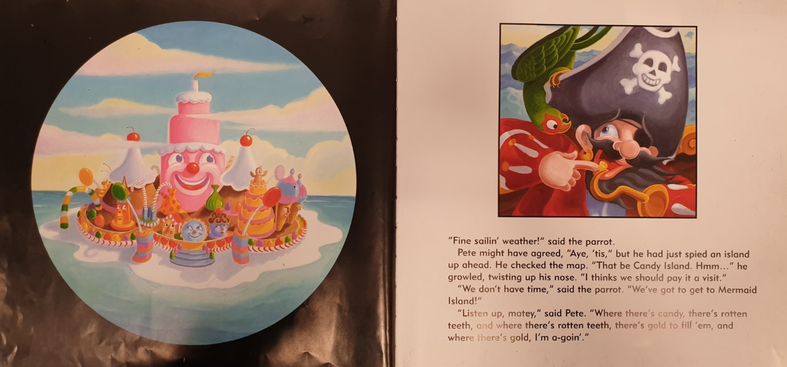

Slide 9
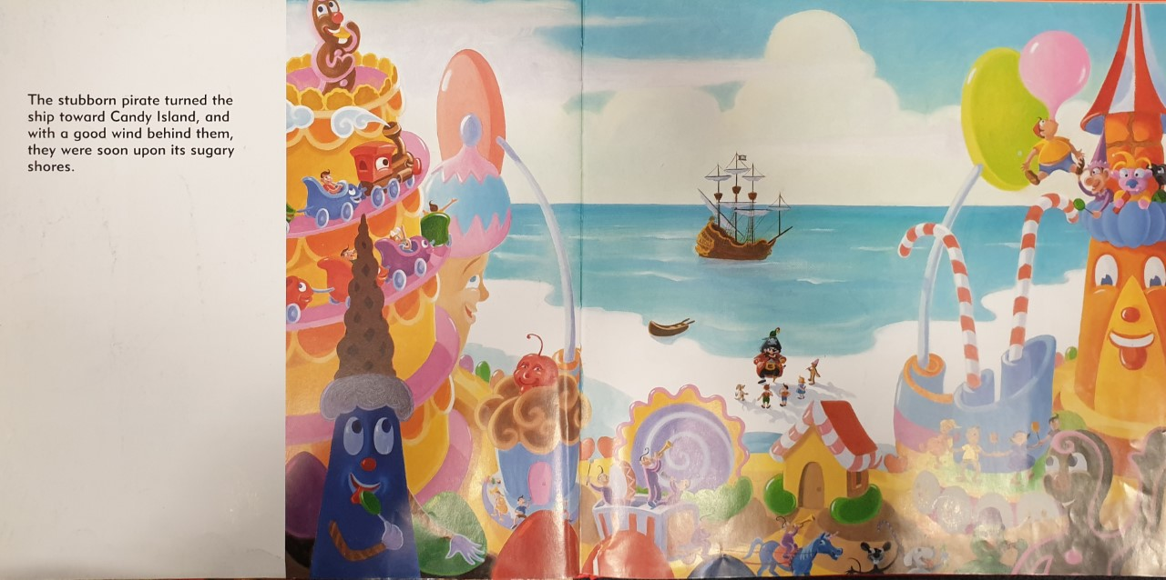

Slide 10
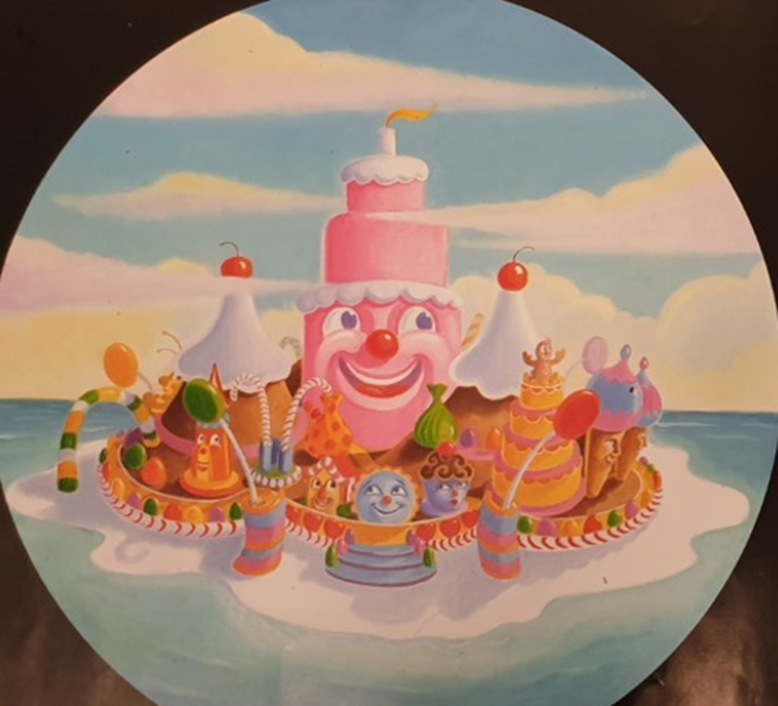
Task 1: Write 2A sentences to describe the island.
A 2A sentence is 2 adjectives (describing words) with a comma between them, followed by the noun (thing you are describing). Write in full sentences!
You can use your imagination too.
E.g.
The soft, springy floor bounced you as high as the clouds.
The delicious, pink roof was magically waterproof.
Colourful, squishy sweets surround the whole island.

Slide 11
Here is a list of things you may describe:
Floor
Roof
House
Building
Road
Street
Lamp post
Cake
Jelly
Candy canes
Sweets
Lollies
Write at least six 2A sentences.

