Slide 1

Monday 22nd February 2021
Writing

Slide 2
Year 1
The sound /k/ spelt with ‘k’ not ‘c’, before e, i and y
Kent
sketch
kit
skin
frisky
skill
risky
kettle
kilt
king
Year 2
The u sound spelt with o
other
mother
brother
nothing
Monday
money
cover
honey
discover
wonder
Can you practise your spelling for 5 minutes? Look at how many letters are in each word.
Write the first 5 words in sentences.

Slide 3
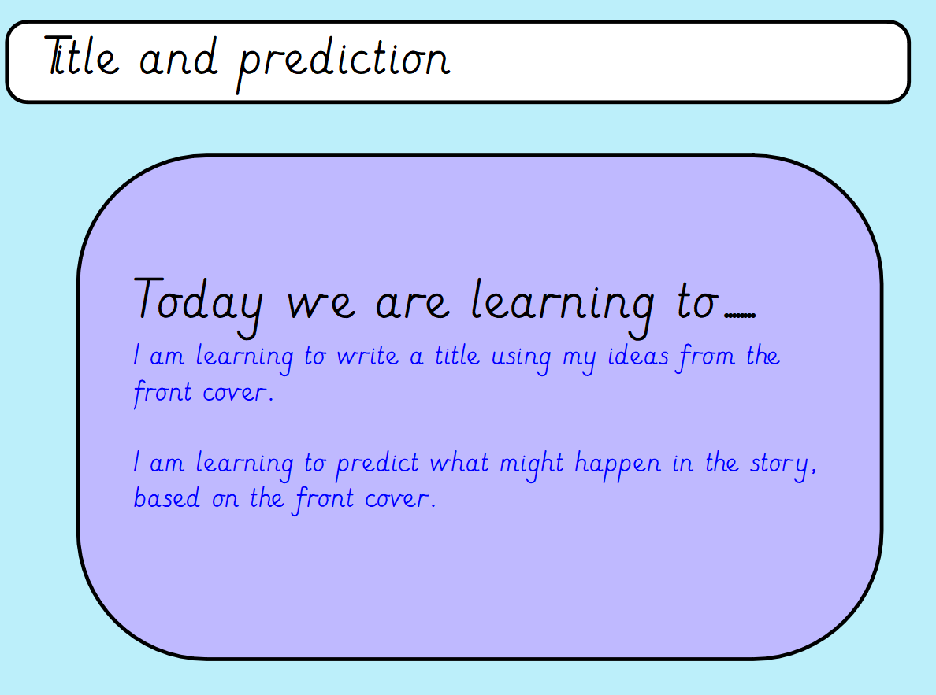

Slide 4
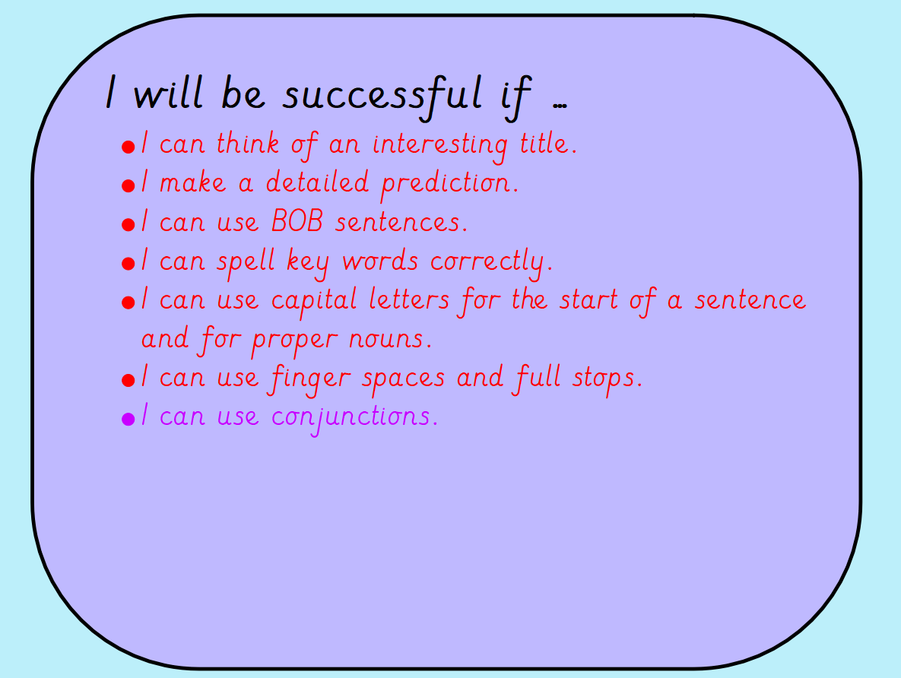

Slide 5
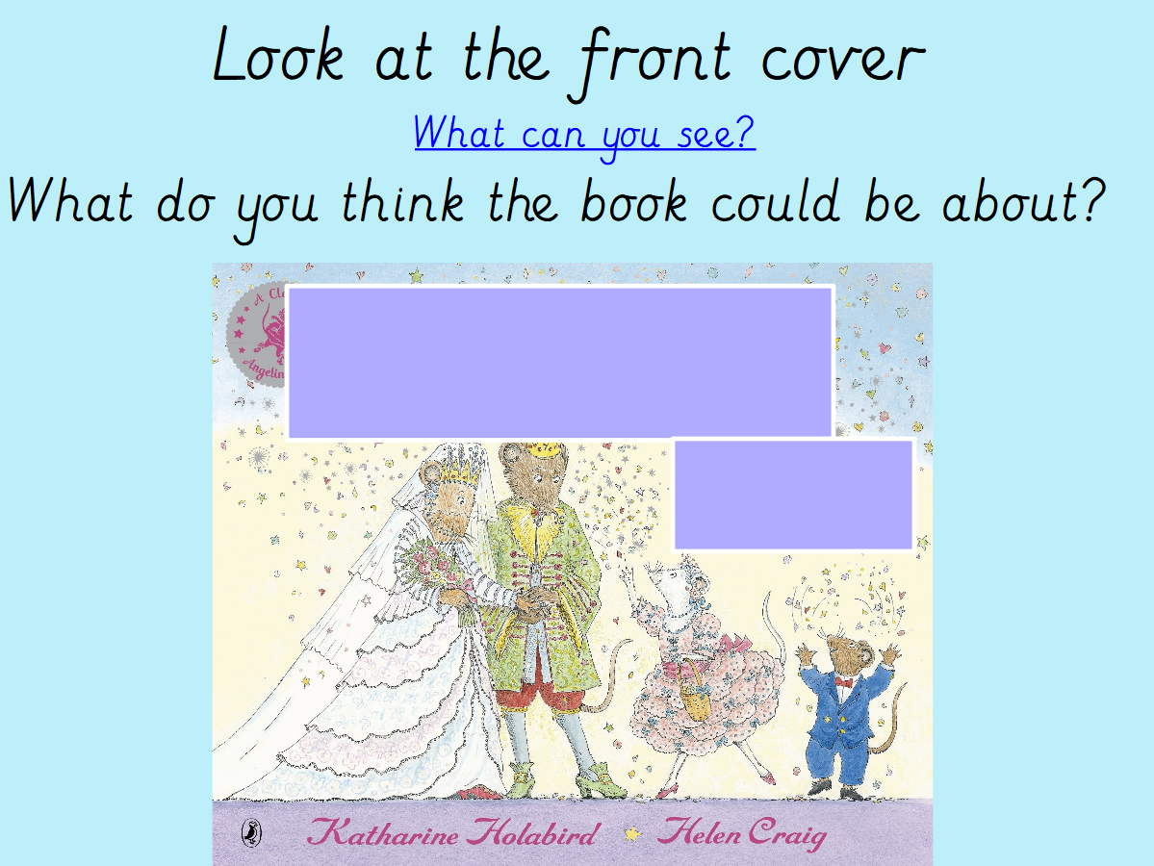
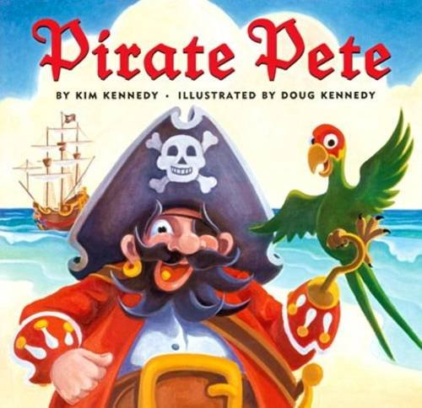

Slide 6
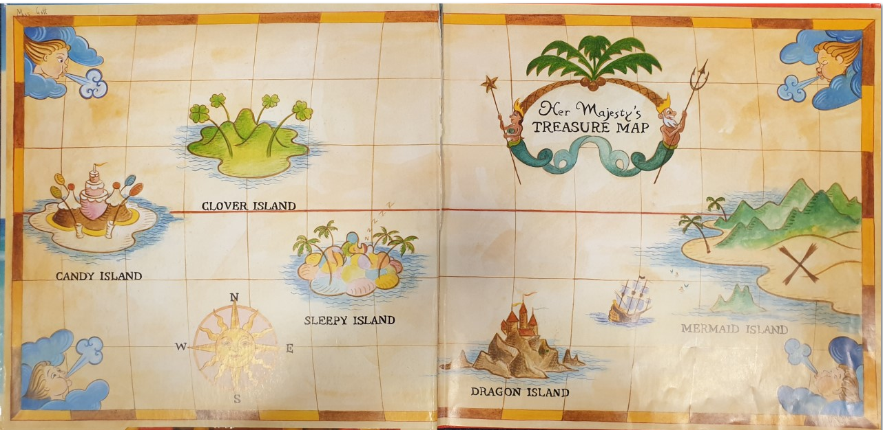
Here is a little clue

Slide 7
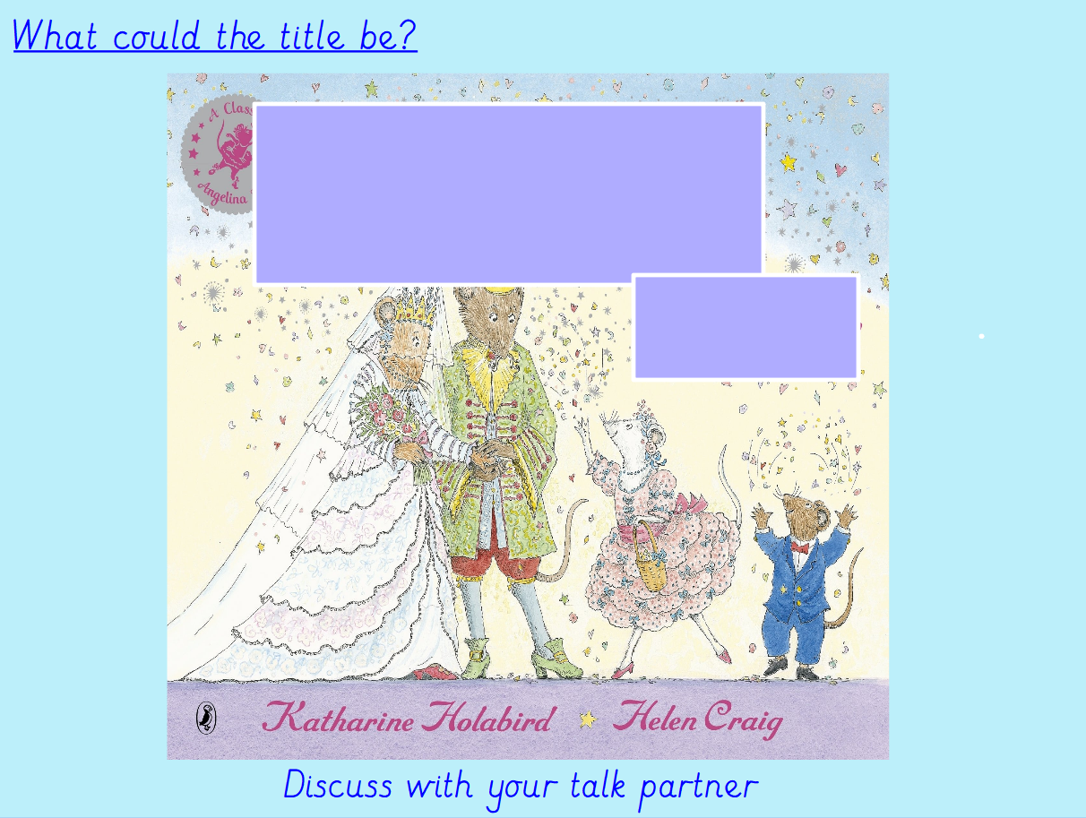
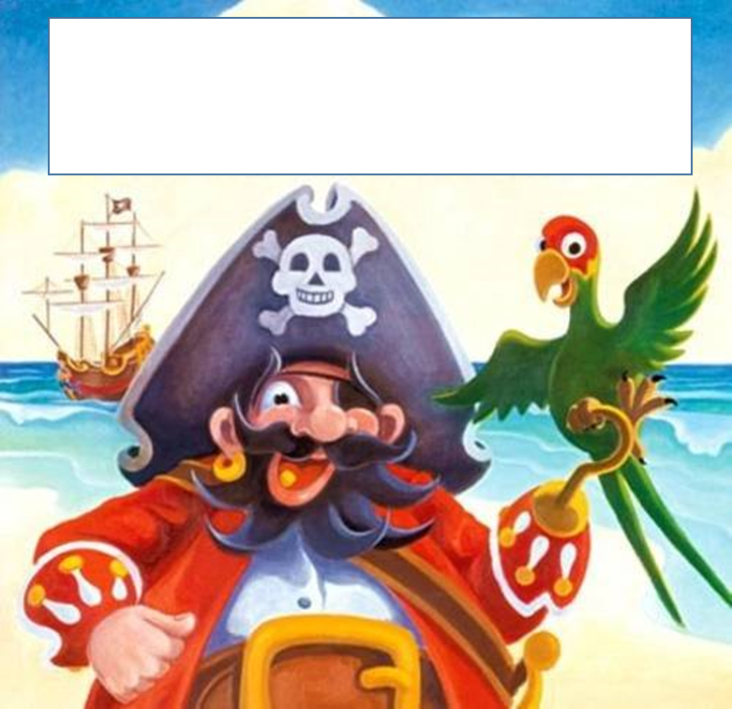
Discuss your ideas with someone

Slide 8
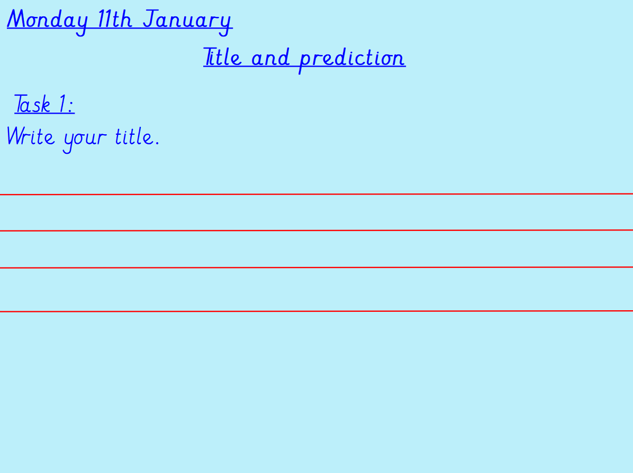
Can you think of 5 interesting titles of what the book could be called?
Remember each title needs to start with a capital letter!

Slide 9
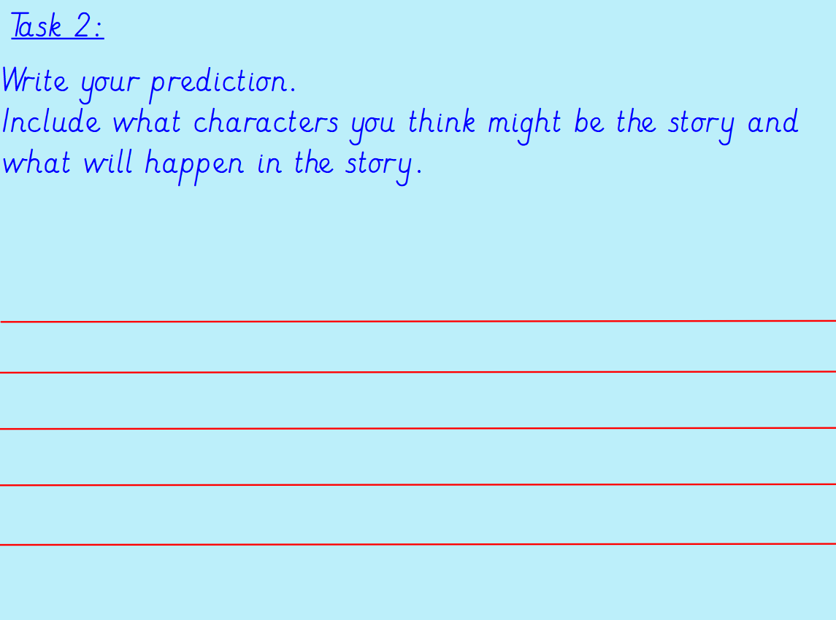
Our new book is called Pirate Pete. Can you write a prediction? Can you include some 2A sentences? Can you include some BOB and BOYS sentences?

