Slide 1
Thursday 25th February 2021
Writing

Slide 2
Year 1
The sound /k/ spelt with ‘k’ not ‘c’, before e, i and y
Kent, Kentt
scech, sketch
kit, cit
scin, skin,
frisky, friskee
skil, skill
riskee, risky
kettle, kettul
cilt, kilt
king, kinng
Year 2
The u sound spelt with o
other, uver, othr
muther, muver, mother
brother, bruver, bruther
nothing, nofing, nothin
Mundy, Mondy, Monday
money, muny, monee
cuvr, covur, cover
honey, honee, huney
discuver, discover, discovr
wonder, wunder, wondr
Which one looks correct? Write it down

Slide 3
Today we are learning to:
I am learning to explain using BOB/BOYS sentences.
I will be successful if:
I explain the start of the story in sentences.
I use BOB/BOYS sentences
I use capital letters, finger spaces and full stops accurately.
I start my sentences in different ways.
My writing is beautiful and neat

Slide 4
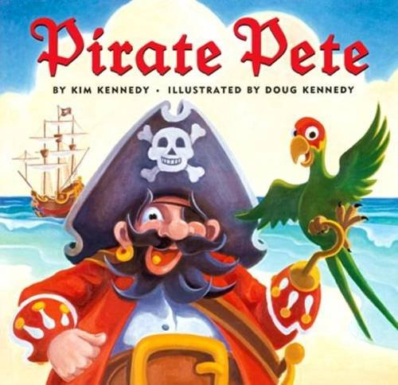
Our story is called Pirate Pete.
The next slides are the first pages.

Slide 5
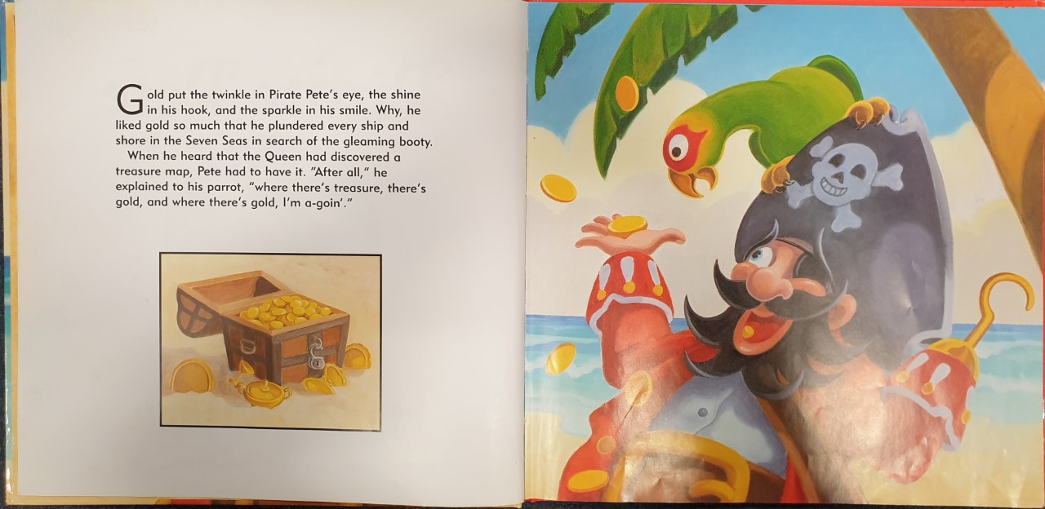

Slide 6
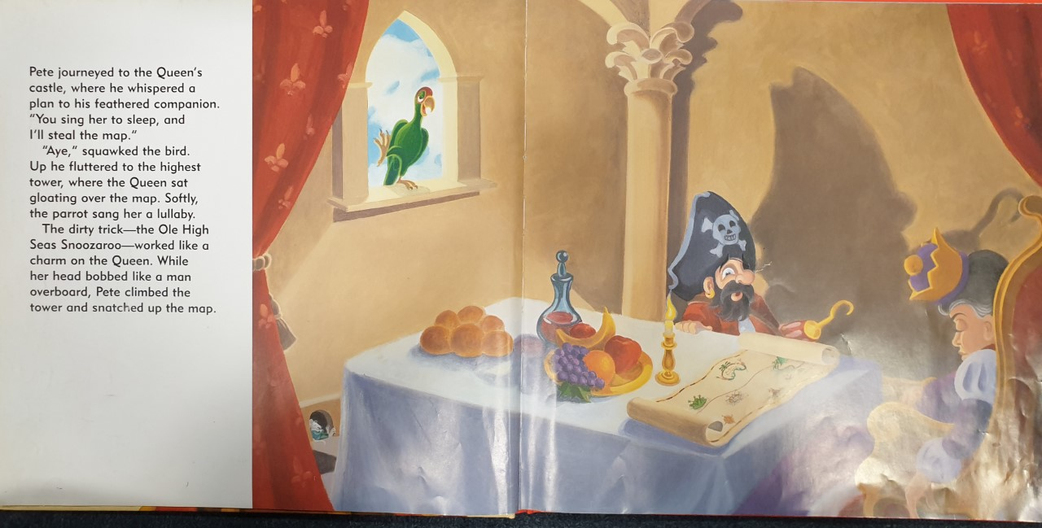

Slide 7
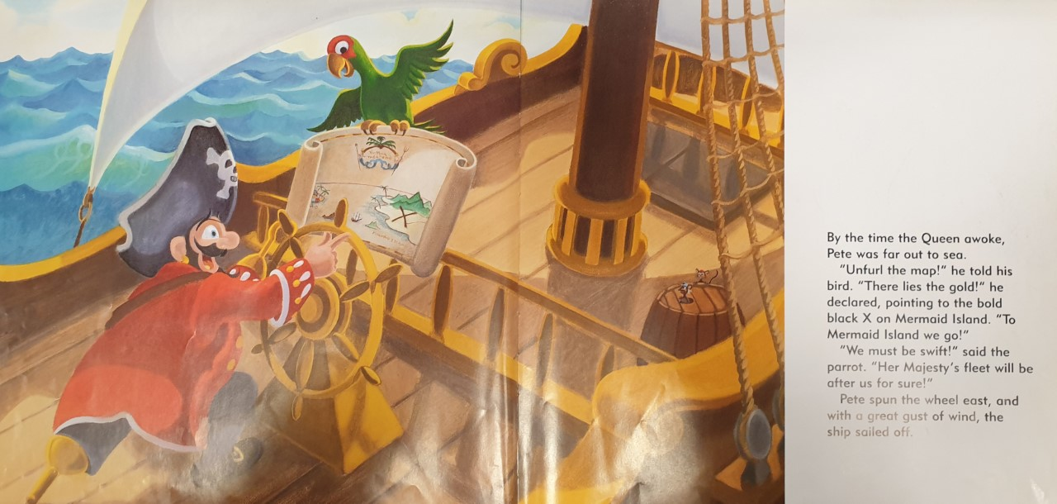

Slide 8
What kind of character do you think Pirate Pete is?
Why?
Task 1: Can you explain what has happened in the story so far then use BOB (but, or because)/BOYS(but, or, yet, so) sentences to explain your thinking about Pirate Pete?
Discuss this with someone first, then write at least 5 sentences. Include time conjunctions if possible.

Slide 9
Task: Write BOB/BOYS sentences to explain what has happened so far and what you think about Pirate Pete.
E.g. First of all, we know that Pirate Pete loves gold because he plundered every ship and shore in the Seven Seas. I think he must be a great pirate, but he is very greedy. Then, Pirate Pete created a plan to steal from the Queen, so he could steal even more booty.

