Slide 1
Monday 25th January
Drama

Slide 2
Year 2 – adding ing, er, ed, est and y to words of one syllable ending in a single consonant after a single vowel
patting
patted
humming
hummed
dropping
dropped
sadder
saddest
runner
runny
Year 1 –vowel digraph ur, ir
girl
bird
shirt
first
third
turn
hurt
church
burst
burn
Write a list of your spellings. Adult say 5 sentences with the first 5 spellings in. Child should write each sentence down.

Slide 3
Today we are learning to........ I am learning to rehearse a story. I am learning to act out a story. I am learning to retell a story.
I will be successful if ... I can remember parts of the story. I can retell the story in detail. I can answer question about the story. I can do freeze frames for parts of the story.

Slide 4
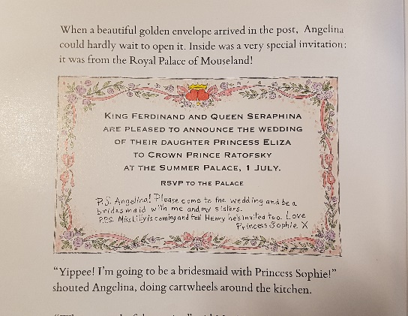
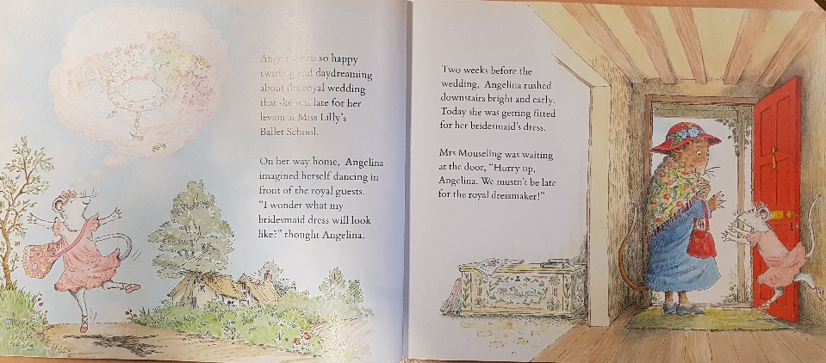
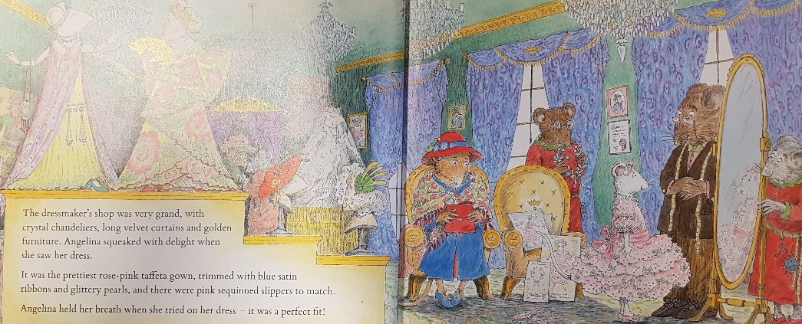
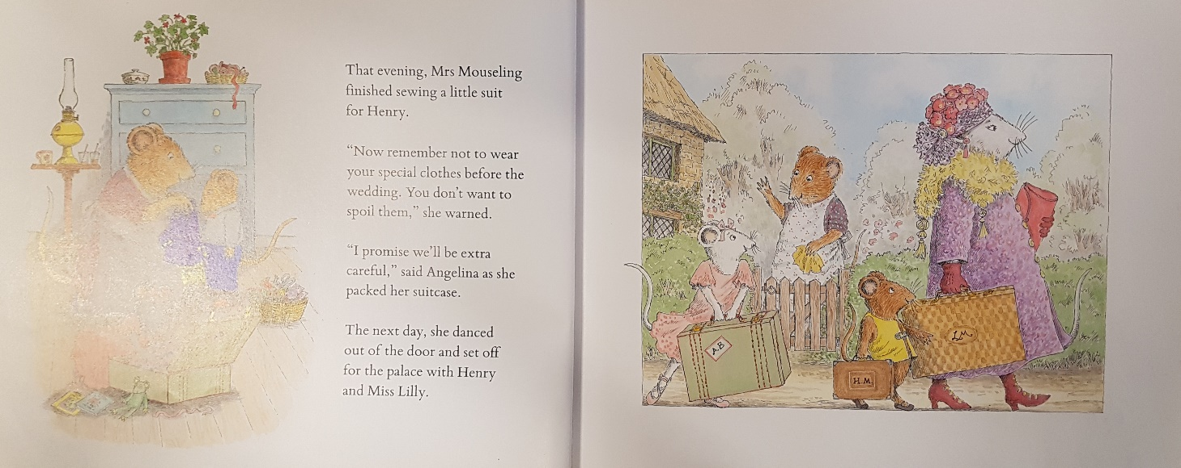
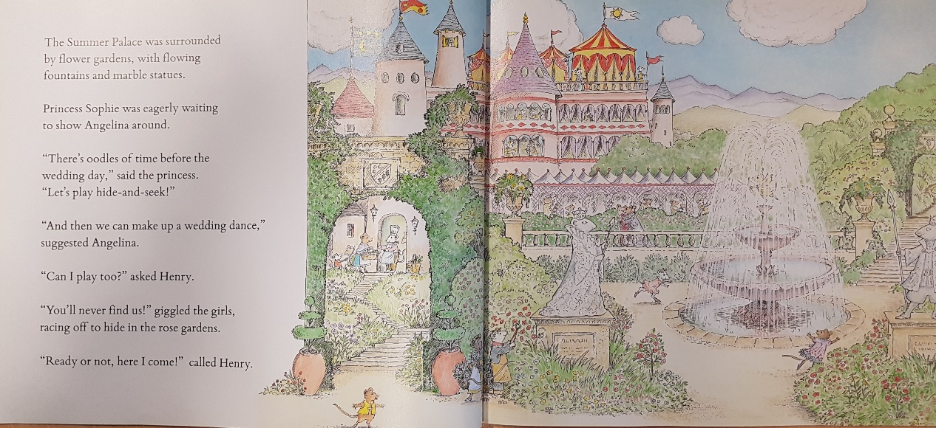
Retell the story using the pictures
Say at least a sentence aloud for each picture.

Slide 5
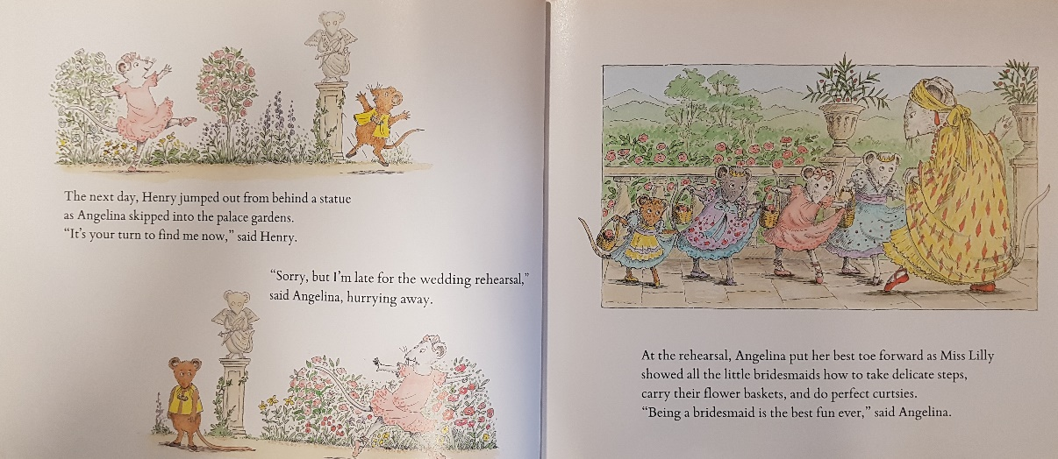
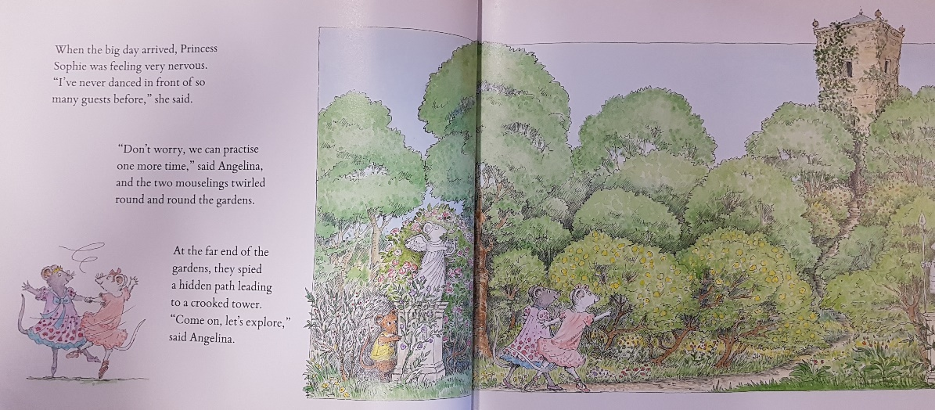
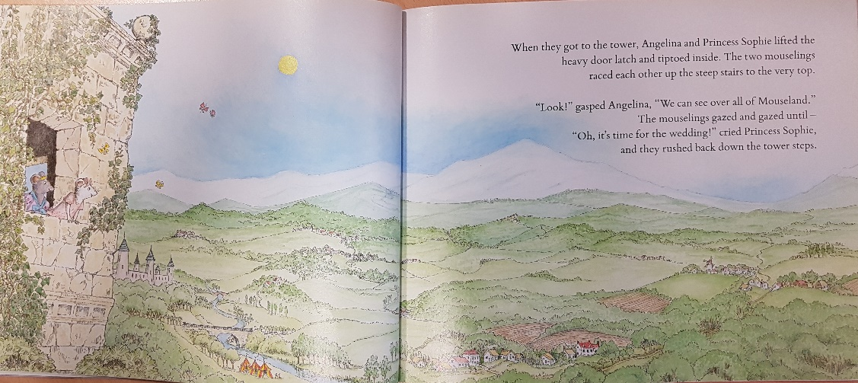
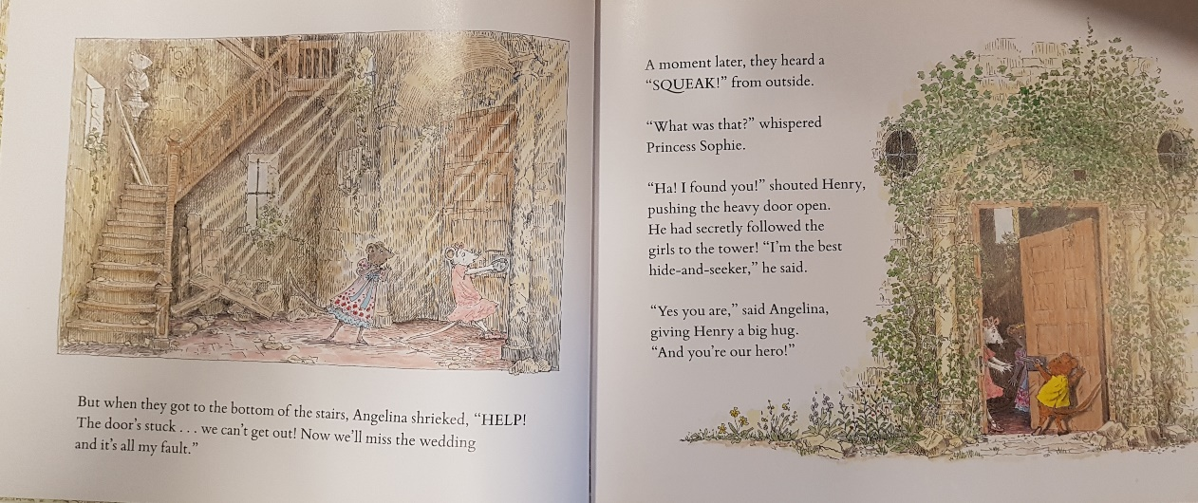
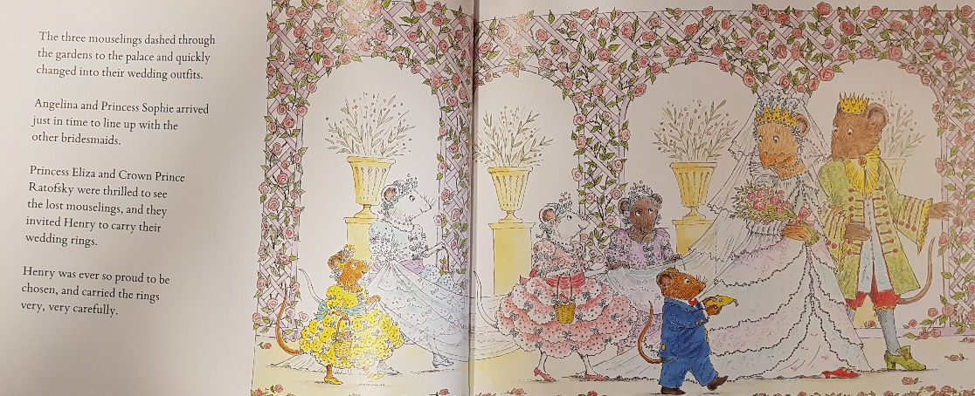
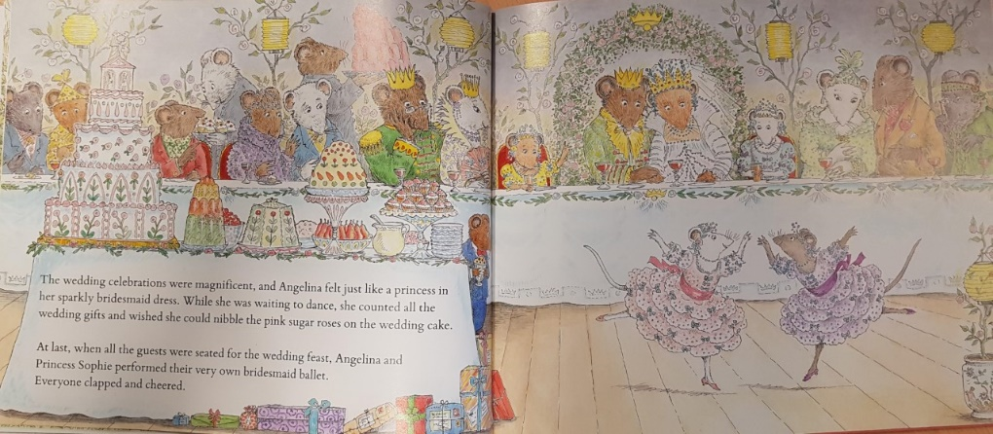
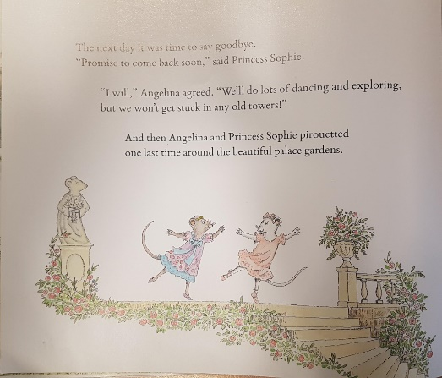

Slide 6
Freeze frames
Pick a character from each picture. Pose like them and freeze! Remember to think about your facial expression. Think about how they might be feeling and what they might be saying.

Slide 7

Freeze frames
Pick a character from each picture. Pose like them and freeze! Remember to think about your facial expression. Think about how they might be feeling and what they might be saying.

Slide 8

Freeze frames
Pick a character from each picture. Pose like them and freeze! Remember to think about your facial expression. Think about how they might be feeling and what they might be saying.

Slide 9
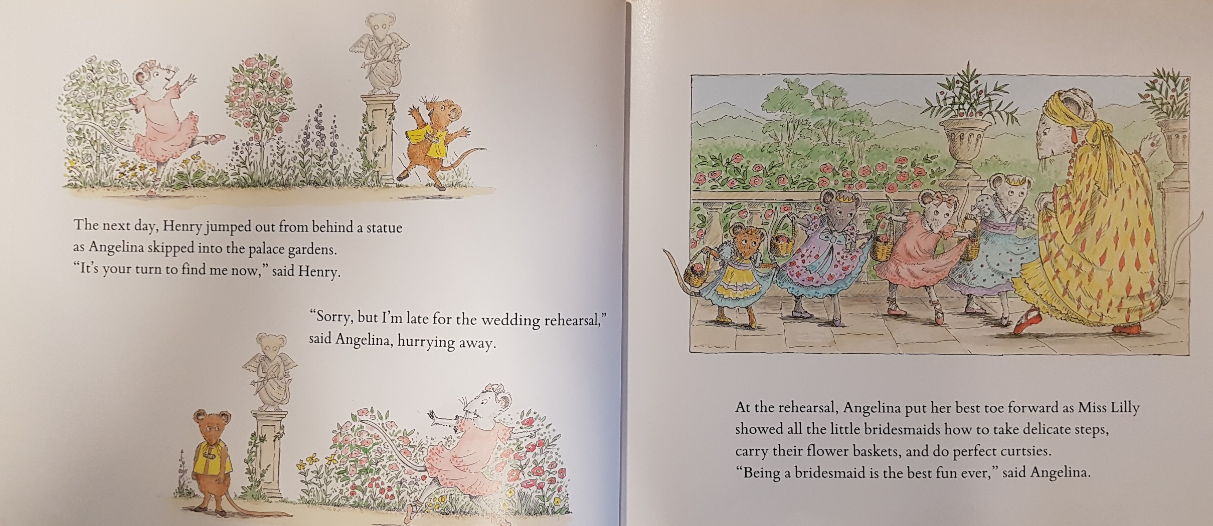
Freeze frames
Pick a character from each picture. Pose like them and freeze! Remember to think about your facial expression. Think about how they might be feeling and what they might be saying.

Slide 10

Freeze frames
Pick a character from each picture. Pose like them and freeze! Remember to think about your facial expression. Think about how they might be feeling and what they might be saying.

Slide 11
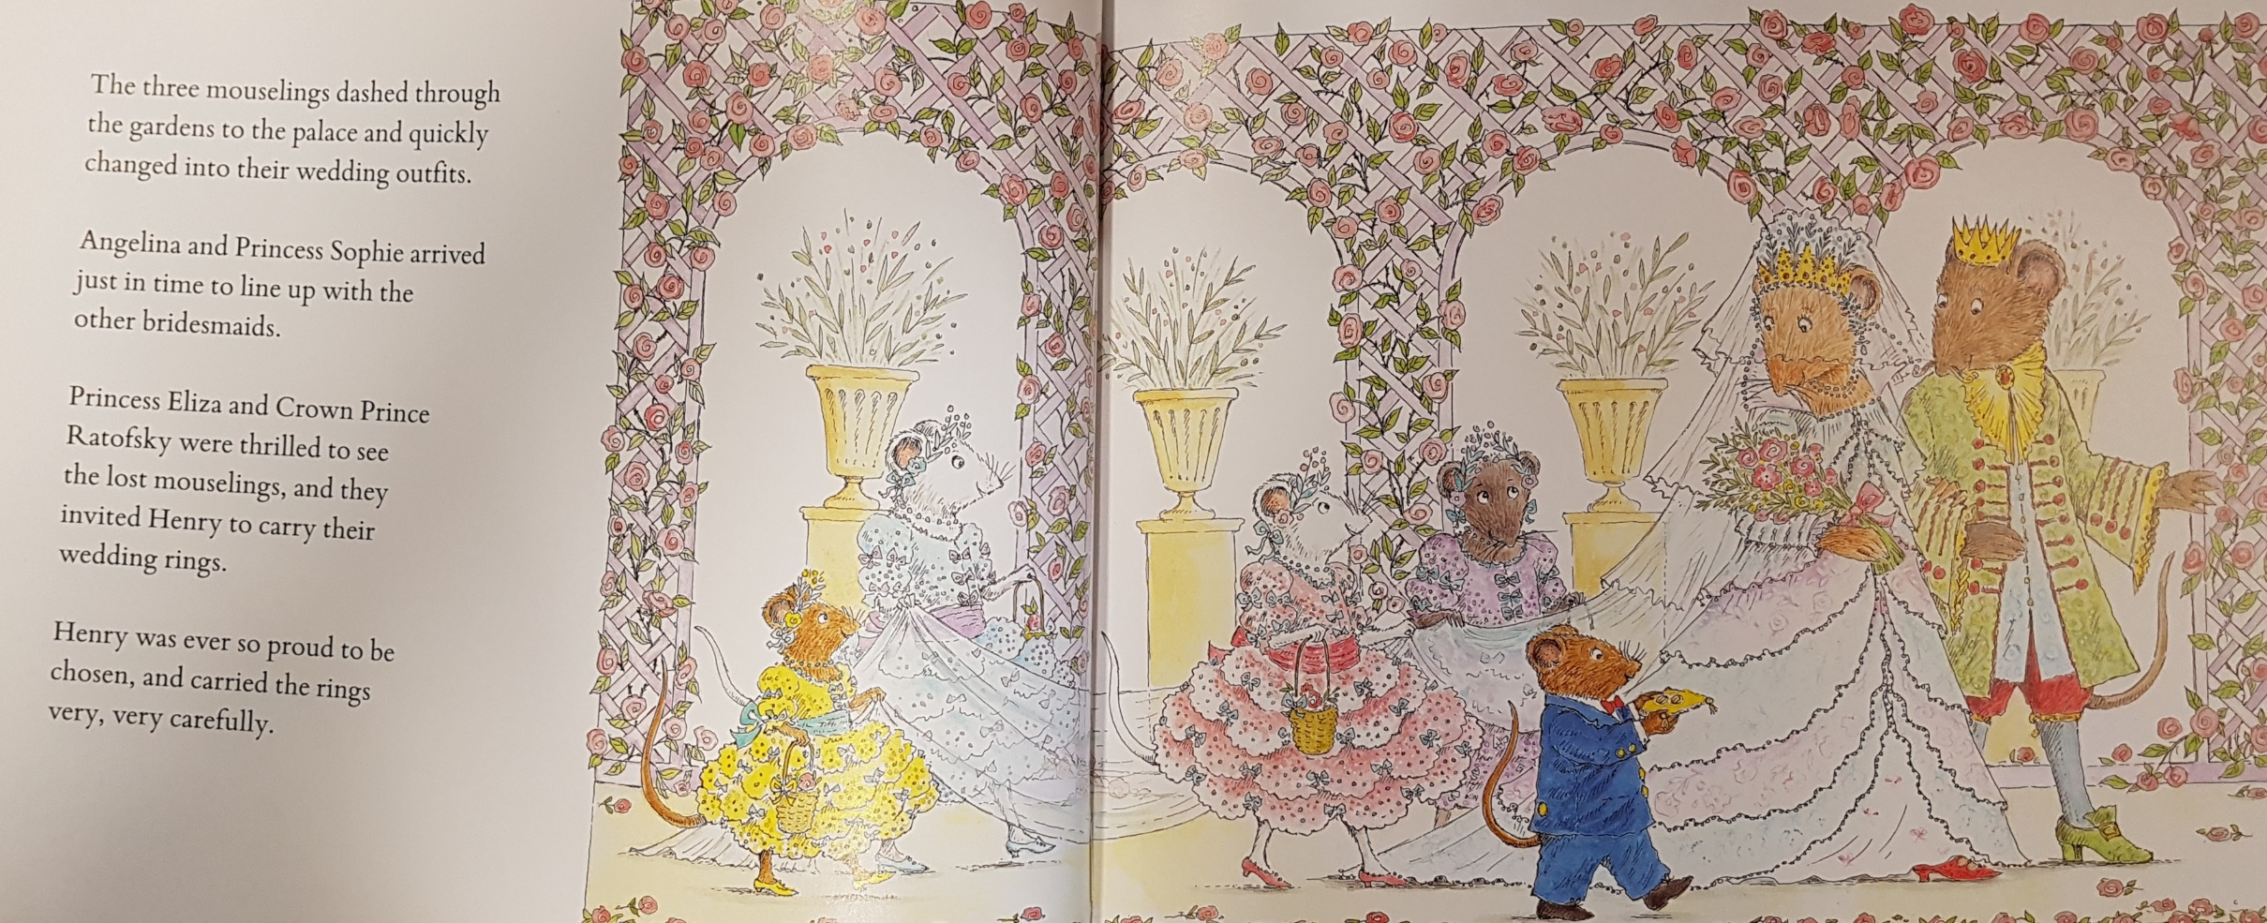
Freeze frames
Pick a character from each picture. Pose like them and freeze! Remember to think about your facial expression. Think about how they might be feeling and what they might be saying.

Slide 12
Select 2 or 3 pictures from the story. Act out the scene.
Remember that actors need super facial expressions.
Have some fun!

Slide 13
Write these word so you can spell them correctly when we write the story.
Angelina
invitation
wedding
palace
mouse
bridesmaid
Mrs Mouseling
dressmaker
garden
fountain
rehearsal
celebration

