Slide 1

Friday 26th February 2021
Writing

Slide 2
Year 1
The sound /k/ spelt with ‘k’ not ‘c’, before e, i and y
Kent
sketch
kit
skin
frisky
skill
risky
kettle
kilt
king
Year 2
The u sound spelt with o
other
mother
brother
nothing
Monday
money
cover
honey
discover
wonder
Spelling check- adult read out each word for child to write.

Slide 3
Today we are learning to:
I am learning to use speech marks/ inverted commas accurately.
I will be successful if:
My writing is beautiful and neat.

Slide 4
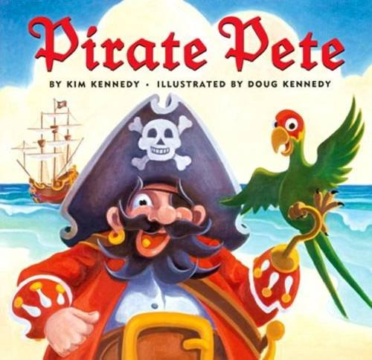
Our story is called Pirate Pete.
The next slides are the first pages.

Slide 5
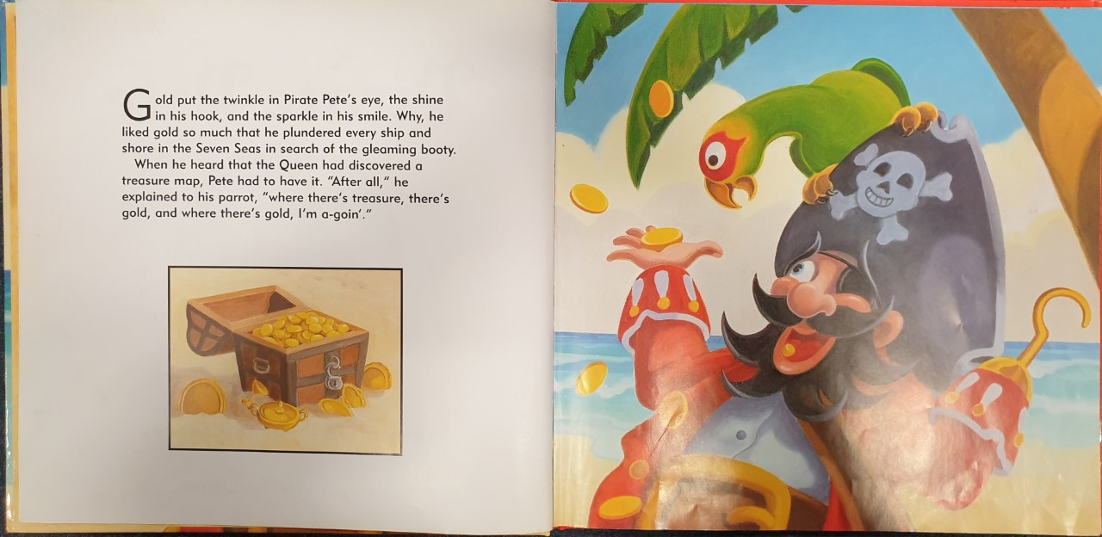

Slide 6
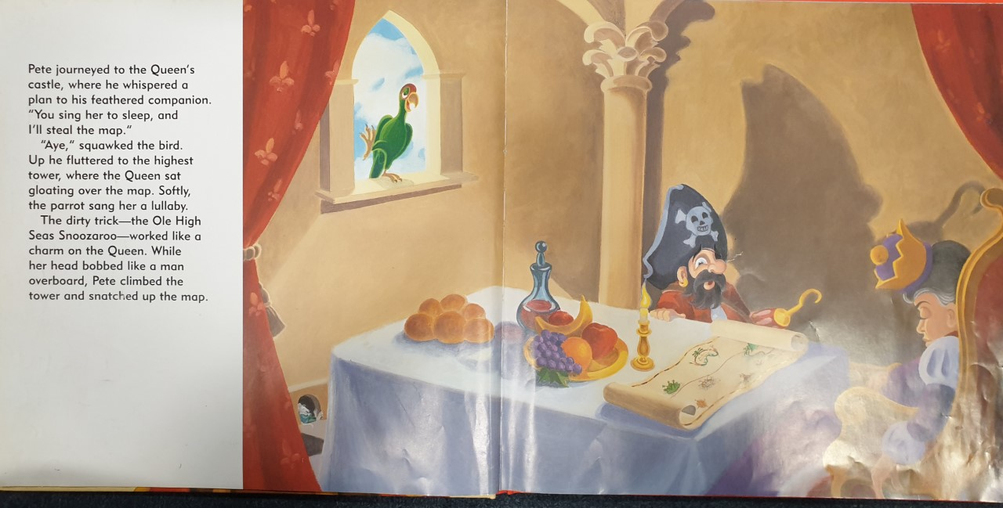

Slide 7
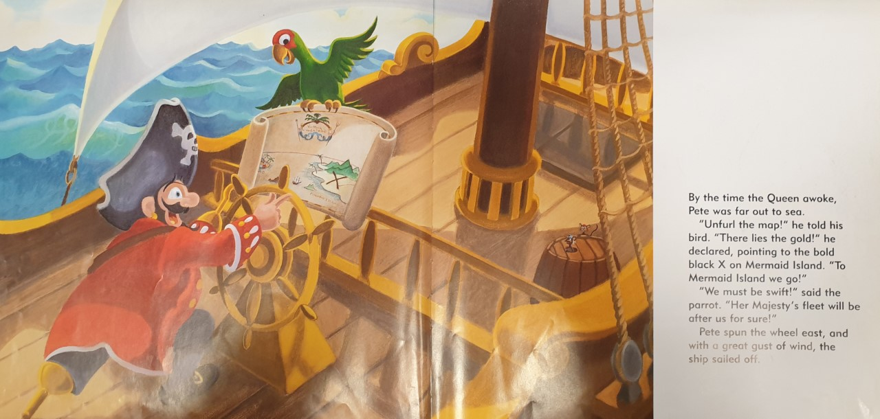

Slide 8
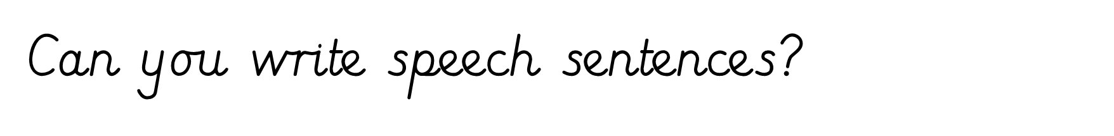
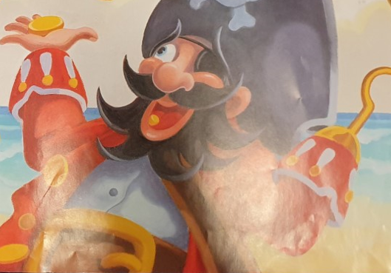
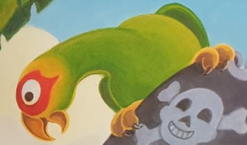
“My favourite thing in the world is beautiful, gleaming gold. Wouldn’t it be great to find some?” exclaimed Pirate Pete.
“Aye. That would be fantastic and I would love some tasty food,” squawked the small, green bird.

