Slide 1
Friday 29th January
Apostrophes for possession

Slide 2
Year 2 – adding ing, er, ed, est and y to words of one syllable ending in a single consonant after a single vowel
patting
patted
humming
hummed
dropping
dropped
sadder
saddest
runner
runny
Year 1 –vowel digraph ur, ir
girl
bird
shirt
first
third
turn
hurt
church
burst
burn
Check you know the spellings. Ask someone to read each spelling and you write each one down.

Slide 3
Today we are learning to........ I am learning to recognise apostrophes. I am learning to use apostrophes for possession.
I will be successful if ... I can recognise apostrophes I can say what an apostrophe is used for. I can use apostrophes for possession.

Slide 4
An apostrophe looks like this:
Adam’s bike is red.
We use apostrophes for possession.

Slide 5
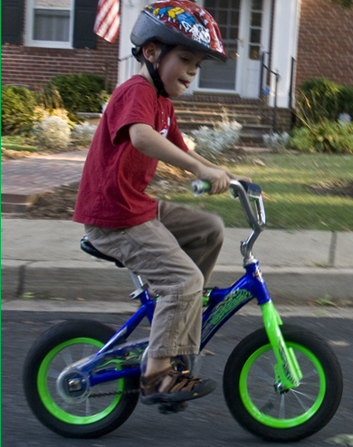
Showing Possession
Apostrophes can be used to show that something belongs to someone or something. This is called possession.
When we are talking about one thing we call this singular.
For example, a boy or a bike.
When we need to say that something belongs to something singular, we put an apostrophe and then an ‘s’ at the end of the name that it belongs to.
Photo courtesy of woodleywonderworks (@flickr.com) - granted under creative commons licence - attribution

Slide 6
For example
Person: The boy’s bike.
Common noun: The bike’s handlebars were bent in the crash.
Proper Noun: India’s national flag has three horizontal stripes.
Photo courtesy of woodleywonderworks (@flickr.com) - granted under creative commons licence - attribution

Slide 7
If the noun is singular and ends in -s, add -'s, as in the following examples:
My boss's job disappeared due to budget cuts.
The class's average score was impressive.
Robert Burns's poetry is difficult to understand.
Charles Dickens's novels are many and varied.

Slide 8

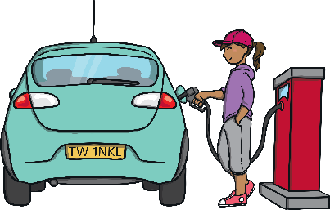
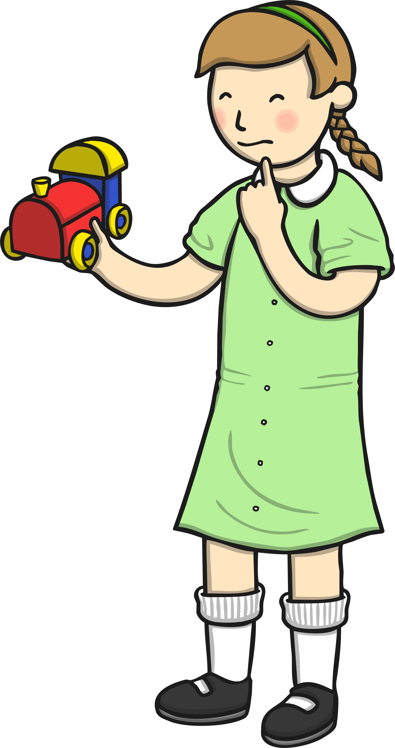
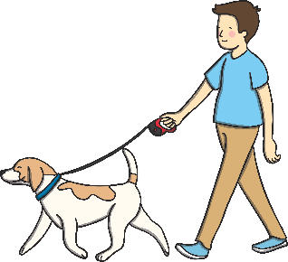

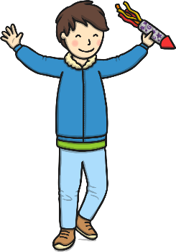
Can you write a sentence to describe each picture using an apostrophe to show possession?
Nadia
Rachel
Clara
E.g. This is Nadia’s radio.
This is
This is
Owen
Kaylee
Malik

Slide 9
Task 2:
Complete the apostrophe sheet
(Year 2 only)

