Slide 1

Wednesday 3rd February
Non-chronological report

Slide 2
Year 1 Spellings – Adding –er and –est to adjectives where no change is needed to the root word
grander
grandest
fresher
freshest
quicker
quickest
taller
tallest
slower
slowest
Year 2 Spellings – the or sound spelt a before l or ll
all
ball
call
walk
talk
always
small
wall
fall
altogether
Look, cover, say, write and check.

Slide 3
Today we are learning to... I am learning to read and write facts. I am learning to create a non-chronological report.
I will be successful if ... I can think of an interesting title. I can spell key words correctly. I can use capital letters for the start of a sentence and for proper nouns. I can use finger spaces and full stops. I can use conjunctions.

Slide 4
This week we are creating a booklet about Queen Elizabeth II
Each day we will complete a different section of our fact file.
Today we are going to write facts about the tasks that the Queen does as part of her role.
On Thursday we will write about the Queen’s family.
On Friday we will create a contents page and back cover.
You can add in extra pages over the week if you wish.

Slide 5
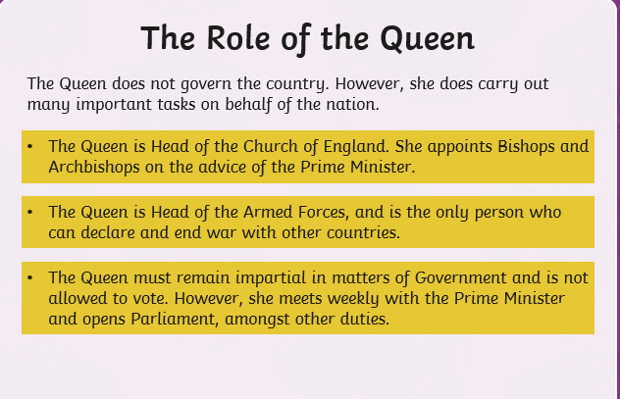
Task:
Create a page about the Queen’s role.
In order to do this, we must know some facts, please use the PowerPoint provided and the internet to support you with this.

Slide 6
The role of the Queen
Here is an example:
The Queen leads a very busy life. Each year she makes hundreds of official visits. She has meetings with the British Prime Minister and with leaders from other countries. Every day she is sent important news which tells her what the government is doing.
The Queen does not govern the country. However, she does carry out many important tasks on behalf of the nation.
The Queen is Head of the Church of England. She appoints Bishops and Archbishops on the advice of the Prime Minister.
The Queen is Head of the Armed Forces, and is the only person who can declare and end war with other countries.
The Queen must remain impartial in matters of Government and is not allowed to vote. However, she meets weekly with the Prime Minister and opens Parliament, amongst other duties.

