Slide 1
Wednesday 3rd March 2021
Writing

Slide 2
Year 1 - The split vowel
digraphs ‘a-e’ and ‘e-e’
made
came
same
take
safe
date
lake
these
theme
complete
Year 2 - the ee sound spelt ey
key
donkey
monkey
chimney
valley
trolley
turkey
hockey
parsley
journey
Can you practise your spelling for 5 minutes? Look at how many letters are in each word. Write a list of all 10 spellings.
Write the last 5 words in sentences.

Slide 3
Today we are learning to:
I am learning to use speech marks/ inverted commas accurately.
I will be successful if:
My writing is beautiful and neat.
I can start a new line for a new speaker.
I remember to put an inverted comma before the character talks.
I end what the character is saying with inverted commas.
I can use interesting synonyms for ‘said’.
I spell key words correctly.

Slide 4
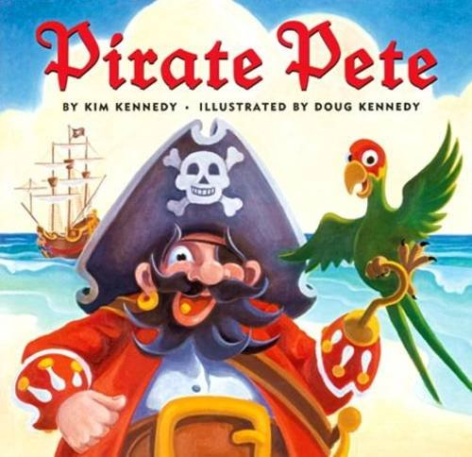
What have we found out so far in the story?
Who are the main characters?
Where have they visited?

Slide 5
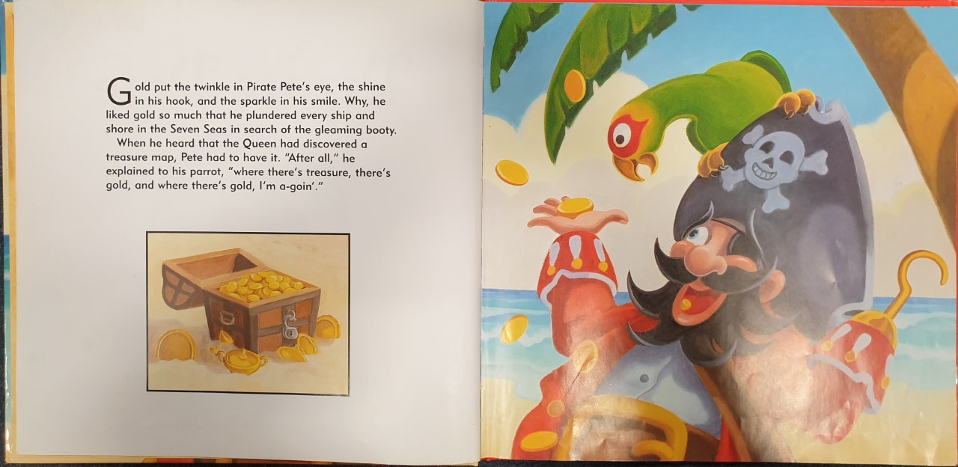

Slide 6
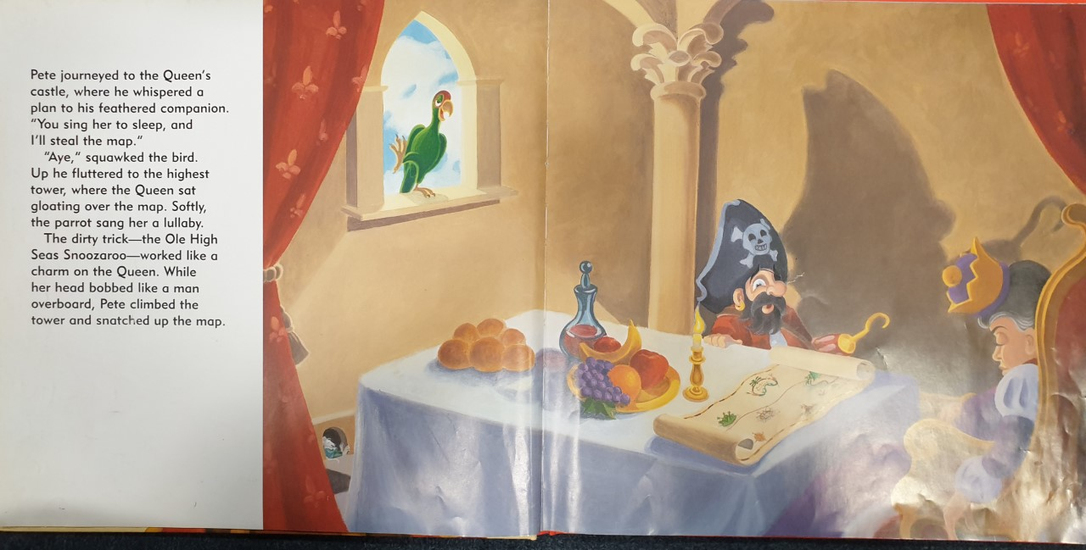

Slide 7
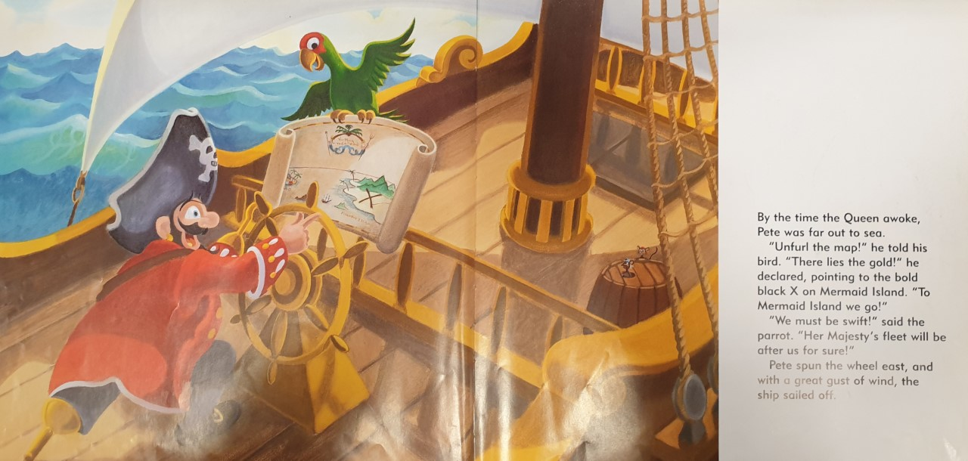

Slide 8
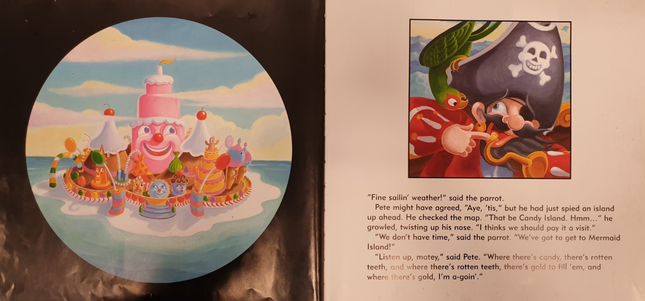

Slide 9
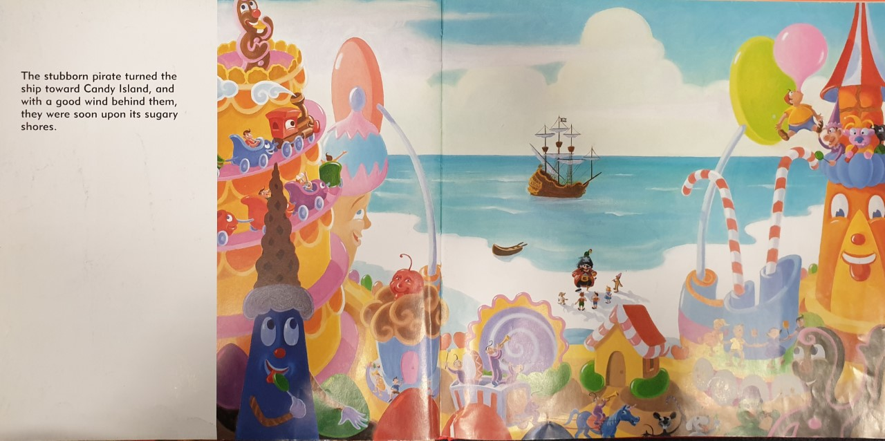

Slide 10
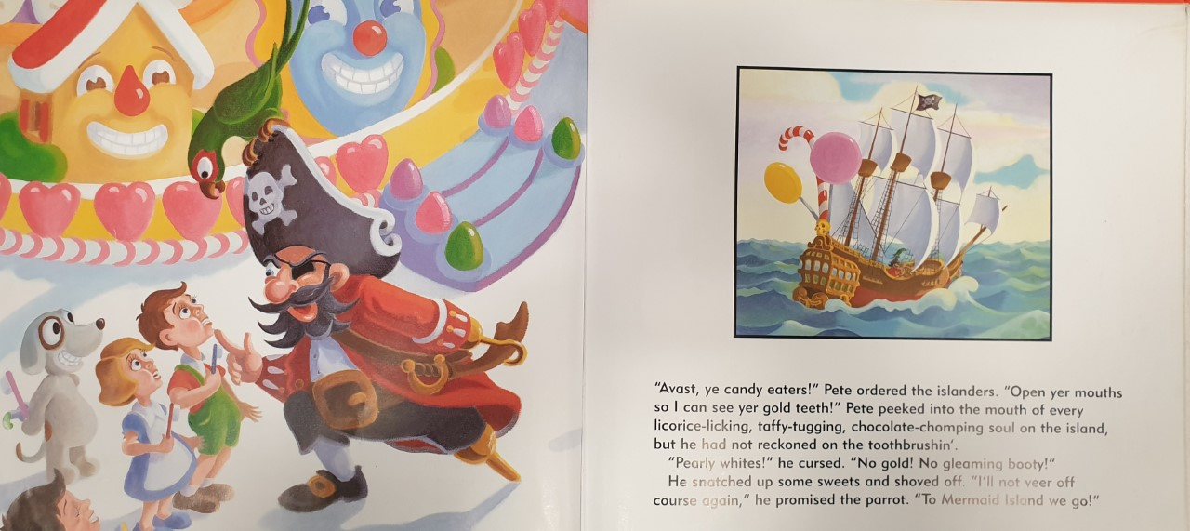

Slide 11
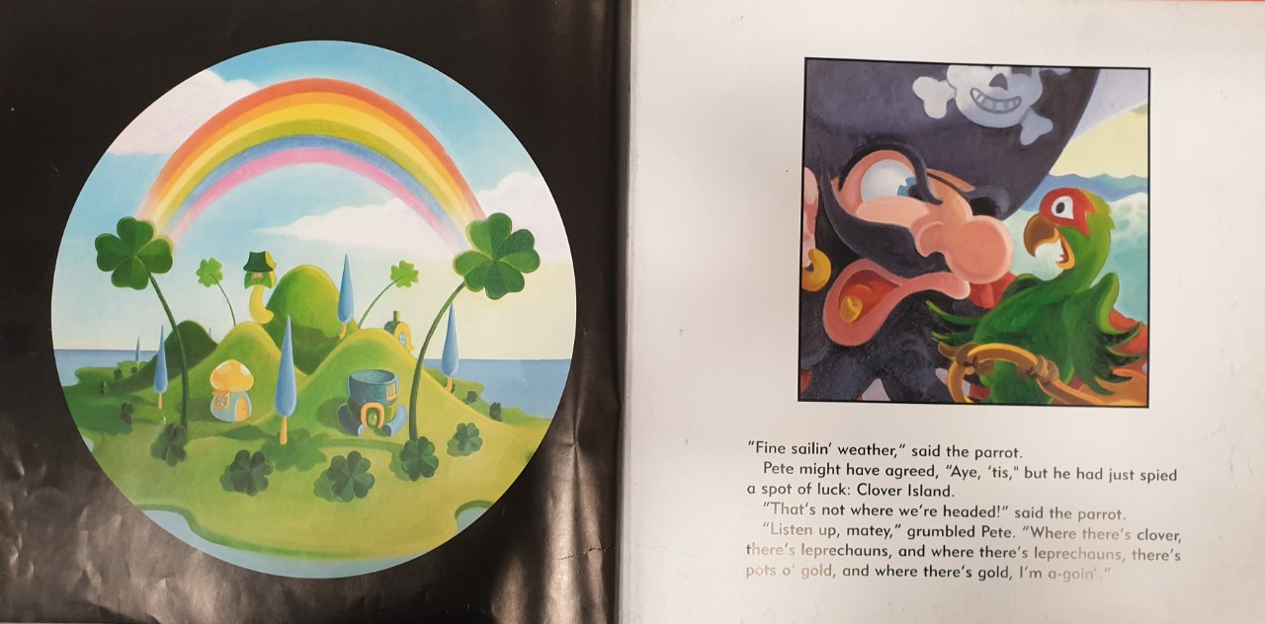
What could Pirate Pete be saying to his parrot? How do you think he feels?

Slide 12
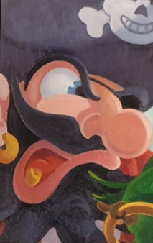

Task: Write speech sentences. Write a conversation between the characters. Each character should respond at least two times.
“ I can see a lush, green island and I bet that it is full of precious, golden booty. We are heading there now” roared Pirate Pete.
“ You said we wouldn’t veer off course again, Captain. Do you think that is a good idea?” squeaked the concerned, little bird.
I will be successful if:
My writing is beautiful and neat.
I can start a new line for a new speaker.
I remember to put an inverted comma before the character talks.
I end what the character is saying with inverted commas.
I can use interesting synonyms for ‘said’.
I spell key words correctly.

