Slide 1
Thursday 4th March 2021
Writing

Slide 2
Year 1 - The split vowel
digraphs ‘a-e’ and ‘e-e’
made, mayd
caim, came
same, saim
take, taik
sayf, safe
date, dait
lake, layk
these, thees
theem, theme
complete, compleet
Year 2 - the ee sound spelt ey
cey, key, kee
donkey, donkee, doncey
mukey, monkee, monkey
chimney, chimnee, chiney
valee, valey, valley
trolly, trolee, trolley
turkey, turcey, turkee
hockee, hocky, hockey
pasley, parsley, parsly
journey, journee, jorney
Which spelling looks correct? Write a list of the ten correct spellings.

Slide 3
Today we are learning to:
I am learning to create my own island.
I will be successful if:
I draw a detailed picture.
I write beautiful and neat using whooshes and flicks/joined up
I write a list of the things that you could:
1. see
2. hear
3. smell
4. touch
5. taste

Slide 4
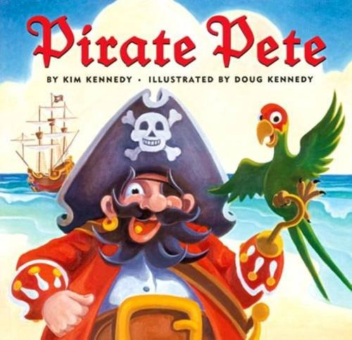
What have we found out so far in the story?
Who are the main characters?
Where have they visited?

Slide 5
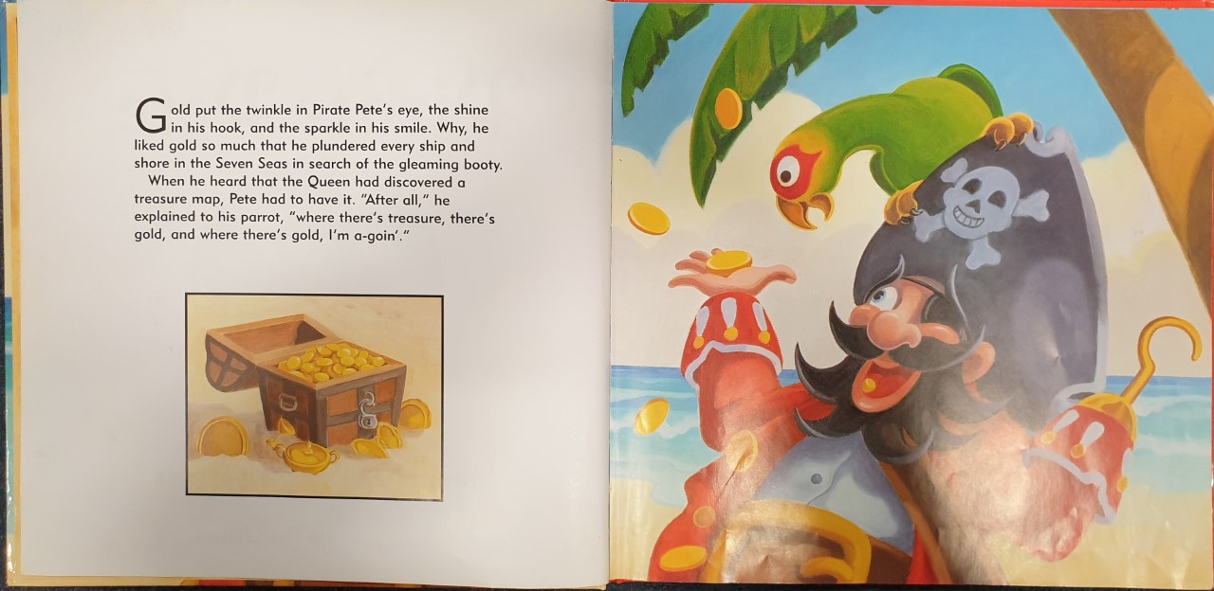

Slide 6
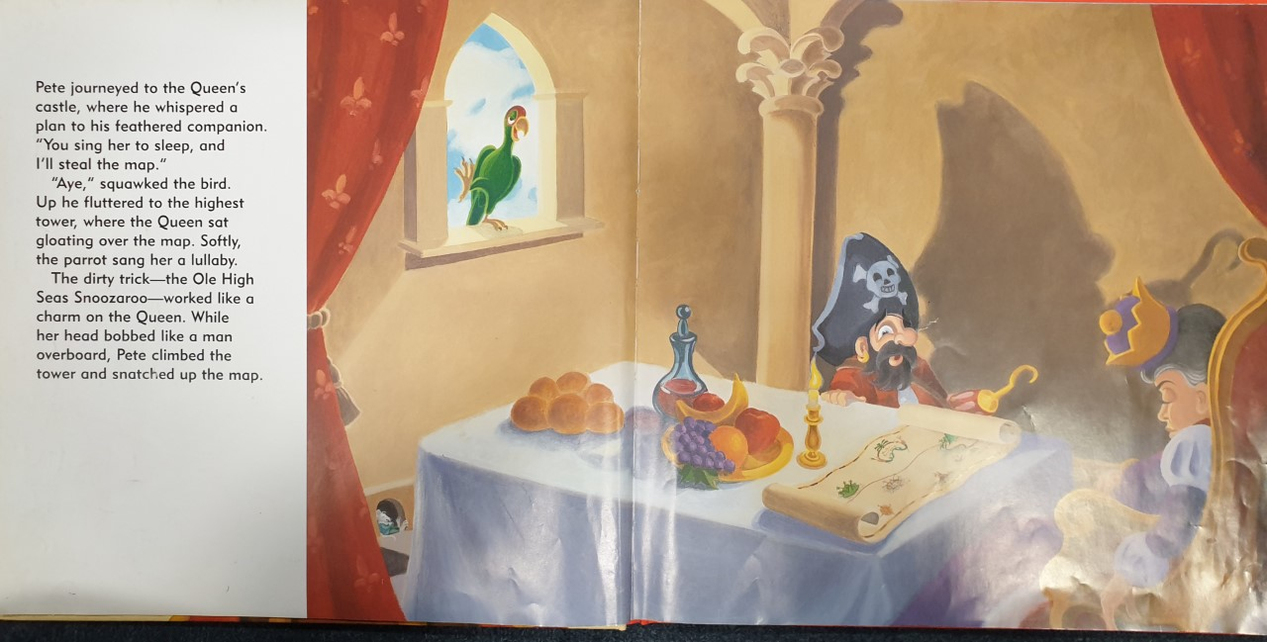

Slide 7
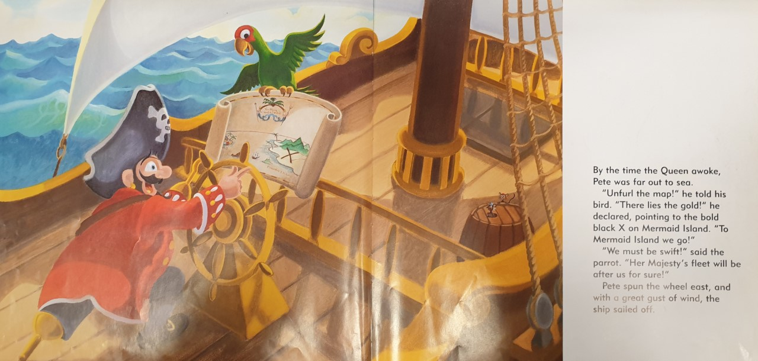

Slide 8
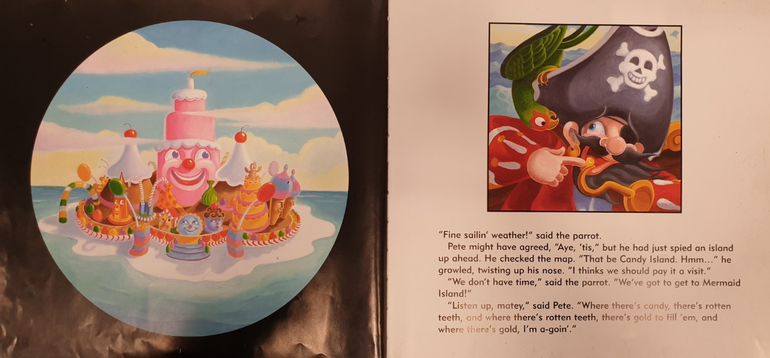

Slide 9
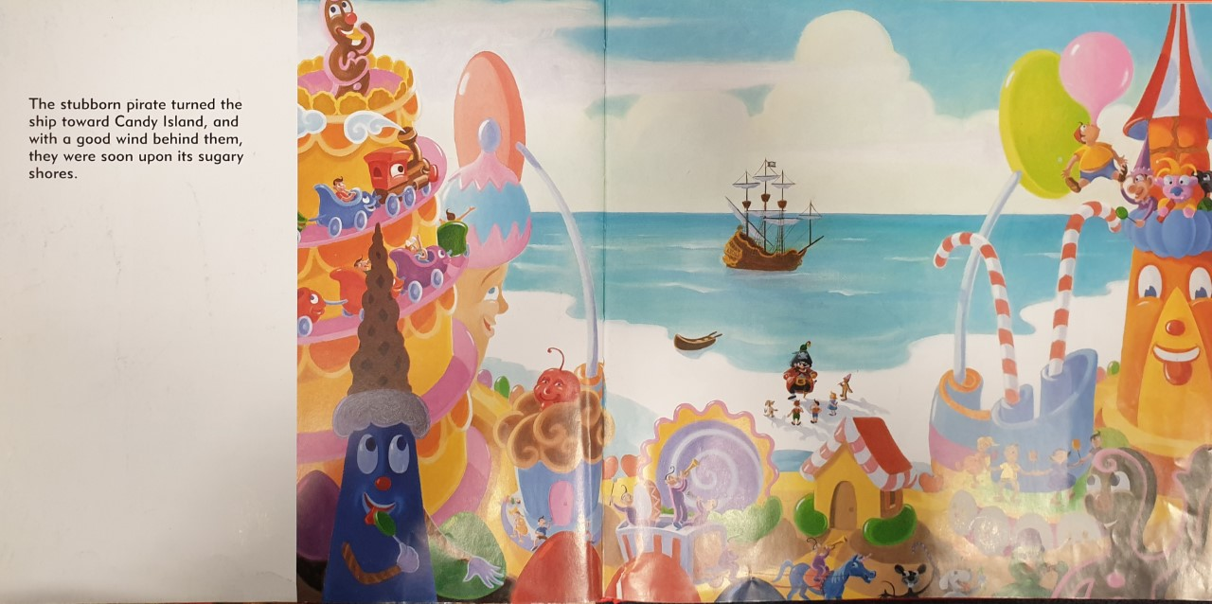

Slide 10
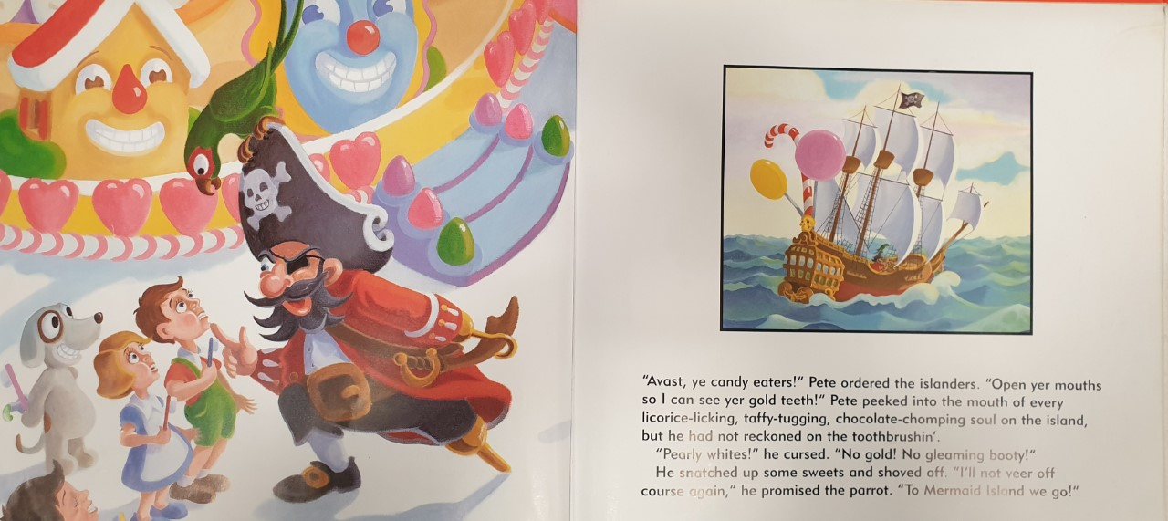

Slide 11
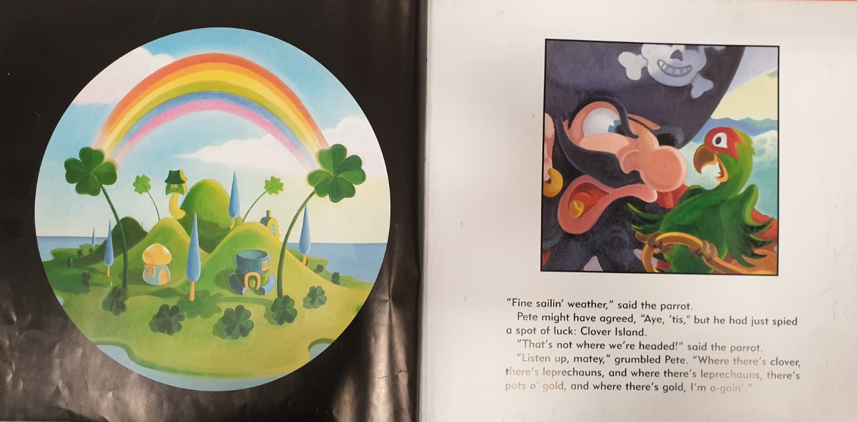

Slide 12
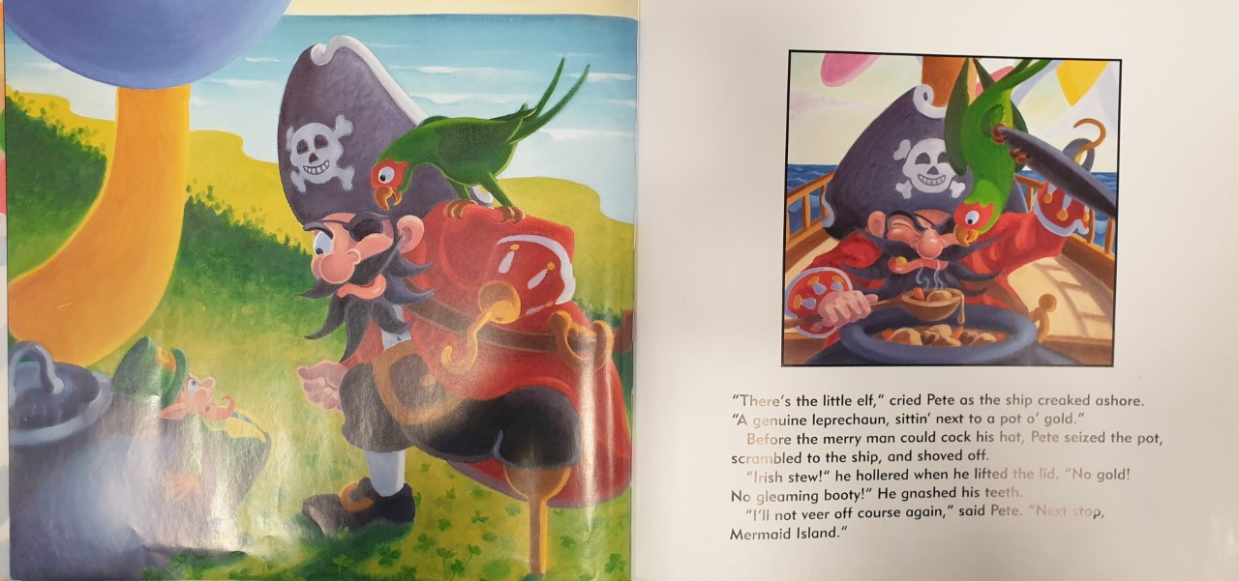

Slide 13
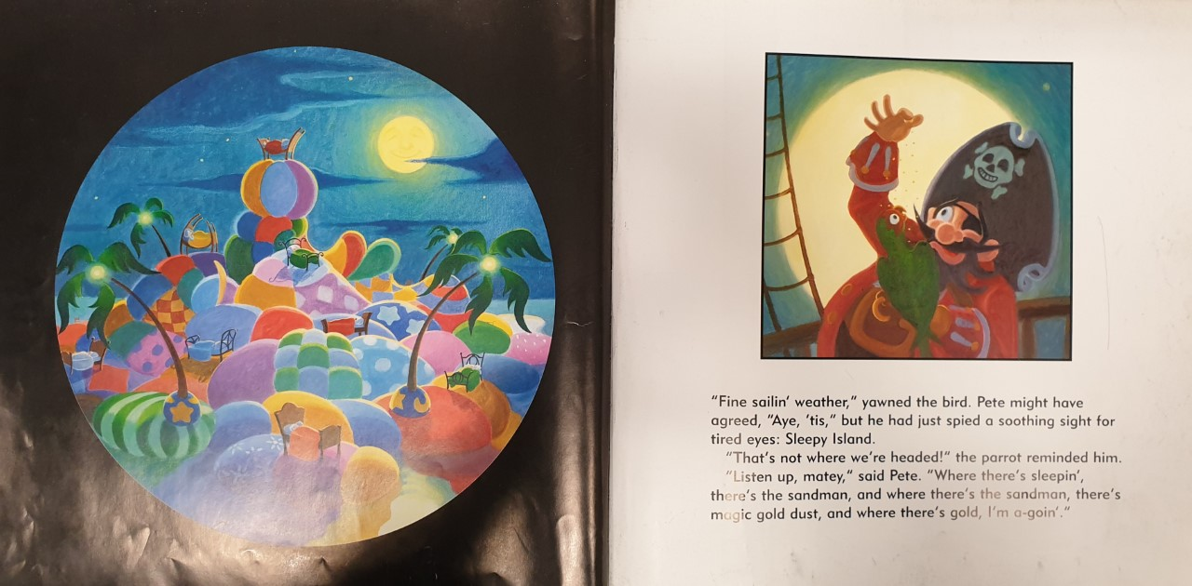

Slide 14
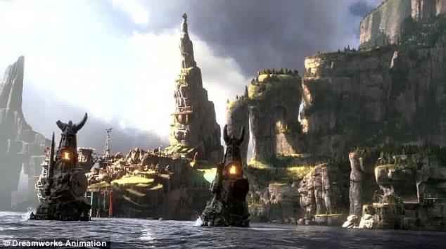
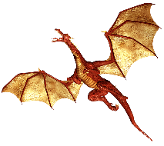
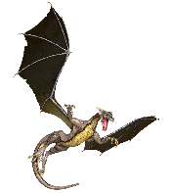
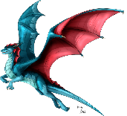
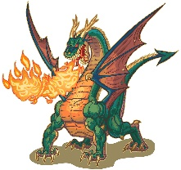
Task 1: Draw the island that you think Pirate Pete will visit after Sleepy Island. Use your imagination.
Example

Slide 15
Task 2:
Write a list of the things that you could:
1. see
2. hear
3. smell
4. touch
5. taste
You can smell:
fire
Example
You can see:
massive, terrifying dragons
steep, enormous cliffs
evil, strange statues
You can hear:
rocks tumbling
squeals of dragons
a colossal, impenetrable army banging on their armour

