Slide 1
Friday 5th February
Non-chronological report

Slide 2
Year 1 Spellings – Adding –er and –est to adjectives where no change is needed to the root word
grander
grandest
fresher
freshest
quicker
quickest
taller
tallest
slower
slowest
Year 2 Spellings – the or sound spelt a before l or ll
all
ball
call
walk
talk
always
small
wall
fall
altogether
Check you know the spellings. Ask someone to read each spelling and you write each one down.

Slide 3
Today we are learning to... I am learning to read and write facts. I am learning to create a non-chronological report.
I will be successful if ... I can think of an interesting title. I can spell key words correctly. I can use capital letters for the start of a sentence and for proper nouns. I can use finger spaces and full stops. I can use conjunctions.

Slide 4
This week we are creating a booklet about Queen Elizabeth II
Today we are going to create a contents page and back cover.

Slide 5
Task: Create a contents and back page. If you have not completed a different page or you would like to add a different page then please do that.

Slide 6
Contents Introduction Page 2 Childhood Page 3 Early Life Page 4 The Royal Family Page 5
Here is an example:

Slide 7
Back page
On the back page you need to create a blurb. This is a little teaser to try and get the reader interested.
You need to mention what facts they may find out if they read the fact file.

Slide 8
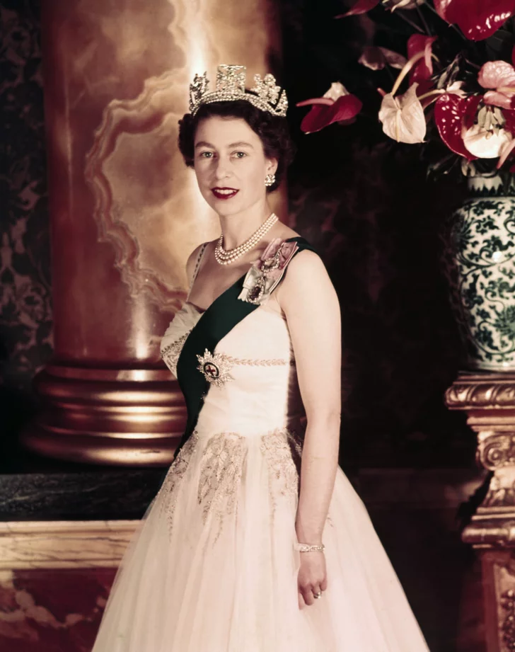
Do you love finding out about he queen?
You will find out about Queen Elizabeth II’s childhood, role as the Queen and the Royal Family.

