Slide 1
Friday 5th March 2021
Writing

Slide 2
Year 1 - The split vowel
digraphs ‘a-e’ and ‘e-e’
made
came
same
take
safe
date
lake
these
theme
complete
Year 2 - the ee sound spelt ey
key
donkey
monkey
chimney
valley
trolley
turkey
hockey
parsley
journey
Spelling check

Slide 3
Today we are learning to:
I am learning to use a range of interesting adjectives
I am learning to write 2A sentences with a comma
I will be successful if:
Discuss what the setting looks like
I use 2 amazing adjectives for each 2A sentence
I remember the comma to separate the adjectives
I remember to use all the line. It is not a list, so you do not need to start a new line for each 2A sentence
I start my sentences in different ways
I check that I have written a full sentence
My writing is beautiful and neat

Slide 4
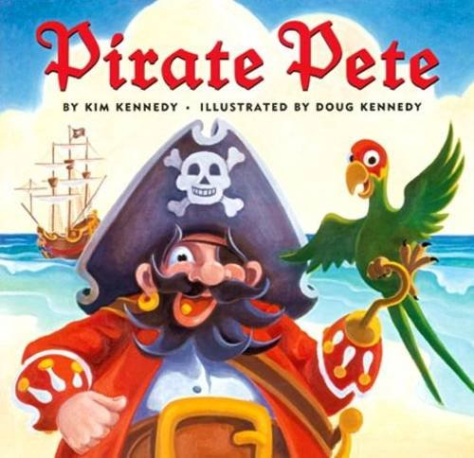
Our story is called Pirate Pete.
What kind of character do you think he might be? Why?

Slide 5
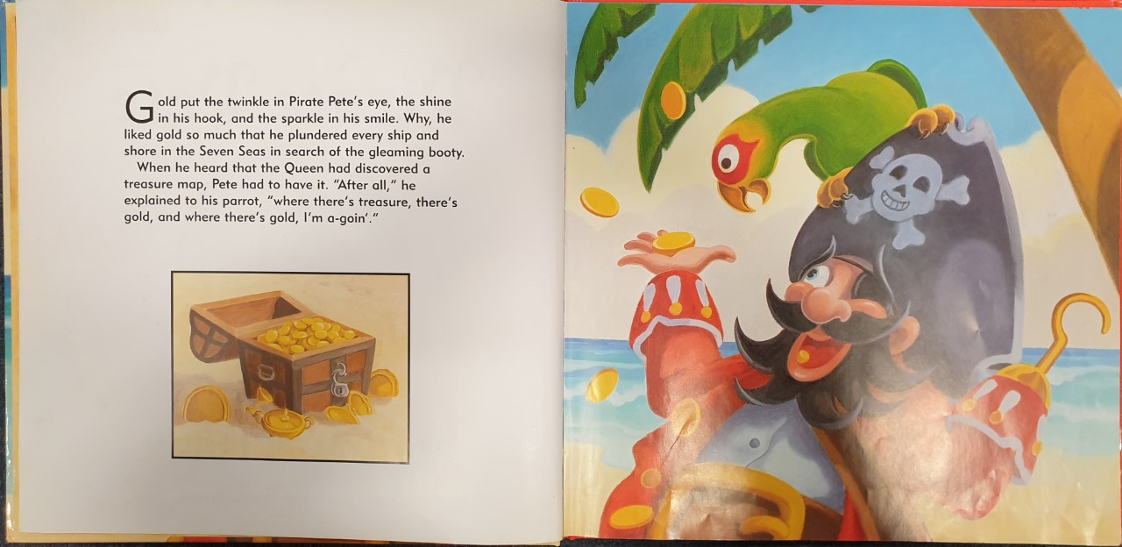

Slide 6
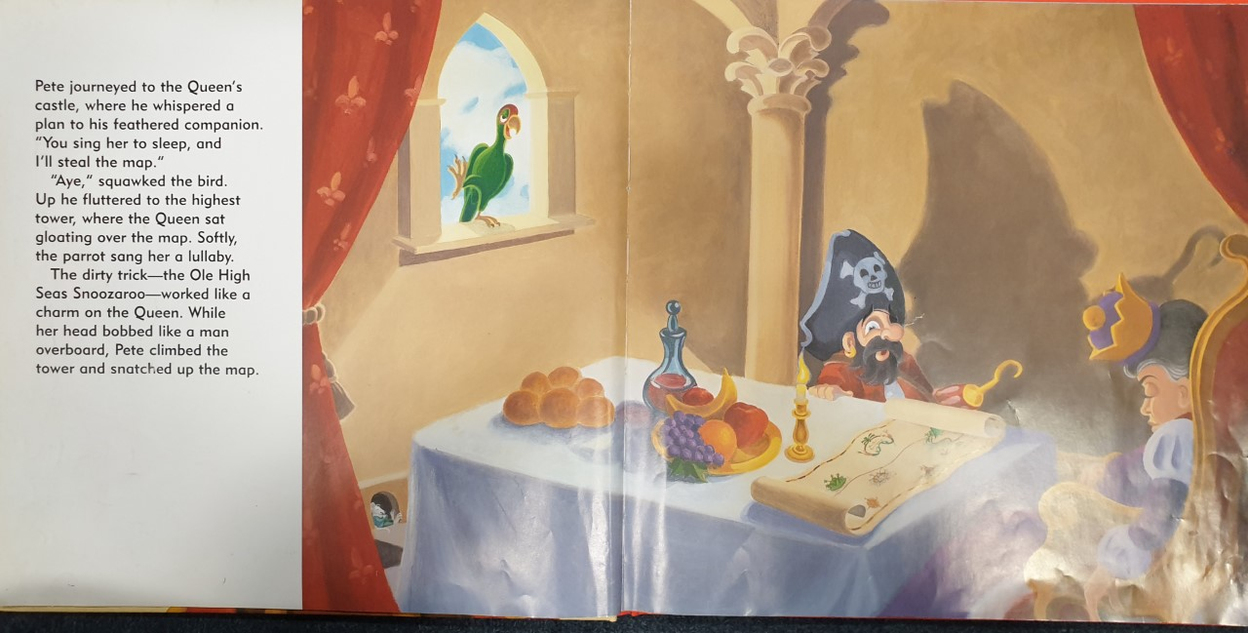

Slide 7
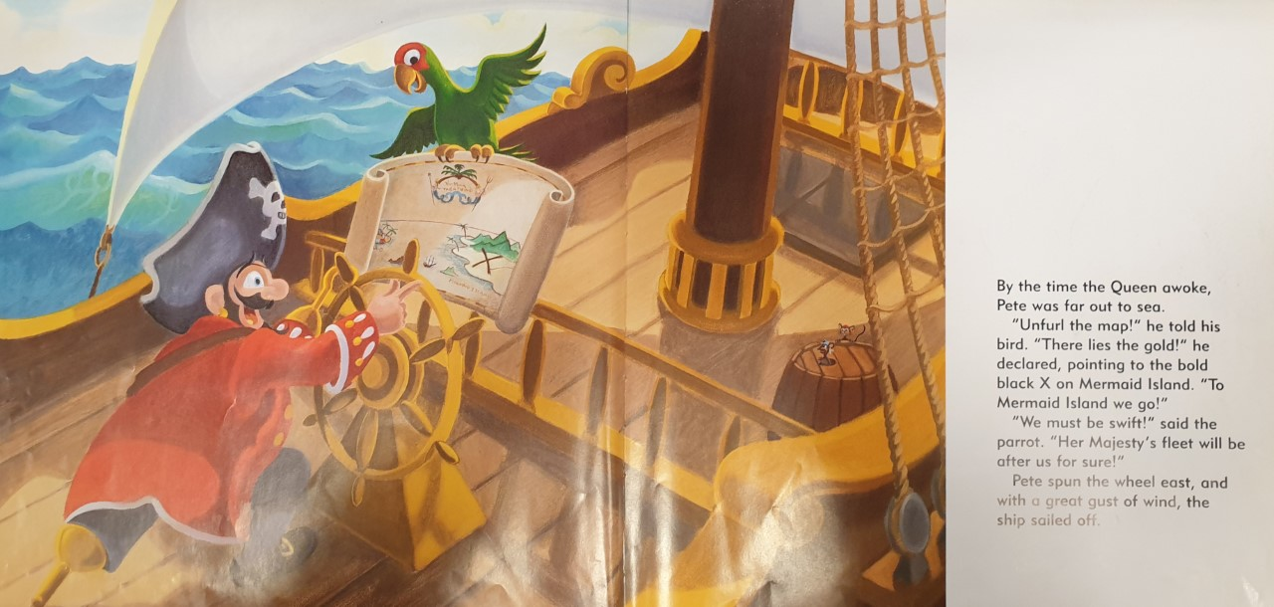

Slide 8
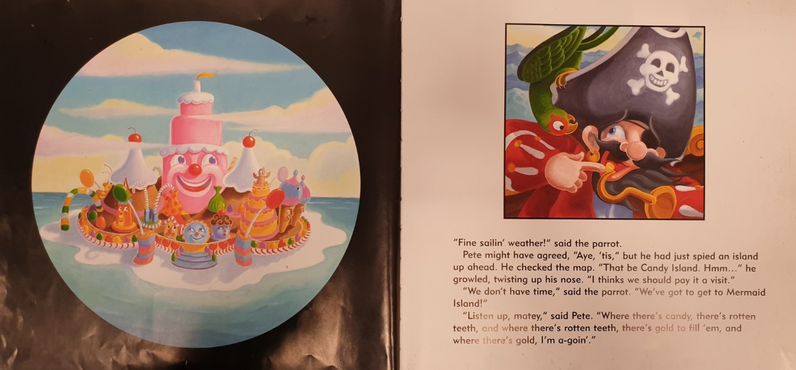

Slide 9
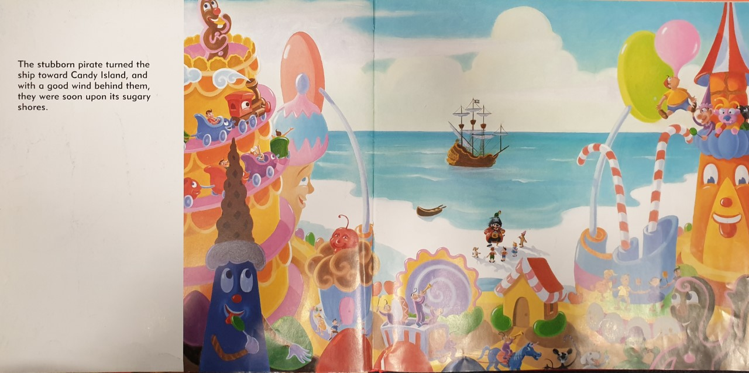

Slide 10
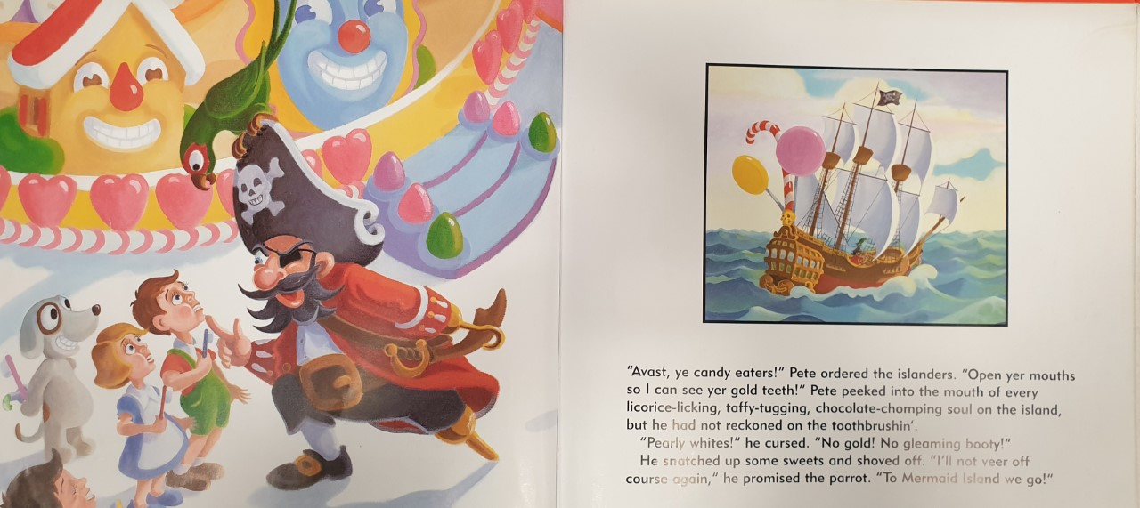

Slide 11
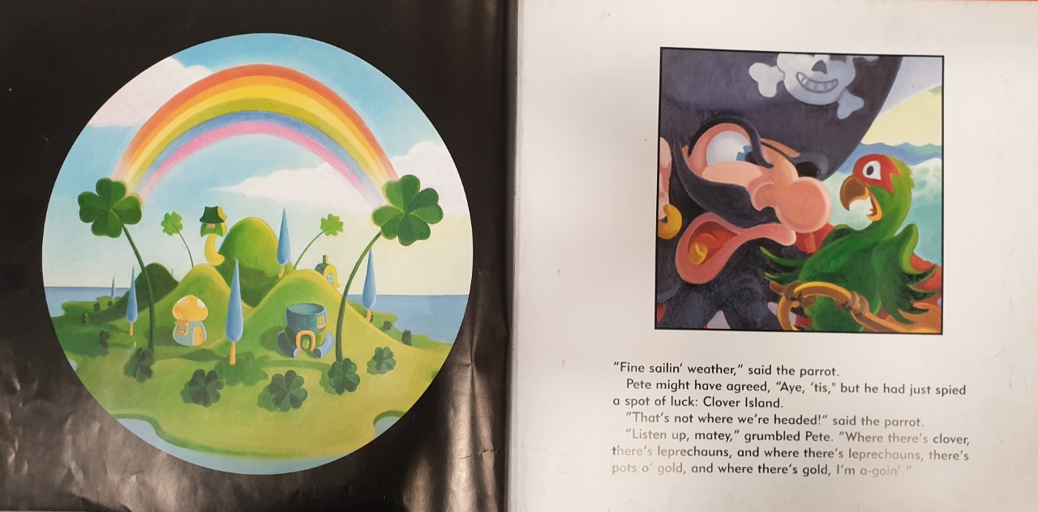

Slide 12
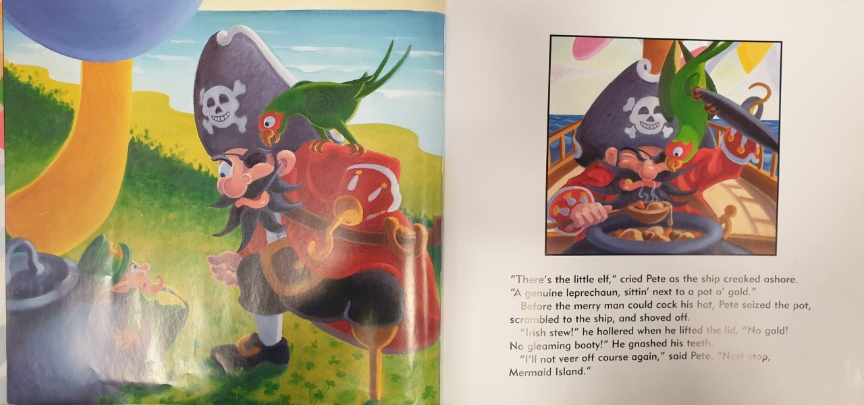

Slide 13
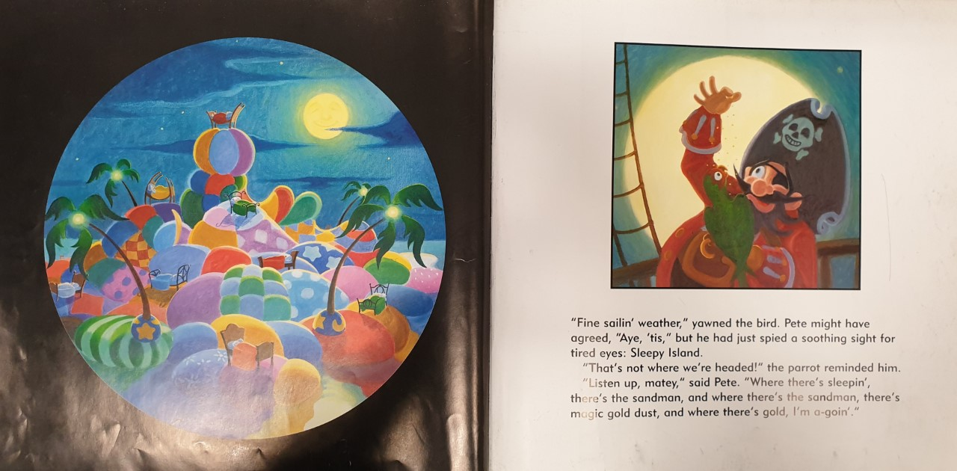

Slide 14
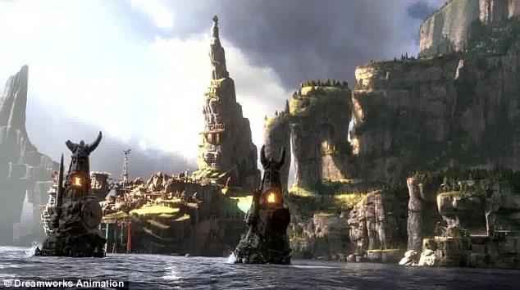
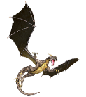


Example
Task:
Write a description of your island.
Dragon Island
The creepy island is surrounded by massive, terrifying dragons that breathe fire. The remote place has steep, enormous cliffs which makes it hard to attack. The evil, strange statues are enough to scare you away. It is guarded by a colossal, impenetrable army which scare off intruders by banging on their armour and growling loudly. You can hear the sounds of the rocks tumbling and smashing into the water and the squeals of angry dragons.

