Slide 1

Tuesday 9th February
Sikhism Fact File

Slide 2
Year 1 - Days of the week and common exception words
Monday
Tuesday
Wednesday
Thursday
Friday
Saturday
Sunday
there
here
they
Year 2 – common exception word
fast
last
father
class
grass
pass
plant
path
bath
people
Write a list of your spellings. Adult say 5 sentences with the last 5 spellings in. Child should write each sentence down.

Slide 3
Today we are learning to... I am learning to read and write facts. I am learning to create a non-chronological report.
I will be successful if ... I can think of an interesting title. I can spell key words correctly. I can use capital letters for the start of a sentence and for proper nouns. I can use finger spaces and full stops. I can use conjunctions. I can use 2A, BOB/BOYS sentences.

Slide 4
This week we are creating a booklet about Sikhism
Each day we will complete a different section of our fact file.
Today we will look at the facts about where Sikh’s worship.
On Wednesday we will write facts about the 5K’s and clothing.
On Thursday we will write about food.
On Friday we will create a contents page and back cover.

Slide 5
Task: Create a page about where Sikh people go to worship.
Use this link to find some facts:
https://www.bbc.co.uk/bitesize/topics/zsjpyrd/articles/zkjpkmn

Slide 6
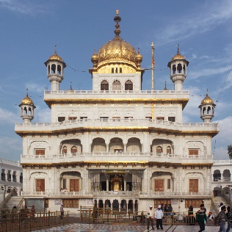
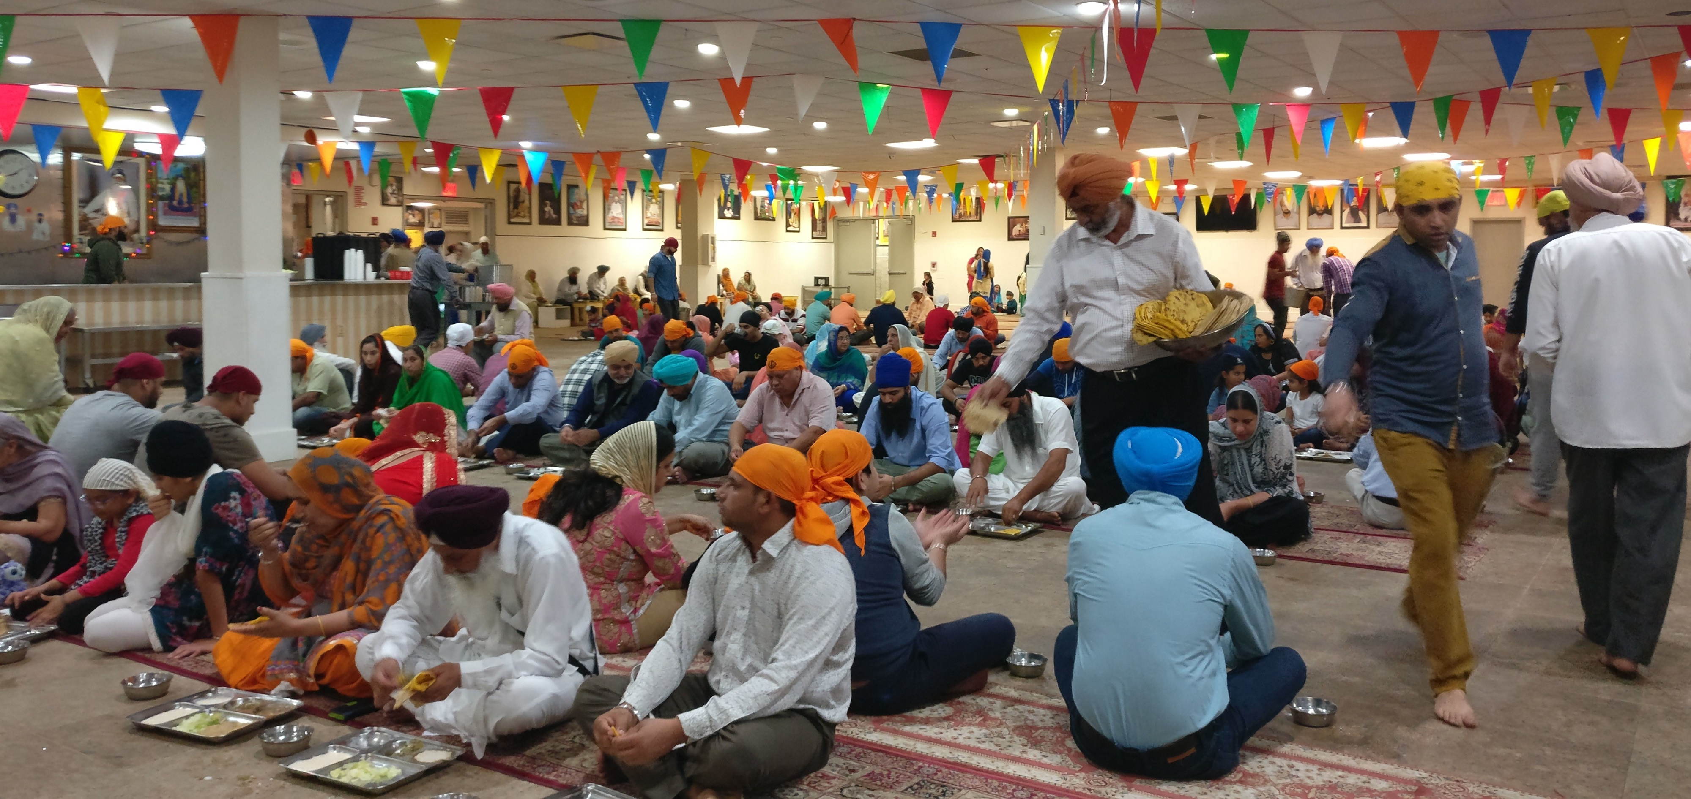
Place of Worship
Here is an example:
Where do Sikh people worship?
The Sikh place of worship is called a Gurdwara which means 'Gateway to the Guru'. A Gurdwara is any building where the Guru Granth Sahib is kept.
In the UK, Sikh’s usually go to the Gurdwara on Sundays. During the services they listen to teachings based on the Guru Granth Sahib. They also chant and say prayers from the gurus. These are called Keertan.
The Langar
The service ends in a langar (a shared meal). Everyone is welcome to share the meal.

