Slide 1
Monday 18th January
Instructions

Slide 2
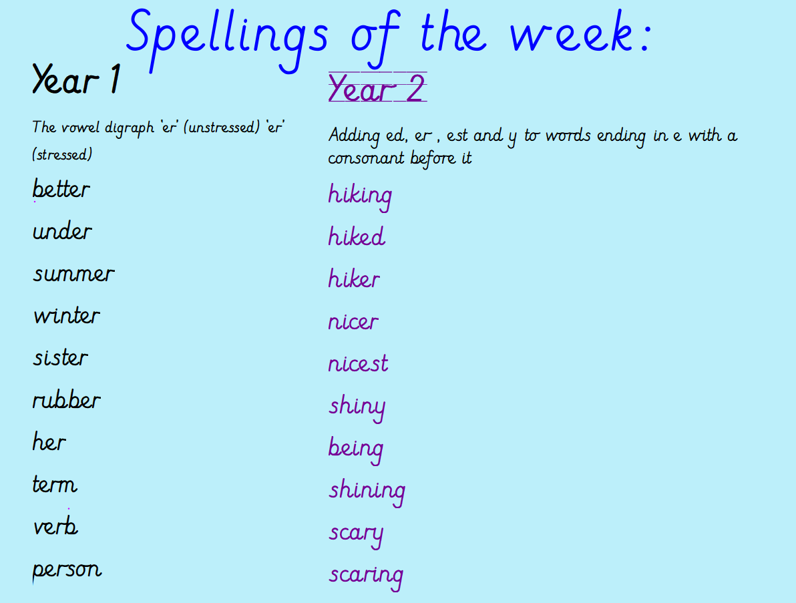

Slide 3
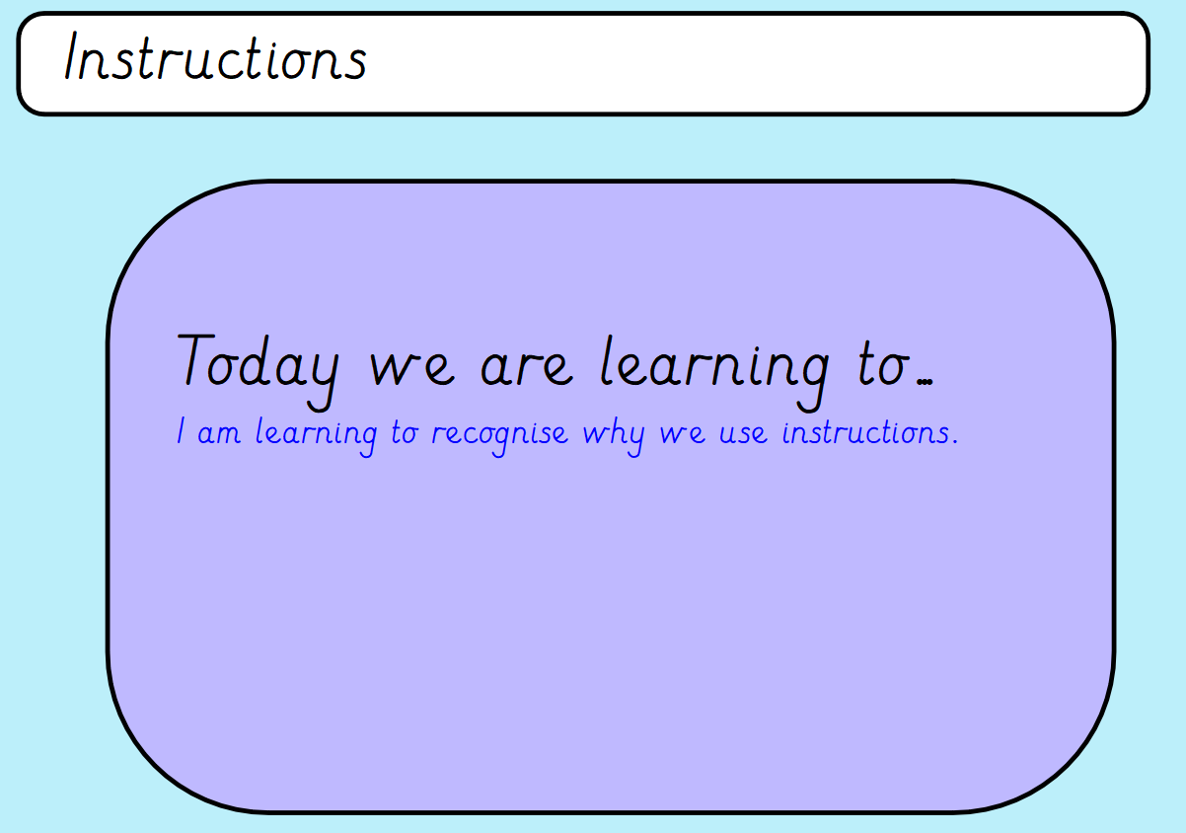
I will be successful if ...
I can say why we need instructions.
I can think of types of instructions.
I can recognise imperative verbs.

Slide 4


Slide 5
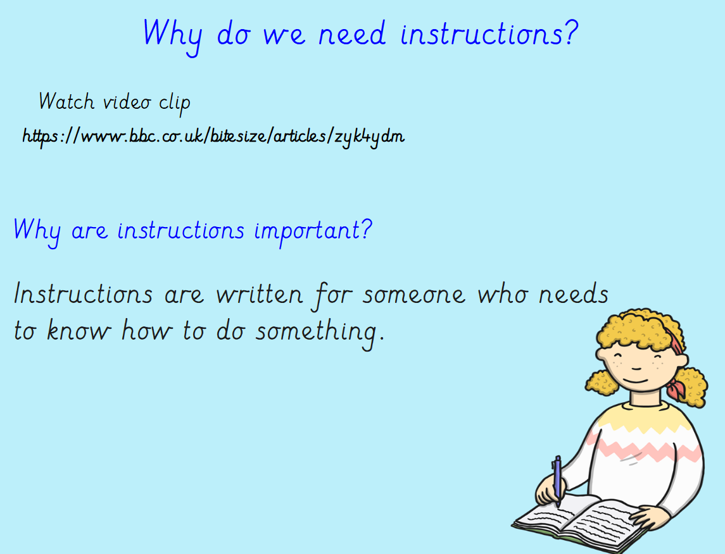

Slide 6
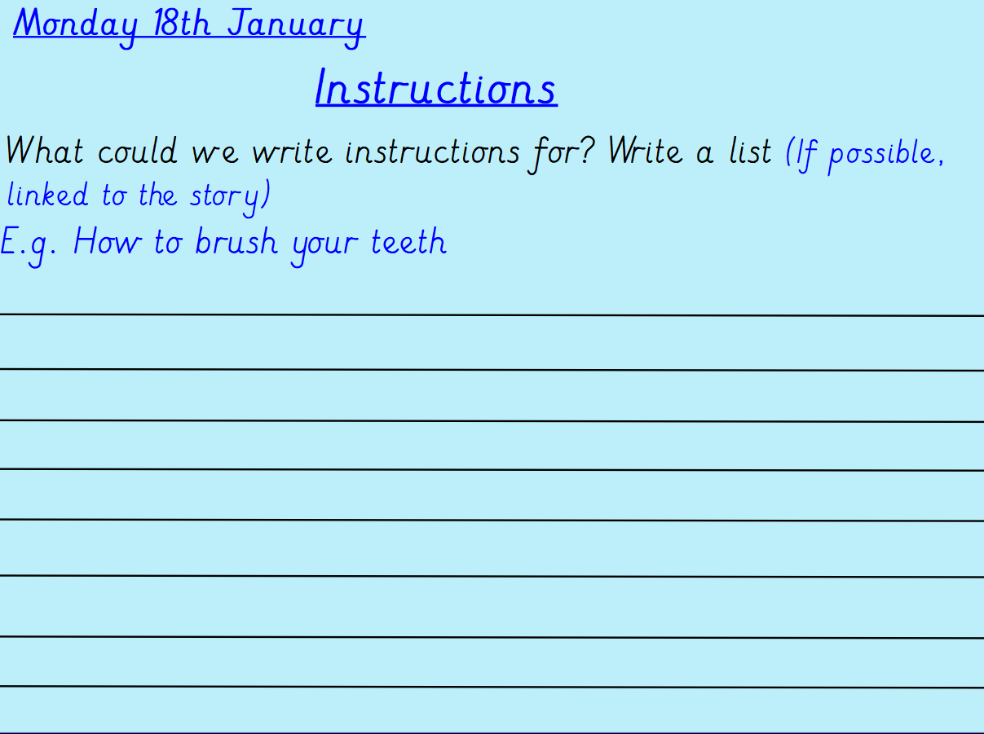
Imagine what you might need to teach to a younger child.

Slide 7
Can you find any instructions at home?

