Slide 1
Tuesday 19th January
Imperative verbs

Slide 2
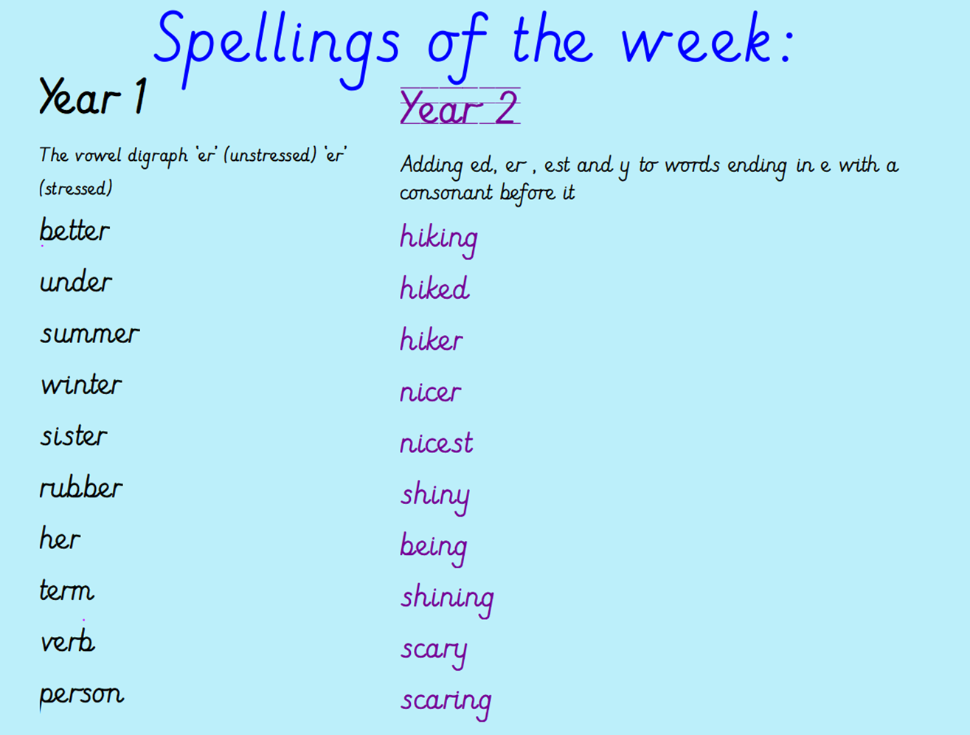

Slide 3
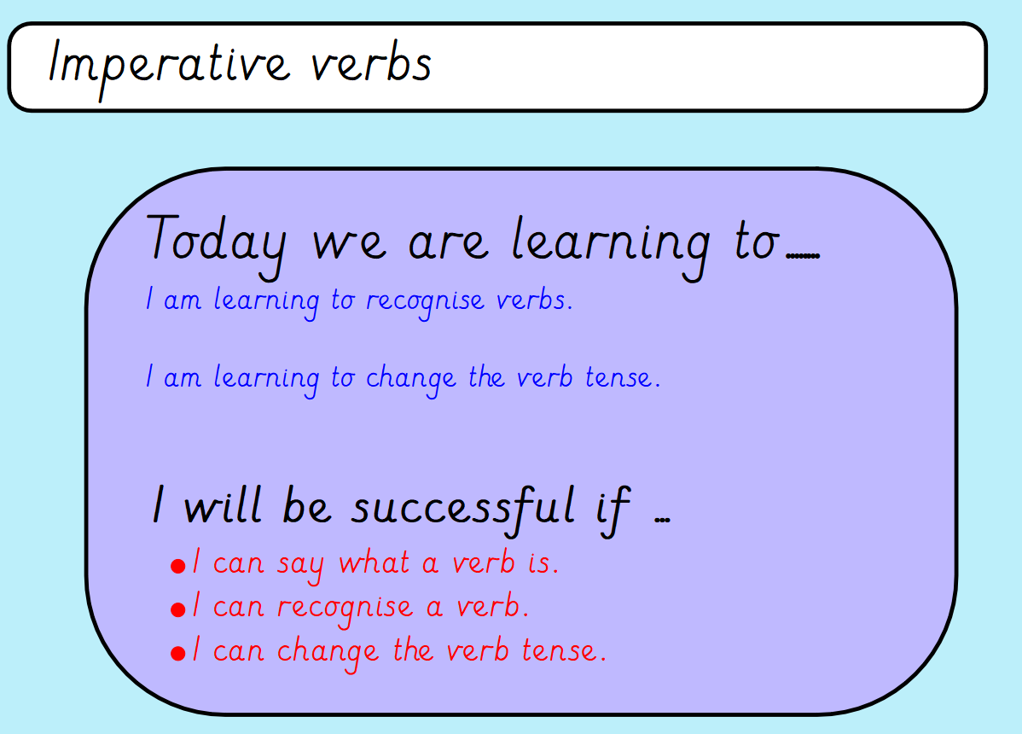

Slide 4
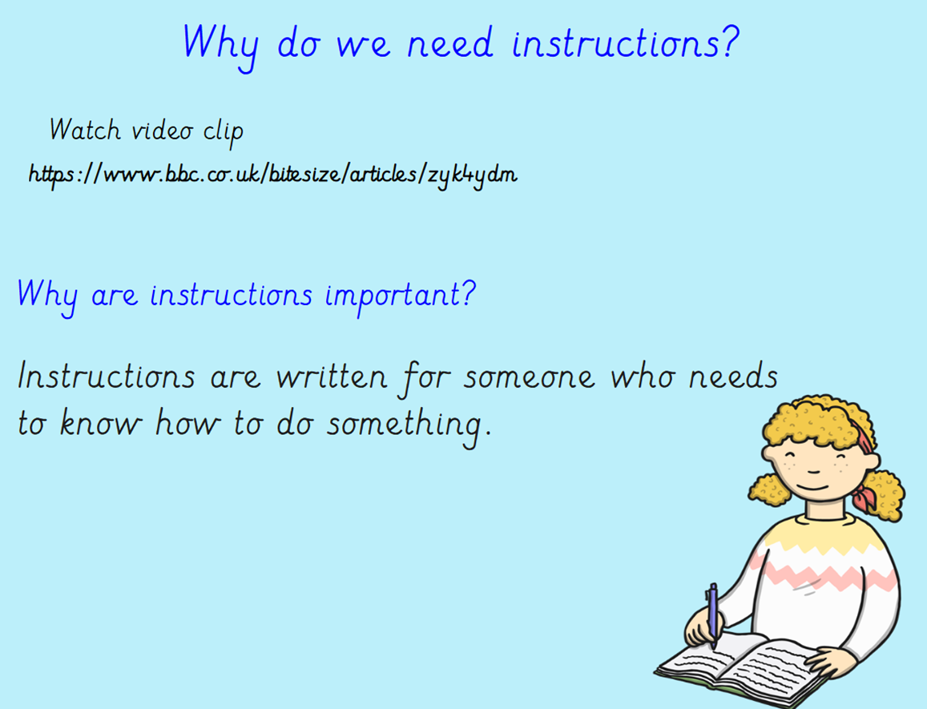

Slide 5
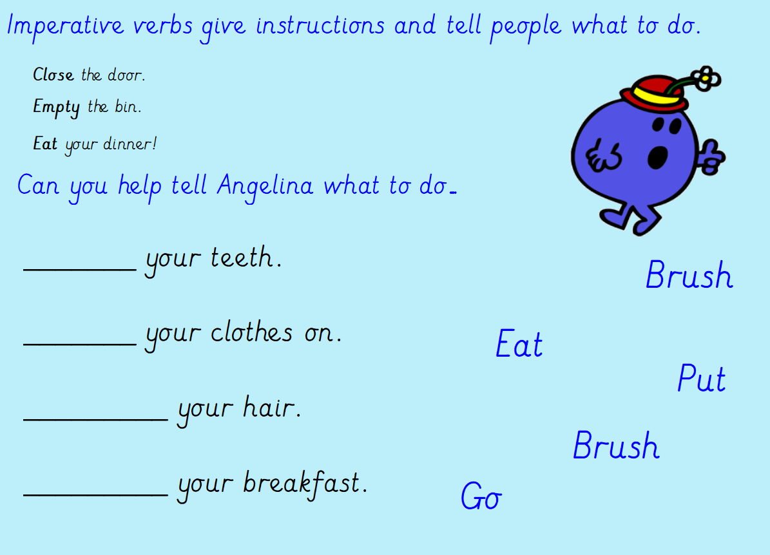

Slide 6
What is a verb? Say some out loud Use the website to find out about imperative verbs: https://www.bbc.co.uk/bitesize/articles/zbxgn9q

Slide 7
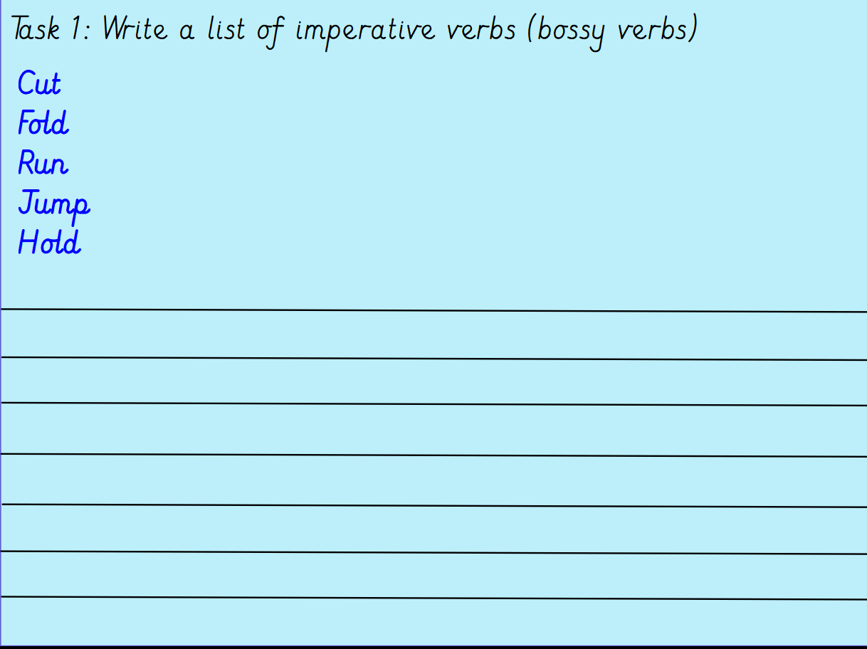

Slide 8

https://www.bbc.co.uk/bitesize/articles/zh4thbk
Past tense
When verbs are written in the past tense they often end in -ed.
If the word already ends in an e then you just need to add a -d.
For example: free = freed, agree = agreed
However, this is not always the rule. Sometimes the word completely changes.
For example: run = ran
Top tip!
Think carefully about how to change the verbs to the past tense. Do you need to add -ed or change the word?

Slide 9
