Slide 1
Wednesday 20th January
Time conjunction

Slide 2
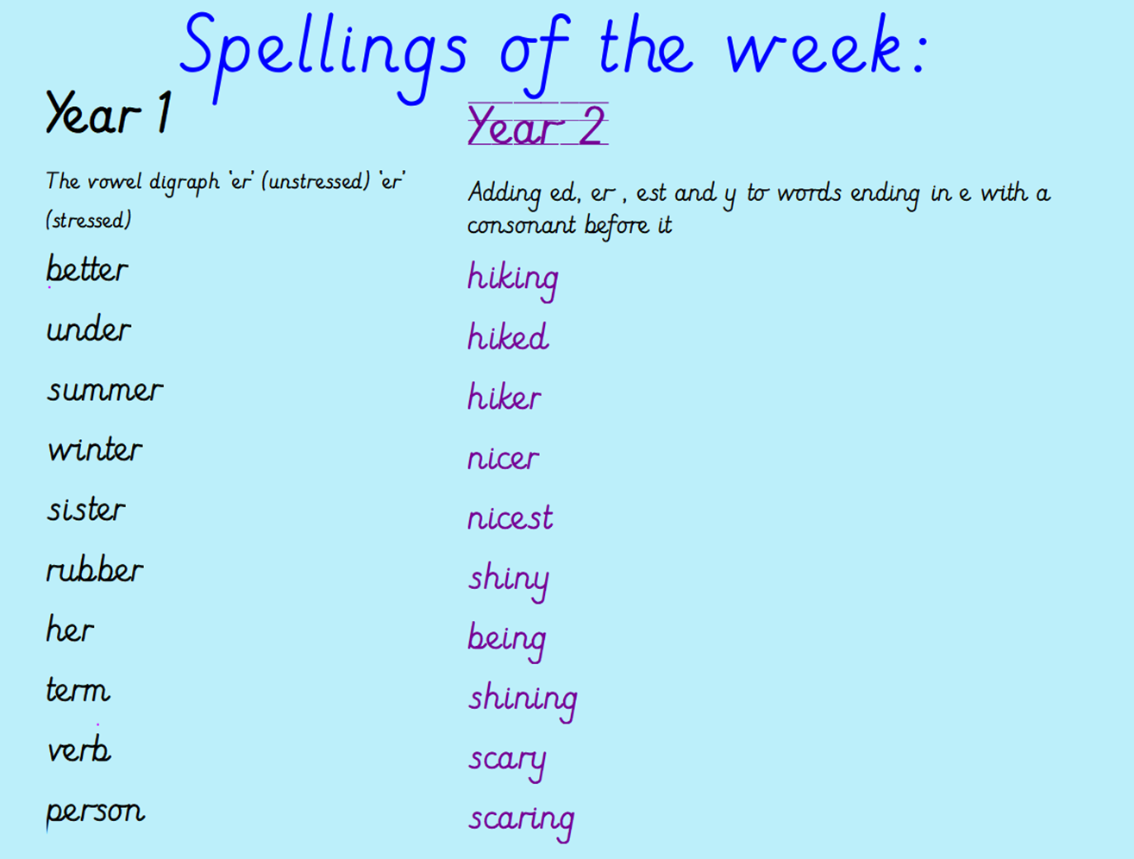
Ask the children to
look, cover, say, write and check each spelling.

Slide 3
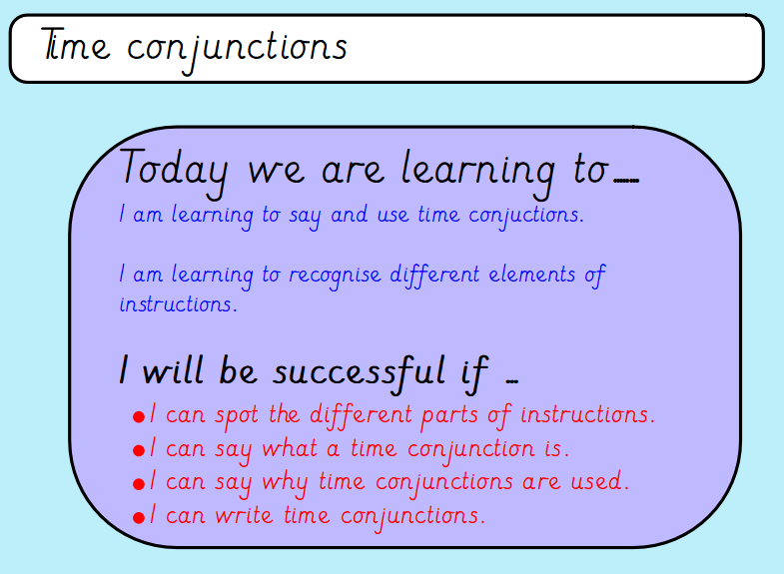

Slide 4
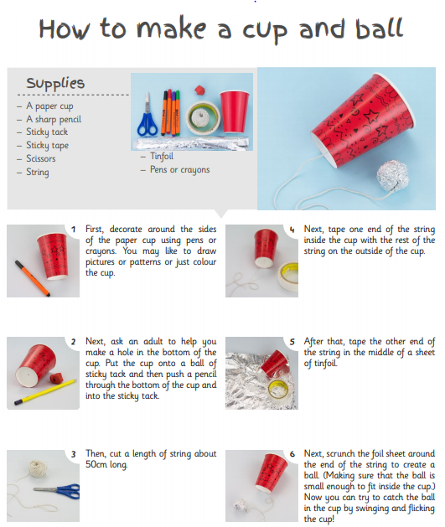
Look closely at this set of instructions.
What sections and types of words can you spot? How is it organised?

Slide 5
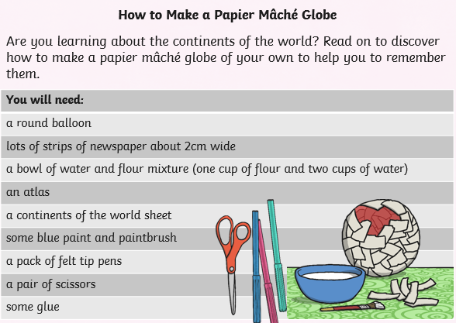
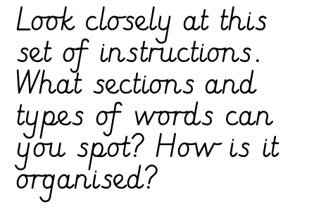
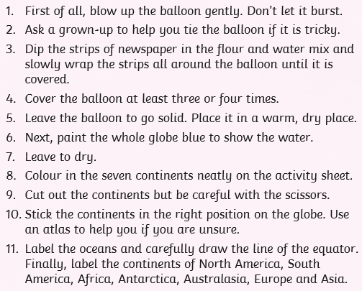

Slide 6
Did you spot any time conjunctions?
Can you explain what a time conjunction is?
Why do we use them?

Slide 7
A time conjunction tells us when something is happening. When writing instructions, they are normally at the start of a sentence.
If you were to write a set of instruction based on how to make a jam sandwich you may start like this:
First collect two slices of bread, butter, jam, a knife and a plate.
Then place one slice of bread on the plate.

Slide 8
Time conjunctions
Write a list of at least eight time conjunctions.
Challenge: can you think of twelve?

