Slide 1

Thursday 21st January
Writing instructions

Slide 2
Select and record the correct spellings.
Year 1 The vowel digraph ‘er’ (unstressed) ‘er’ (stressed) better, beter undr, under summer, sumer wintar, winter sister, sistr ruber, rubber her, hur term, turm vurb, verb person, pirson
Year 2 Year 2 adding ed, er , est and y to words ending in e with a consonant before it hikin, hiking, hyking hyked, hicked, hiked hyker, hiker, hayker nicer, nycer, nicker nysest, nicest, nicesst shinee, shiny, shayny beang, being, beeing shayning, shining, shinning scary, scery, scarry scering, scaring, scairing

Slide 3
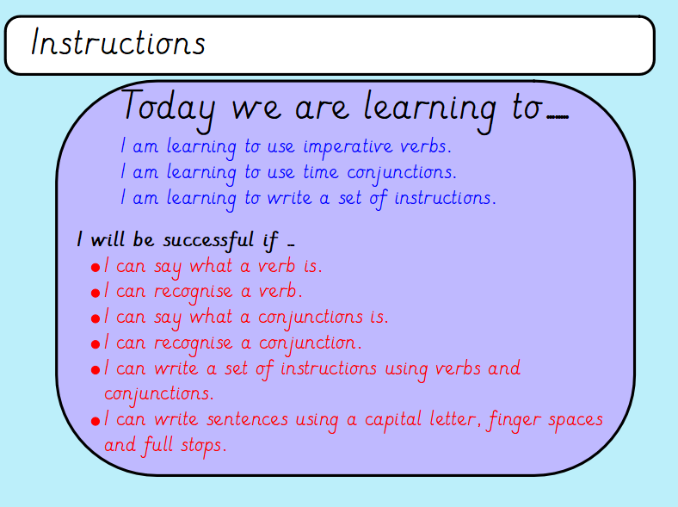

Slide 4
You are going to write a set of instructions today.
Think back to Monday when you thought about what instructions would be useful.
Task: Write a set of instructions.
They could be:
How to make a certain sandwich
How to make cake/biscuit etc.
How to wash your hands properly
How to brush your teeth
It can be anything that you like.

Slide 5
Instructions
Remember to include:
Title
What you will need
Method - simple steps in the correct order
Imperative verbs
Time conjunctions

Slide 6
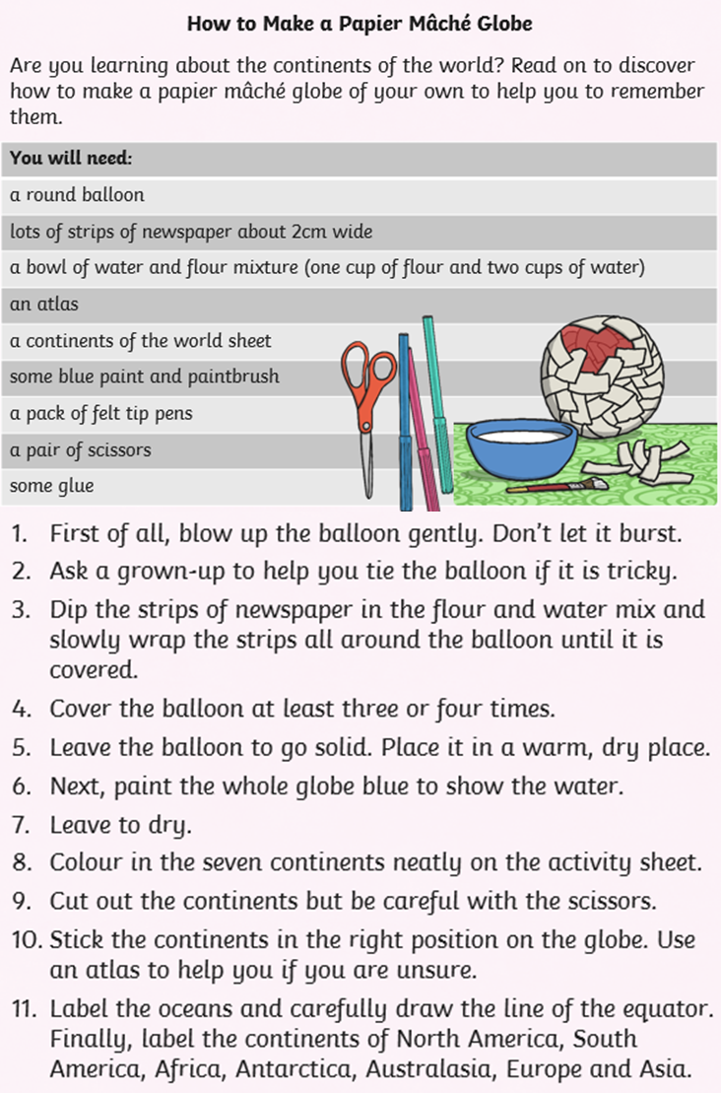
Here is an example

