Slide 1
Writing
Thursday 14th January 2021

Slide 2
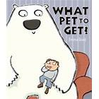
This week our story is ‘What Pet to Get?’
https://www.youtube.com/watch?v=GU4rmVkQtUc

Slide 3
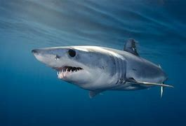
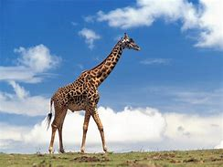
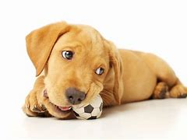
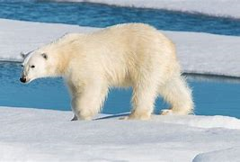
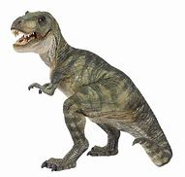
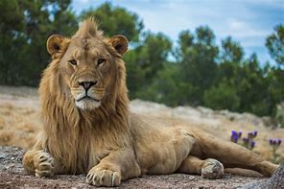
Can you name the different animals from the story? Do you think the animal would make a suitable pet? Why?

