Slide 1
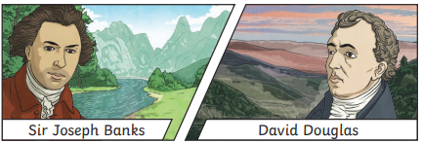
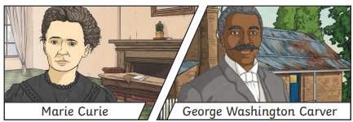
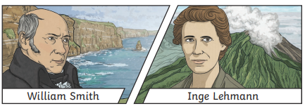
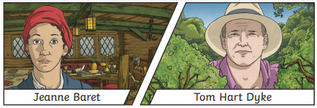
Yarm Primary
Y3 | Enquiry Question:
Subject Specific Vocabulary​ |  |  | Sticky Knowledge about
Botanist | A person who studies plants. | After half term, we will be learning about the Scientists and Inventors. What can you find out about these famous Scientists and Inventors?
 |  |  | Sir Joseph Banks introduces 80 species of plants, including eucalyptus and the banksia, which is named after him.
​Scientist | A person who tries to understand how our world, or other things, work. Scientists make observations, ask questions and do extensive research work in finding the answers to many questions others may not know about.
 |  |  | George Washington Carver came up with more that 100 uses of a peanut so farmers could sell these plants at a higher price. The use of peanuts included paints, face creams, plastics and medicines. Marie Curie was a famous scientist who developed the use of x-rays, which meant that a lot more patients could be correctly diagnosed and treated.
​geology | The study of the earth and what it is made of.
​seismologist | The study of earthquakes, including how they happen and how to measure them.
Inventor | A person who makes new inventions, devices that perform some kind of function. They may invent new ideas or methods.
​concave | Mirrors that are concave bulge inwards making the reflections appear larger. | ​
 |  |  | The Douglas Fir tree is named after the botanist David Douglas. He also introduced pines to Britain.
​convex | Mirrors that are convex bulge outwards and make the reflection appear smaller.
X-rays | Electromagnetic radiation that passes through opaque materials and enables us to see images og things inside our bodies. |  | William Smith studied geology and would study the pattern of fossils. He realised that he could tell the age of a rock by looking at fossils.
magma ​ | Hot molten rock found deep below the Earth’s surface, which flows out of a volcano.
 |  |  | Inga Lehmann was a seismologist and looked at waves of energy caused by earthquakes.

