Slide 1
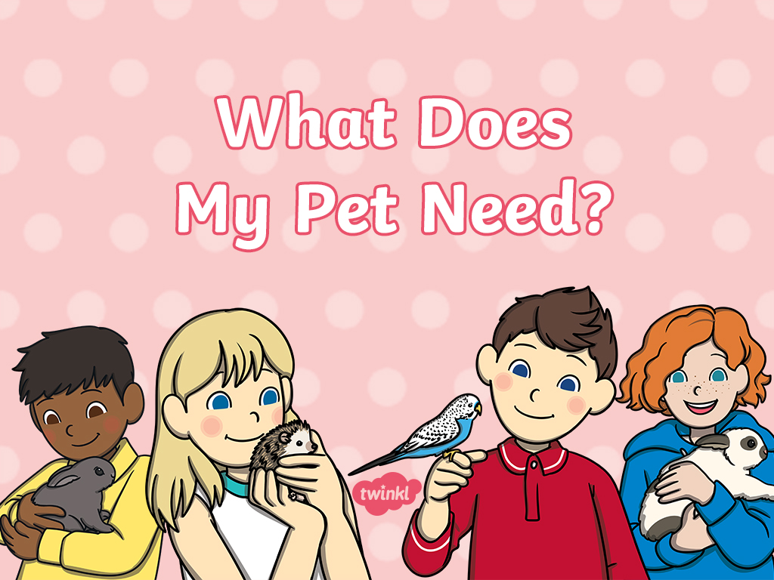

Slide 2



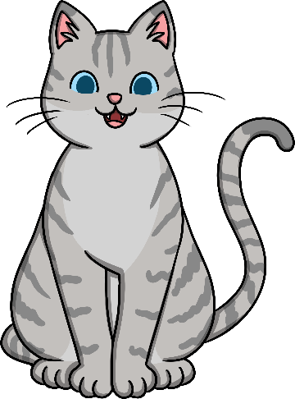

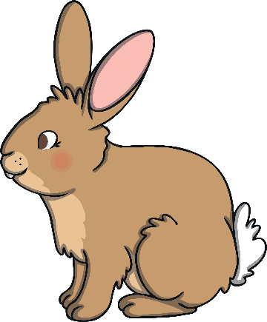

Instructions
Use this fun, interactive PowerPoint to help you learn all about what pets need.
Each slide will show a different pet with a variety of items.
Click on the three items you think each pet needs to stay healthy, strong and happy.
start

Slide 3




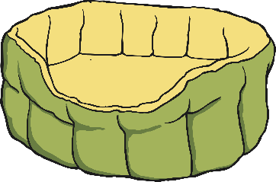
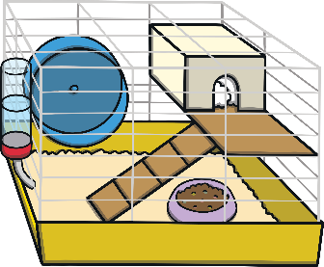


What Do Cats Need?
try again
try again
try again
next

Slide 4

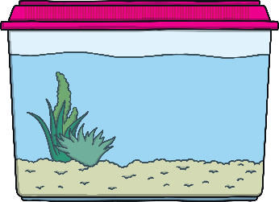



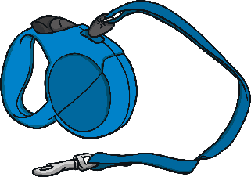

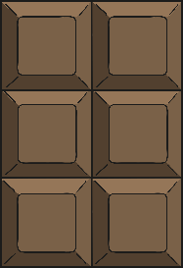
What Do Dogs Need?
try again
try again
try again
next

Slide 5






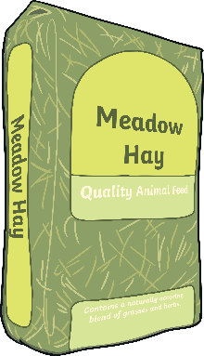

What Do Rabbits Need?
try again
try again
try again
next

Slide 6

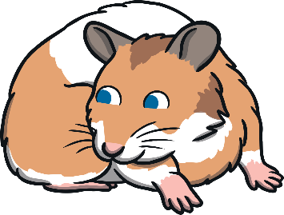

What Do Hamsters Need?
try again
try again
try again
next

Slide 7
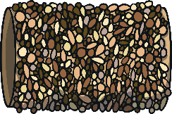
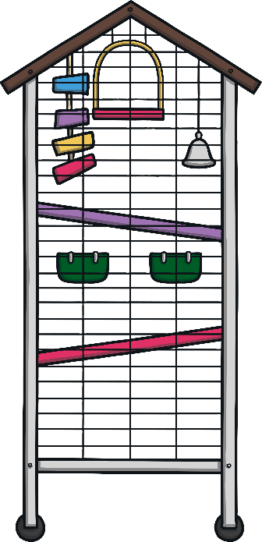
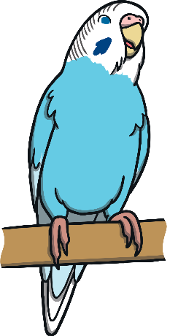

What Do Birds Need?
try again
try again
try again
next

Slide 8

What Do Fish Need?
try again
try again
try again
end

Slide 9
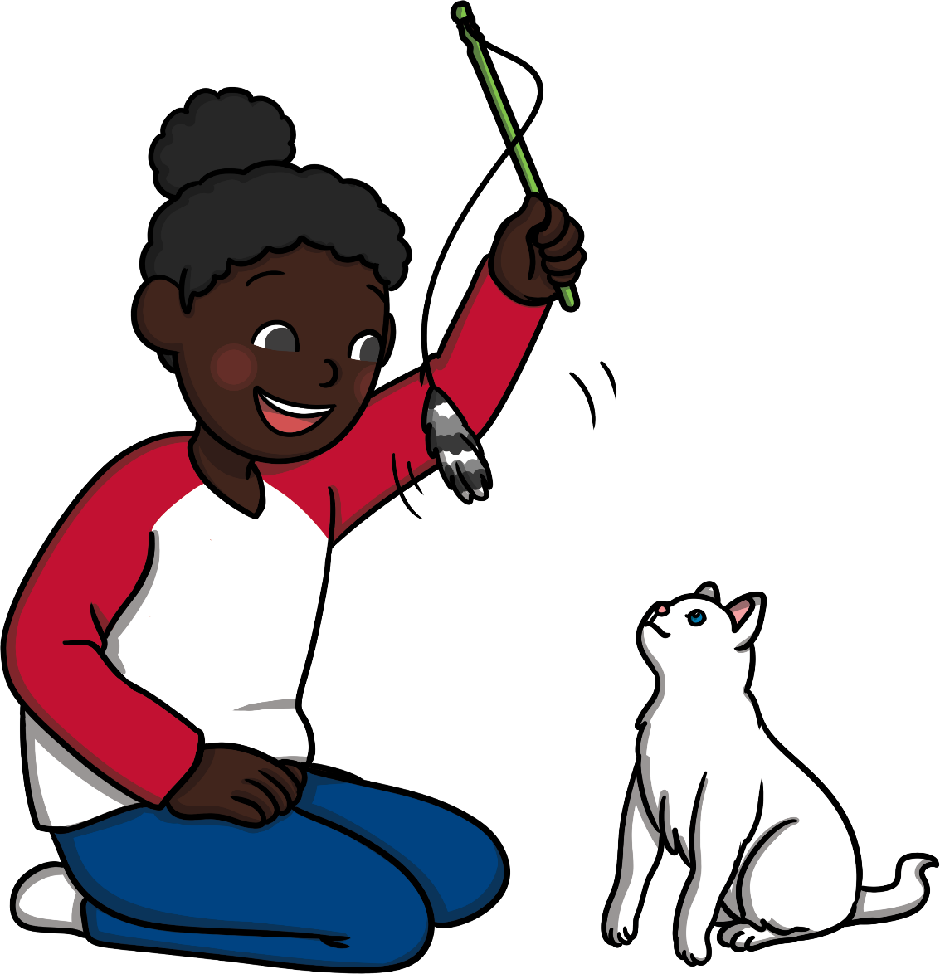
Well Done!
You have learnt all about what pets need.

Slide 10
