Slide 2
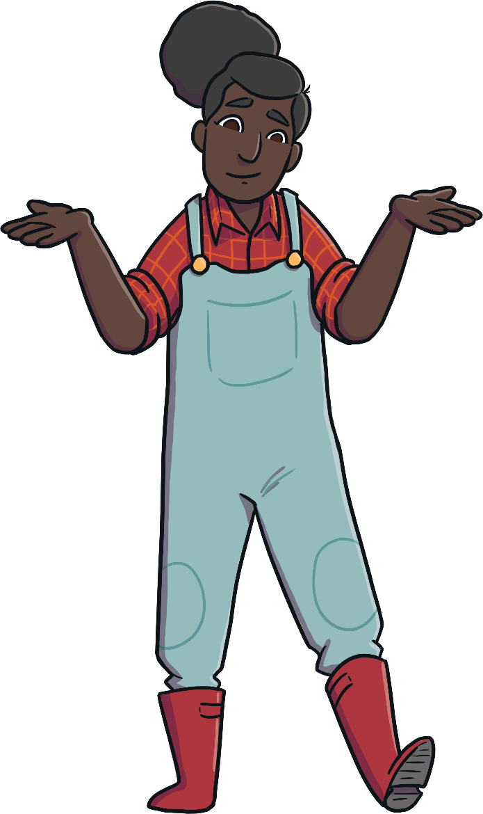

What Am I?
Can you follow the clues to work out which farm animal is being described?
Click on the suns to reveal each clue!
Start

Slide 3

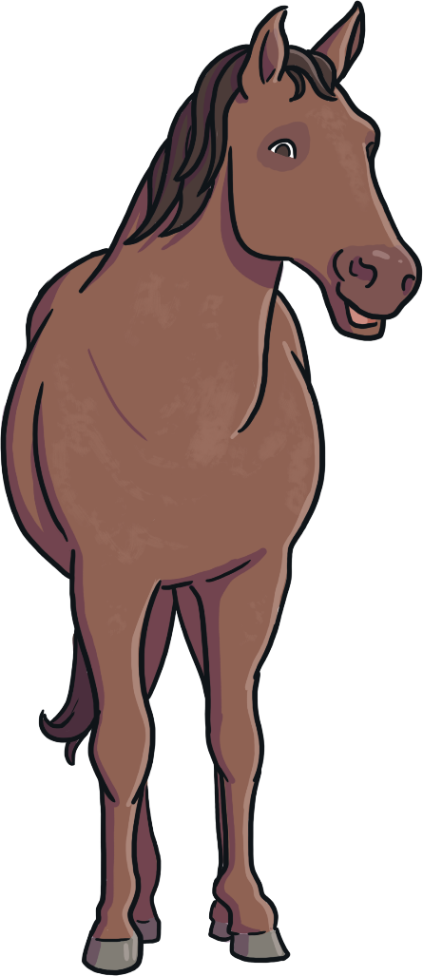
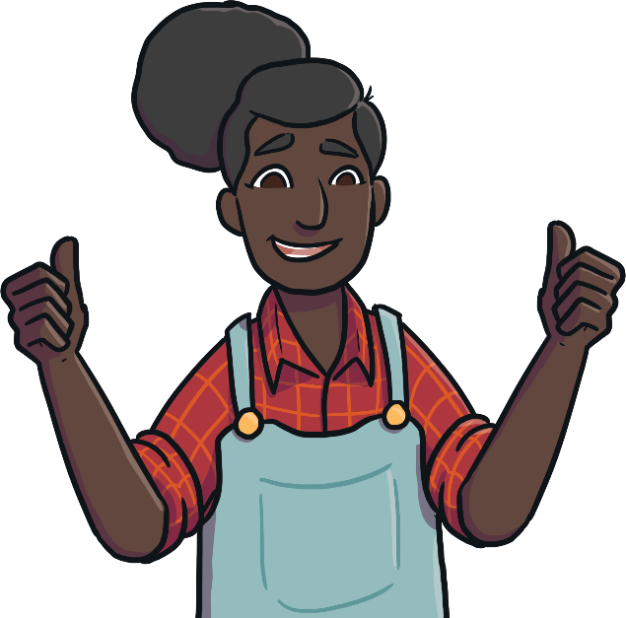
What Am I?
I am a horse!
I am very tall.
I have a long mane.
I eat hay.
What am I?
Click on me to reveal the answer!
Previous
Next

Slide 4
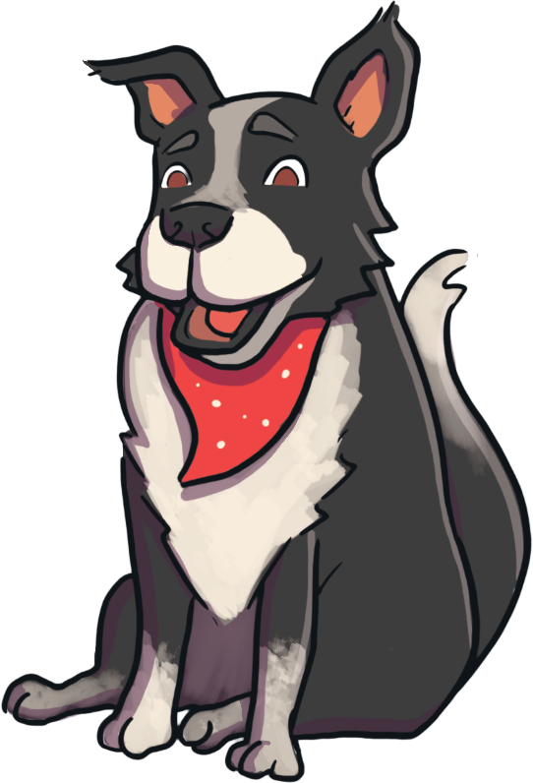
What Am I?
I have four legs.
I am a dog!
I like to go for walks.
I bark.
What am I?
Click on me to reveal the answer!
Previous
Next

Slide 5
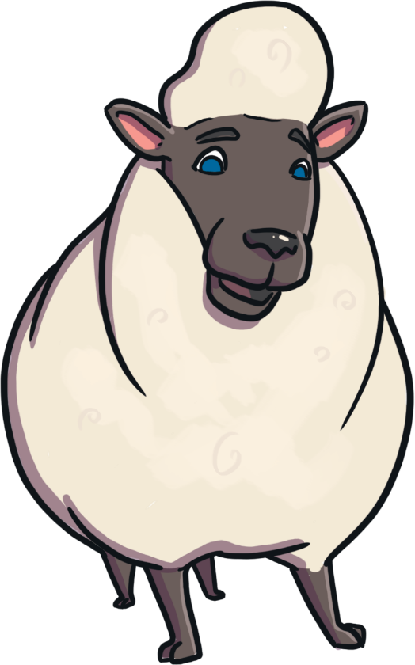
What Am I?
I eat grass.
I am a sheep!
My babies are called lambs.
I have wool on my body.
What am I?
Click on me to reveal the answer!
Previous
Next

Slide 6
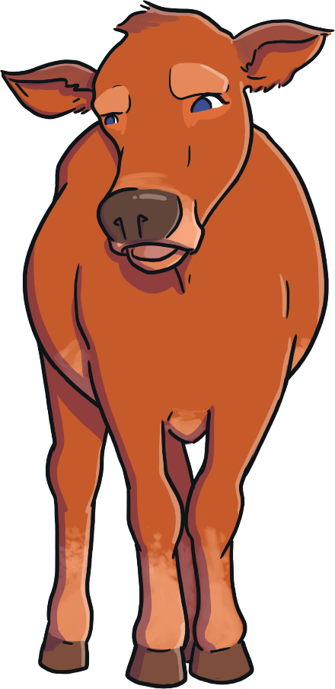
What Am I?
I am quite big.
I am a cow!
I make milk.
I say ‘moo’.
What am I?
Click on me to reveal the answer!
Previous
Next

Slide 7
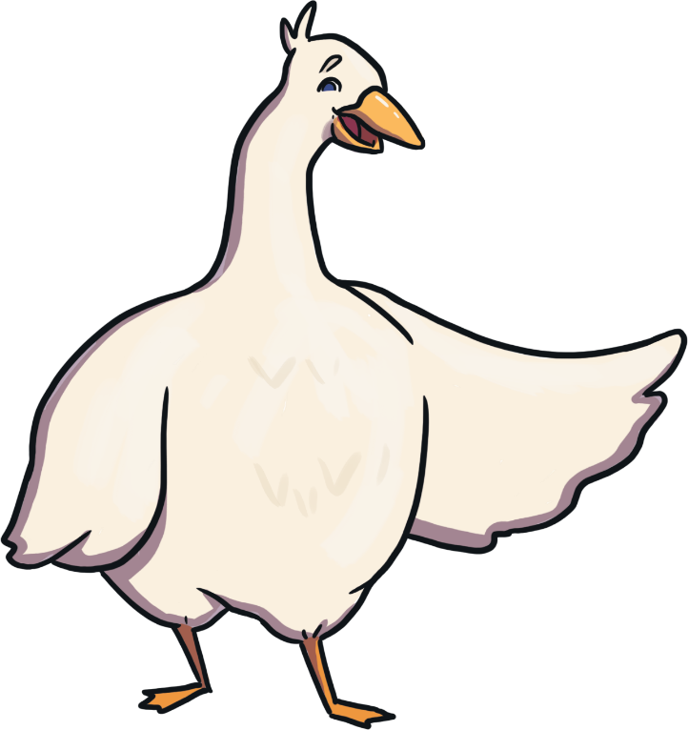
What Am I?
I have two legs.
I am a goose!
I have a beak.
I like to swim.
What am I?
Click on me to reveal the answer!
Previous
Next

Slide 8
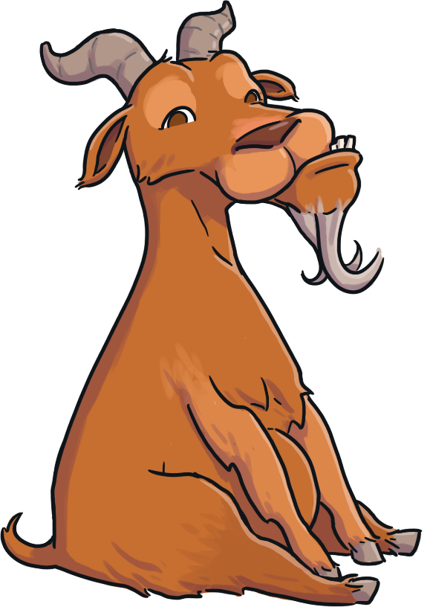
What Am I?
I sometimes have horns.
I am a goat!
I am a bit like a sheep.
I like to climb.
What am I?
Click on me to reveal the answer!
Previous
Next

Slide 9
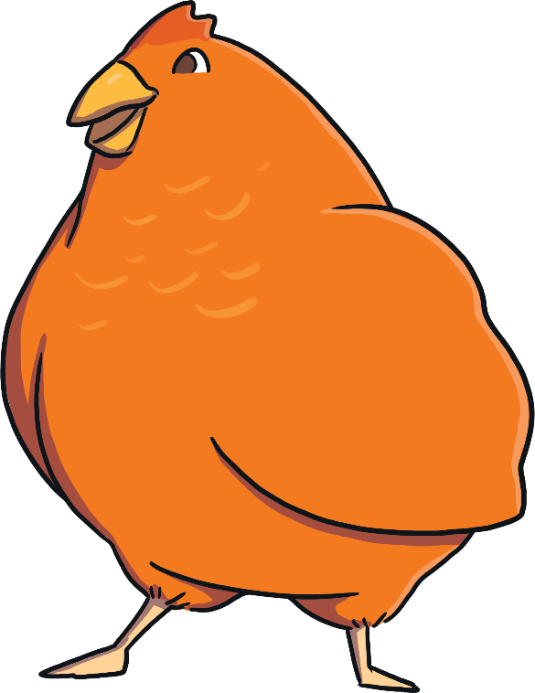
What Am I?
I cluck.
I am a hen!
I have feathers.
I lay eggs.
What am I?
Click on me to reveal the answer!
Previous
Next

Slide 10
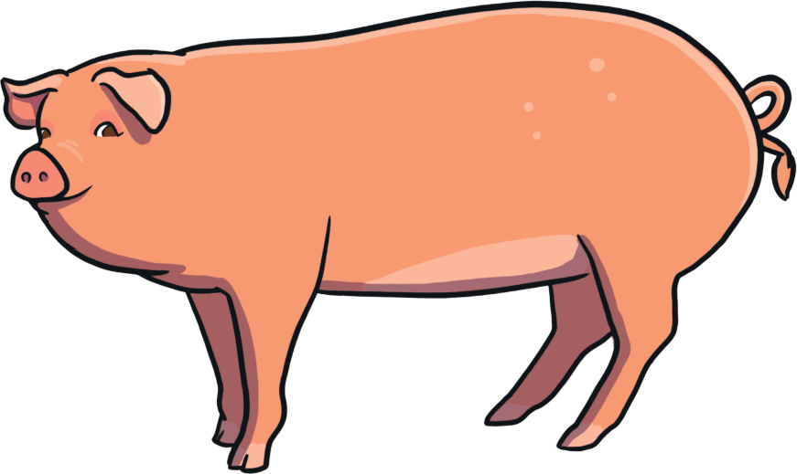
What Am I?
I have a curly tail.
I am a pig!
I like to roll in mud.
I have a snout.
What am I?
Click on me to reveal the answer!
Previous
Next

Slide 11
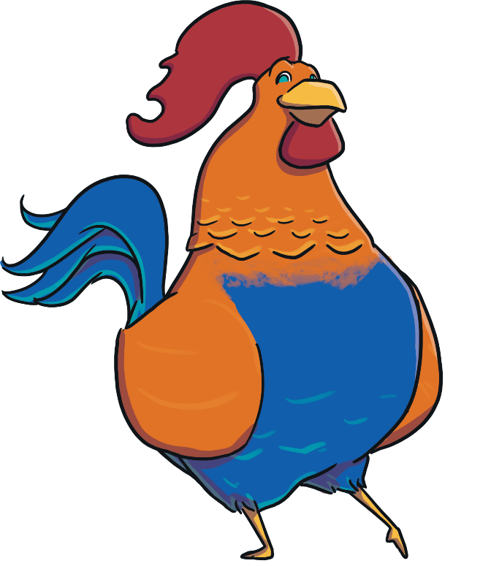
What Am I?
I have brightly coloured feathers.
I am a rooster!
I have claws.
I make a lot of noise in the morning.
What am I?
Click on me to reveal the answer!
Previous
End

