Slide 2
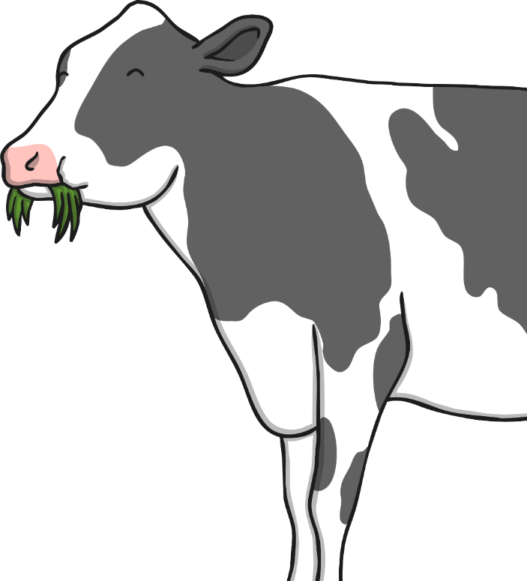

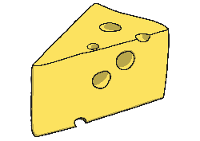
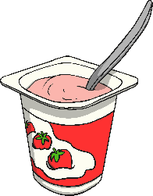

Cows
Cows live on a farm. They give us milk that we drink. Milk is also used to make dairy products like cheese, ice cream, butter, and yogurt.

Slide 3
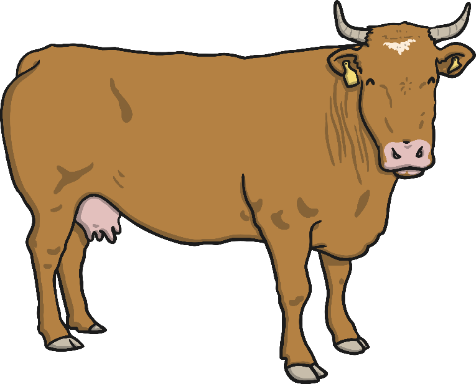
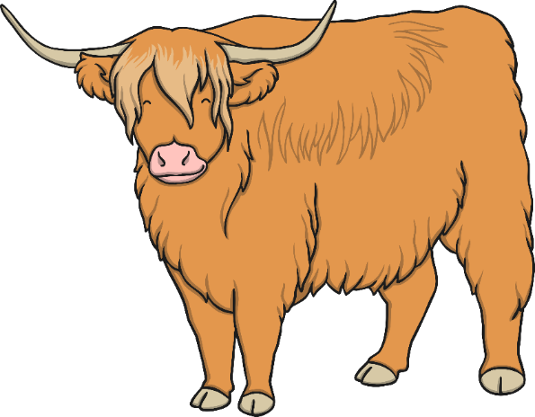
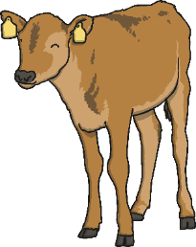
Cows
Female cows give milk. A male cow is called a bull. A baby cow is a calf.
Male | bull
Female | cow
Baby | calf

Slide 4
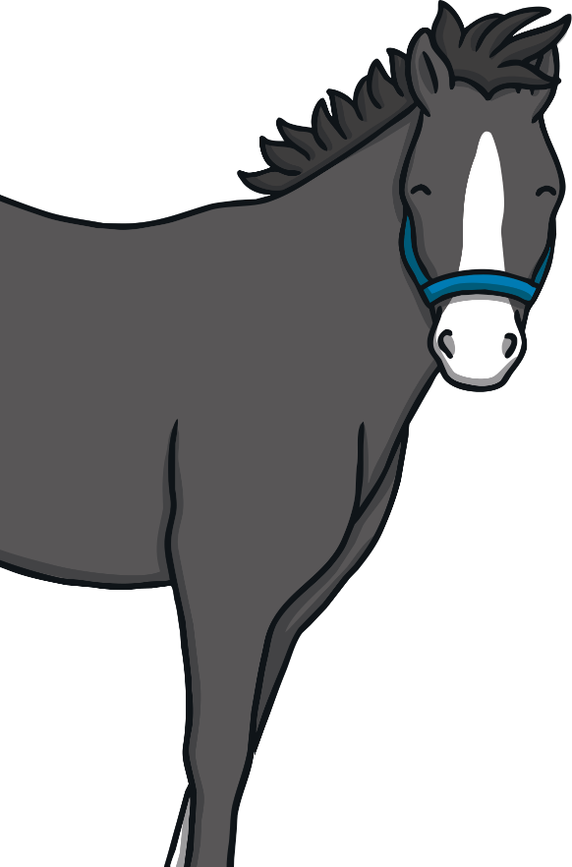
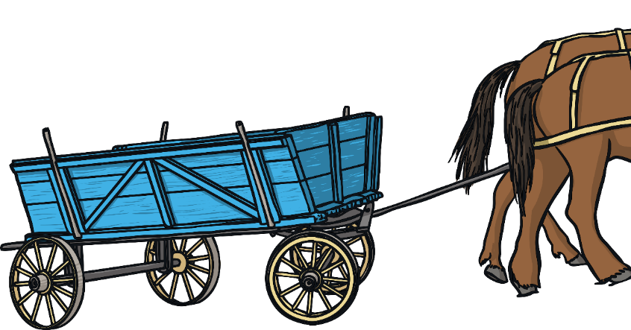
Horses
Horses live on the farm and help the farmer.
Horses are used to pull wagons and trailers. Sometimes they are used to pull plows. People also ride horses.

Slide 5
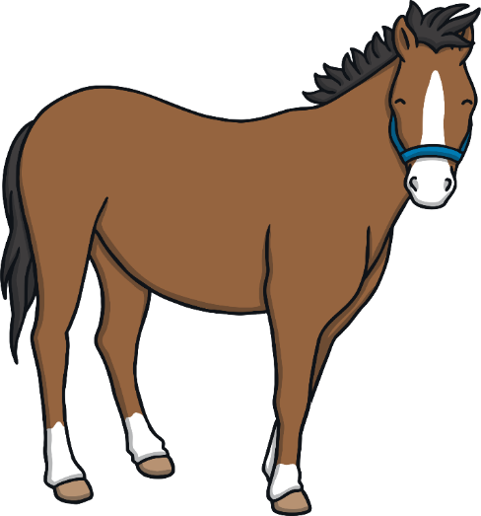
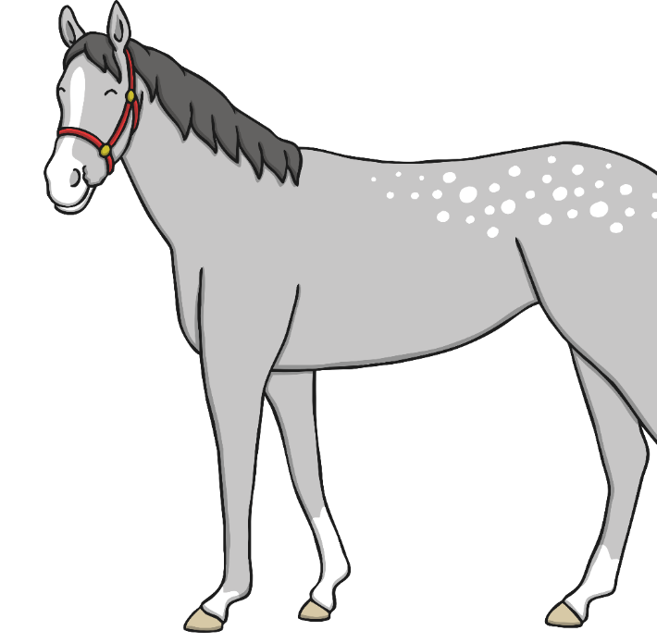
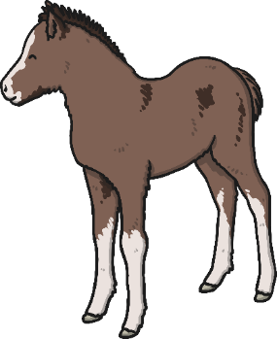
Horses
Female horses are called mares, male horses are called stallions, and baby horses are called foals.
Male | stallion
Female | mare
Baby | foal

Slide 6
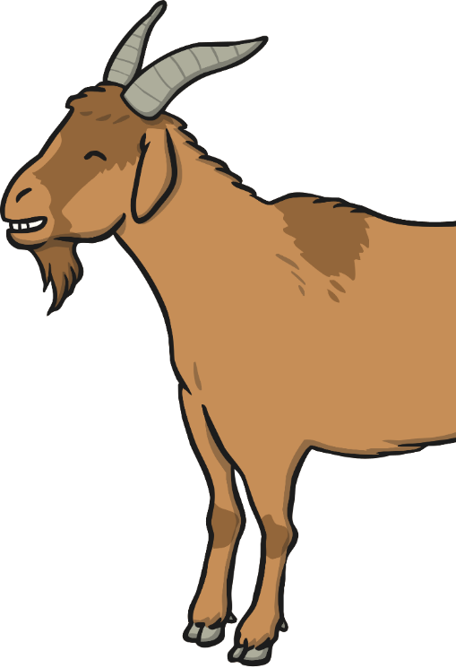
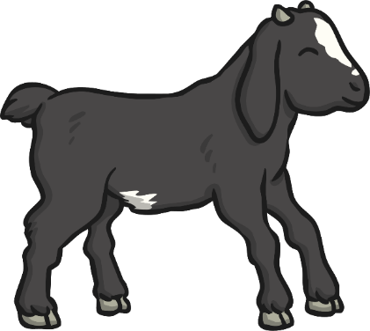

Goats
Goats live on a farm too. They can be milked just like a cow. Their milk can be used to make butter, cheese, yogurt, and even soap. A baby goat is called a kid.

Slide 7
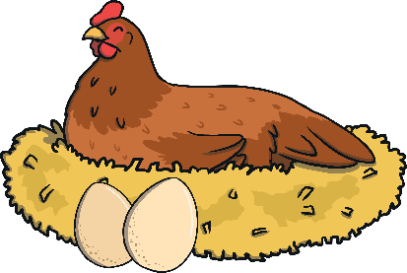
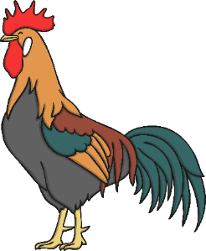
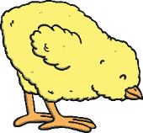
Chickens
A female chicken is a hen. Hens lay 1 – 2 eggs each day.
A male chicken is called a rooster. They wake the farm up every morning by saying,
“Cock-a-doodle-do.”
A baby chicken is called a chick.
Male | rooster
Female | hen
Baby | chick

Slide 8
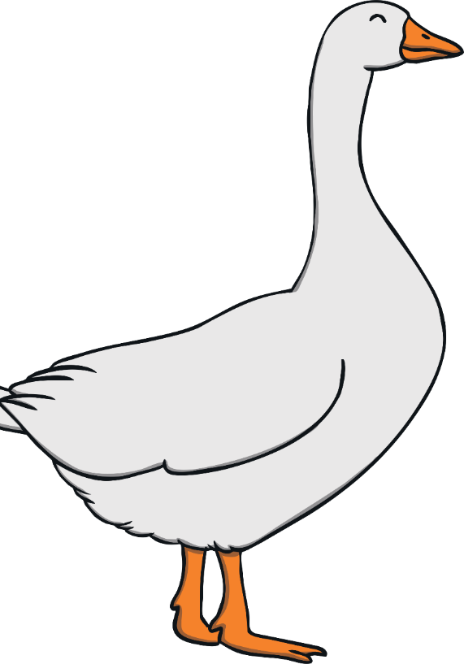
Geese
A female goose lays eggs, like a chicken. She will have 4 - 5 goslings at a time.
A male goose is called a gander.
A baby goose is called a gosling.
Geese live in ponds and enjoying swimming. They make a “honking” sound.
Male | gander
Female | goose
Baby | gosling

Slide 9
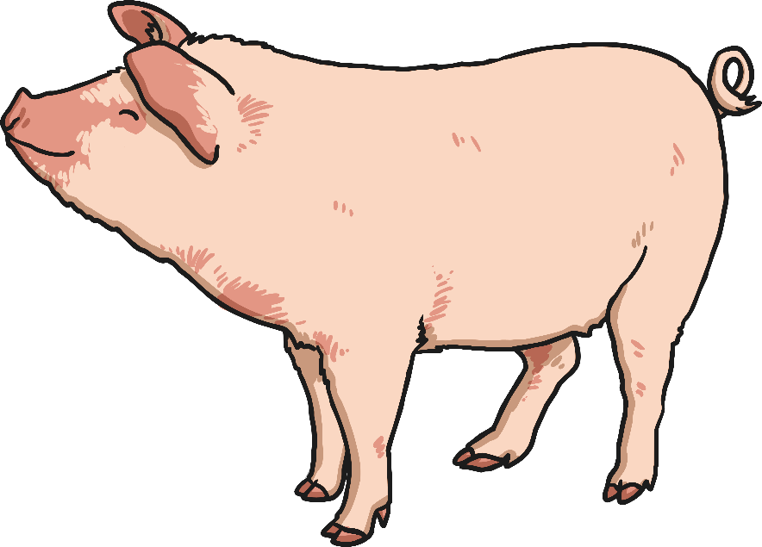
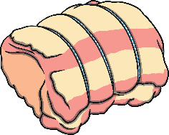
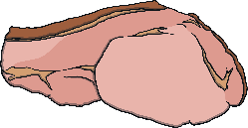

Pigs
We get pork, bacon, and sausage from pigs. Pigs live in a pen called a pigsty. It is usually filled with dirt or mud. Pigs like to roll and lay in the mud, because it helps them stay cool. They can’t sweat like other animals.

Slide 10
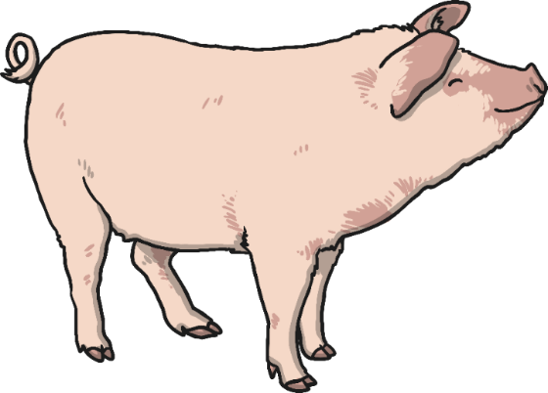
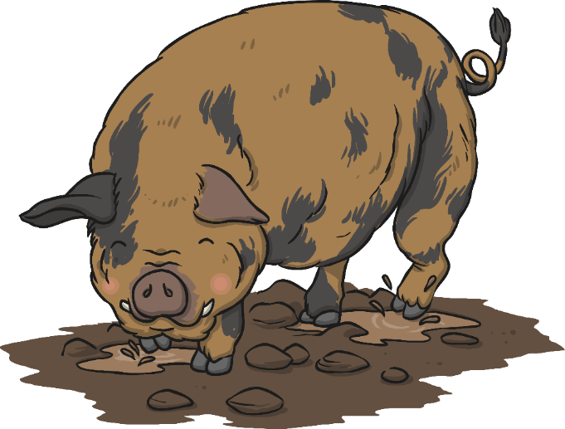
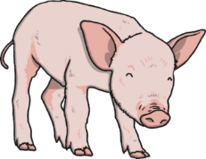
Pigs
Male | boar
Female | sow
Baby | piglet
A female pig is a sow. A male pig is a boar. Baby pigs are called piglets.

Slide 11
Higher Order Thinking Questions
Why do pigs like to roll in the mud?
How are chickens and geese the same?
What are your favorite foods we get from cows and why?
If you could be a farm animal which one would you be and why?
If you had a farm what kind of animals would you have and why?

Slide 12
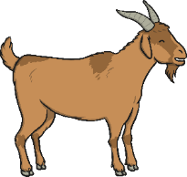



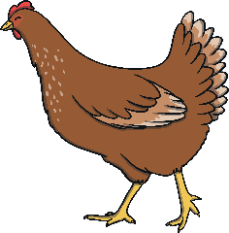
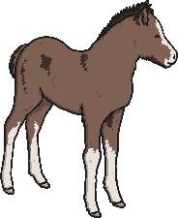
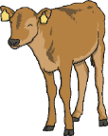

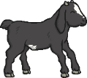

Match the Mom and Baby

