Slide 1
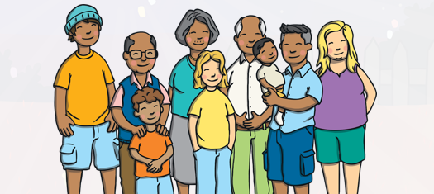
Yarm Primary
EY2 | Enquiry Question: Are all families the same?
Subject Specific Vocabulary​ |  |  | Sticky Knowledge
Family | A group of people around you and help you | For the following half term, our PSHCE topic will be around families and committed relationships. We will explore the people in our family and find out about how they are all special.
 |  |  | Our family is made up of different people.
Special | A positive quality about people.
 |  |  | Families are in all different shapes and sizes but each one is very special
Similarities | Something that is the same
Differences | Something that is not the same |  | Families can enjoy doing different things together.
 |  | ​
Diversity | People may be different in many ways. |  | Our Golden Rules are: We are gentle. We are kind and helpful. We listen. We are honest. We work hard. We look after property.
Together | With another person or people

Slide 2
My Family – Who is in your family? Can you draw and label a picture of the different people in your families.
Our Families – What do you like to do with your family? Can you make a poster to show the different things that you do?
Family Superheroes – Who is important in your family? Why are they special?

