Slide 1
Friday 29th January
Book evaluation
Learning objective: Today I am learning to reflect upon my views of the book
Success Criteria: I know I will be successful if - I can complete each section of the grid I can state what I liked and disliked about the book I can state if there was anything that puzzled me about the book I can state if I spotted any patterns or connections

Slide 2
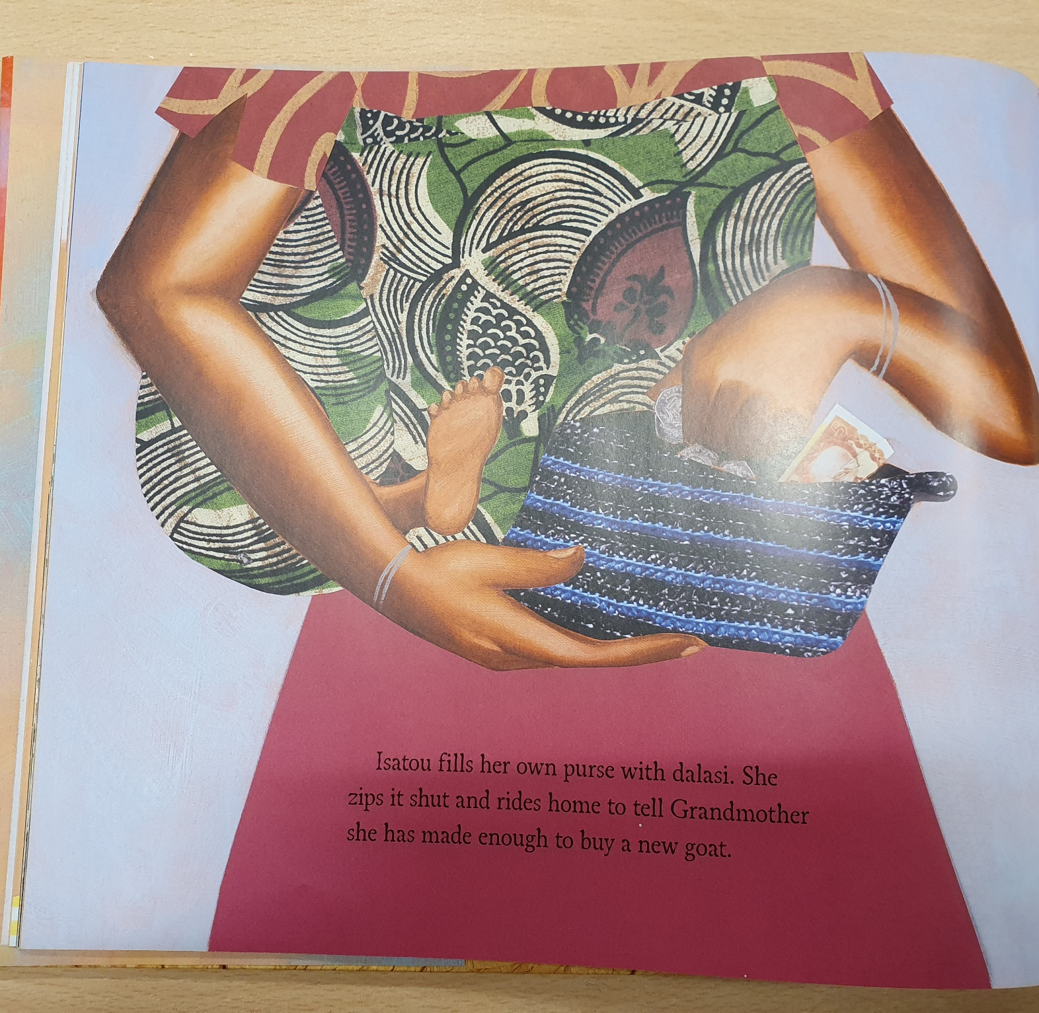
Today we will finish reading the book.

Slide 3
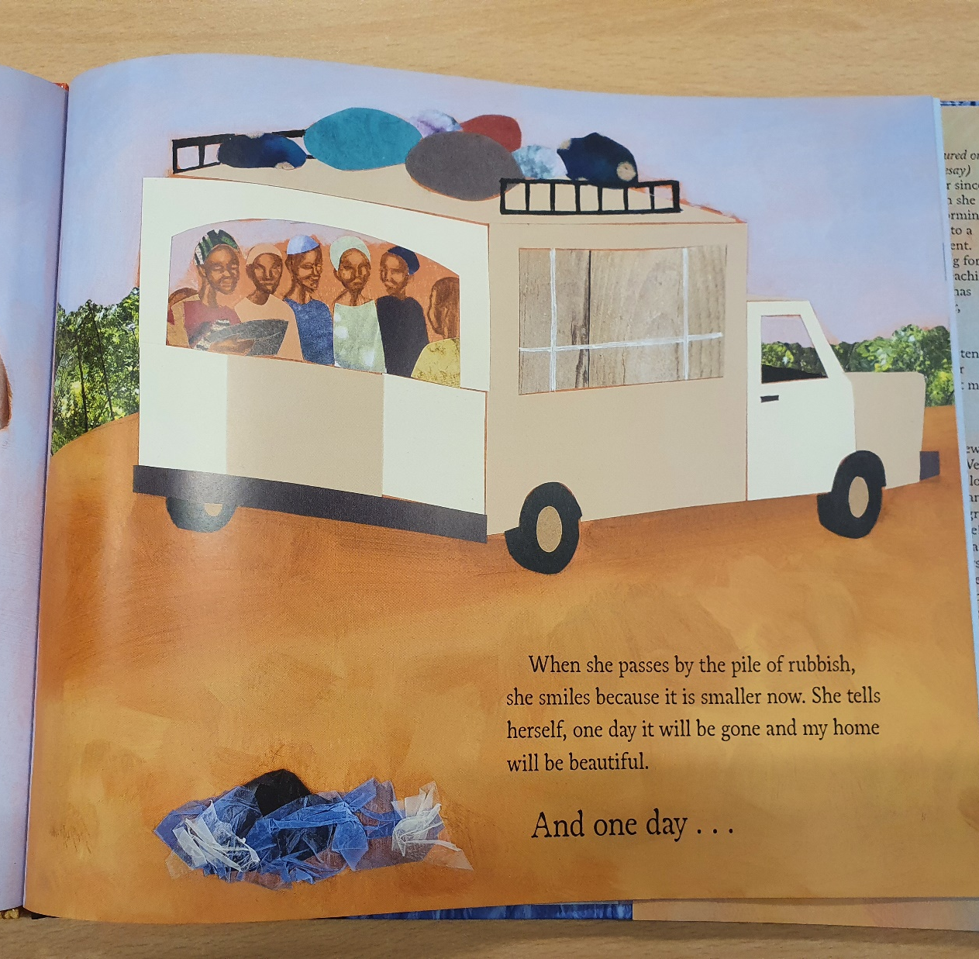

Slide 4
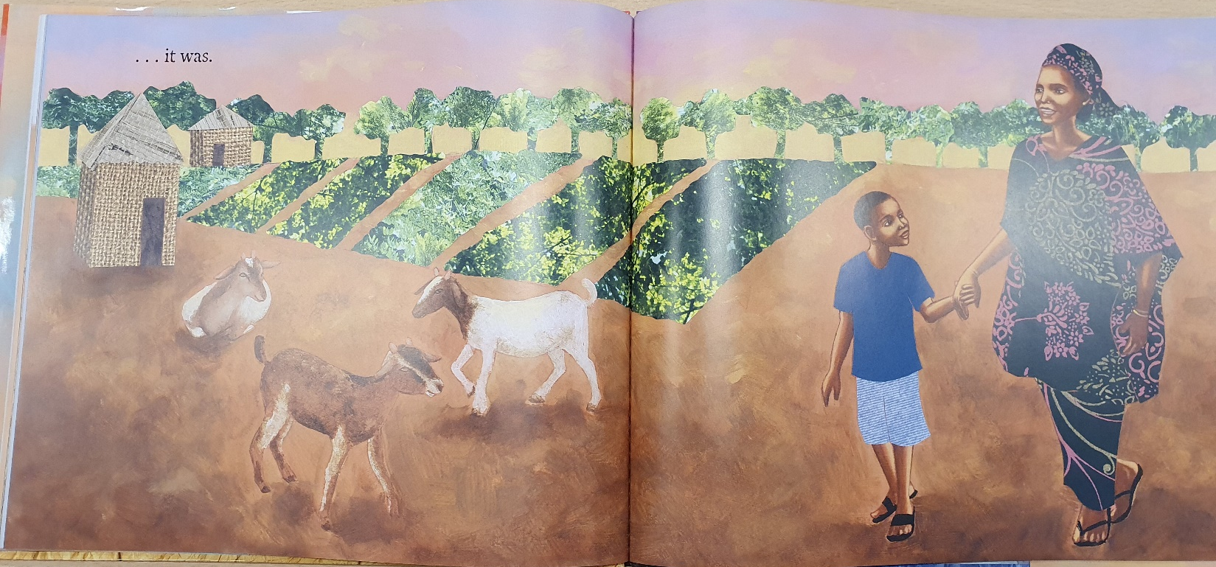
The end.

Slide 5
Now I would like you to compare and contrast the last double spread with the opening double page spread.
I would like you to consider the following:
*What do you notice?
*How do the two compare and contrast?
*How does the positioning of the characters differ and influence your perspective?
*How is colour used and to what effect?

Slide 6
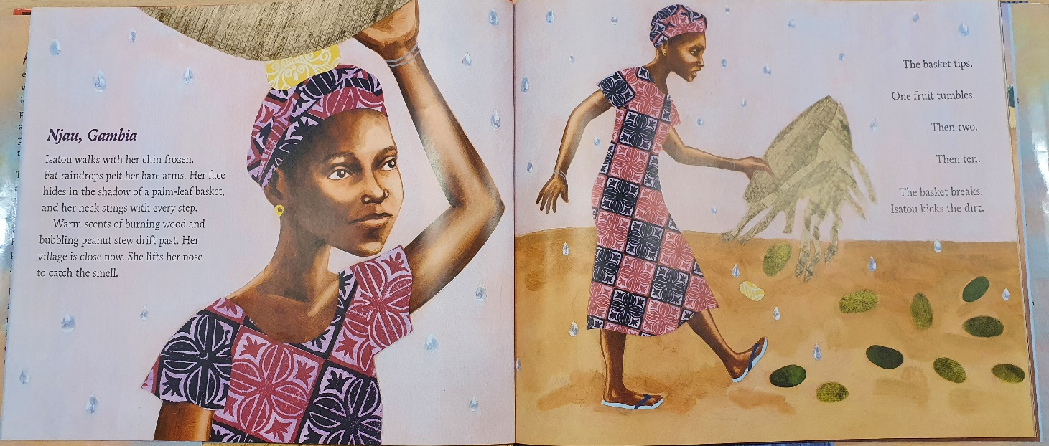

Slide 7
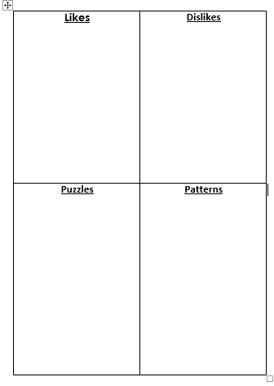
I would now like you to reflect upon your views of the text using the grid below.
Please complete each section as fully as you can as this will help you with your next challenge.

Slide 8
Likes
Was there anything you liked about the book?
What especially caught your attention?
What would you have liked more of?

Slide 9
Dislikes
Was there anything you disliked about the book?
Were there parts that bored you?
Would you have skipped parts? If so, which ones?
Would you have fully read the book on your own? If not, where would you have gave up?

Slide 10
Puzzles
Was there anything that puzzled you?
Was there anything that you’d never found in a book before?
Was there anything that took you completely by surprise?
Did you notice any apparent inconsistencies?

Slide 11
Patterns
Were there any patterns?
Were there any connections that you noticed?

Slide 12
Here are some other useful questions for you to consider…
When you first saw this book, even before you read it, what sort of book did you think it would be?
Have you read other books like it?
Have you read this book before? If so, was it different this time?
While you were reading it, or now when you think about it, were there word or phrases or other things to do with the language that you liked? Or didn’t like?
If the writer asked what could be improved in the book, how would you have made it better?
Has anything that happens in the book ever happened to you?
When you were reading the book, did you ‘see’ the story happening in your imagination?
What will you tell your friends about this book?

Slide 13
Task
Now you have completed all sections of your grid and considered the extra questions, it is your task to write a paragraph summarising your thoughts, feelings and reflections of he book. Use your recordings from the grid to help you.
Remember to always use correct spelling, capital letters and punctuation in your writing and to really consider your presentation too – what would your teacher say if you were in class?

