Slide 1
Thursday 11th February
Features of a Formal Letter
Learning objective: Today I am learning the features of a formal letter.
Success Criteria: I know I will be successful if – I can recognise the features of a formal letter I can find the features of a formal letter on an example letter

Slide 2
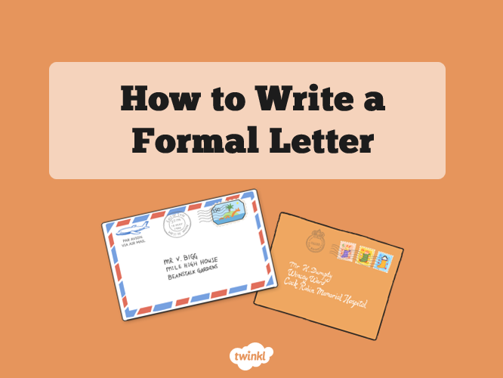
Today we will learn the features of a formal letter before we go on to write our own letter tomorrow.
So, what are the features of a formal letter?
Lets find out!
First, go through the PowerPoint named ‘How to write a Formal letter’ which will highlight the features of a formal letter.

Slide 3
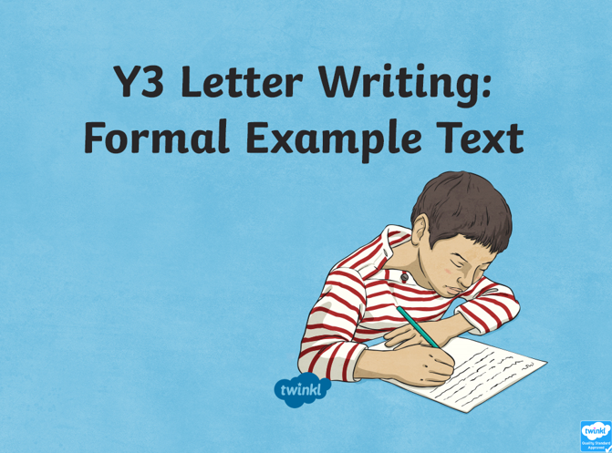
Now let’s have a look at an example of a letter…
Read through the PowerPoint named ‘Example of a Formal Letter’.
See if you can spot any of the features as you go.

Slide 4
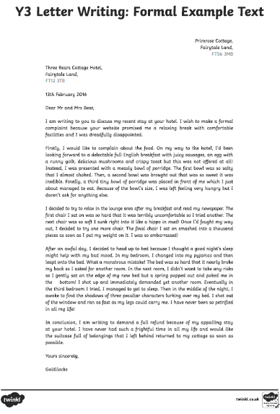
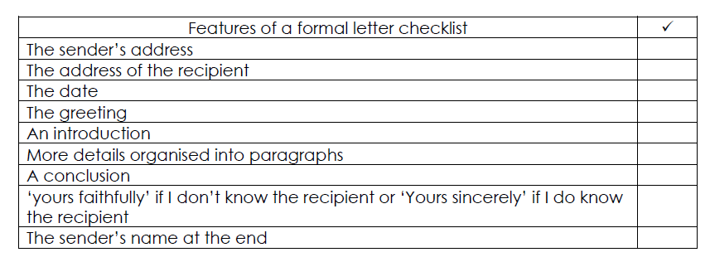
Task
Today your task is to highlight on the example letter template all of the features of a formal letter.
Use the checklist to remind you what you are looking for and carefully highlight each of the features on the example letter.
Checklist
Example letter

