Slide 1
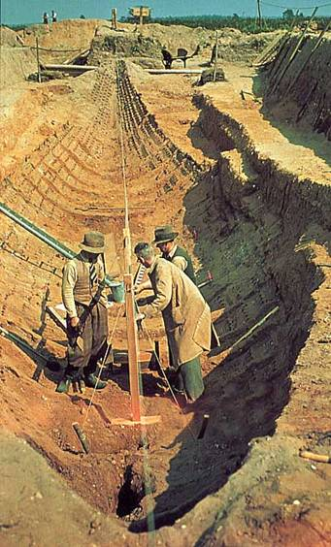
The mystery of the empty grave
To complete a historical enquiry of the events of Sutton Hoo.
To use evidence to make suggestions and draw conclusions.

Slide 2
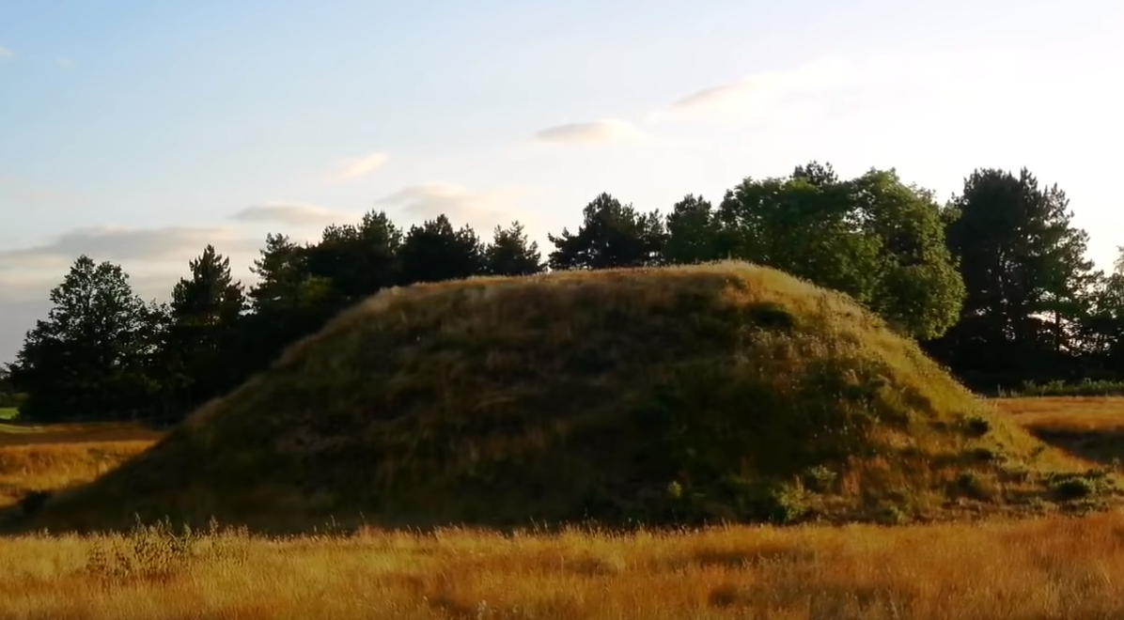
What could this mysterious mound be?

Slide 3
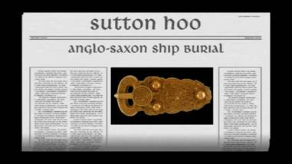
Breaking News!
Click here to show the start of the video to introduce the
Suttoon Hoo site (first 45 seconds)

Slide 4

First episode recording tomorrow!
What have we already discovered?
Why hypothesis have you come up with?

Slide 5
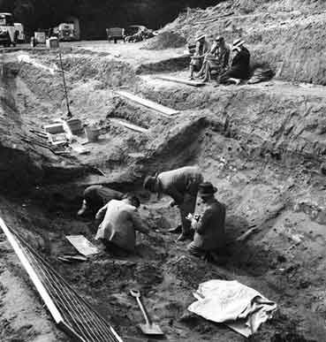
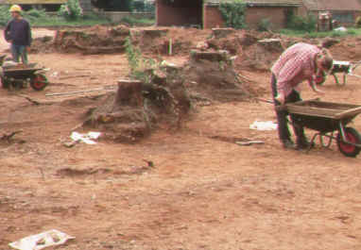
Archaeologists discovered the famous ship burial at Sutton Hoo.
Do you know what an Archaeologist is?
Talk-Pair-Share
1939

Slide 6


Slide 7
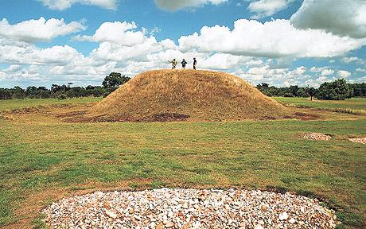

Slide 8
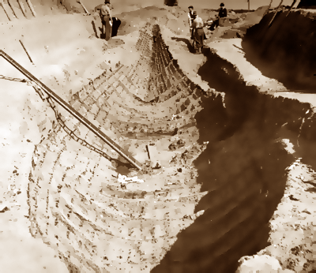

Slide 9
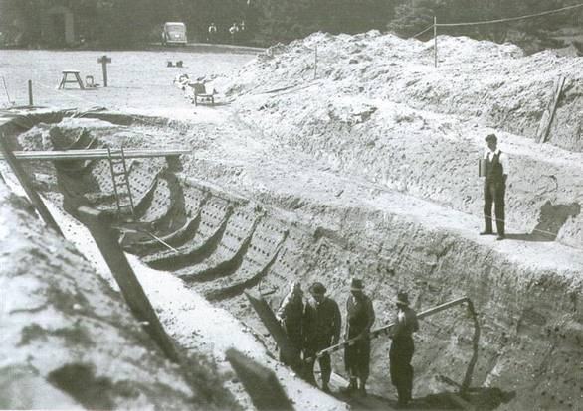

Slide 10
You can use any of the following objects that you can see to complete your main task today!

Slide 11
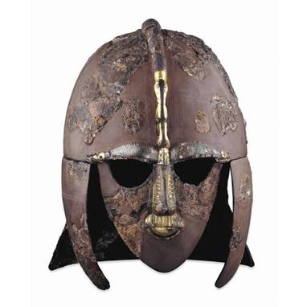

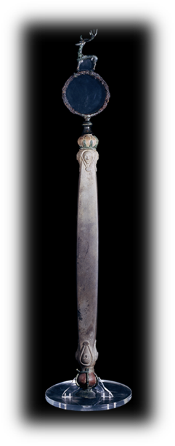
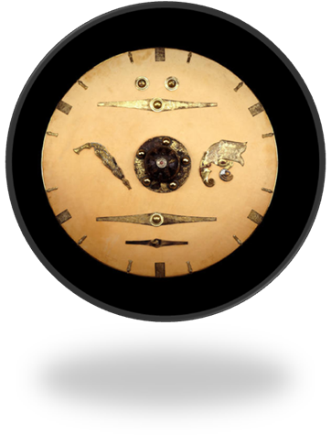
The finds

Slide 12
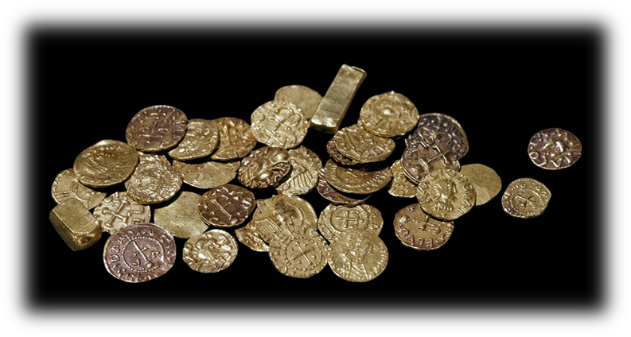
37 coins dated about AD 625

Slide 13
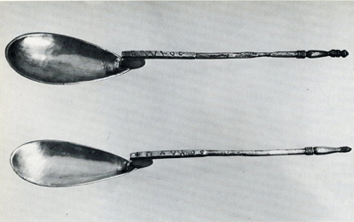
2 silver spoons
One spoon is inscribed Paul the other Saul
They are christening spoons
The owner at some time must have been Christian but the burial is pagan.

Slide 14
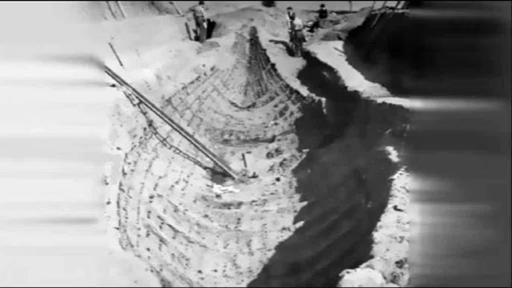
What do the finds tell us?
Watch the short video
Link is to beginning of clip: show from discovery of finds starting
at 6min 15sec

Slide 15
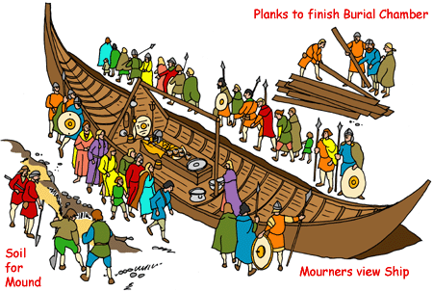
Artist’s impressions of the final scene

Slide 16
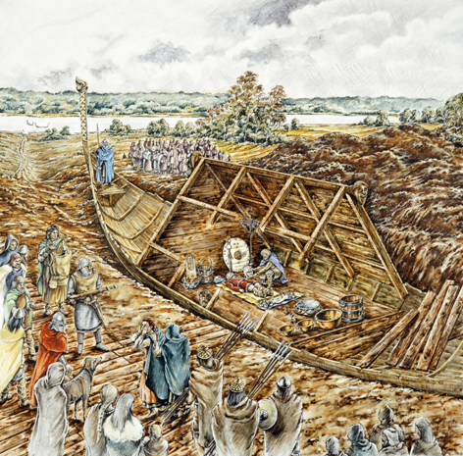
http://www.bbc.co.uk/schools/primaryhistory/anglo_saxons/kings_and_laws/teachers_resources.shtml

Slide 17


Which clue tells us?
The owner must have been very important.
B. The owner was a king.
C. The burial must have been between AD 595 and AD 625.
D. The owner was an East Anglian.
E. The owner was possibly Christian at some stage.
F. The owner was a ‘superking’ or Bretwalda.

Slide 18

So who was he?
Here are 4 possible people it might be. Before we look at them let’s remind ourselves of what we are looking for?

Slide 19
A
He was the first English king to receive a Christian baptism.
Sigebert
Sigeberht of East Anglia (also known as Saint Sigebert) was King of East Anglia from c.629 to c.634.

Slide 20
Eorpwald was the son of Raedwald and ruled as King of East Anglia from
c.624 to c.627.
B
Eorpwald
He received Christian teaching and was Christian in his ways.

Slide 21
C
Raedwald
Rædwald, was King of the East Angles from c. AD 600 until his death in c.624.
He was converted to Christianity but was thought to have gone back to being a pagan.
He was a Bretwalda, a superior king.

Slide 22
D
Offa of Mercia
He was a Bretwalda, a king who had power over other kings in England.
Offa
Many historians think Offa was the most powerful Anglo-Saxon king before Alfred the Great.
Offa was the King of Mercia from AD 757 until his death in July 796.

Slide 23
Why couldn’t it be Ethelbert?
Ethelberht, King of Kent (reigned c.560-616)
who became the first English king to be converted to Christianity
One of the most important Anglo-Saxon kings

Slide 24
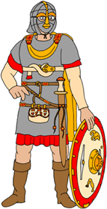
So, who is the owner?
Sigebert
A
Eorpwald
B
C
D
Raedwald
Offa

Slide 25
Your Turn!
Your task is to complete your own enquiry sheet.
You need to select three objects, think about what they are and what they might tell us about their owner.
You will find out very soon if you are right!

Slide 26
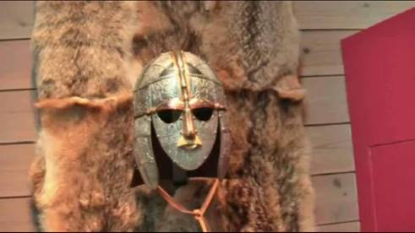
The answer?

Slide 27
Thursday 4th February
What was discovered at Sutton Hoo?
Your task is to analyse the evidence before you.
What could the object be?
Why might it be important/What might it have been used for?
This is what it should look like!
Your description
Challenge – What could we conclude as to who might have owned these items?

