Slide 1
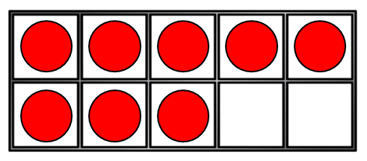
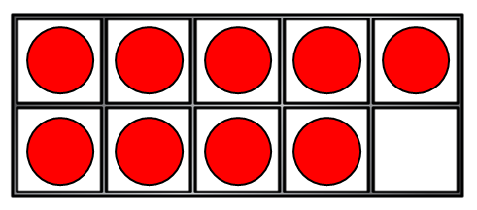
1) This symbol > means
2) Let’s compare 5 8
3) Write a number less than 4
4) Compare

Slide 2
1) This symbol > means
2) Let’s compare 5 8
3) Write a number less than 4
4) Compare
Greater than
<
3, 2, 1, 0
<

Slide 3


Greater than or less than
less than
is ___________
greater than
is ___________

Slide 4







Let’s use symbols to compare!
11 | 12 | 13 | 14 | 15 | 16 | 17 | 18 | 19 | 20
$$<$$
$$=$$
$$<$$
$$<$$
15 fourteen
$$<$$
eleven 1 ten and 9 ones
$$=$$
10 $+$ 8 eighteen

Slide 5
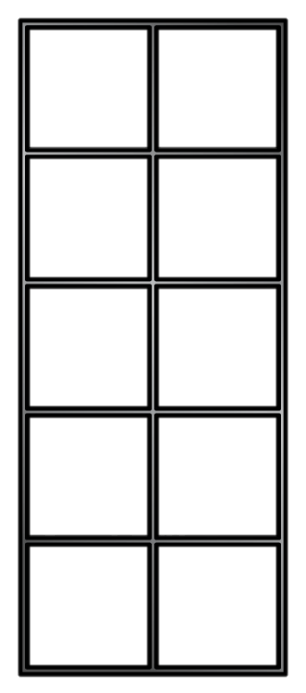
Comparing number sentences
9 + 3
<
8 + 3
is greater
than

Slide 6
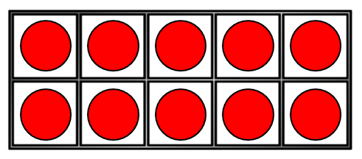
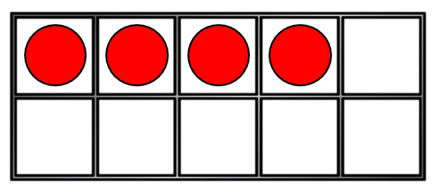
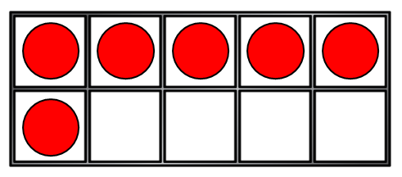
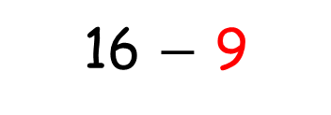
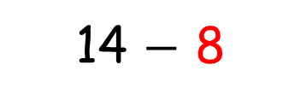
Comparing number sentences
14 $−$ 8
<
16 $−$ 9
is less
than

Slide 7

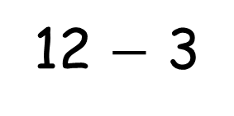
I answer both sides first, then I put in the symbol!
>
<
>
<
=
=
15
12 + 3
12 + 4
16
15
12 + 3
12 $−$ 3
9
15
12 + 3
13 + 2
15

Slide 8

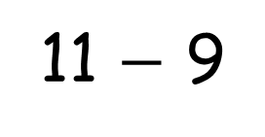
I don’t need to answer both sides every time.
Look carefully!
What is the same? What is different?
>
<
>
<
=
>
=
11 + 9
11 + 5
11 + 9
11 $−$ 9
11 + 9
12 + 8

Slide 9

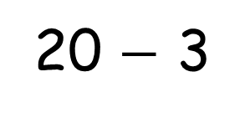
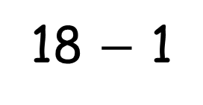
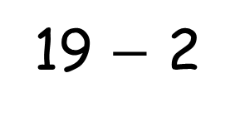
Think carefully!
What can you do to make them equal?
17
13 + 4
=
20 $−$ 3
13 + 4
=
19 $−$ 2
13 + 4
=
18 $−$ 1

