Slide 1
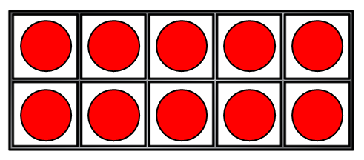
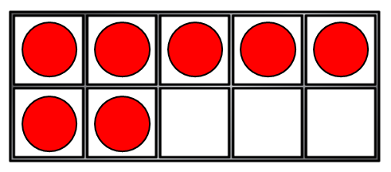
These are number bonds to ___
5 + 2 1 + 6 3 + 4
2) What symbol means “add” ?
3) Let’s count in 2s starting at 12
4) How many counters?
+

Slide 2
These are number bonds to ___
5 + 2 1 + 6 3 + 4
2) What symbol means “add” ?
3) Let’s count in 2s starting at 12
4) How many counters?
7
+
12, 14, 16, 18, 20…
+
17

Slide 3
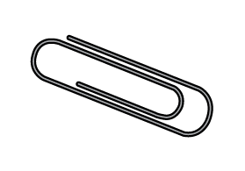
Have a think
This is like counting in 2s!
2, 4, 6, 8
How long is 4 paperclips?
8 cm

Slide 4
Have a think
5, 10, 15
How long is 3 pencils?
15 cm

Slide 5
Have a think
How long is 1 pencil and 1 paperclip?
5 + 2 =
7 cm

Slide 6
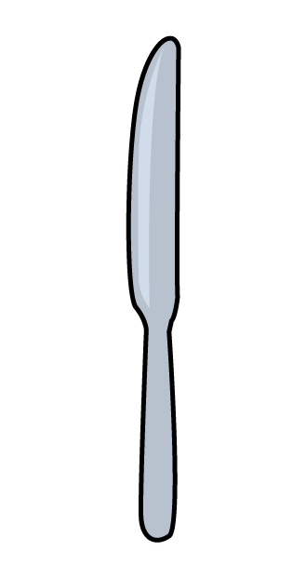
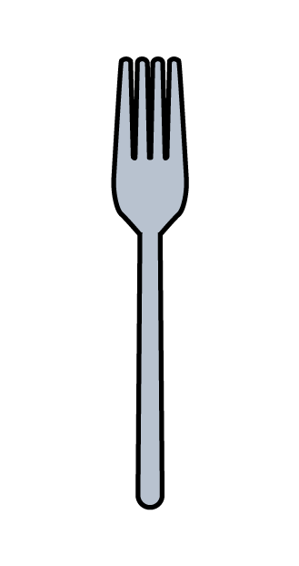
Adding lengths
Have a think
8 cm
6 cm
What is the total length of the
8 + 6 =
14 cm

Slide 7
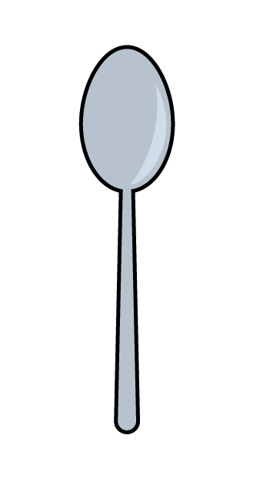
Adding lengths
Have a think
6 cm
8 cm
3 cm
What is the total length of the
3 + 8 =
11 cm

Slide 8
Adding lengths
Have a think
3 cm
8 cm
6 cm
What is the total length of 2
3 + 3 =
6 cm
2 is equal to 1

Slide 9
Adding lengths
Have a think
3 cm
8 cm
6 cm
What is the total length of 2
6 + 6 =
12 cm

Slide 10
Adding lengths
Have a think
3 cm
8 cm
6 cm
Which is longer?
6 + 6 =
12 cm
3 + 8 =
11 cm

