Slide 1
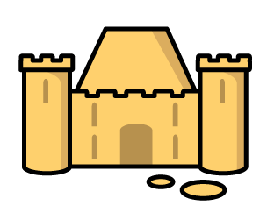

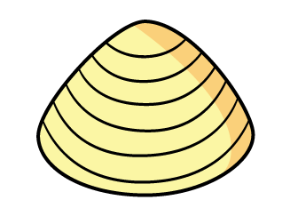
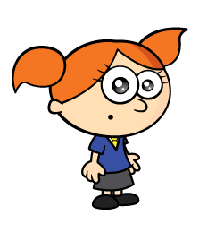
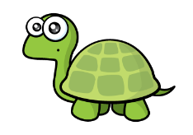
Have a think
The shells have to be the same size.
The castle is 5 shells long.

Slide 2
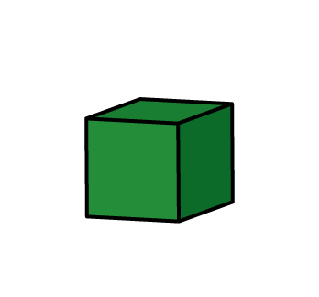
Have a think
Tiny, you cannot leave spaces.
The castle is 5 blocks long.

Slide 3
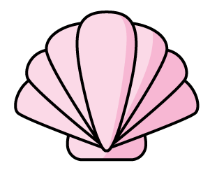
The sandcastle is 6 long.

Slide 4
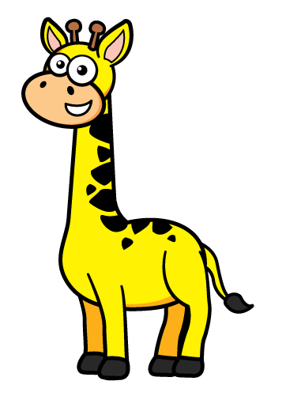
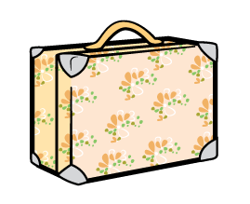
The giraffe is tall.
4

Slide 5
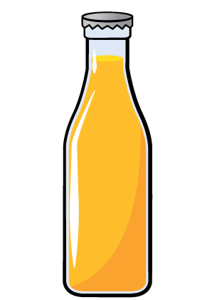
The giraffe is tall.
4
7
The giraffe is tall.

Slide 6
What objects can you find to measure with?

Slide 7
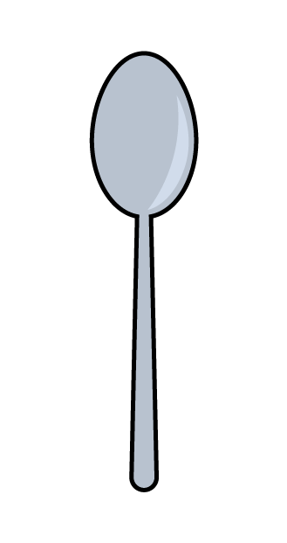
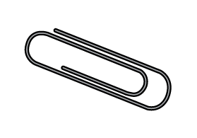
Have a think
The spoon is long.
6

Slide 8
Have a think
How long is the spoon?
26
The spoon is shorter than 3 .
The spoon is 2 and 6 long.

Slide 9
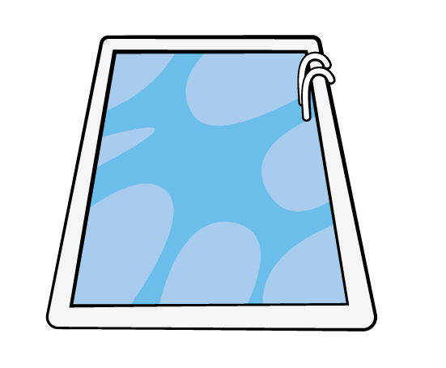
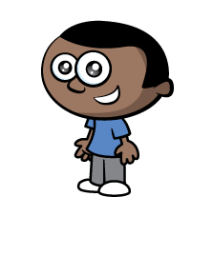
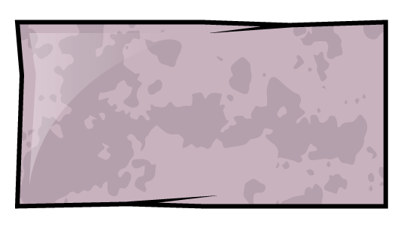
How long is the pool?
I will use
to measure!
I will use
to measure!

Slide 10
How long is the pool?
48, 49…..
I have so much more to measure.
The pool is 28
long.
Who chose the better object to measure with? Why?

Slide 11
What can you measure?
What will you use to measure with?

